Slide 1
The role of Gender Equality Rapporteurs
Workshop on gender equality and intersectionality mainstreaming, Strasbourg, 3-4.11.2025
Cécile Gréboval, Senior Gender Equality Advisor - Programme Manager, Gender mainstreaming,
1

Slide 2
Who are the GERs?
Gender Equality Rapporteurs (GERs) were first introduced in the Council of Europe through the launching of the Transversal Programme on Gender Equality (2012).
GERs are central actors for the implementation of gender mainstreaming throughout the Organisation.
As of November 2025, 50+ GERs have been appointed.
This has led to sustained efforts to introduce a gender equality perspective in a growing number of policies of the Council of Europe.
Notes:
GM an objective of the Council of Europe Gender Equality Strategy 2018-2023 and of the previous strategy 2014-2017)
52 GERs

Slide 3
The key role of Gender Equality Rapporteurs: what the CoE recommends
GERs play the role of ambassadors of gender equality and gender mainstreaming in their respective institutional setting.
“Handbook for Gender Equality Rapporteurs: Gender Equality and Gender Mainstreaming in Practice,” April 2022
What does this mean in practice?

Slide 4
The three roles of Gender Equality Rapporteurs
Wear your gender and intersectional glasses
3. Be well connected and use networking
2. Multiply knowledge and inspire others
Notes:
1: change of perspective and look at your issues differently
2: what helps a lot is to find the right information, contacts, data
3: there are allies/ organisations that support your work

Slide 5
Compile information
Check previous gender mainstreaming activities of your committee (secretariat, previous GER)
Check the gender equality website (www.coe.int/equality) of the Council of Europe, contact the Gender Equality Division
Use the GER Handbook and the online course on gender equality and gender mainstreaming
Get information from GERs of committees working on similar issues.
Propose the drafting of a factsheet / study /information document on gender equality issues in your area

Slide 6
Invest in terminology and common language
Help colleagues in the committee know what they are talking about and ensure the use of the same terminology (for example, the difference between “sex” and “gender”). The Council of Europe Gender Equality Guidelines on the use of language as a driver of inclusivity can be of help in this regard.
Be aware of possible linguistic challenges about the term gender and its translation in different languages.
Raise the issue of gender-sensitive terminology and communication in the documents and tools produced by the committee
We all have assumptions and gender stereotypes that can impact our work. Check your own gender stereotypes and assumptions on the issues dealt with by your committee.

Slide 7
Use the programming process of the entity as an outline
Keep in mind the terms of reference /work programme /rules of procedure of your entity regarding gender mainstreaming + other commitments in this respect
Look at the long-term planning of your entity to identify priorities and possible actions, involve supportive colleagues
Before there are elections/nominations in the committee, remind of the need to achieve a gender-balanced representation (a minimum of 40% of each sex, parity 50/50 would be ideal), suggest rules as relevant

Slide 8
Prepare the meetings of your committee
Before plenary meetings, look at the agenda and identify the potential topics/activities where it might be relevant to raise gender equality issues, contact the chair /secretariat
Look for allies and involve other members of the committee, get support from the chair, find colleagues interested in the issue
Look for an evidence-based approach in the work of the committee: research and disseminate data and information on the gender equality perspective in relation to the topic at stake.
Notes:
Be aware of the potential existence of good-quality research that you could build on.

Slide 9
Organise a training session, hearing, round table or other event
Propose the inclusion of a session/hearing on gender equality or gender mainstreaming during a future committee meeting
Ask the Secretariat and/or Gender Equality Division to recommend potential experts, relevant international or civil society organisations
Ask other committee members to present examples from their country
Such work, especially in areas where gender mainstreaming is new may raise the profile of your committee and create new links

Slide 10
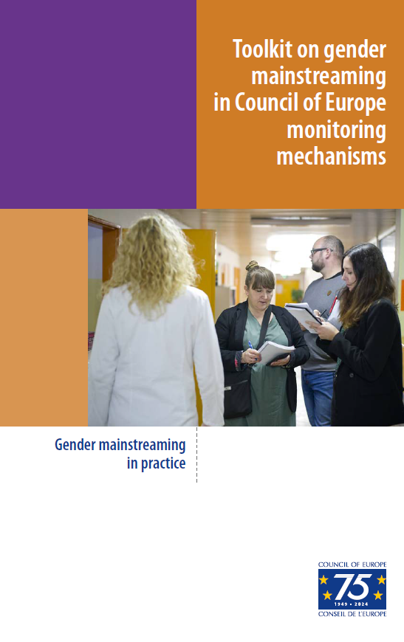
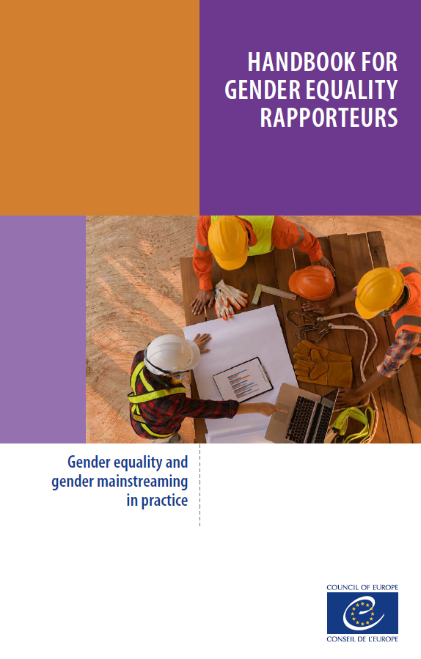


Slide 11
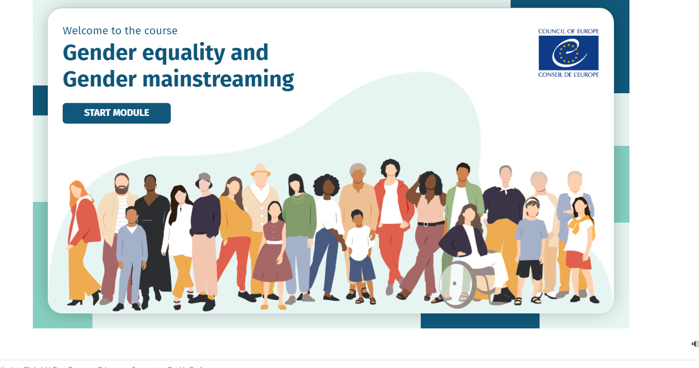

Slide 12
Online course on gender equality and gender mainstreaming
Launched on International Women’s Day 2024
Available for free to everyone on the CoE HELP Platform
Takes about 2,5 hours - EN
Target audience: CoE staff and experts but also anyone interested in learning about gender equality and gender mainstreaming
An introduction and 3 modules

Slide 13
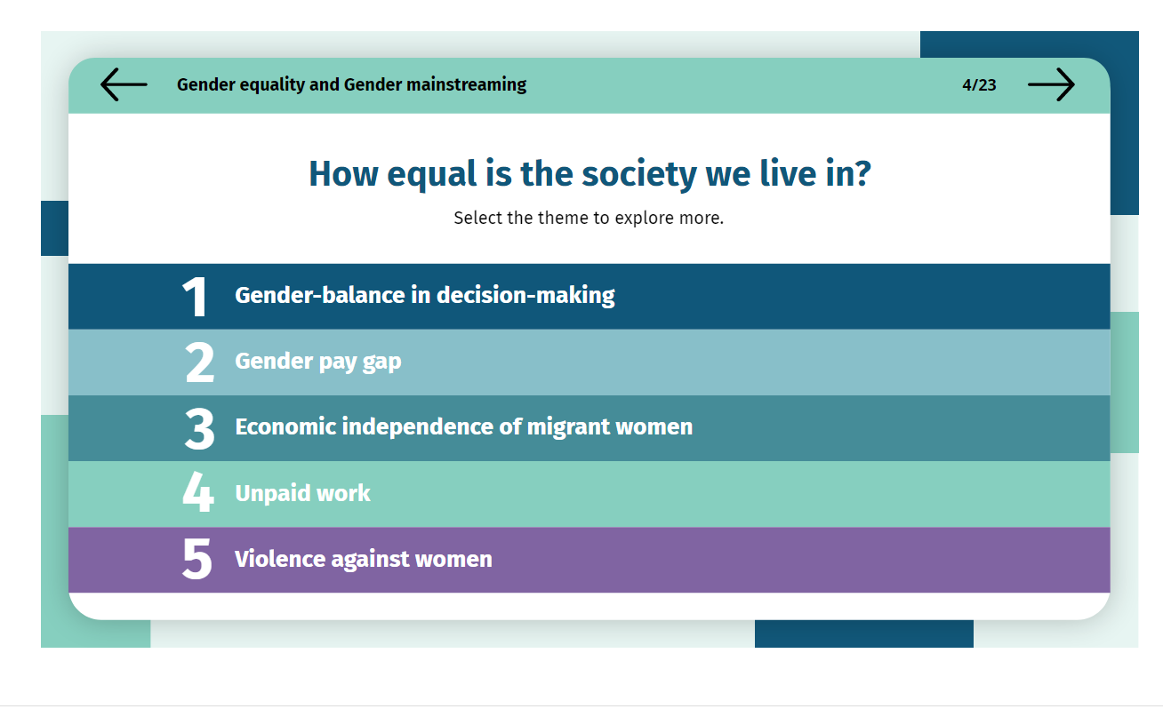

Slide 14
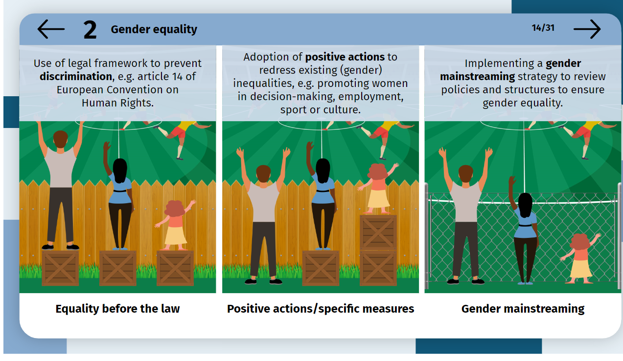

Slide 15
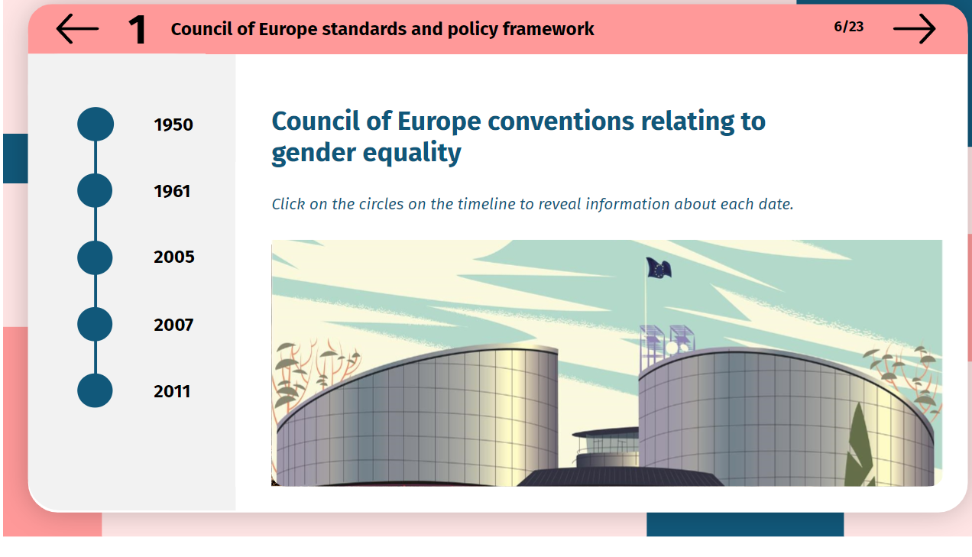

Slide 16
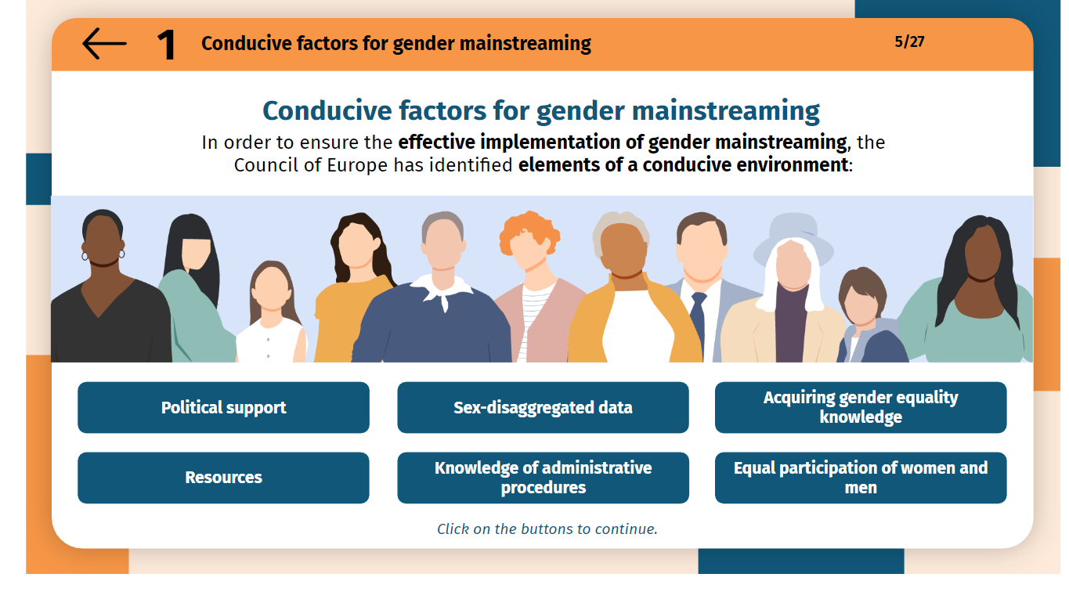

Slide 17
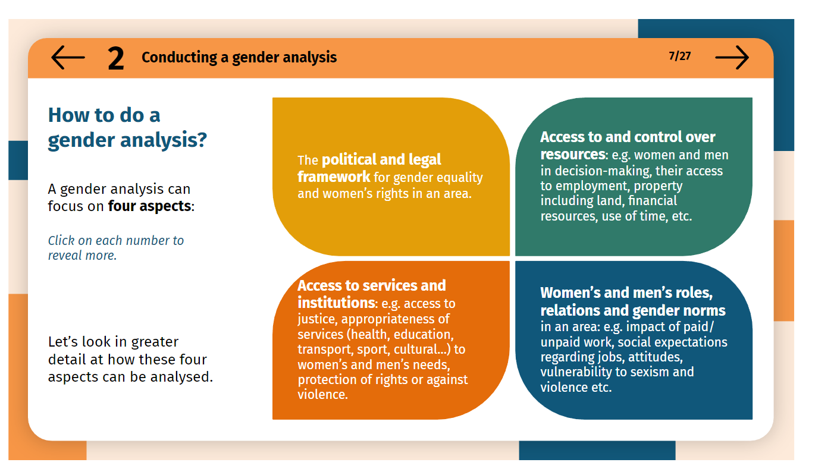

Slide 18
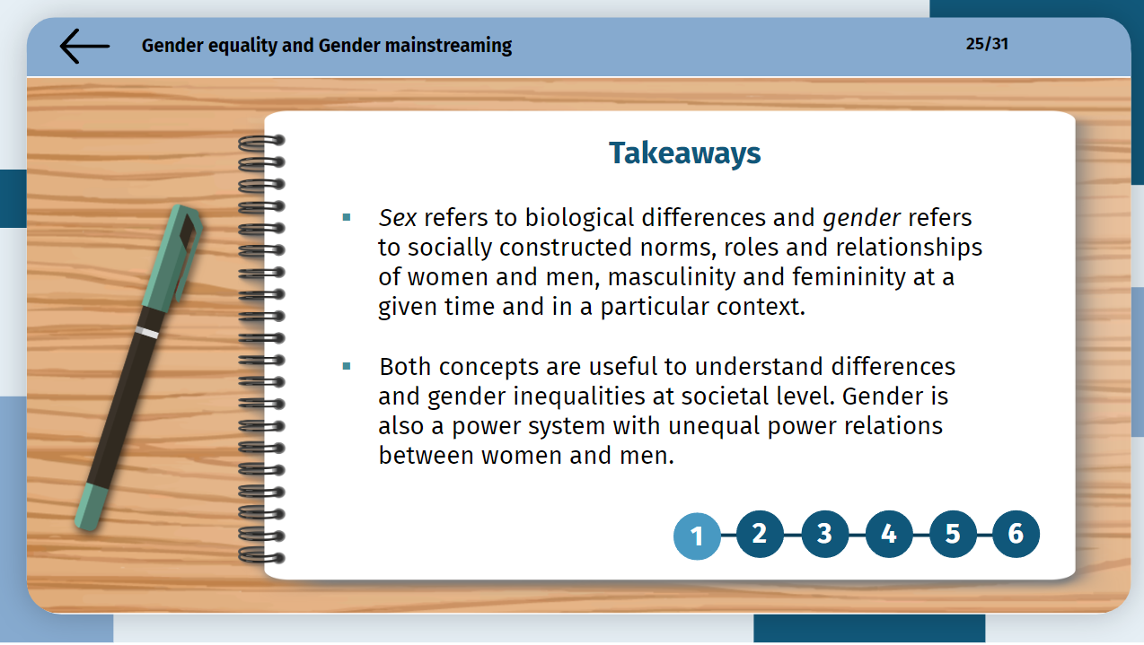

Slide 19
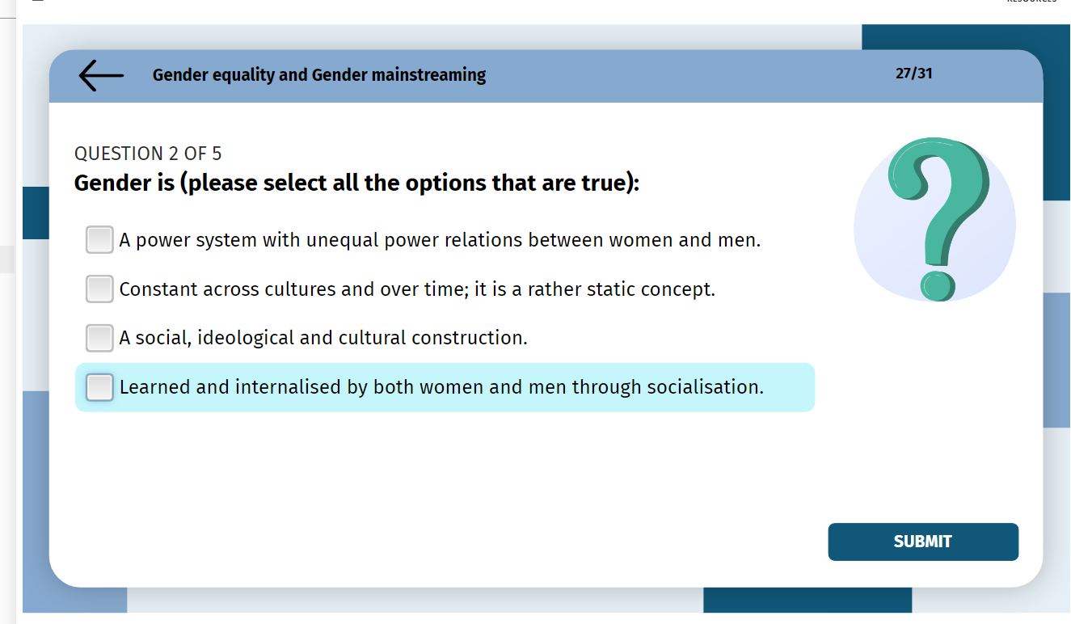

Slide 20
The use of ‘gender transformative’ approaches
Krista Orama, Policy Advisor, Gender Equality Division
20

Slide 21
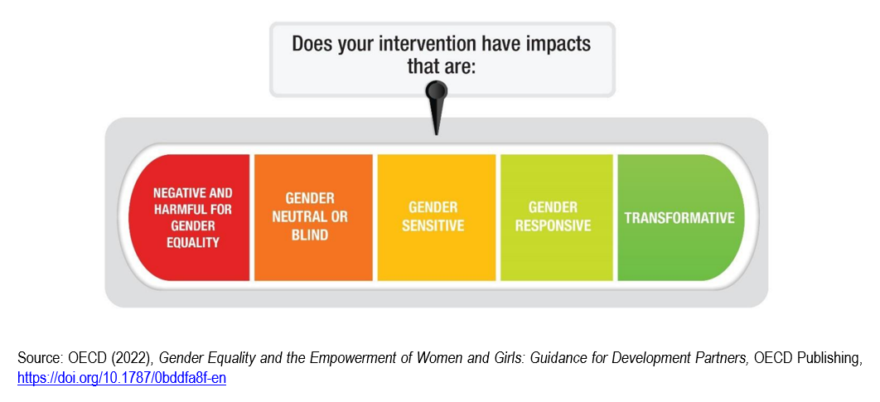
Gender equality integration continuum

Slide 22
Gender equality integration continuum
‘Do no harm’ principle = operating at least at a gender sensitive level. Analysis incl. risk analysis required to be aware of gendered and intersectional aspects.

Slide 23
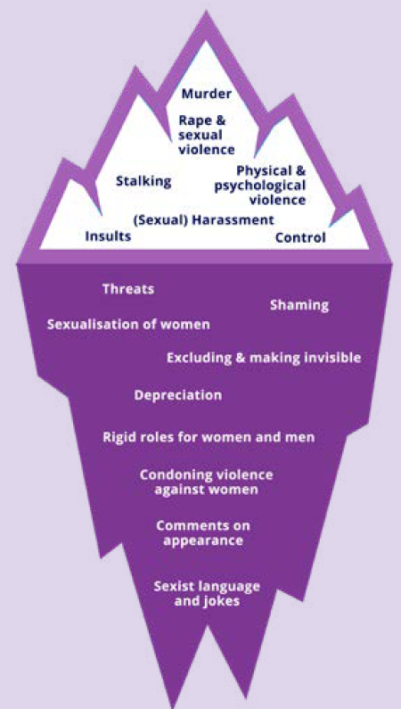
The continuum of violence against women
Source: Handbook for Gender Equality Rapporteurs. Gender equality and gender mainstreaming in practice (Council of Europe, 2022)

Slide 24
CoE Gender Equality Strategy 2024-2029 on gender transformative approaches
Refers to a commonly used definition:
  Gender transformative approaches seek to challenge gender inequality by transforming harmful gender norms, roles and relations, while working towards redistributing power, resources and services more equally (UNFPA 2023).
Guides us to:
  … address the root causes of gender inequality
  … through applying a transformative, intersectional and human rights-based approach
  … with a view to resulting in better policy making and more sustainable advancement of gender equality.
Notes:
the Council of Europe will ensure that new initiatives and standards are
gender transformative, taking into account the diverse situations of women
and men, girls and boys, and multiple and intersecting forms of discrimination,
and therefore result in better informed policy making, a better allocation of
resources and better governance, contributing to the sustainable advancement
of gender equality.
transformative, intersectional and human
rights-based approach to address the root causes of gender inequalities
Specific references in the context of violence against women and girls and domestic violence, decision-making processes, mainstreaming, budgeting

Slide 25
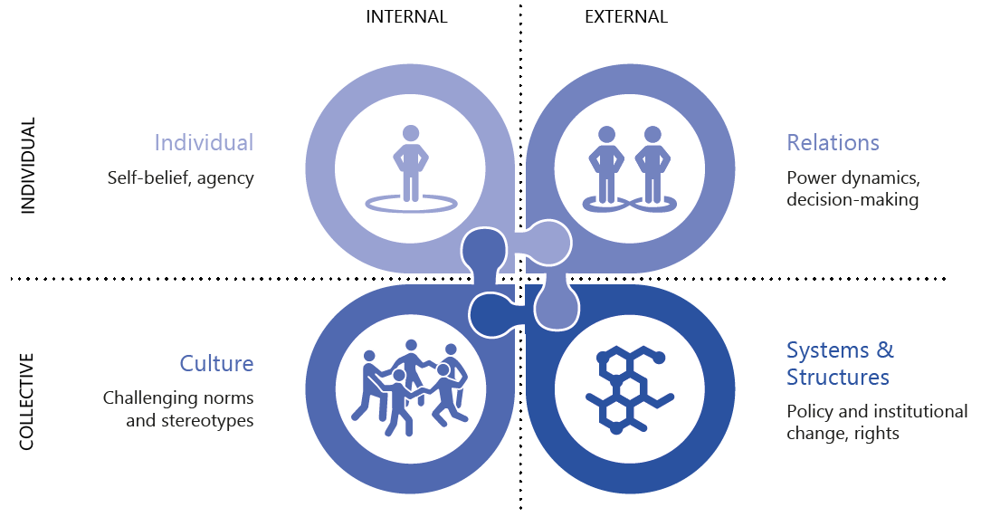
How to apply gender transformative approaches
Identify the gender norms, roles and relations, incl. power relations, relevant for your committee’s area of work.
  Analyse dimensions of change.
Explore and set objectives on how your committee’s work can contribute to addressing the root causes of gender inequalities in its area.
Figure: Four dimensions of social change (Ken Wilber, adapted with permission)
Source: Gender-Transformative Approaches: From Theory to Impact, EUMS Working Group on Gender Transformative Approaches (2024)
Notes:
the Council of Europe will ensure that new initiatives and standards are
gender transformative, taking into account the diverse situations of women
and men, girls and boys, and multiple and intersecting forms of discrimination,
and therefore result in better informed policy making, a better allocation of
resources and better governance, contributing to the sustainable advancement
of gender equality.
transformative, intersectional and human
rights-based approach to address the root causes of gender inequalities
Specific references in the context of violence against women and girls and domestic violence, decision-making processes, mainstreaming, budgeting

Slide 26

cecile.greboval@coe.int
krista.orama@coe.int
Gender mainstreaming at the Council of Europe (coe.int)
www.coe.int/equality

