Slide 1
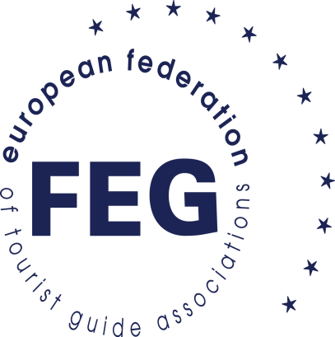
FEG
EUROPEAN FEDERATION
OF TOURIST GUIDE
ASSOCIATIONS
BASED IN FRANCE
SINCE 1986
Themis Chalvantzi-Stringer FEG Executive Committee Officer

Slide 2
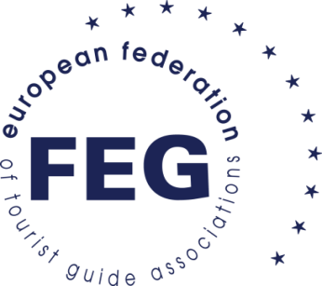
TOURIST GUIDES IN EUROPE
EUROPEAN STANDARDISATION COMMITTEE (CEN) EUROPEAN STANDARD EN13809:2003
Tourism services - terminology
2.3.5 ► tourist guide = person who guides visitors in the language of their choice and interprets the cultural and natural heritage of an area, which person normally possesses an area-specific qualification usually issued and/or recognised by the appropriate authority

Slide 3
We are the tourism and culture professionals and are in direct everyday contact with visitors in our countries. We are the ambassadors of a destination or a country and by promoting it correctly, we aspire to attract more visitors

Slide 4
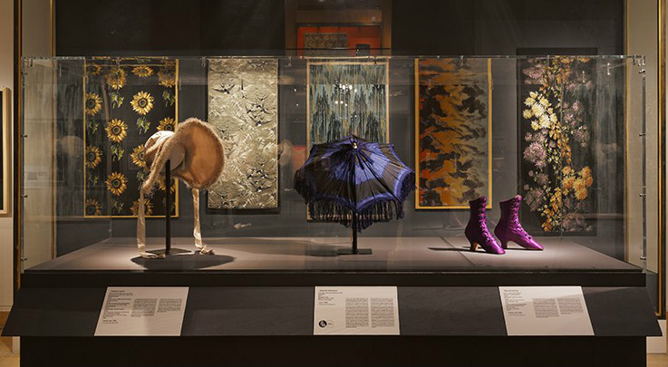
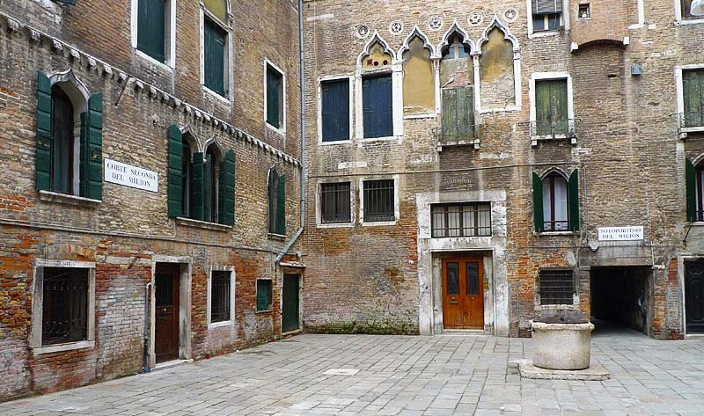
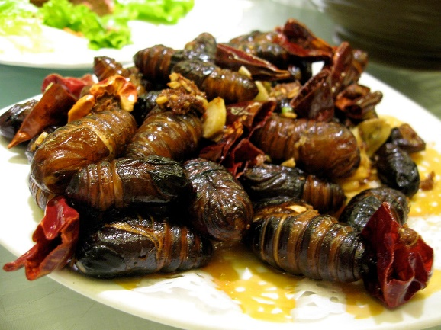
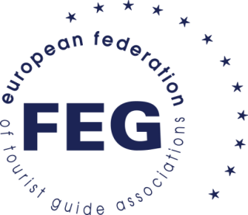
What do these pictures have in common?
Silk Cap from York © Pinterest
Display at Silk Museum, Lyon © Lyon Fabric Museum
Marco Polo’s House, Venice
Cooked Silk Worms ©Wikimedia Commons

Slide 5
Western Silk Road project
Greece: the cross roads of silk trade and production.
Metaxourgio, a hipster neighbourhood of Athens takes its name from the silk factory that was established in the area in 1854.
Silk Wedding Caftan, Soufli, Greece
©Cultural Piraeus Bank Group Cultural Foundation

Slide 6
Western Silk Road project
Oldest find of Viking Age silk in Norway.
Comes to Norway either via Central Europe or the Russian Rivers.
Persian patterns.
Silk from the Oseberg Burial, 9th C AD, Norway
©The Viking Silk Road, KHM-UiO

Slide 7
Western Silk Road project
Silk arrives in the 9th C in Valencia with the Arabs.
In the 18th C half the population worked in silk.
St Jerome was the first Cardinal to wear silk.
Valencia Silk Museum © theculturalvoyager.com

Slide 8
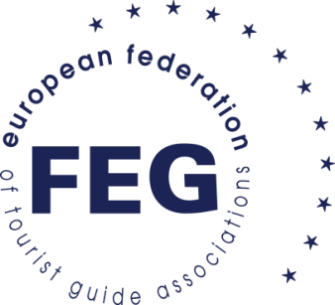
Western Silk Road Continuous Professional Development
Online learning platform for tourist guides.
Guides work through modules, both general and more specific to their country of origin.
Practical guiding sessions in different countries on Western Silk Road. FEG is collaborating with ATHINA Educational Network, an independent civil non-profit organization.

Slide 9
How FEG can help
FEG promotes sustainability and off the beaten track tourism.
FEG welcomes working together and educational opportunities. FEG has an active CPD programme.
FEG members represent the whole of Europe (28 country members). We are cross language and cross border.
Guides are underused in cultural routes.
Guides can help promote routes to Tour Operators and clients.
The Western Silk Road connects with a lot of the existing Cultural routes (Viking Routes, Phoenician Routes, Jewish Heritage, El Legado Andaluci etc).

Slide 10
Qualified and properly trained professional Tourist Guides are the best ambassadors of their countries

Slide 11
Thank you for your attention!

