Slide 1


Slide 2
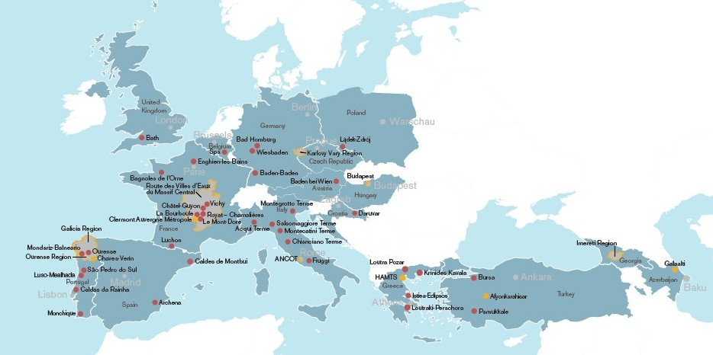
WHO WE ARE
The European Route of Historic Thermal Towns is an international network of sustainable tourist destinations. The Route is managed by the EHTTA , an international non-profit association representing 50 towns and territories across Europe.

Slide 3
HOW WE PROMOTE CULTURE THROUGH TOURISM
Tourism packages
Festivents Tourism fairs
Co-operations with Travel Agency Social Media

Slide 4
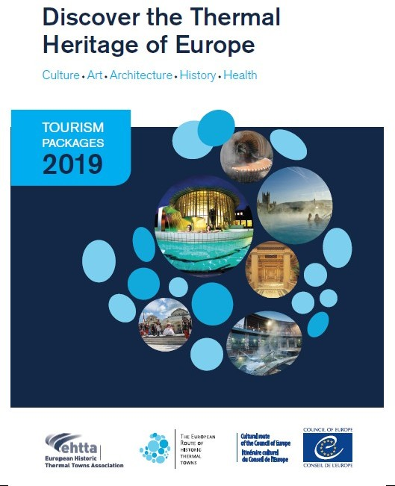
Tourism packages
We offer thematic and inspirational packages to our amazing destinations
We have created a corporate product
„Tourism packages“ divided in themes and interests
The packages are available:
  online on the EHTTA website
  in the brochure: https://ehtta.eu/portal/ehtta/download

Slide 5
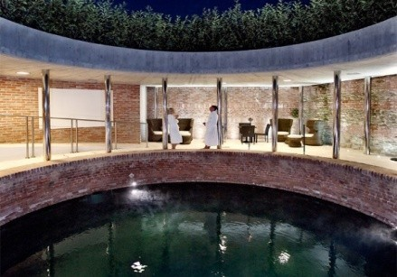
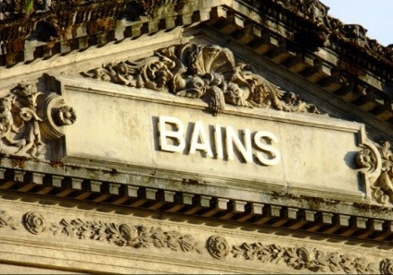
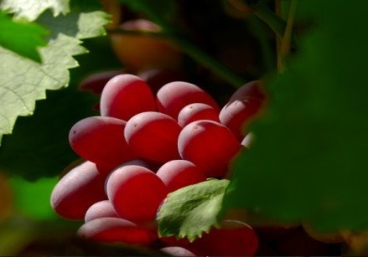
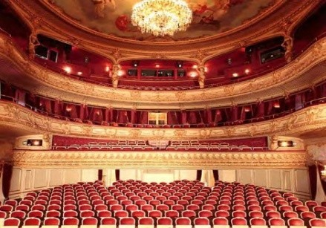
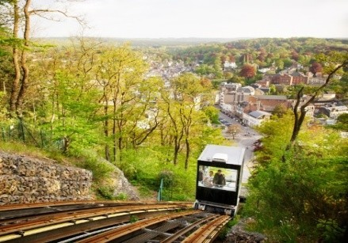
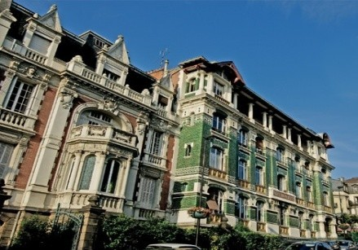
How to buy a package
visit the TOURISM section in the EHTTA website: https://ehtta.eu/portal/tourism/
click on the thematic section and look for your favourite offer
click on its link and buy it directly from the hotel, thermal establishment, B&b or farmhouse
Pure Spa Experience
Ancient Spa Traditions
Gastronomic Experiences
Special Events
Out & About
Keep discovering

Slide 6
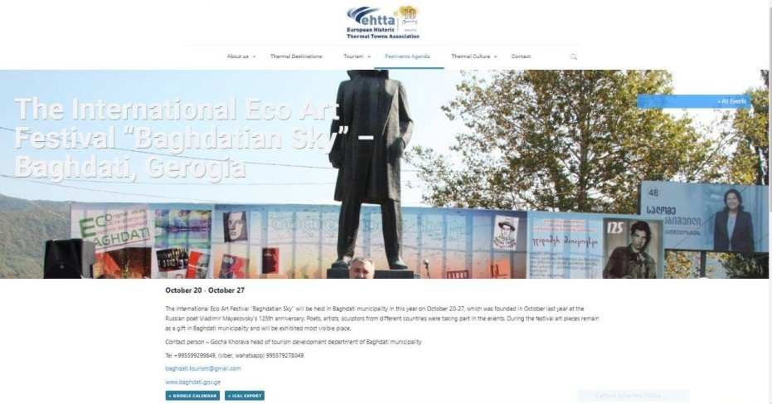
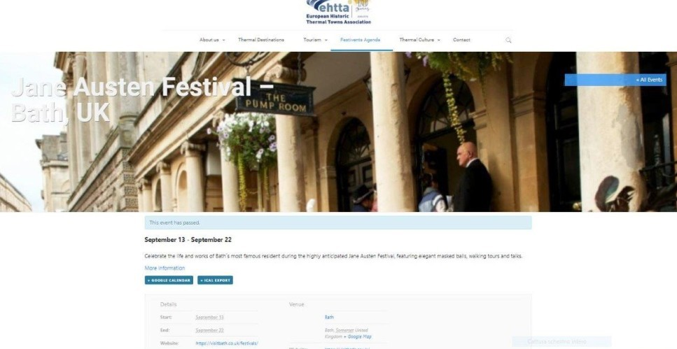
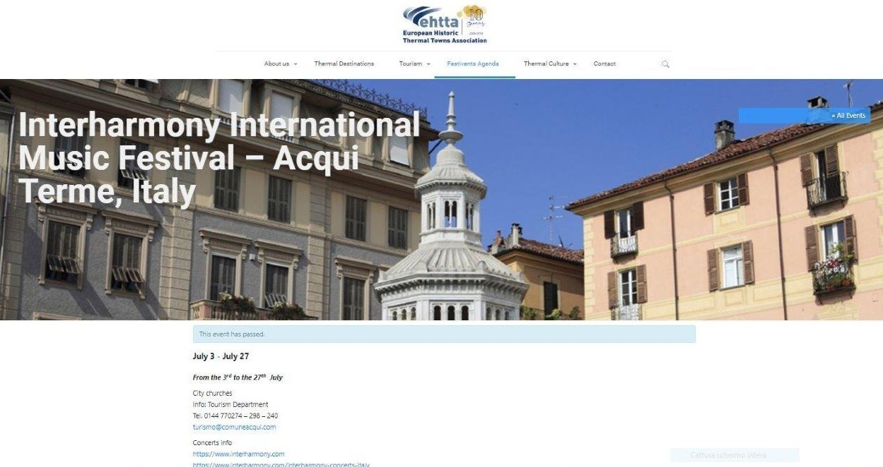
Festivents...link your travel to the CULTURAL EVENTS CALENDAR
Visit the daily updated calendar of events at the section FESTIEVENTS https://ehtta.eu/portal/events/

Slide 7
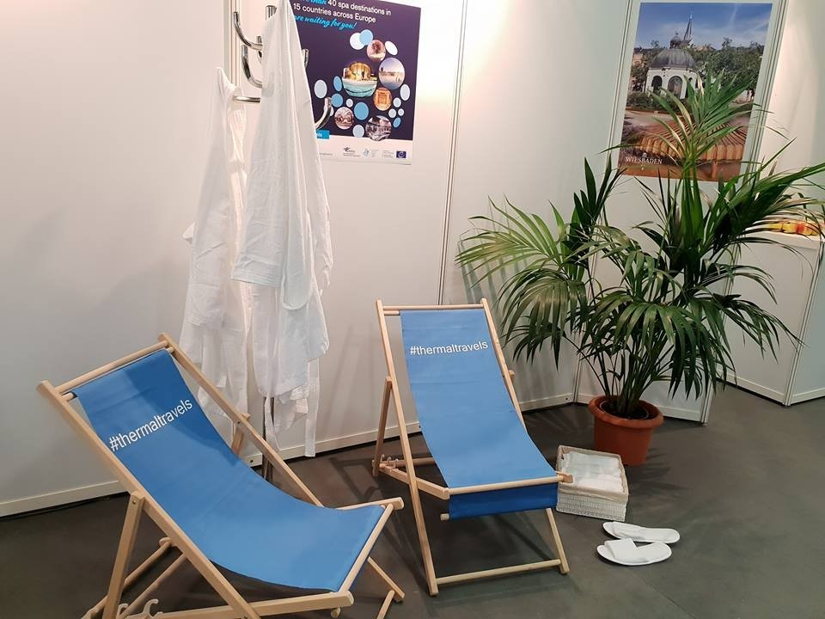
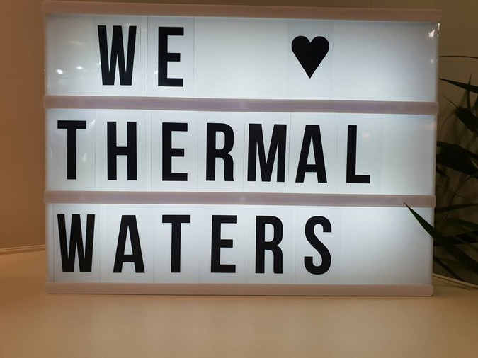
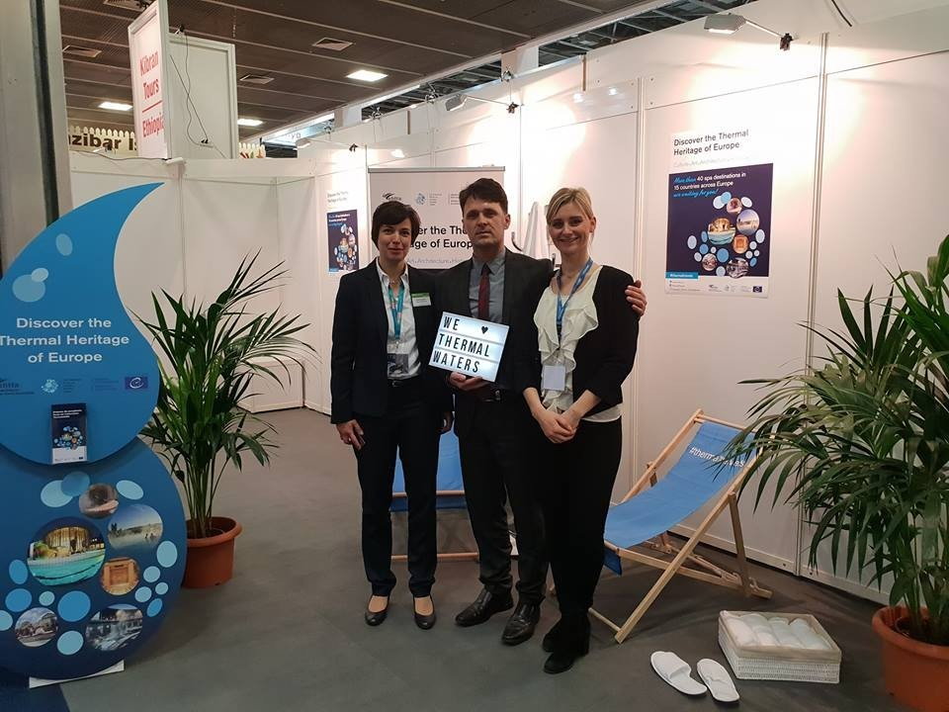
Tourism fairs in autumn
4 – 6 November - LONDON WTM London
It provides an exclusive platform for spa and wellness travel buyers and suppliers to meet
and conduct business over three days in a dedicated lounge for spa and wellness travel
professionals. EHTTA will propose tourist packages and other activities.
20 – 21 November – BRUSSELS
EHTI European Health Tourism Industry Summit
A gathering of prominent stakeholders devoted to reinforce the development of Europe as a destination of health.

Slide 8
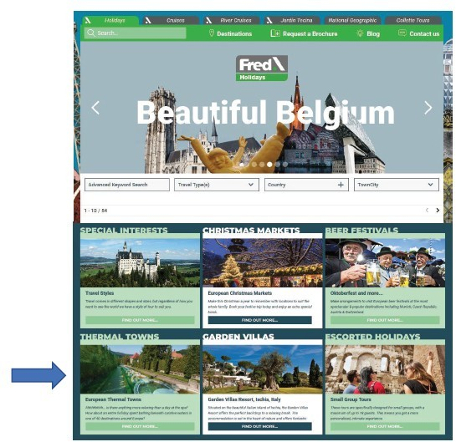
Co-operations with Travel Agency Fred.\Holidays 2019
EHTTA started cooperating with Fred.\ Holidays in 2019 as part of Fred. Olsen Travel, one of the UK’s most established travel companies.
https://www.fredholidays.co.uk/
Own Landing page in the section „Special interest holidays“
Every member has its own entry
Send out of 2 Newsletter to potential tourists but also their business and press contacts
  page in their winter brochure (first page – great visibility)
  pages in their annual brochure 2020 Social Media
•
•
•
•
•

Slide 9
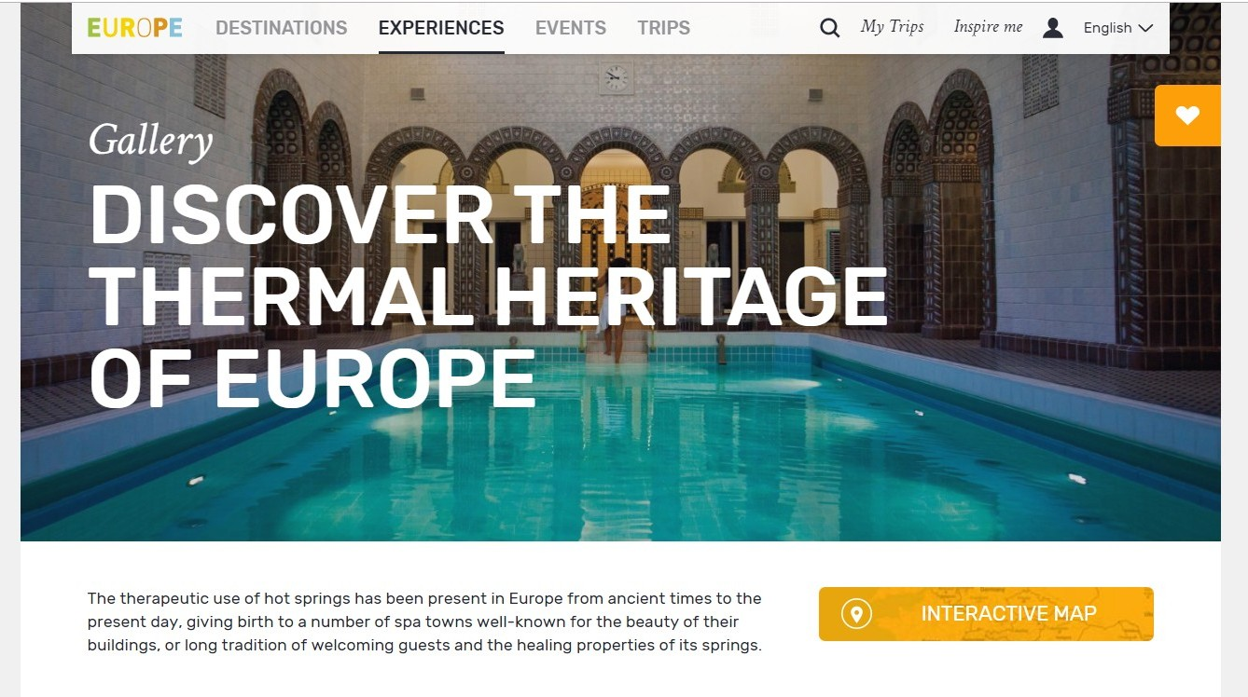
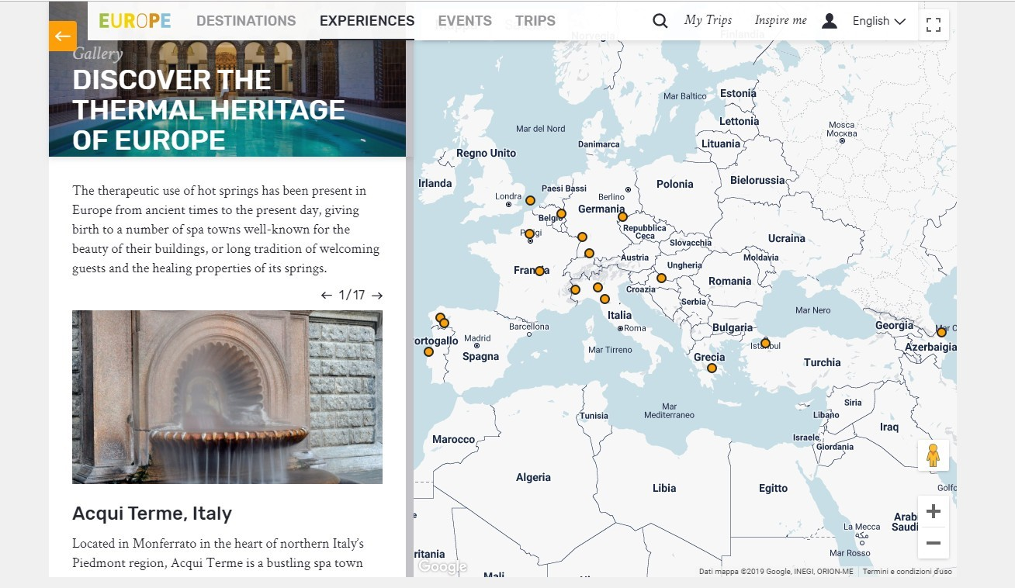
DISCOVER THE THERMAL HERITAGE OF EUROPE
in a gallery of historical thermal towns on VISITEUROPE, the portal of the European Travel Commission
Thermal towns represent:
European architecture,
culture, gastronomy,
heritage, stunning
landscapes and sustainable tourism
https://visiteurope.com/en/experience/discover-thermal-heritage-europe/

Slide 11

THANK YOU FOR THE ATTENTION
Raffaella Caria
EHTTA – Executive Secretary contact@ehtta.eu

