Slide 1
Child protection during COVID-19
Hanna Vseviov
Head of Department of Child Well-Being
26.06.2020

Slide 2
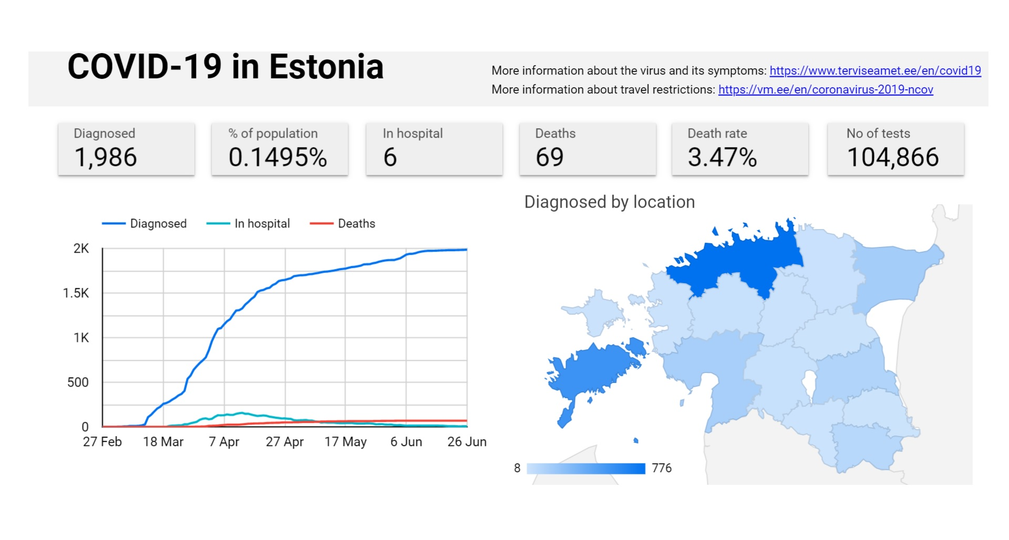
Emergecy situation was declared on the 12th of March and ended on the 17th of May

Slide 3
Challenges in child protection during COVID-19
Child protection is based on
noticing
informing
good communication and one-on-one work with the client
How to manage that while
children are at home and not in the view of health or educational systems
tensions in the families arise, but difficult to have privacy
physical contact restricted or limited, services closed
Notes:
scheduled treatment

Slide 4
Some of the actions taken in Estonia (1)
Regional crisis boards set up in order to manage the practical work organization – people responsible for child protection and welfare included.
Crisis communication, incl all recommendations, guidelines and gathering statistics went through the boards.
List of vital services compiled and sent out to the LGs – emphasis on child protection and different welfare services
Practical guidances on service provision, information exchange, child protection work, school meals delivery etc

Slide 5
Some of the actions taken in Estonia (2)
Estonian Social Insurance Board took more active role in direct communication with welfare institutions and possible risk families – every institution and region was devided between certain case managers.
All families where there had been domestic violence during the last year where called out.
More human resources were directed to the child helpline
Legal acts were complemented in order to support the service provision and management via e-solutions
Notes:
the state agency of child protection and welfare
Victim support

Slide 6
Positives
While many countries are challenged to find digital solutions to tackle problems created by the COVID-19 pandemic, Estonia has in many ways had an advantage due to our long-term efforts to digitalise the public administration.
Every school uses e-learning platforms and the communication between parents, teachers and students takes place in the platform. Also, many of the study materials are digitalised.
All LG-s use the same child protection and social work data register (linked to other data bases), which can be accessed from home (with ID card).
There is digital access to governmental services, digital documents can be signed and exchanged securely.
Judges, court staff and legal professionals are able to conduct most proceedings in writing remotely thanks to the information system and digital court file application. If needed, virtual meeting rooms can be used.
Notes:
Remote working. All of this has resulted in a minimal need to reorganize work and change existing laws.

Slide 7
Lessons learned
Too many or too theoretical recommendations, guidelines etc, overwhelming amount of data requests and uncoordinated help offers
More proactiveness from the child protection needed (possible new risk groups), „rehearsal“ of client work using e-solutions
Overhasty shutdown of some services (rehabilitation)
Children as a hidden risk group of COVID-19

Slide 8
Thank you!
Hanna Vseviov
hanna.vseviov@sm.ee

