Slide 1

Testing and Evaluating Alternatives in Practice
Regional and National Level Examples
Radostina Pavlova
Center for Legal Aid – Voice in Bulgaria
Strasbourg, 04.04.2019

Slide 2
Introduction:
Center for Legal Aid – Voice in Bulgaria
Sofia-based NGO founded in the public benefit in 2009
Mission: to promote the rights of refugees, asylum seekers and migrants through pro bono legal aid and advocacy at national and EU levels
Pilot Project: “Protecting migrants with precarious status: decreasing the use of detention and applying community-based alternatives” funded by EPIM (2017-2019)

Slide 3
Why Pilot Engagement-Based ATDs?
Evidence that enforcement-based approaches do not deliver on migration policy objectives
Need to test application of alternatives on small-scale, low-risk basis
Building evidence on ATD also in the so-called “transit” contexts
Common goal with governments: to reduce irregularity
Notes:
Cite IDC and other (?) research; Return Handbook; EC proposal for AMF 2021-7

Slide 4
Pilots participating in the European ATD Network
Bulgaria – CLA – migrants who are in an irregular situation or about to lose the legal right to be on the territory, placing them at risk of detention (50)
Poland – SIP – migrants in return procedures, including refused asylum seekers, who are unsuitable for detention due to their vulnerability. Some are already placed on reporting conditions (20)

Slide 5
Pilots participating in the European ATD Network
Cyprus - Cyprus Refugee Council people in detention and at risk of being detained, including asylum seekers, refused asylum seekers, irregular third country nationals and people considered to be unremovable (23)
UK – Detention Action – young male ex-offenders with barriers to removal, to reduce the risk of absconding and reoffending and assist them to meet the conditions of their release and avoid long-term detention.

Slide 6
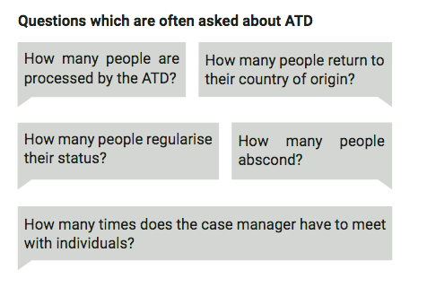

Slide 7
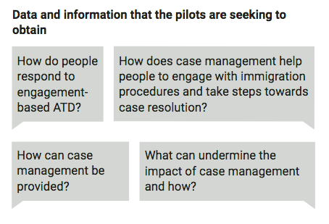

Slide 8
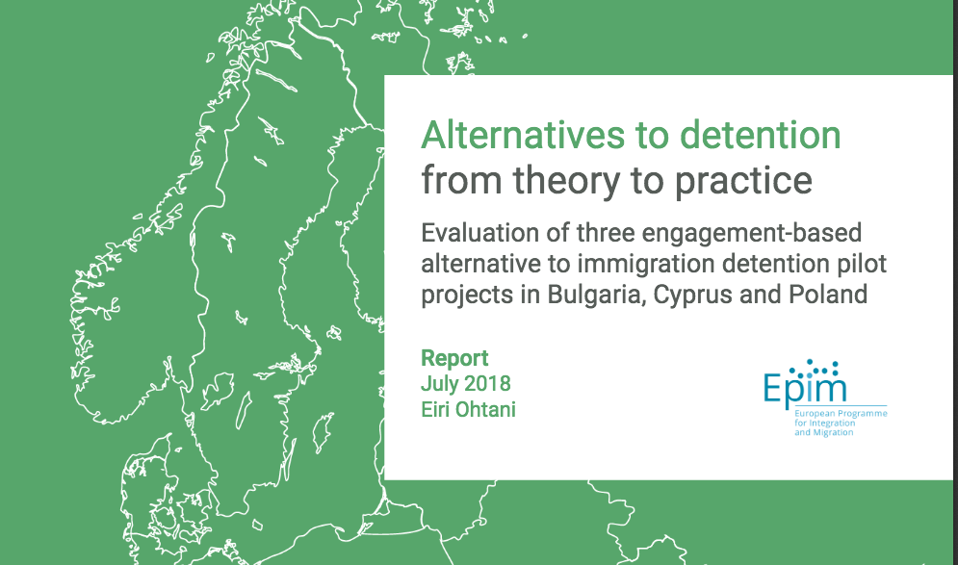
Notes:
Regional Evaluation from July 2018 – sample of 31 case from 3 pilot projects (Bulgaria, Cyprus, Poland)
Another one coming up in 2019
Independent evaluator hired by EPIM – present today to answer questions
Printer copies of the report available here

Slide 9
Findings – Regional Evaluation
97% of individuals remained engaged and didn’t abscond
77% clients previously detained, 65% with vulnerabilities
Positive impact towards case resolution in majority of cases (88%)
Improved coping and well-being for 100% of clients

Slide 10
Bulgarian Pilot – Key Figures
Countries of Origin
Afghanistan – 4
B & H – 1
Bangladesh – 3
Cameroon – 4
CDV – 8
Eritrea – 1
Ghana – 3
Guinea – 1
Iraq – 12
Iran – 7
Palestine/Lebanon – 2
Rwanda - 1
Somalia - 3

Slide 11
Bulgarian Pilot – Key Figures
Length of stay in Bulgaria when enrolled in Case Management
Less than 6 months - 0
6 mths - 1 year: - 3
Up to 2 years: - 9
Up to 3 years: - 10
Up to 4 years: - 3
Up to 5 years: - 12
Up to 6 years: - 8
Up to 7 years: - 1
Up to 8 years: - 2
Up to 11 years: - 1
Up to 25 years: - 1

Slide 12
Bulgarian Pilot – Key Figures
Outcomes (March 2019)
Re-detained - 7 people (14 %)
out of them: 3 signed to return from within detention and were returned
2 re-detained and released
1 currently in detention
Only 2 deported forcibly
Voluntarily returned – 9 people (18 %)
out of them: 3 returned from within detention
3 re-entered with legal status in BG or EU

Slide 13
Bulgarian Pilot – Key Figures
Outcomes (March 2019)
Received status in BG – 7 people (14 %)
Out of them: 4 humanitarian status
3 - residence status after re-entry
Ongoing – 22 people (44 %)
Absconded (left BG) – 10 people (20 %)
Out of them, with 6 the Case Mangers still have contact
Lost contact – 2 people (4 %)

Slide 14
Case example #1
Male, Cote d’Ivoire, 32 y.o.
Assisted voluntary return after exhausting all options

Slide 15
Case example #2
Male, Bangladesh, 27 y.o.
Well integrated in community and workplace
Left country irregularly upon second asylum refusal

Slide 16
Case example #3
Male, Rwanda, 39
Long history of undocumented in BG, re-detained and released by court
Vulnerability – psychological, trauma
Unreturnable without legal path to status

Slide 17
THANK YOU!

