Slide 1

European judicial systems
CEPEJ Evaluation Report
2022 edition (2020 data)
Update: 03/10/2022

Slide 2
2022 CEPEJ
Evaluation Report
Tables, graphs and analyses
Country Profile
CEPEJ -STAT
46
Member
states and entities
+3 observers
20
Months to collect, check and analyse data, to draft the report and to build the internet database

Slide 3





Composed of qualified experts from all the 46 member States of the Council of Europe, the CEPEJ develops tools and proposes concrete measures to improve the efficiency and the quality of the public service of justice
Promotes the effective implementation of Council of Europe’s norms and standards in the field of justice
CEPEJ
Contributes to the optimisation of judicial time management in national courts
Offers effective solutions to the States to prevent violations of Article 6 of the European Convention on Human Rights and reduce the number of applications to the ECtHR
Notes:
Through these objectives, we would like to:
contribute to reduce the number of violations of the right to a fair trial within a reasonable time, Article 6 of the European Convention on Human Rights: this is actually the raison d’etre of the CEPEJ
strengthen the principle of subsidiarity by making national courts more efficient and unburdening the ECtHR.
The CEPEJ also focuses on Articles 5 (Right to liberty and security), 6 (Right to a fair trial), 13 (Right to an effective remedy), 14 (Prohibition of discrimination) of the European Convention on Human Rights, as well as on the evolving interpretation of the Convention by the European Court of Human Rights, and the relevant international instruments elaborated by the Council of Europe.

Slide 4
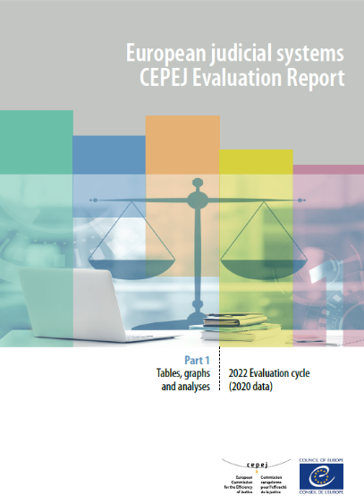
Tables, graphs and analyses (Part 1)
Budgets
Efficiency and Quality
Court organisation
Justice Professionals
Impact of Covid-19 crisis on justice
ICT
Users
Overview of the judicial systems and Identification of trends
Best Practices

Slide 5
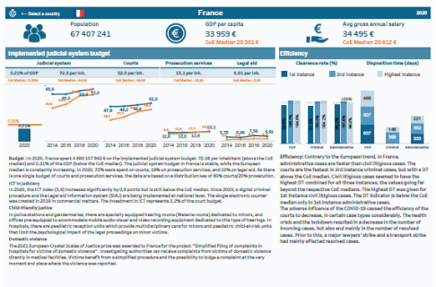
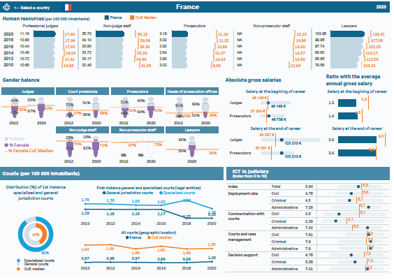
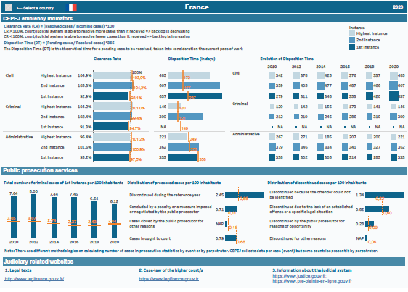
Country profiles (Part 2)
Synthetic analysis on the budget and efficiency as well as country specific highlights
ICT deployment index per categories
Comparison of all indicators with the CoE median.
Evolution of the main indicators since 2010
Main indicators for each country for: justice professionals; courts; prosecution services; efficiency

Slide 6
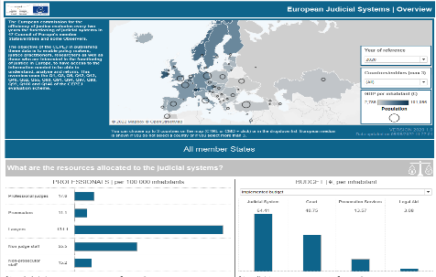
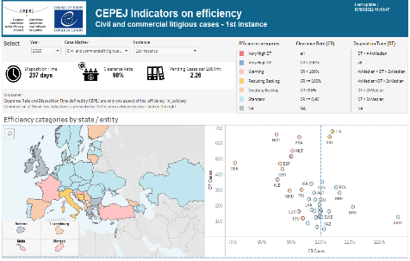
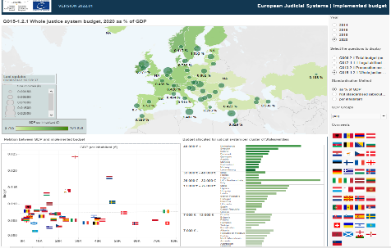
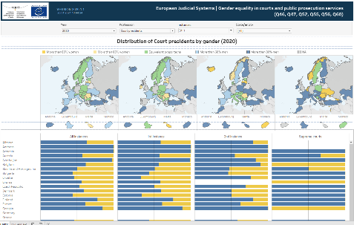
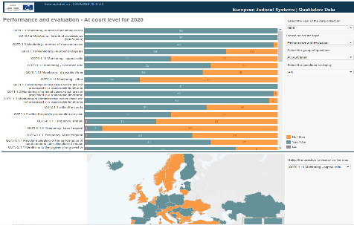
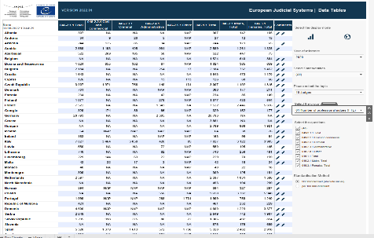
CEPEJ-STAT
DASHBOARDS
EXPLORERS
Overview of judicial systems
Efficiency
Budget of judicial systems
Information and communication technology
Gender balance
Judges and prosecutors
Country/entity profiles
Quantitative data
Variation of quantitative data
Qualitative data
Explorer by question number
Reforms planned for judicial systems

Slide 7
JUDICIAL SYSTEM BUDGET
JUDICIAL SYSTEM BUDGET
1,1 Bn €
79 € per inhabitant
LEGAL AID BUDGET
(9,5% of JSB)
PROSECUTION SERVICES BUDGET
(24,5% of JSB)
COURT BUDGET
(66% of JSB)
Spent on average by the CoE Member States

Slide 8
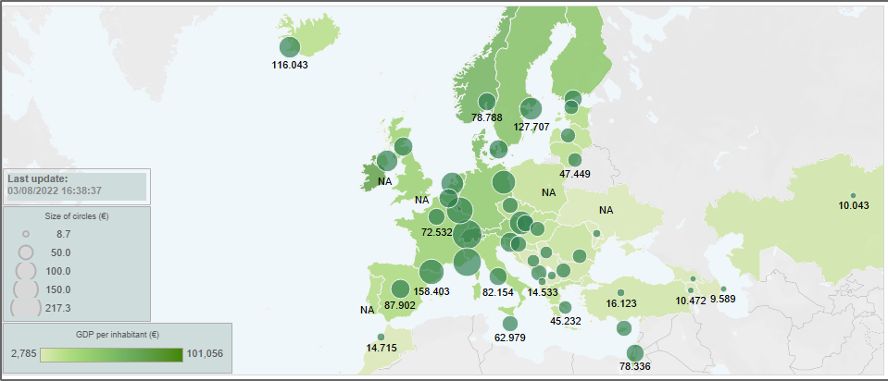
JUDICIAL SYSTEM BUDGET
Judicial System Budget in € per inhabitant and GDP per inhabitant
79 € Per inhabitant
0,35% of GDP
7 € more than in 2018

Slide 9
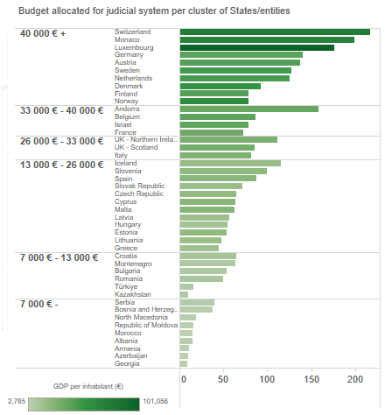
Which countries invest the most in their judicial systems?
Countries with higher GDP per capita
invest more
€ per inhabitant
217 € in Switzerland
199 € in Monaco

Slide 10
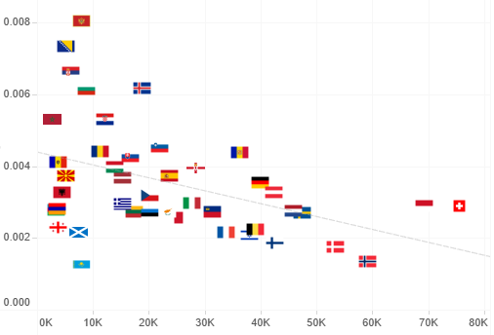
Which countries invest the most in their judicial systems?
JSB % of GDP
Countries with lower GDP per capita
invest more as
% of GDP
0,80% in Montenegro
0,73% in Bosnia and Herzegovina
GDP per capita

Slide 11
Evolution of average approved judicial system budget
+8%
Between 2018 and 2020
Figure 2.5
This graph shows the adjusted average of the approved judicial system budget. Only the values of those countries that provided data for all cycles from 2010 to 2020 are included in this time series.

Slide 12
Components of the judicial system budget
East European countries spend proportionally more on prosecution services (30% or more of the judicial system budget)
Northern European and Common Law countries invest relatively more in legal aid (24% or more of the judicial system budget)
Figure 2.6

Slide 13
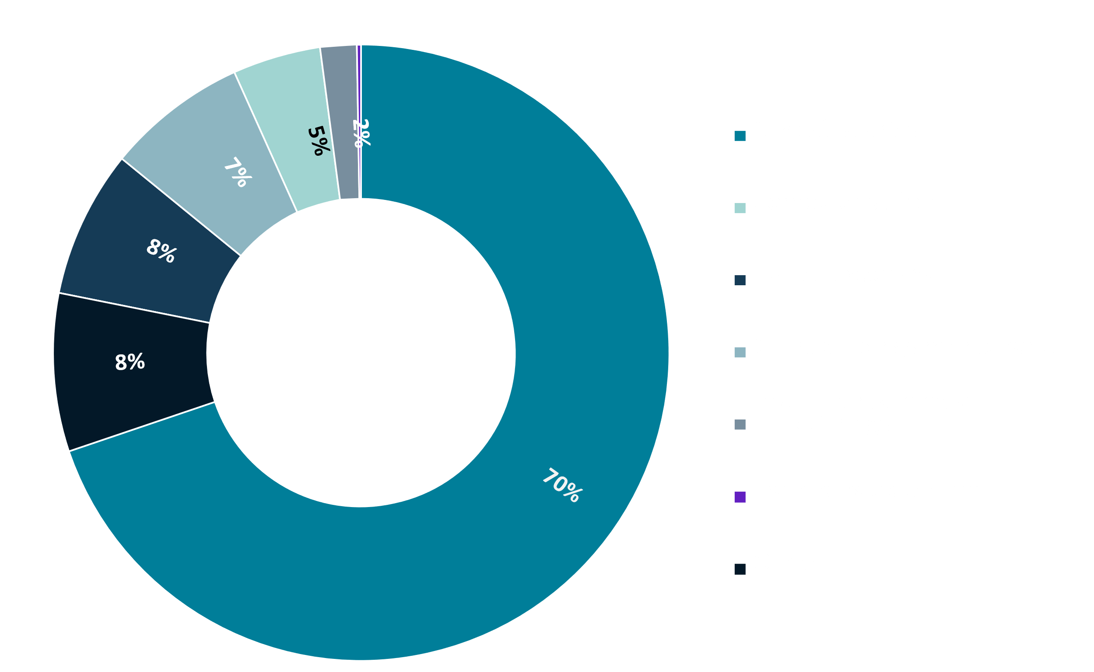
Budget allocated to Courts
Budget allocated to courts seems to be related to:
Wealth of a country
Number of courts
Salaries continued to be the most significant part of the budget of courts (70%)
Ireland 37%
Lithuania 88%
Figure 2.12

Slide 14
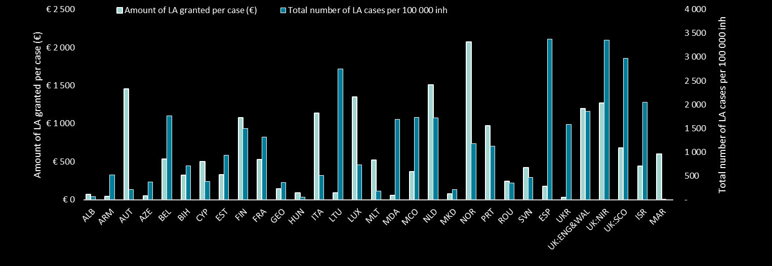
Legal Aid
All countries continue to implement a legal aid system in criminal and other than criminal matters in compliance with the requirements of the European Convention on Human Rights and the case-law of the European Court
Some countries tend to have a low cost per legal aid case and a high number of cases granted legal aid, while others choose to provide a higher amount for a smaller number of cases
Figure 2.30

Slide 15
JUSTICE PROFESSIONALS: Judges
22,2
judges per 100 000 inhabitants on average
Map 3.2

Slide 16
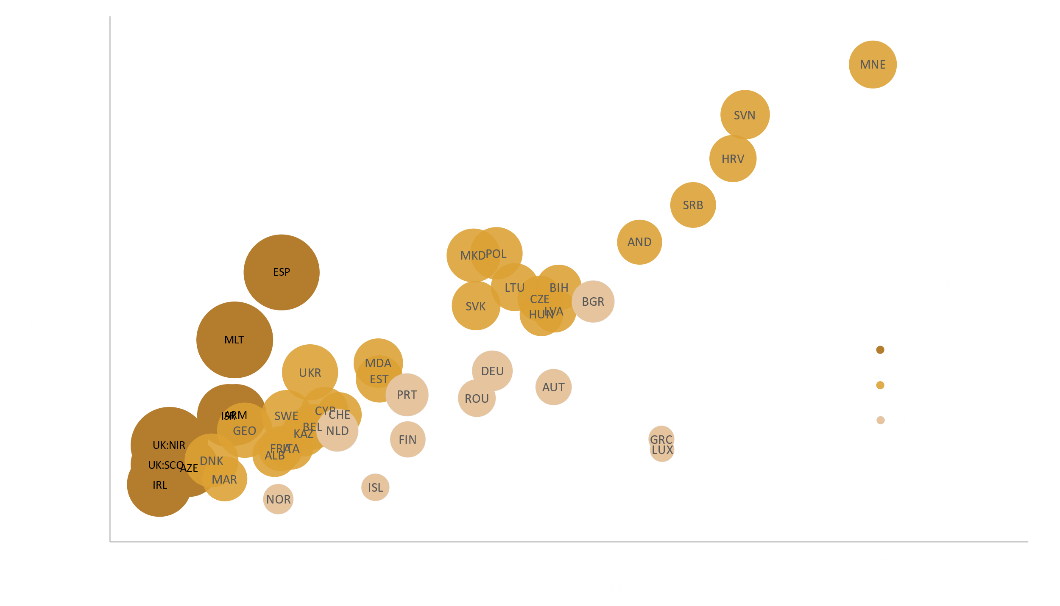
JUSTICE PROFESSIONALS:
Non-judge staff
3,9
Number of non-judge staff per 100 000 inhabitants compared to the number of professional
judges per 100 000 inhabitants; number of non-judge staff per professional judge
Ratio between non – judge staff and professional judges
1 in Luxembourg
9,4
in Malta and Northern Ireland
15
European States have set up Rechtspfleger
Figure 3.13

Slide 17
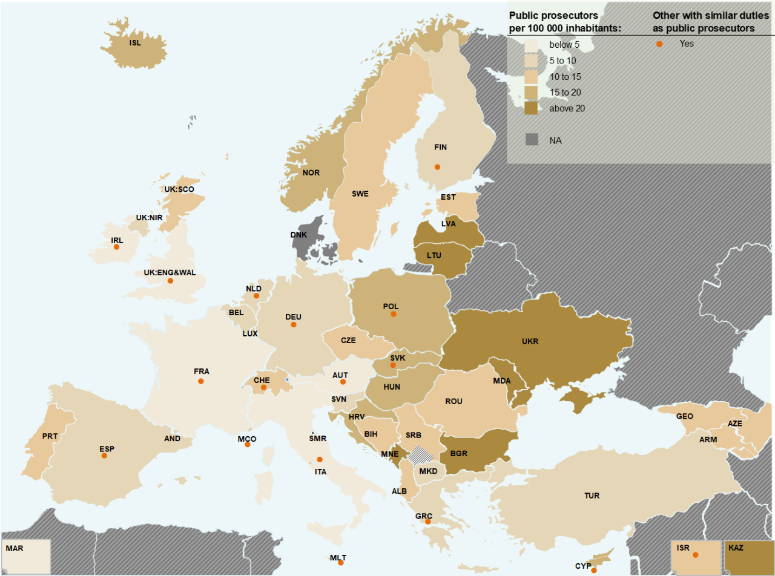
JUSTICE PROFESSIONALS: Prosecutors
Independent status as a separate entity or functional independence as part of the executive or judicial power
20+7+18 States
Received cases per 100 inhabitants
3,1
Prosecutors per 100 000 inhabitants
11,8
Map 3.19

Slide 18
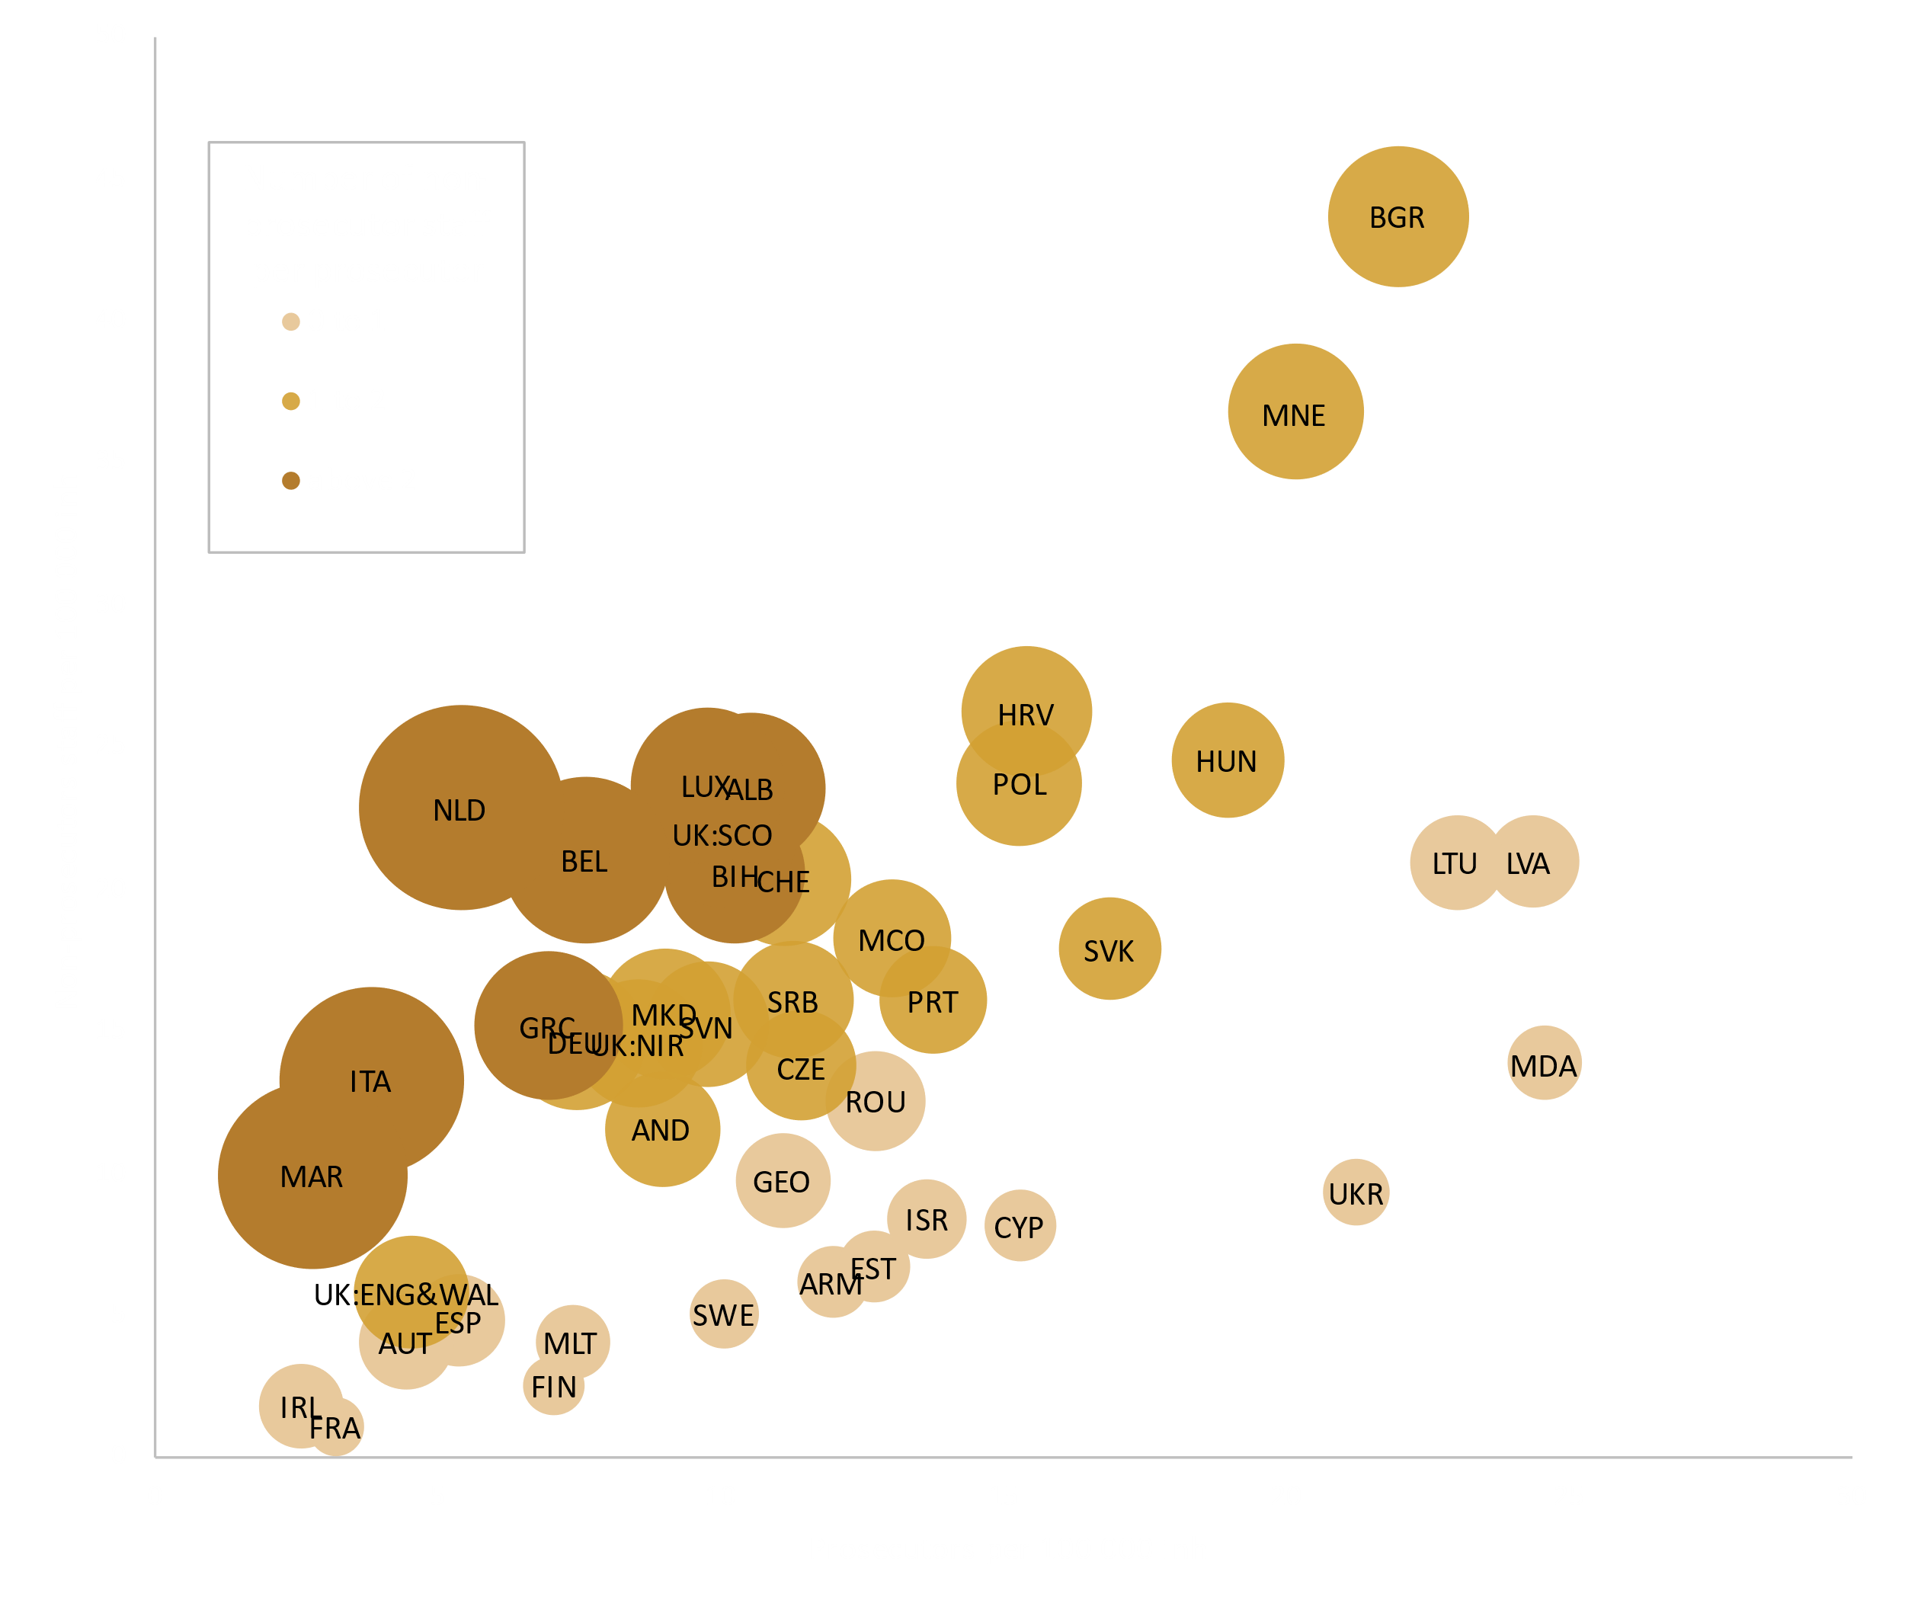
JUSTICE PROFESSIONALS:
Non-prosecutor staff
1,3
Number of non-prosecutor staff per 100 000 inhabitants compared to the number of prosecutors per 100 000 inhabitants; number of non-prosecutor staff per prosecutor
Ratio between non – prosecutor staff and prosecutors
0,5 in Sweden
4,2
in Netherlands
Figure 3.29

Slide 19
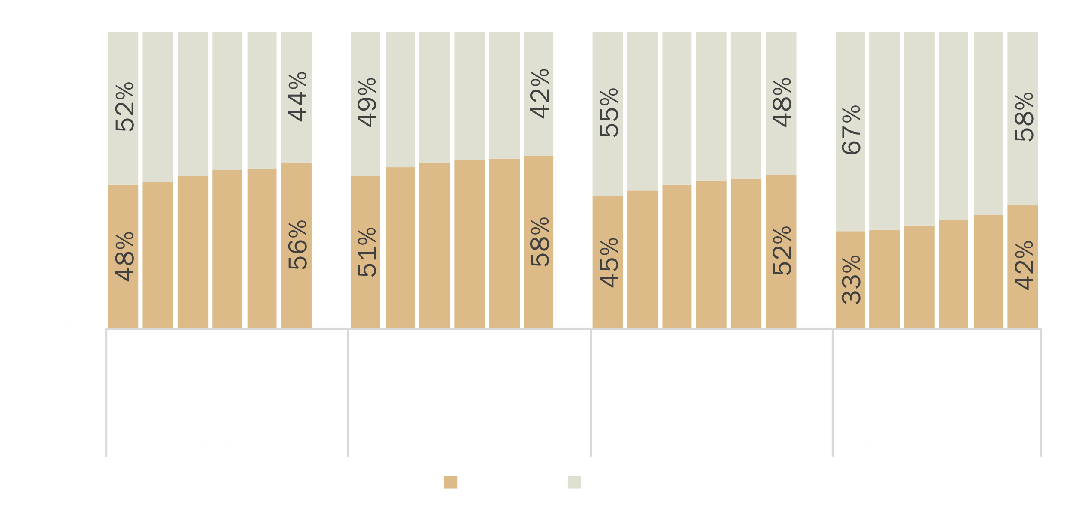

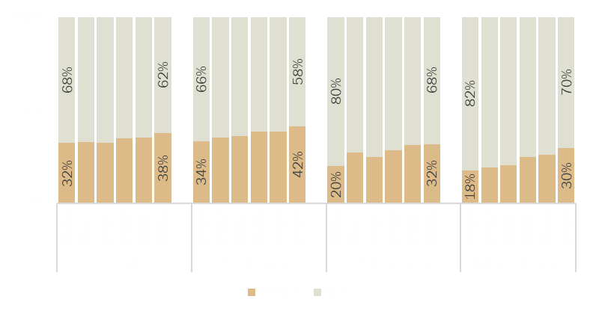
GENDER EQUALITY:
Professional Judges / Court presidents
Distribution of professional judges by gender and by instance
56 %
of female professional judges
Figure 3.31
Distribution of court presidents by gender and by instance
38 % of female court presidents
Figure 3.34
Glass celling still exists!

Slide 20
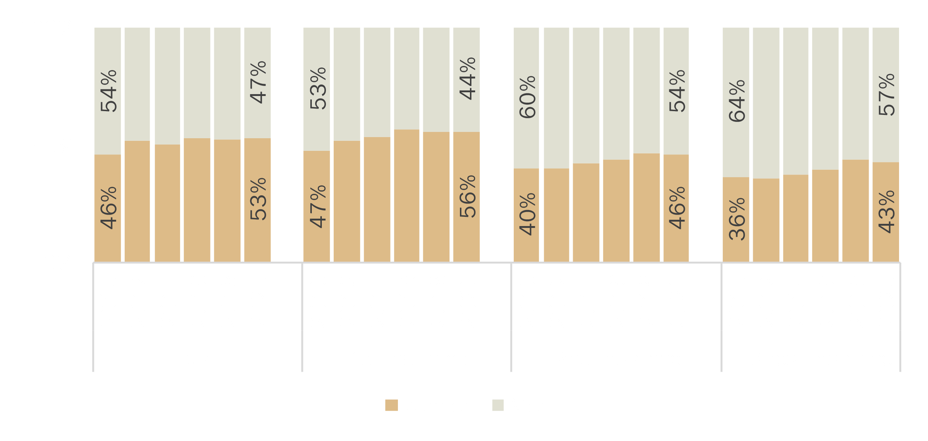

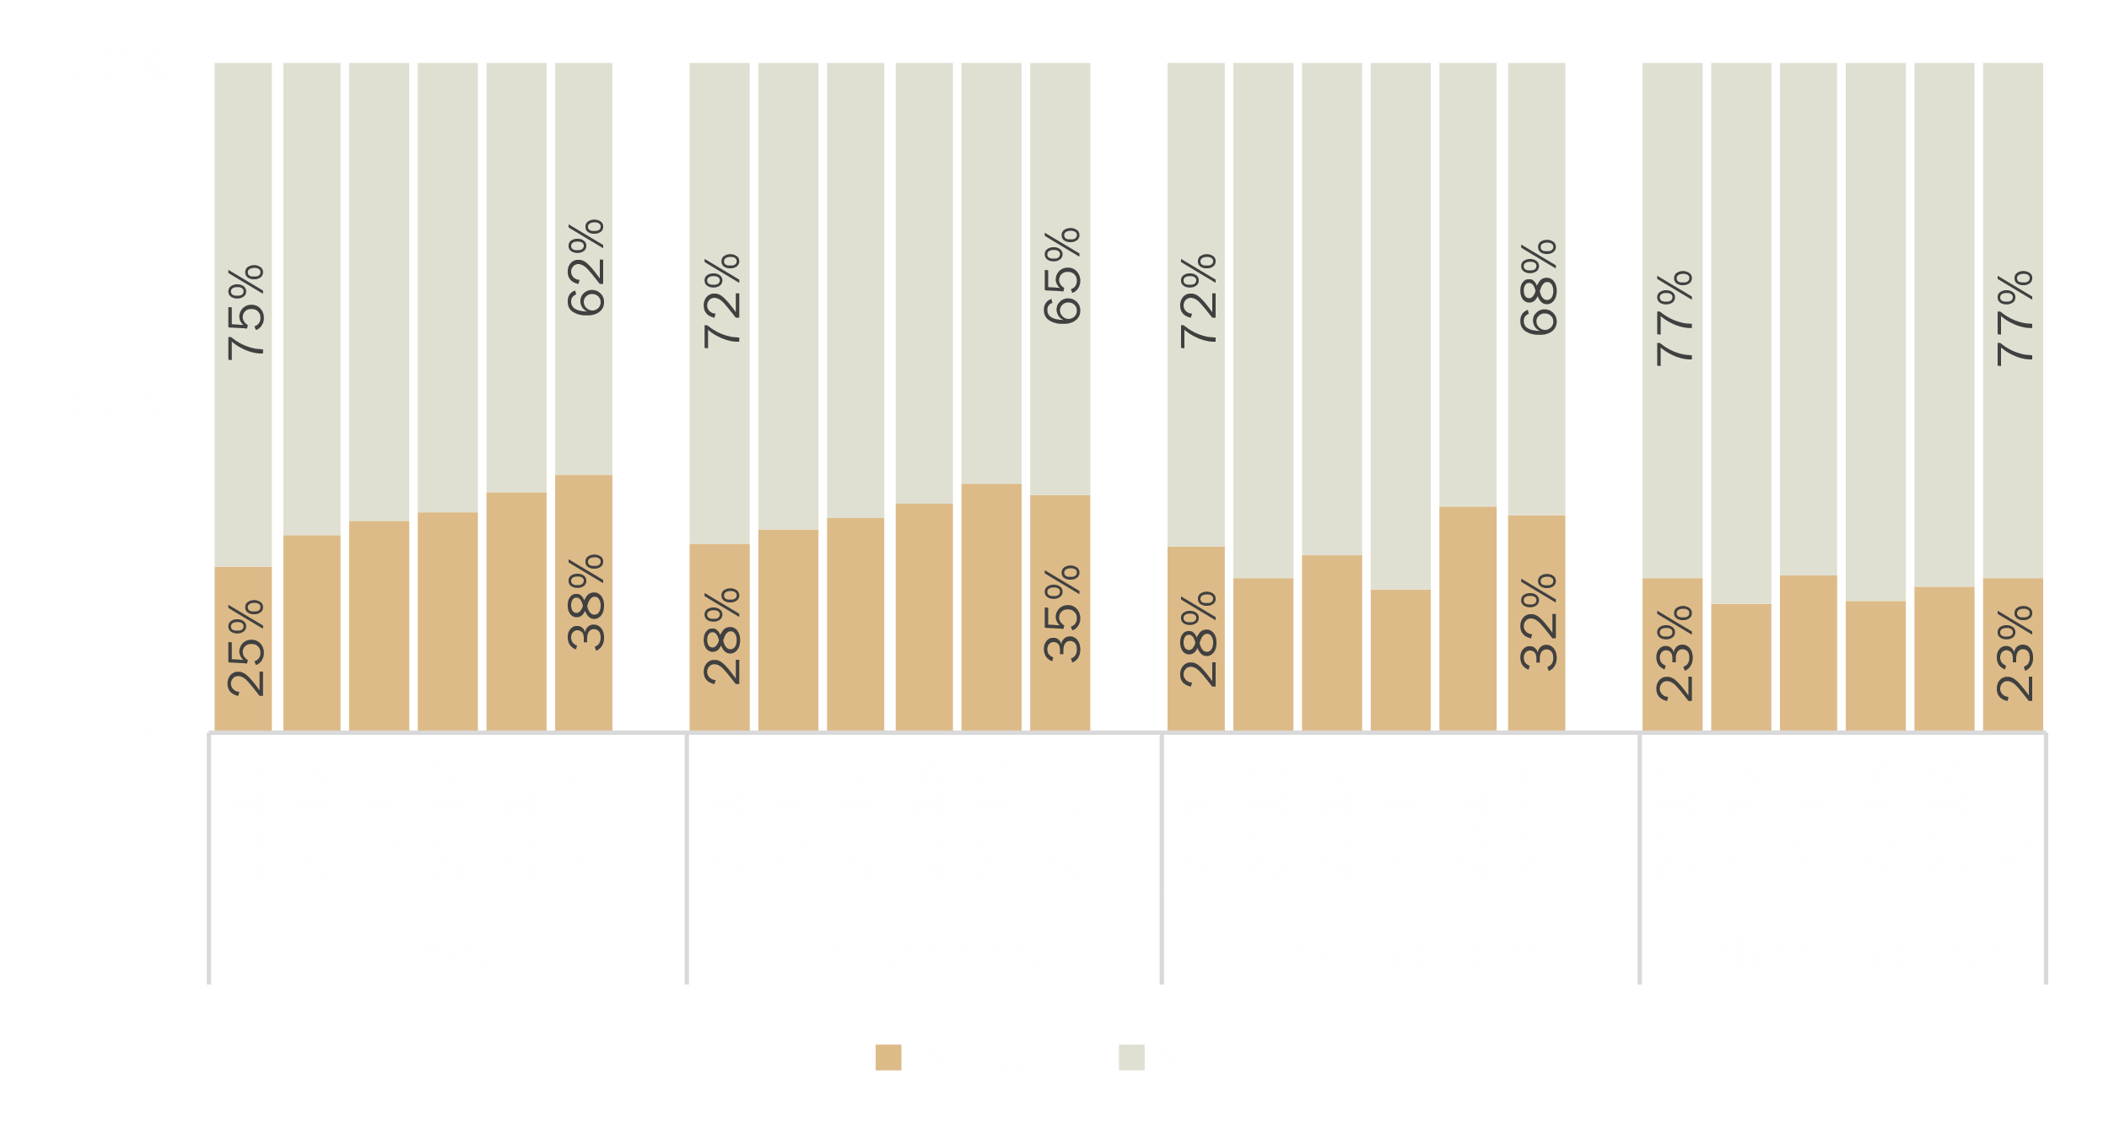
GENDER EQUALITY:
Prosecutors / Heads of prosecution offices
Distribution of public prosecutors by gender and by instance
53 %
of female prosecutors
Figure 3.32
Distribution of heads of prosecution offices by gender and by instance
38 % of female heads of public prosecution offices
Figure 3.36
Glass celling still exists!

Slide 21
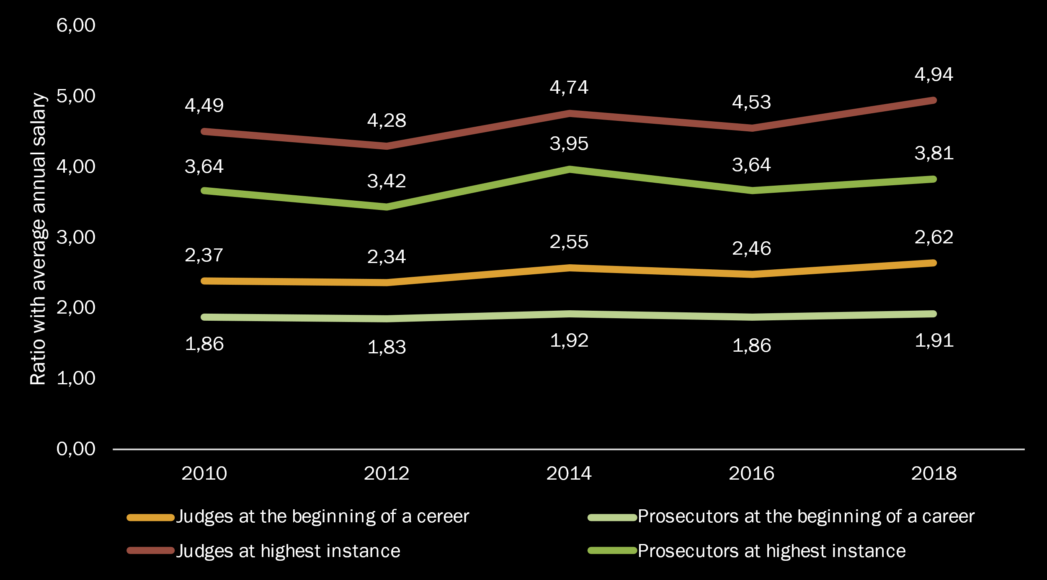
JUSTICE PROFESSIONALS:
How are judges and prosecutors remunerated in comparison with average gross salary?
Judges
At the beginning of career
At the highest instance
Evolution of the average ratios of gross salaries of judges and public prosecutors in relation to annual gross salaries 2010 - 2018
1,0 to 1,3
(Germany, France,
Monaco, Netherlands)
1,7
(Germany and Luxembourg)
6,3 (Azerbaijan)
6,8 (Ukraine)
9,6 (Azerbaijan) 21,6 (Ukraine)
Prosecutors
At the beginning of career
At the highest instance
0,8 (Ireland)
1,7
(Germany and Luxembourg)
4,1 (Romania)
Index = 1 salary = average salary
Index = 2 salary = x2 of average salary
Figure 3.48
6,6 (Ukraine)
7,8 (Georgia)

Slide 22
JUSTICE PROFESSIONALS:
Absolute gross salaries of judges and prosecutors
Judges
Figure 3.46
Prosecutors
Figure 3.47

Slide 23
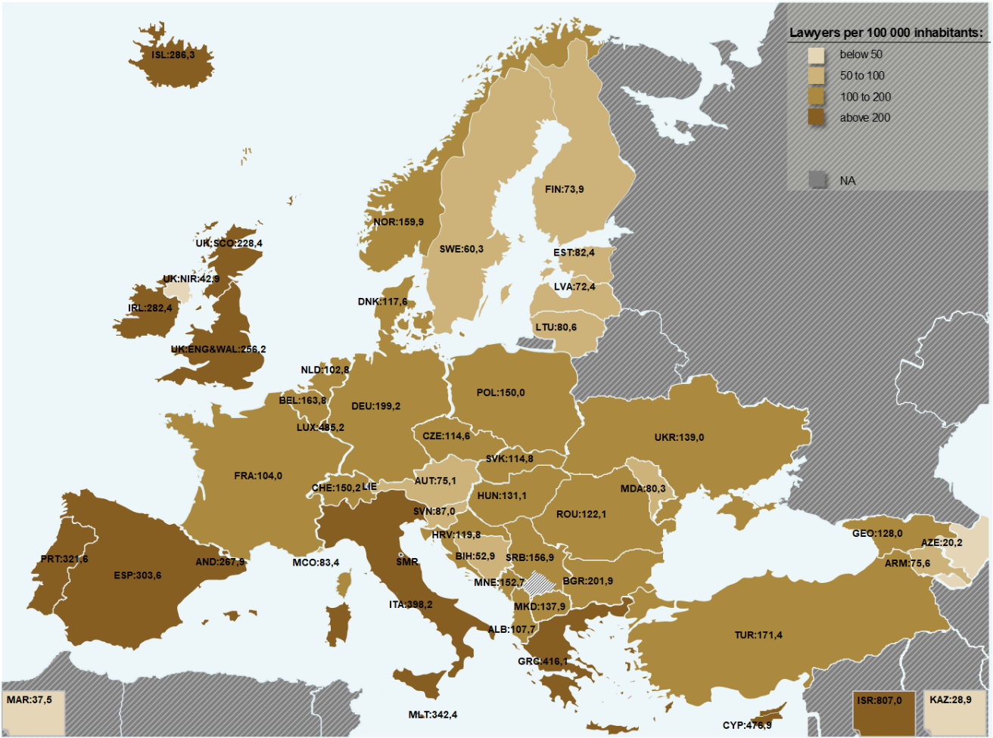
JUSTICE PROFESSIONALS:
Lawyers
172
Per 100 000 inhabitants
Map 3.49

Slide 24
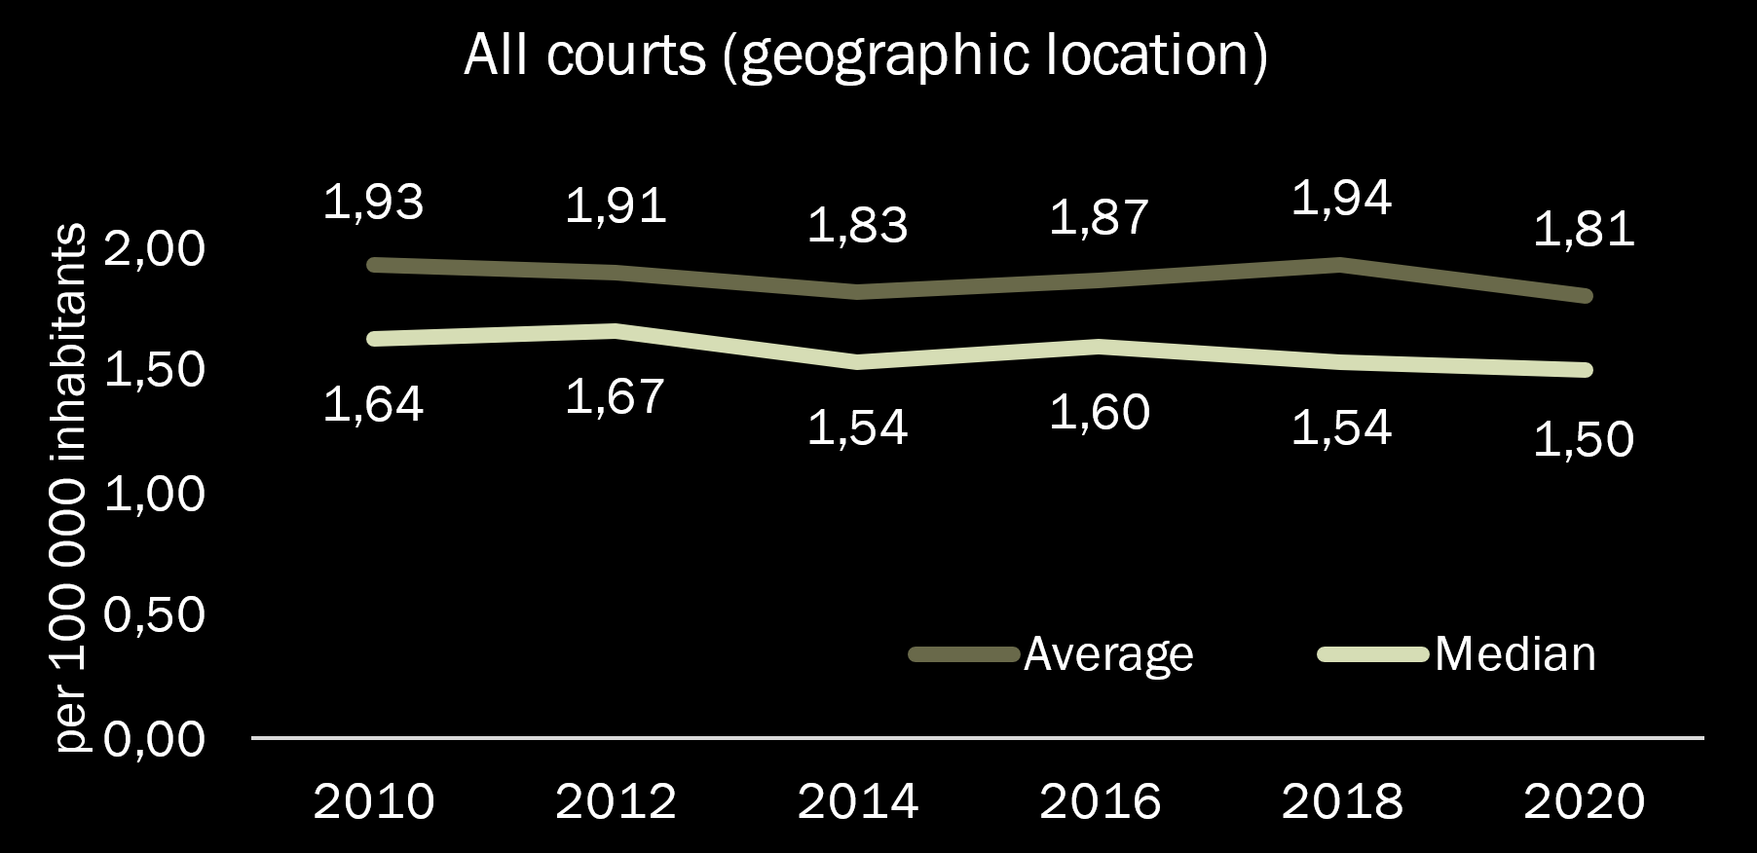
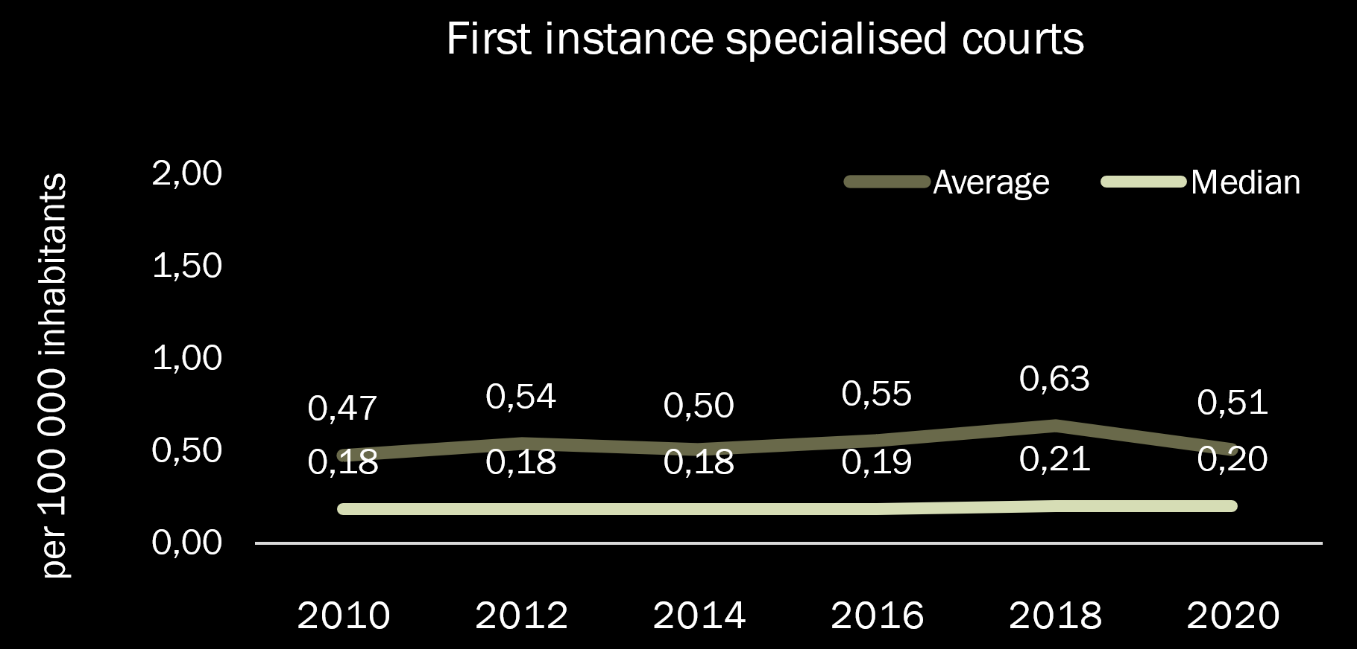
COURTS
2010 -> 2020
Two trends
Specialisation of courts
(stabilising in 2020)
General reduction of courts in Europe

Slide 25
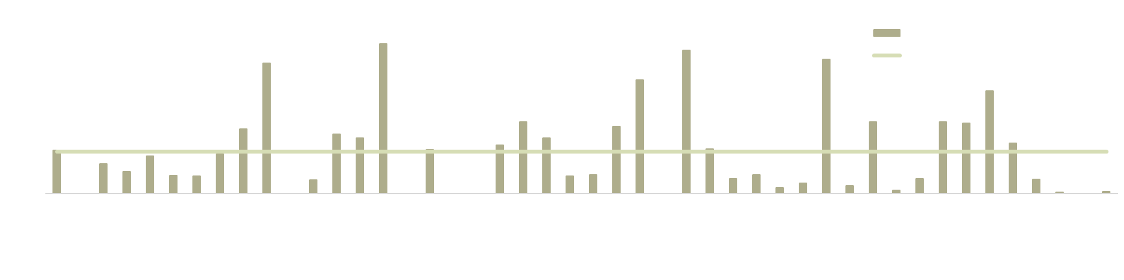
SPECIALISED COURTS
Percentage of first instance specialised courts within the total number of first instance courts (legal entities)
On average
21%
23,6%
In 2010
In 2020

Slide 26
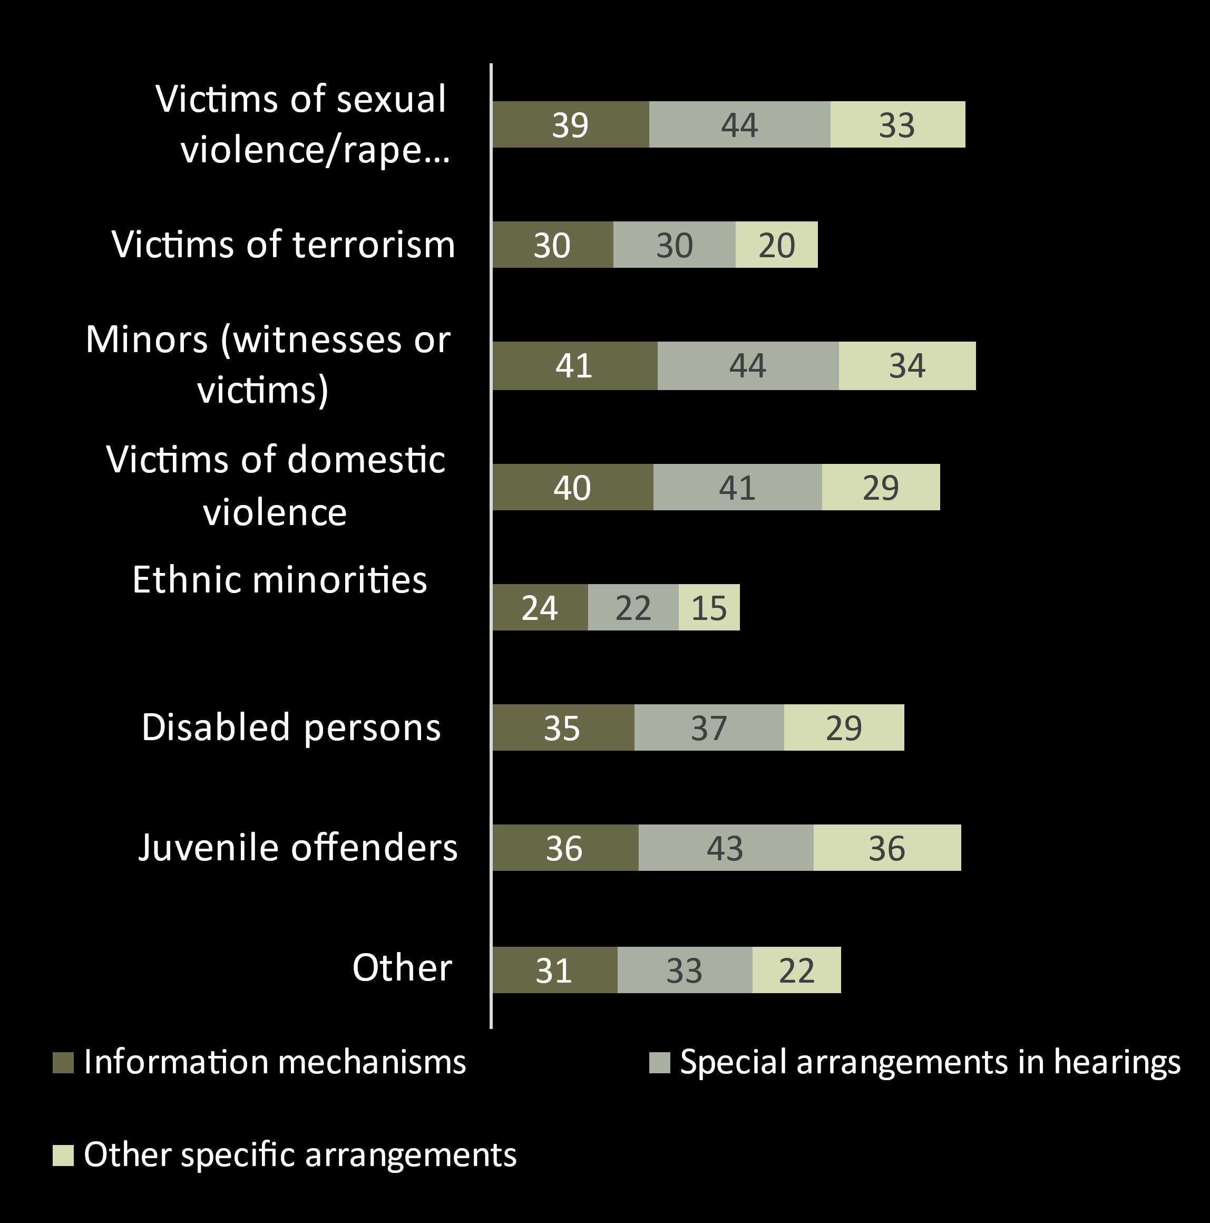
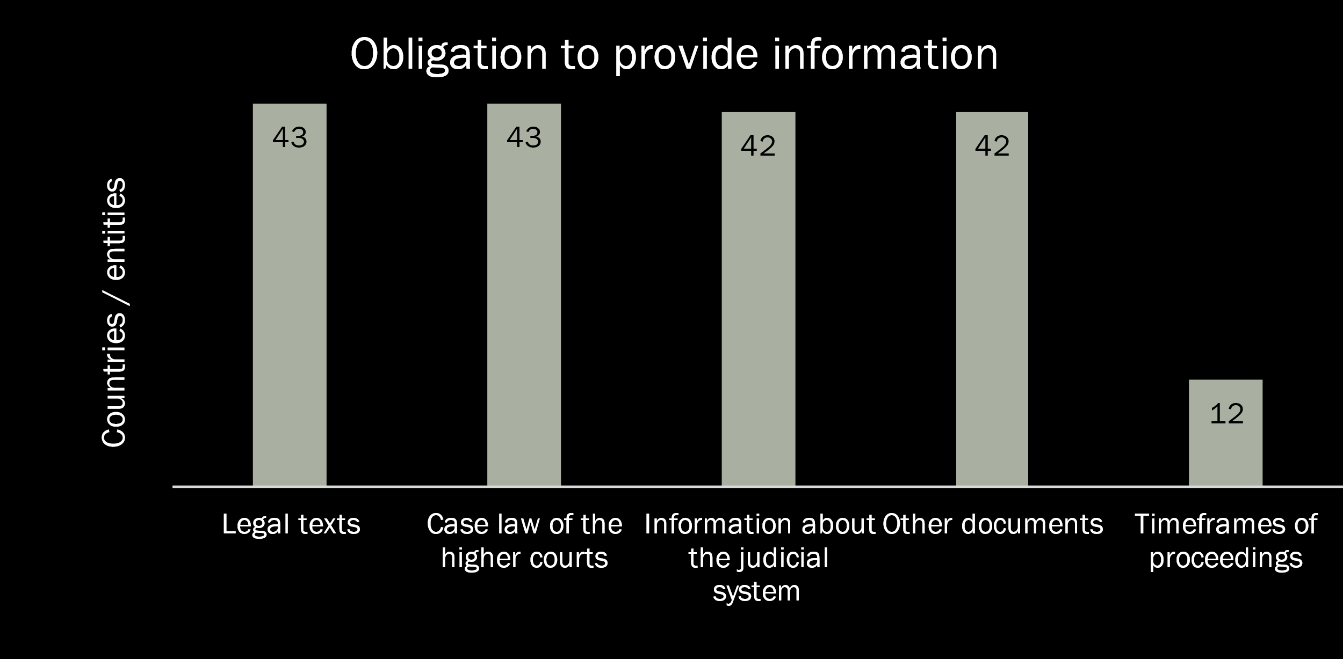
COURT USERS
Most of the States provide information to users (in particular to vulnerable categories)
43 States have established websites making available national legislation, court case-law and pratical information for court users
Figure 4.2.1
Figure 4.2.2

Slide 27
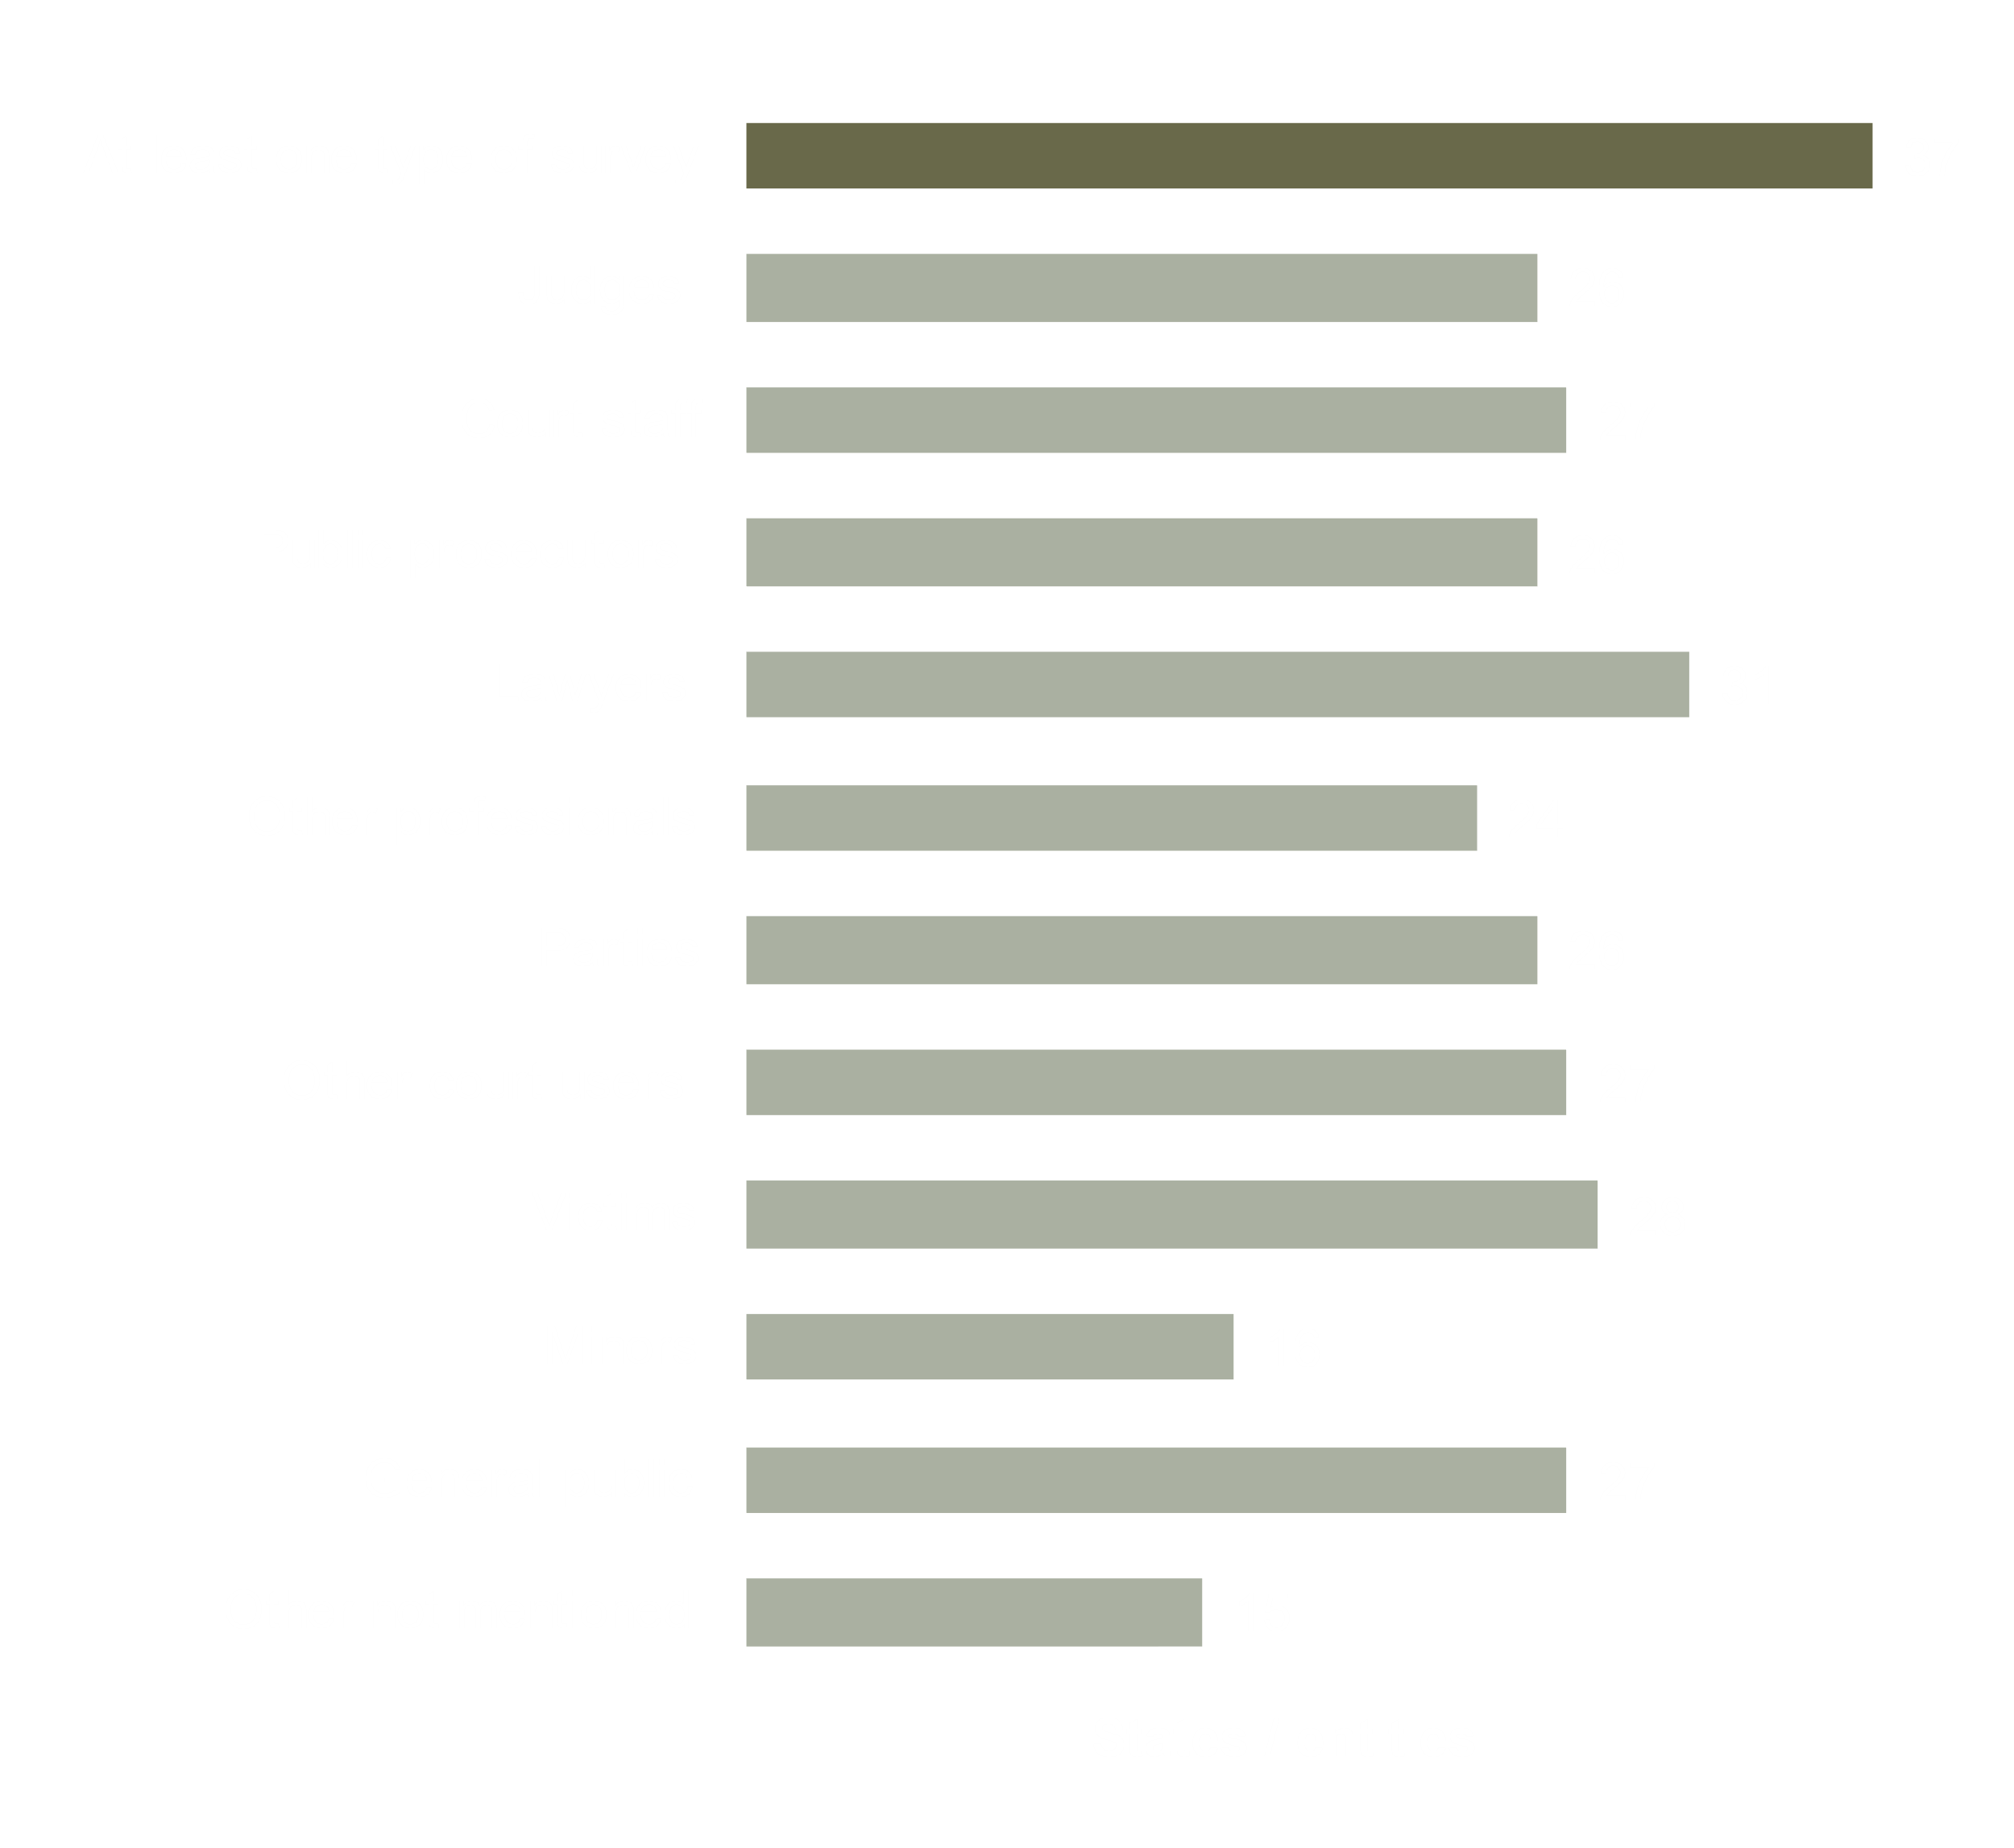
COURT USERS
Existence of surveys to measure the trust in justice and the satisfaction with the services delivered by the judicial system
Satisfaction surveys
Legitimacy
Efficient service
Figure 4.2.6

Slide 28
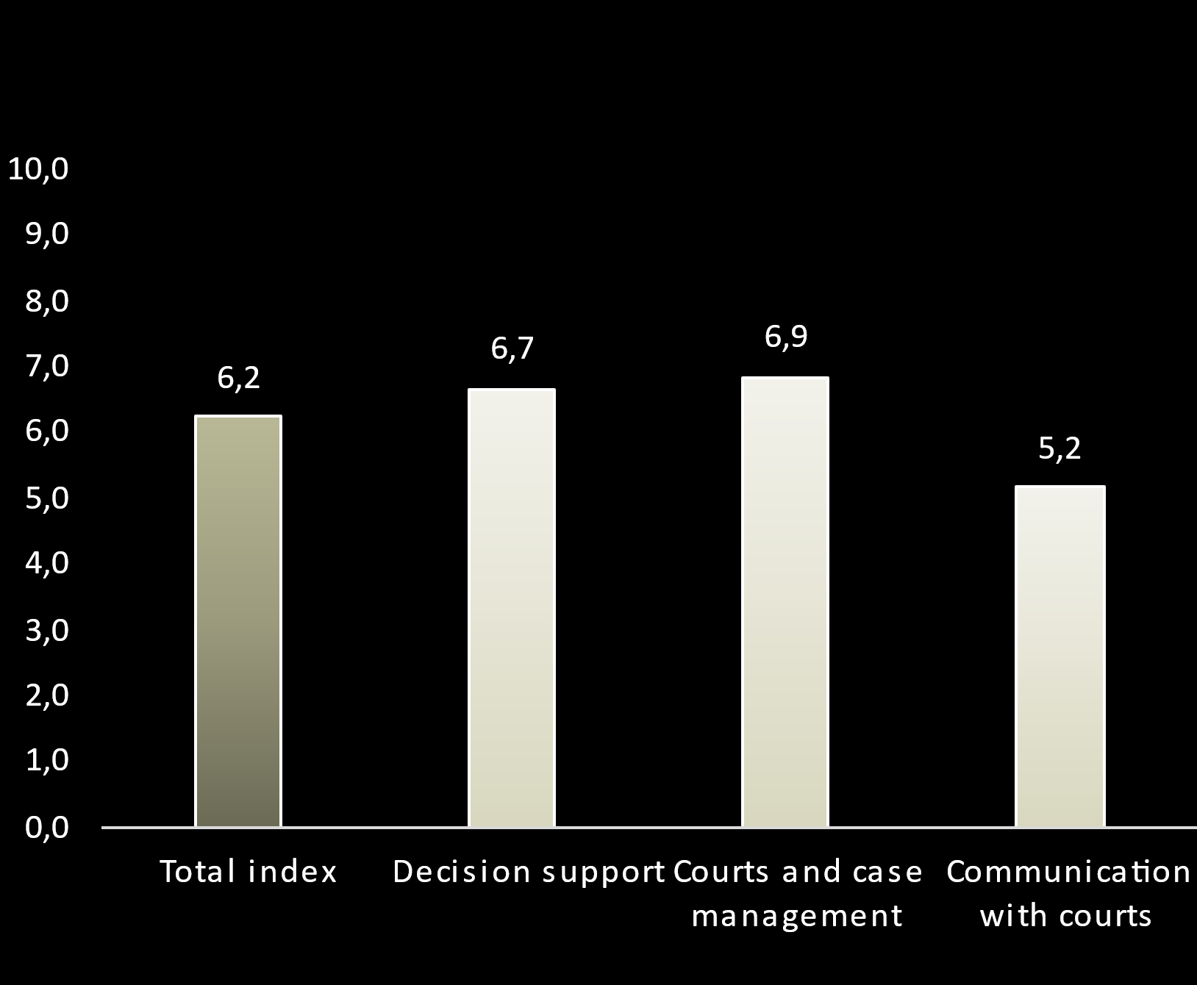
Information and Communication technology (ICT)
General ICT (0 to 10) index varies among States/entities
Average Total ICT Deployment Rate and per category in 2020
1,6
In UK - Scotland
9,8
In Estonia and Latvia

Slide 29
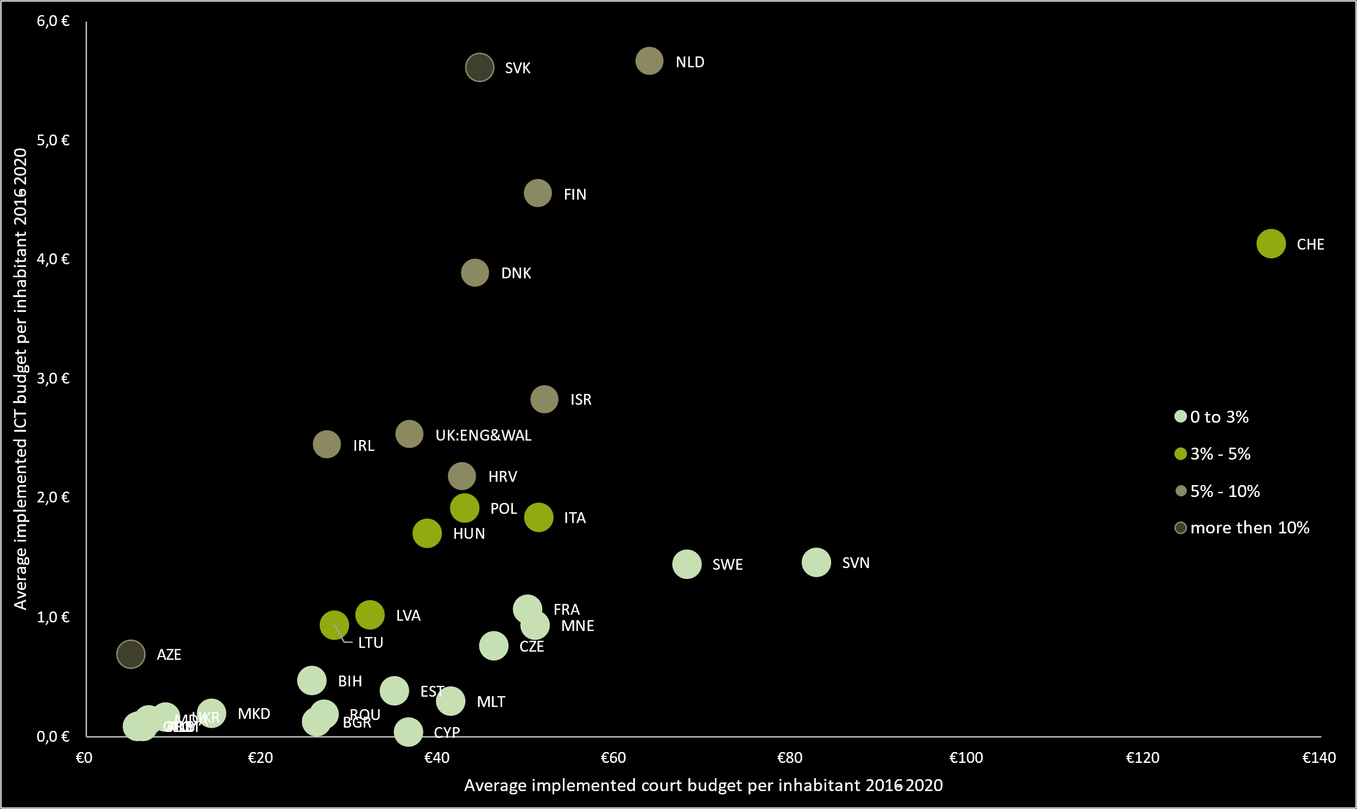
Infomation and Communication technology (ICT)
Implemented budget of courts per capita vs
implemented budget dedicated to ICT per capita in 2020
In 2020,
greater % of courts’ budget has been allocated to ICT compared to the previous cycles
Figure 4.3.2

Slide 30



EFFICIENCY - definitions
The Clearance Rate (CR) is the ratio obtained by dividing the number of resolved cases by the number of incoming cases in a given period, expressed as a percentage.
It demonstrates how the court, or the judicial system is coping with the in-flow of cases and allows comparison between systems regardless of their differences and individual characteristics.
Disposition Time (DT) is the calculated time necessary for a pending case to be resolved, considering the current pace of work. It is reached by dividing the number of pending cases at the end of a particular period by the number of resolved cases within that period, multiplied by 365.
More pending than resolved cases will lead to a DT higher than 365 days (one year) and vice versa.
CR > 100%
Resolving more cases than receiving → backlog is decreasing
CR < 100%
Resolving less cases than receiving → backlog is increasing
$DT=\frac{Pending cases on 31st of December}{Resolved cases}$ X 365
Incoming cases
Resolved cases
Incoming cases
Resolved cases

Slide 31
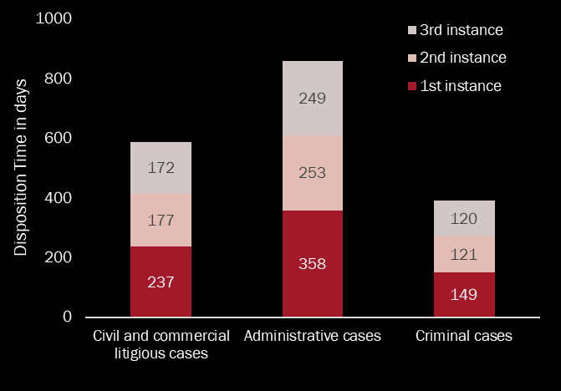
EFFICIENCY
Disposition Time by area of law in 2020 (median in days)
Median Clearance Rate stable and close to 100%
The first instance courts were impacted the most by the pandemic:
98% for civil and commercial litigious cases
97% for administrative cases
95% for criminal cases
Figure 5.2

Slide 32
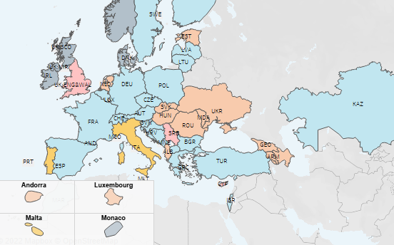
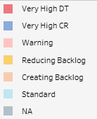
EFFICIENCY
Courts least efficient for first instance Administrative cases
Disposition Time:
Efficiency categories for first instance administrative cases in 2020
358 days
in first instance courts
253 days
In second instance courts
249 days
Map 5.13
In third instance courts

Slide 33
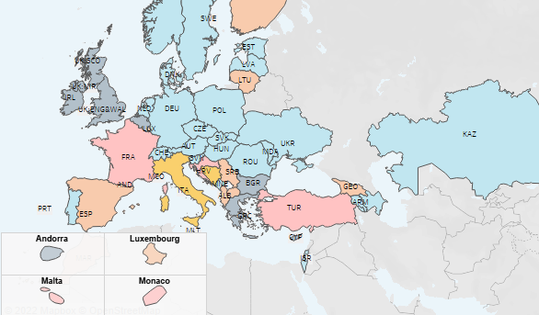
EFFICIENCY
Civil and commercial litigious cases
Disposition Time:
Efficiency categories for first instance civil and commercial litigious cases in 2020
237 days
in first instance courts
177 days
In second instance courts
172 days
Map 5.8
In third instance courts

Slide 34
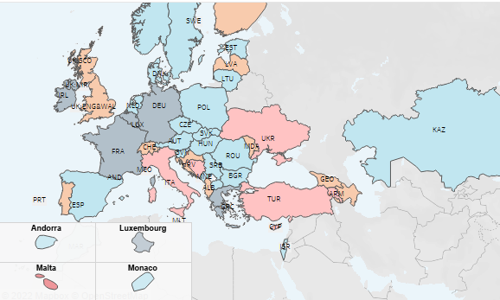
EFFICIENCY
Courts the most efficient for first instance Criminal cases
Disposition Time:
Efficiency categories for first instance criminal cases in 2020
149 days
in first instance courts
121 days
In second instance courts
120 days
Map 5.19
In third instance courts

Slide 35
Covid-19 crisis effect on efficiency
2018
Disposition Time (median in days)
2020
Disposition Time (median in days)
Figure 5.2

Slide 36
Covid-19 crisis effect on ICT index
ICT index by category

Slide 37
USEFUL LINKS
Presentation Note link
Special file link
Part 1: Tables, graphs and analysis
Part 2: Country Profiles
Part 3: CEPEJ-STAT database

Slide 38
Thank you

Slide 39



http://www.coe.int/cepej/
CEPEJ Council of Europe
@CEPEJ_CoE

