Slide 1


An Garda Síochána
Council of Europe
Presentation
Sergeant Dermot Delaney
Sergeant Geraldine Greene
24th November 2020
Garda National Diversity & Integration Unit

Slide 2
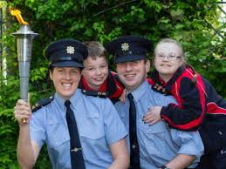
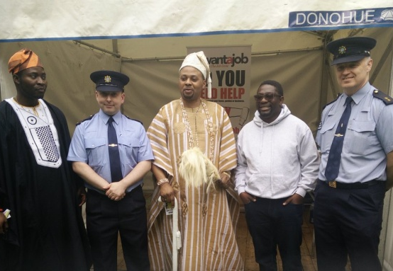
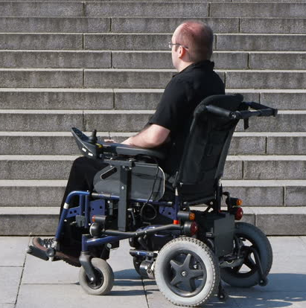
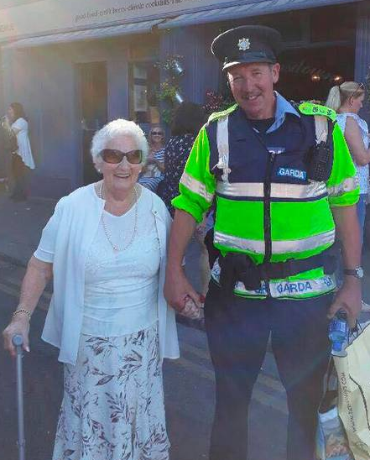
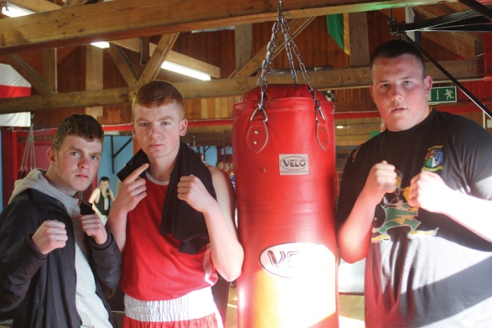
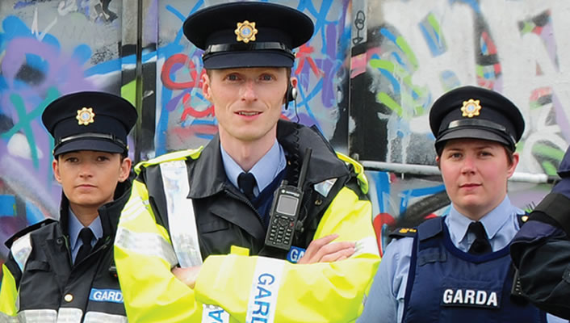
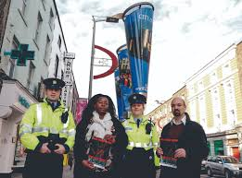
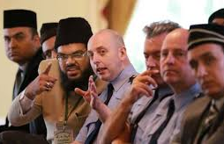
Garda National Diversity & Integration Unit
Provide advice, support and guidance in relation to the 9 Strands of Diversity
Age
Disability
Race
Colour
Nationality
Ethnicity
Religion
Sexual Orientation
Gender
Key Objectives

Slide 3

Legislation
Section 2
Prohibition of Incitement to Hatred Act 1989 (under review)
It shall be an offence for a person to
(a) publish or distribute written material
(b) use words, behave or display written material
(c) distribute, show or play a recording of visual images or sounds
If they are threatening, abusive or insulting and are intended………are likely to stir up hatred
Section 42
Irish Human Rights & Equality Act
A Public body shall, in the performance of its functions have regard to the need to:
(a) eliminate discrimination
(b) promote equality of opportunity and treatment of its staff and the persons to whom it provides services
(c) protect, promote and fulfil the human rights of its members, staff
and the persons to whom it provides services

Slide 4
Prohibition of Incitement to Hatred Act 1989
Since the commencement of the 1989 Act there have been
• 44 prosecutions
• 22 strike outs in Court
• 5 convictions
• 2 custodial sentences
Since 2014 only 7 cases have been before the Courts
Focus is on Hate Speech
Does not address Actions
Gardaí reluctant to use
Cumbersome to apply
DPP slow to prosecute
Difficult to prove in court

Slide 5
Diversity & Integration Strategy
Launched in October 2019
Includes Hate Crime Definition
VISION
We will provide a responsive, equal and accessible policing service to all, particularly those who are marginalised in society, minority groups, and persons from diverse backgrounds.

Slide 6
Definition of Hate Crime
“Any criminal offence which is perceived by the victim or any other person to, in whole or in part, be motivated by hostility or prejudice, based on actual or perceived age, disability, race, colour, nationality, ethnicity, religion, sexual orientation or gender.”
Garda National Diversity & Integration Unit

Slide 7
Definition of Non-Crime Hate Incident
“Any non-crime incident which is perceived by the victim or any other person to, in whole or in part, be motivated by hostility or prejudice, based on actual or perceived age, disability, race, colour, nationality, ethnicity, religion, sexual orientation or gender.”
Garda National Diversity & Integration Unit

Slide 8
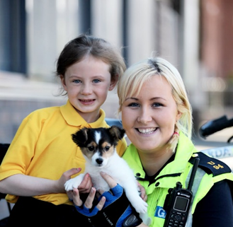
Diversity Strategy – Strategic Priorities
1. PROTECTING THE COMMUNITY - Definition, Online Reporting, Third party referrals
2. DATA - Changes to IT PULSE System, Data collection
3. OUR PEOPLE – Training, Role of GDO, Policy, Procedures & Aide Memoir
4. PARTNERSHIP - Forum, Dialogue Days,
Criminal Justice Partners
5. COMMUNICATION - Hate Crime campaigns
Garda National Diversity & Integration Unit

Slide 9

Framework Vision
Hate Crime: Poster Campaign

Slide 10
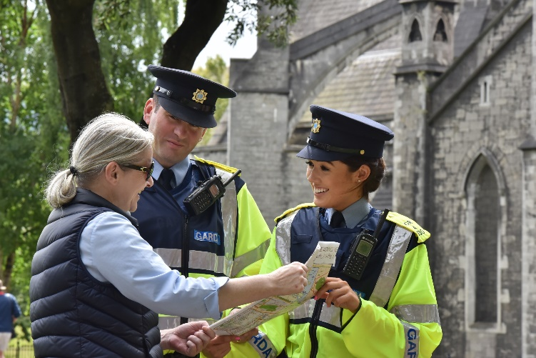
Garda Diversity Officers (GDOs)
Specially trained Gardaí in every Garda division
Deal with all minority / diverse groups
Facilitate access to Garda services
Help to build trust and confidence
Provide additional support to victims of Hate Crime
Garda National Diversity & Integration Unit

Slide 11









Garda National Diversity Forum
Established to monitor and review the implementation of the Diversity and Integration Strategy 2019-2021
Made up of representatives from all diverse / minority groups and victim support
Communication mechanism

Slide 12
Questions

Slide 13
Questions

Slide 14


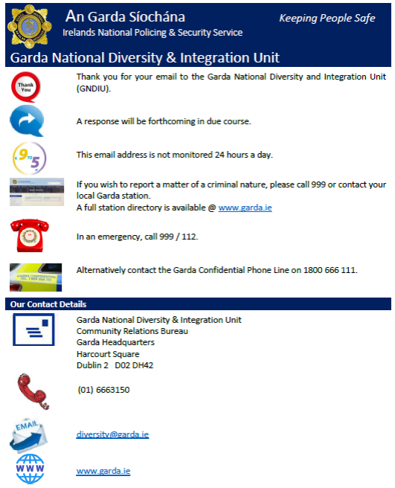
Contact
Us @
 | Sergeant Geraldine Greene Sergeant Dermot Delaney Garda National Diversity & Integration Unit Garda Community Relations Bureau Harcourt Square Dublin 2 D02 DH42 (01) 6663150 diversity@garda.ie www.garda.ie
Garda National Diversity & Integration Unit

Slide 15
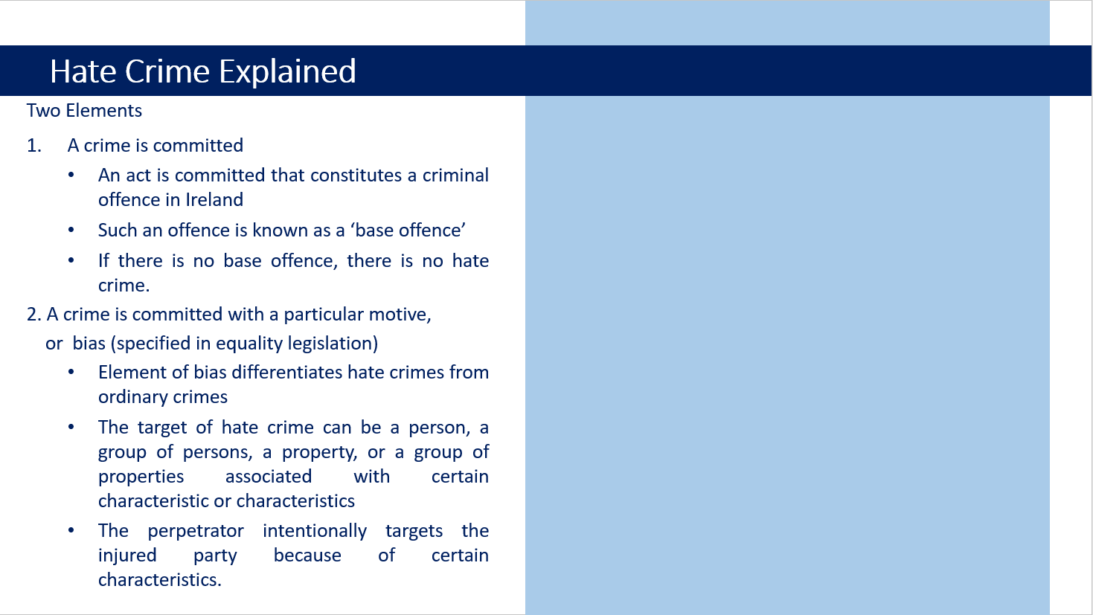
Diversity Strategy – Strategic Priorities
1 – PROTECTING THE COMMUNITY
Protect the safety, wellbeing and rights of all, particularly minority and marginalised communities and vulnerable individuals.
2 – DATA
Ensure the most effective and accurate management of data on hate crime in a safe, secure and legal manner, whilst respecting the privacy and rights of all persons
3 – OUR PEOPLE
Develop the skills and environment needed to ensure Equality, Diversity, Integration and Human Rights in all aspects of operational policing
4 – PARTNERSHIP
Engage with internal and external stakeholders in a proactive and inclusive manner to build trust and identify the policing needs of all diverse, minority and ‘hard to reach’ communities.
5 – COMMUNICATION
Communicate openly, honestly, sensitively and respectfully with all our communities, colleagues and partners to improve trust and confidence in the policing service we deliver to all people.
Garda National Diversity & Integration Unit

Slide 16
Explanatory Notes
A person, community or institution may be a victim of hate crime by virtue of perceived or actual association with a particular group or background.
Motivation is presumed by a demonstration or expression of hostility or prejudice.
Ethnicity includes ‘Traveller’ and ‘Roma’.
Religion includes ‘non-believers’.
Gender includes gender identity, transgender, intersex, gender expression and gender exploration.

Slide 17
Hate Crime Projects
Pulse
Online Training
Online Reporting / Third Party Referrals

Slide 18
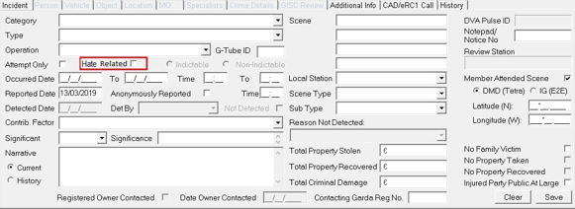
Pulse – Garda Computer System

Slide 19
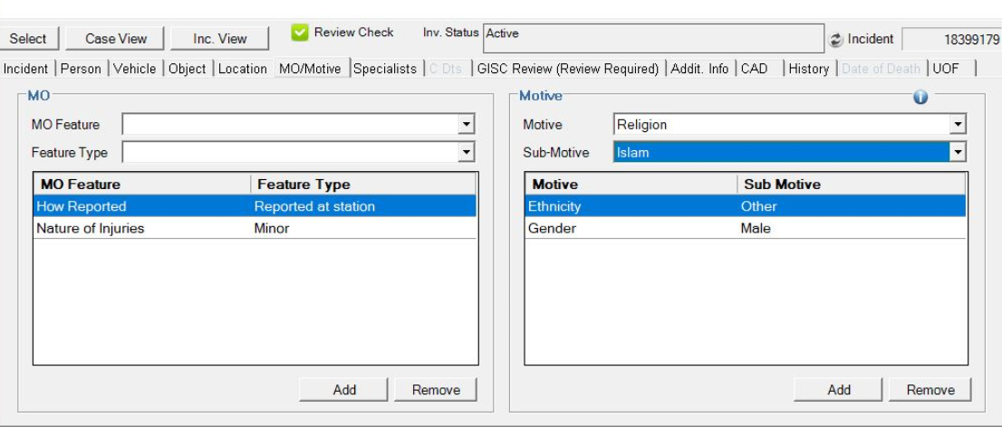
Pulse – Garda Computer System

Slide 20
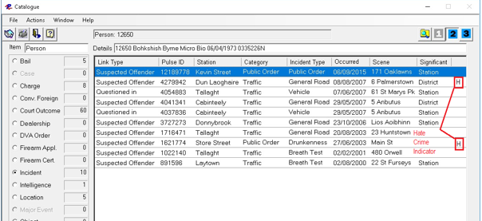
Pulse – Garda Computer System

Slide 21
Online Training Modules
Hate Crime
Cultural Awareness & Diversity
Leadership in Diversity In policing
Dublin City University Review

Slide 22
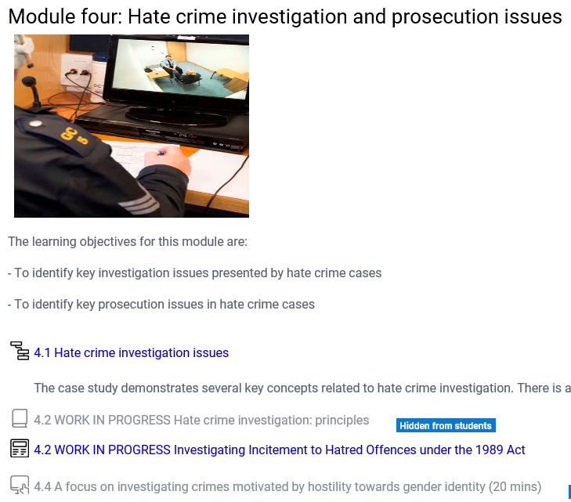
Hate Crime Training

Slide 23
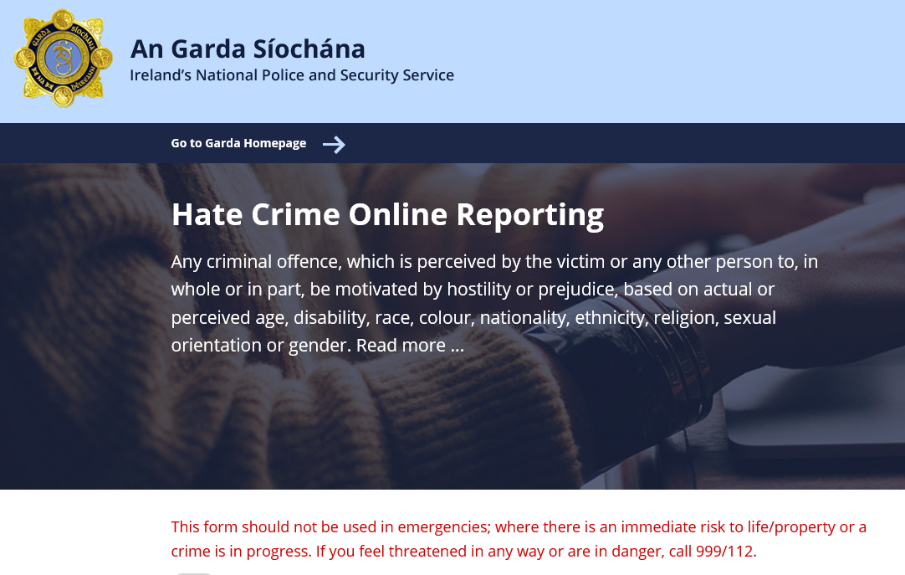
Online Reporting of Hate Crime

