Slide 1

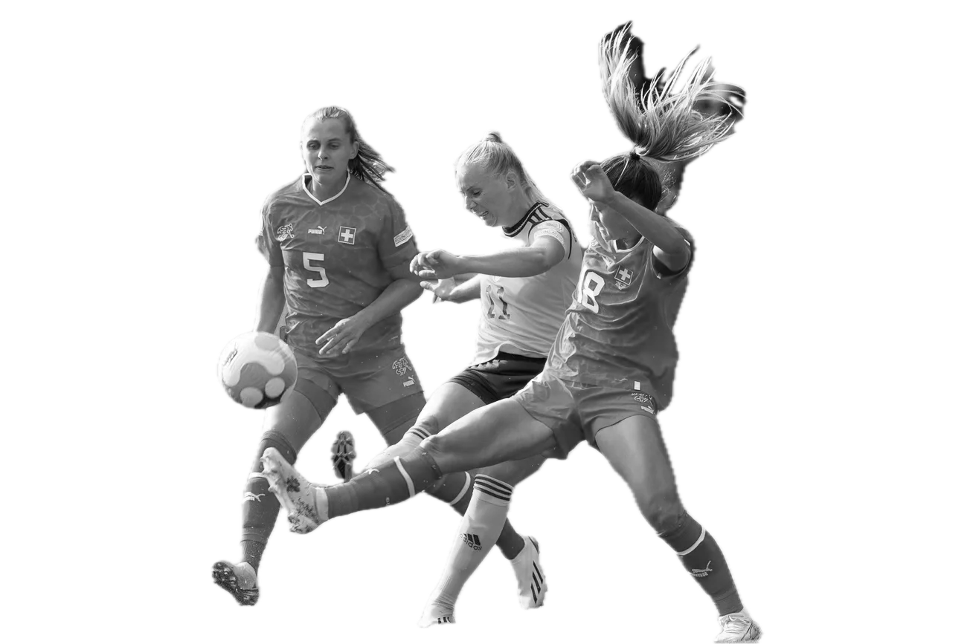
International Team Sport Federations Medical & Integrity meeting
Versoix, 4th of March 2026
CURRENT HEALTHCARE ISSUES
MENSTRUAL CYCLE & HEALTH TRACKING

Slide 2






Data often collected by sports scientist or physiotherapist without appropriate training
Collection and analysis of data is inconsistent
Menstrual Tracking
in Football TODAY
Guidance based on findings is inconsistent or simplified
Goal of collection often not aligning with high quality evidence

Slide 3

Health indicator
Performance
?
Recovery
Injury Risk

Slide 4
“
To date there is insufficient high-quality evidence to confirm or refute a meaningful relationship between menstrual cycle phases and football players’
… performance benefits.
… injury risk.
… recovery.
Verhagen et al. @BMJ Open SEM 2025

Slide 5
“
Tracking the menstrual cycle is meaningful to understanding a player’s normal cycle and any related symptoms and signs.
Verhagen et al. @BMJ Open SEM 2025

Slide 6

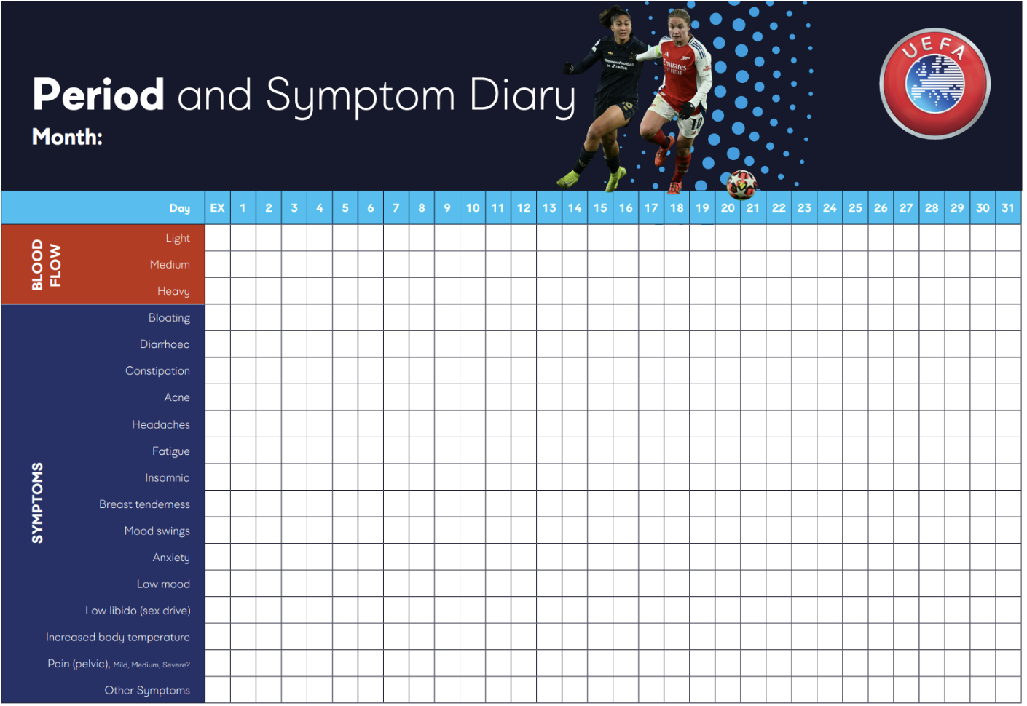

MEDICAL &
ANTI-DOPING
VS
BLEEDING
TRACKING
MENSTRUAL CYCLE TRACKING
DETAILS
LIGHT
HIGH
EFFORT AND EXPERTISE NEEDED
SOME
HIGH

Slide 7
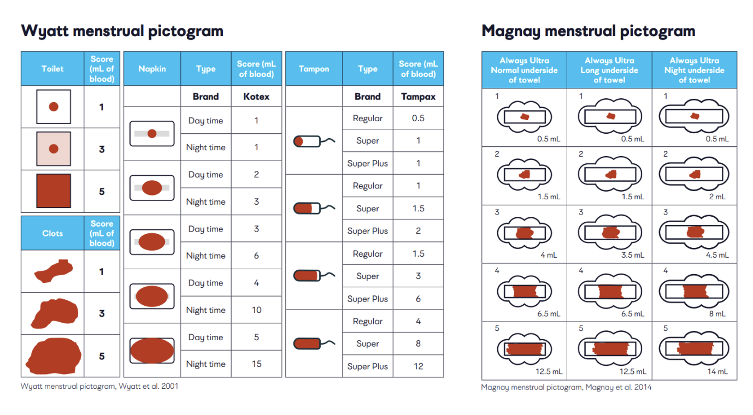
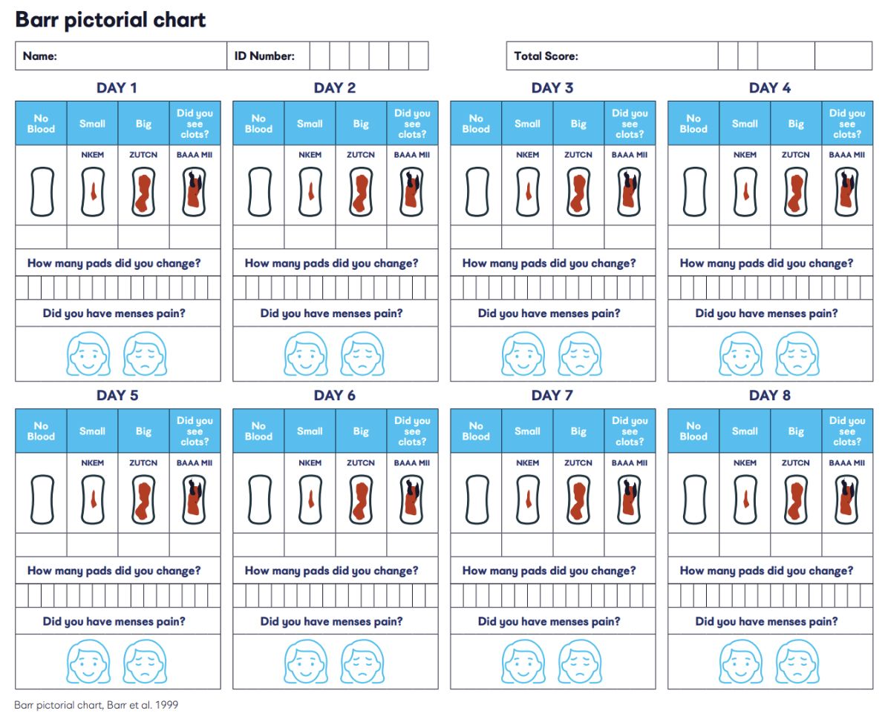

BLEEDING TRACKING
WHAT CAN WE MEASURE?
1
REGULARITY
2
CHARACTERISTICS OF BLEEDING
3
TYPE, INTENSITY AND FREQUENCY OF CYCLICAL SYMPTOMS
Regularity
Impacted by age & maturation
Duration
Min. 3 consecutive cycles in the first instance + tracking 1 cycle for subsequent spot-checks.
Verhagen et al. @BMJ Open SEM 2025
Notes:
Bleeding regularity, duration, and volume should be self-reported for three or more consecutive cycles. As such, the number of non-bleeding days will/should also be collected. A calendar, diary, or bespoke form can be used to collect this information.
A diary can be used as a tool for players to gain awareness and information about the regularity and characteristics of bleeding, their menstrual cycle length, and regularity and number of bleeding days, but the determination of distinctive menstrual cycle phase is unreliable and inaccurate.
Tracking bleeding regularity, duration, and volume does not require ovulation or ovarian hormone measurements.

Slide 8

WHAT TRACKING SHOULD LOOK LIKE IN FOOTBALL TODAY
Players should be educated on menstrual health + objectives of monitoring
Players should know and consent to whom their menstrual health data will be shared
Data handling must be compliant with data protection regulations
+
+
Ensure it is purposeful
+
Adequate resources must be available to take appropriate action
Players should receive regular updates on their menstrual cycle data and trends
Be aware of potential conflicts due to players' cultural differences and beliefs

