Slide 1
Active and Equal:
Women’s Health in Sport across Generations
Annamarie Phelps
European Olympic Committees
IWG Women and Sport

Slide 2
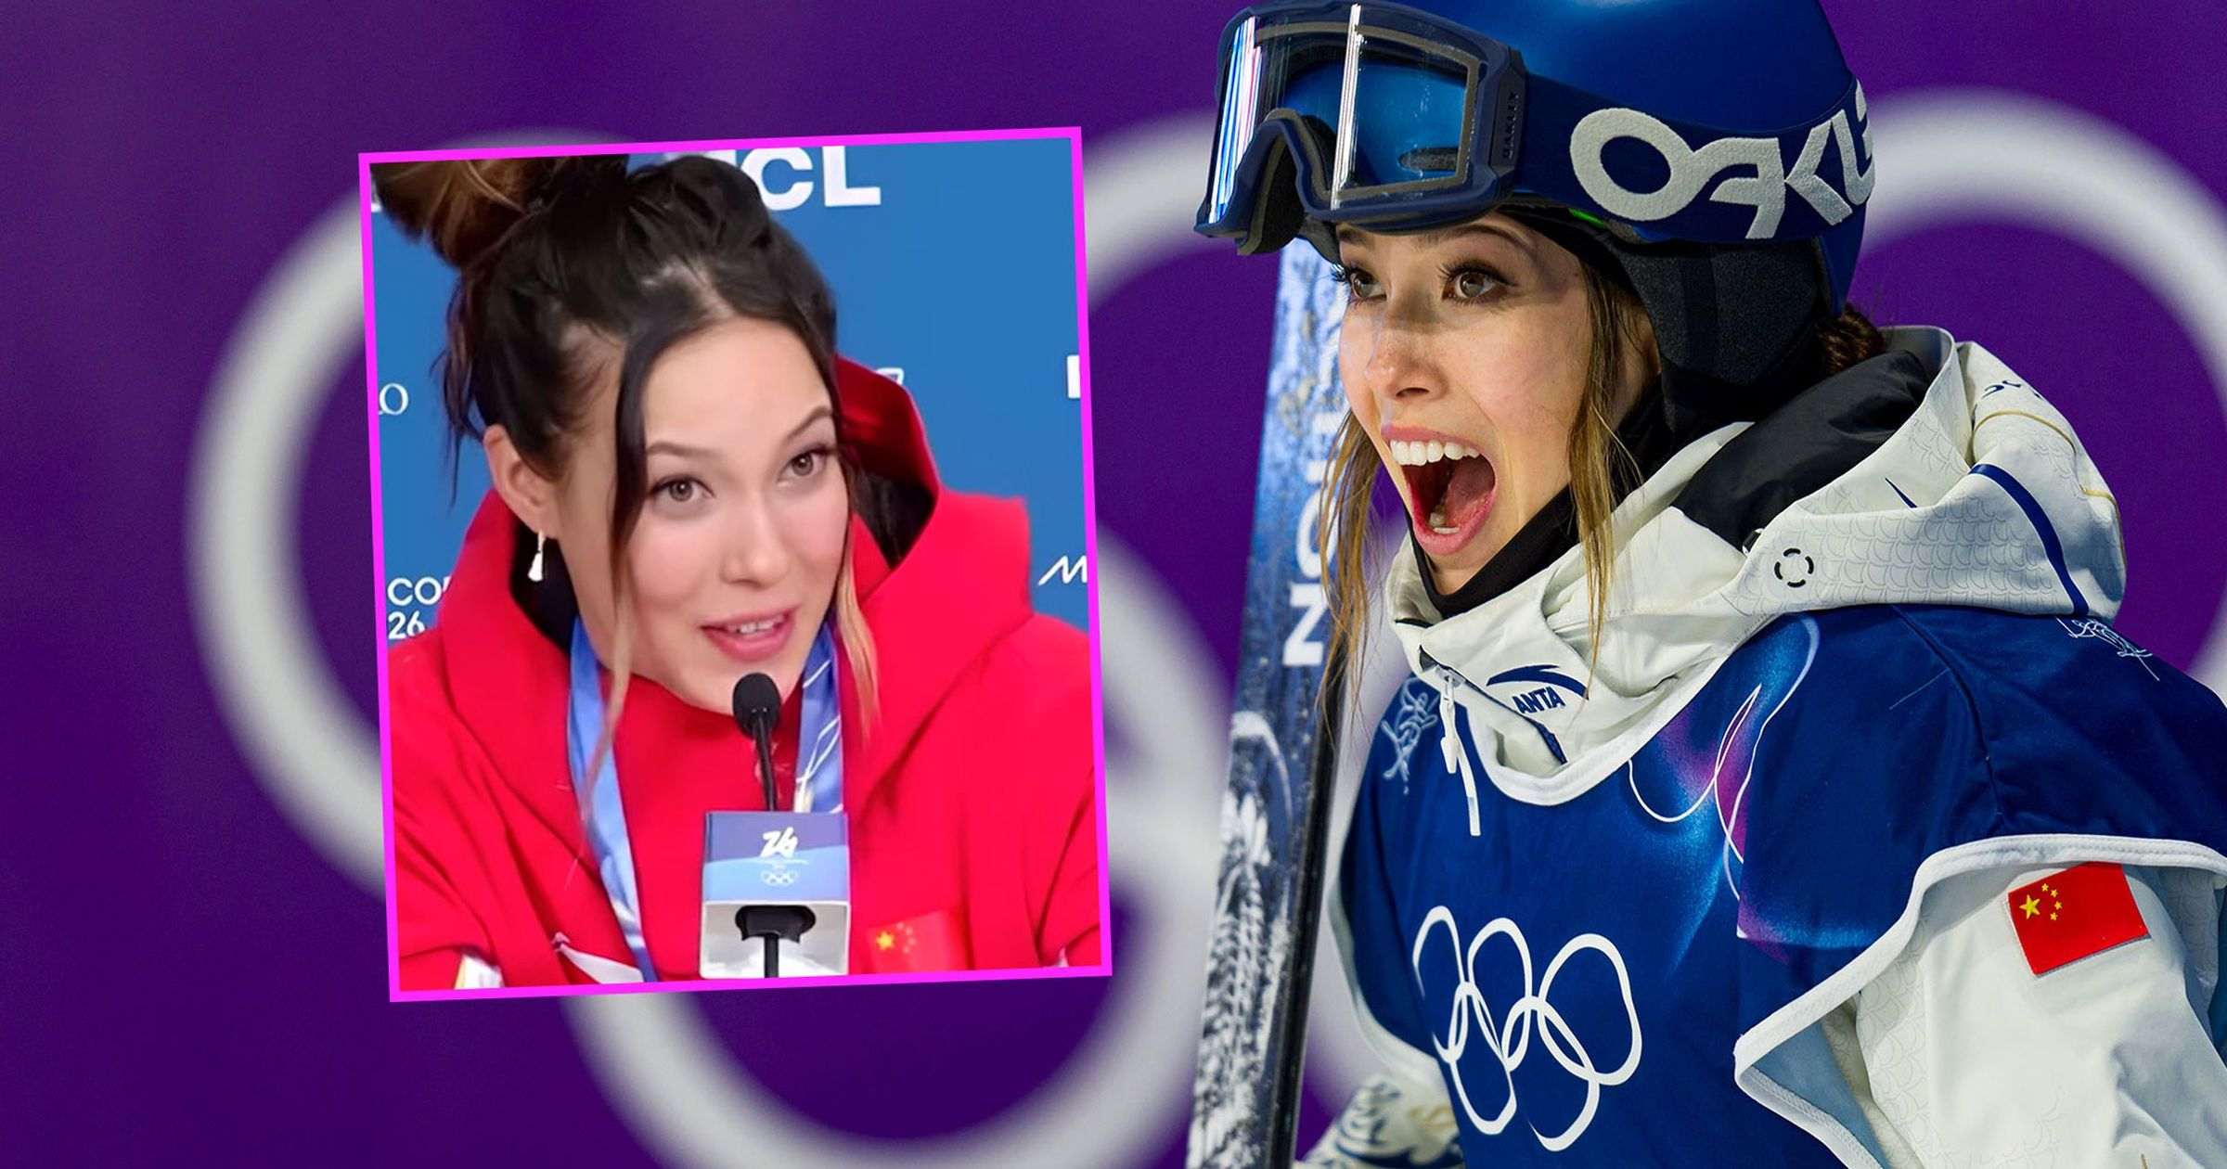
I’m the most decorated freeskier in history. I think that’s an answer in itself…
Notes:
Three medals and and awesome brain.

Slide 3
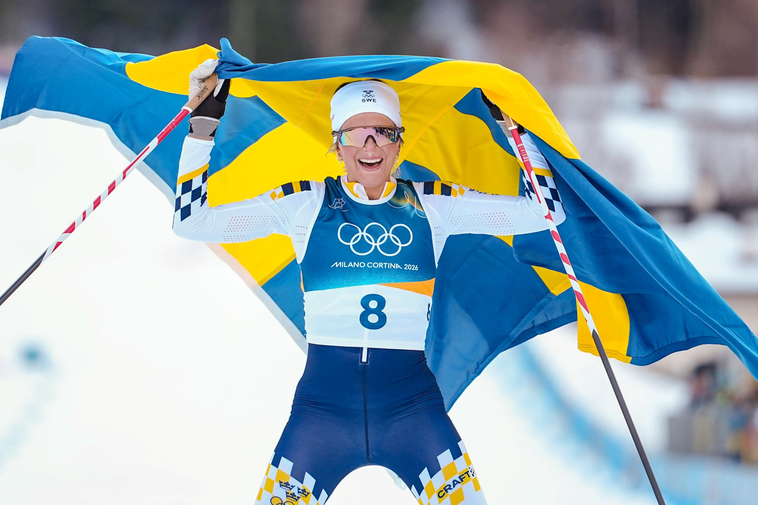
Notes:
15 of 17 single gender medals won by Sweden's women (plus one mixed event): 6 golds to 1 men’s gold;

Slide 4
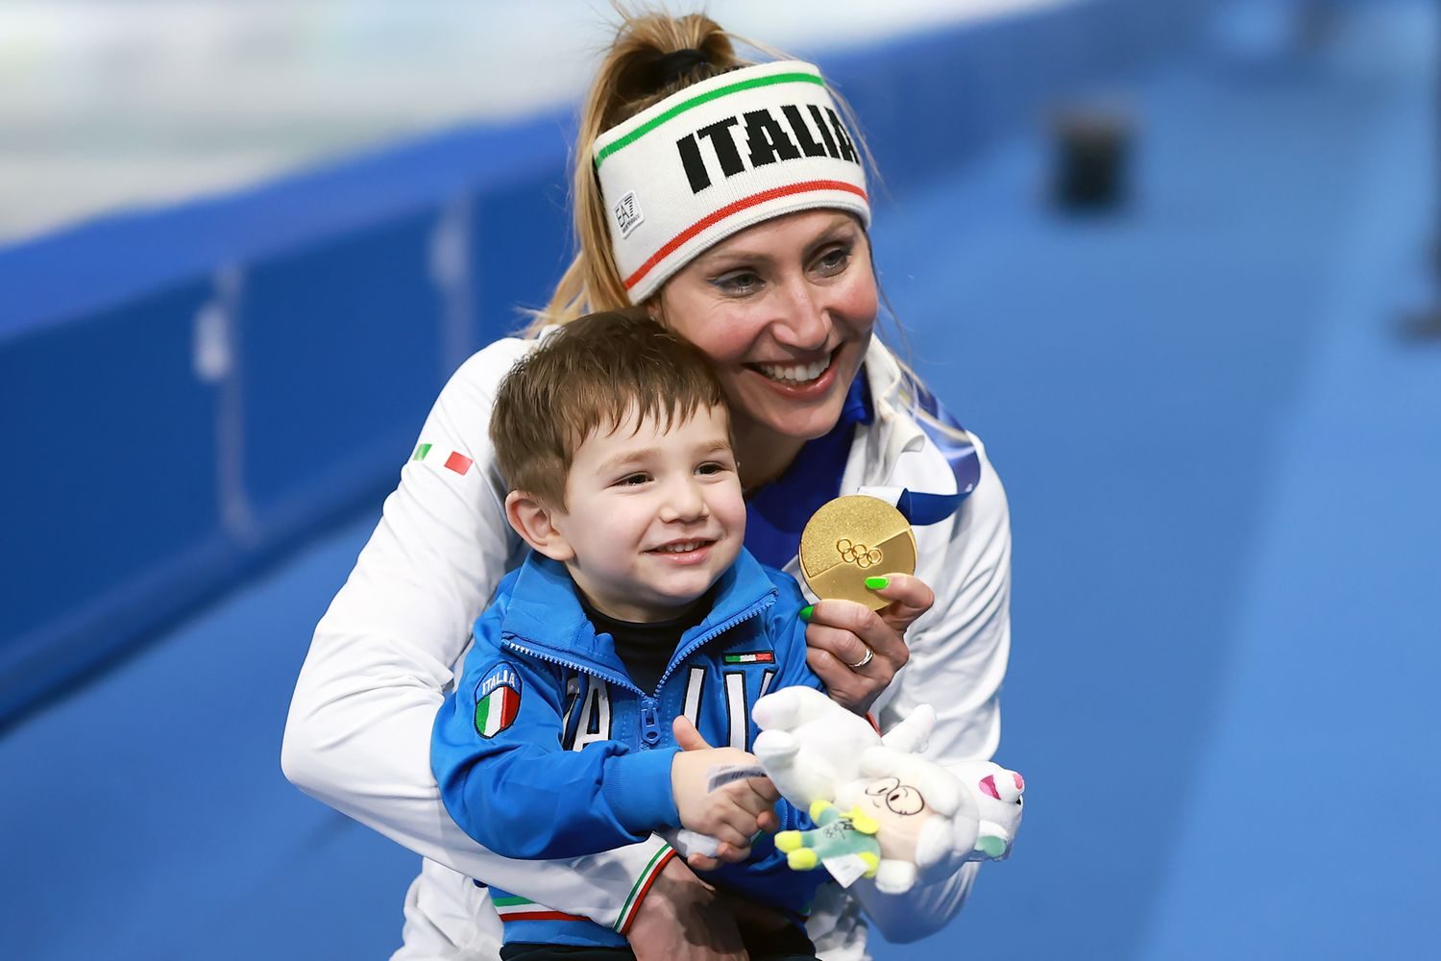
The message I want to show is I didn’t choose between a family, being a mom (and being a speed skater)…
Notes:
Francesca Lollobrigida, 35 and back after taking time out for a son.

Slide 5
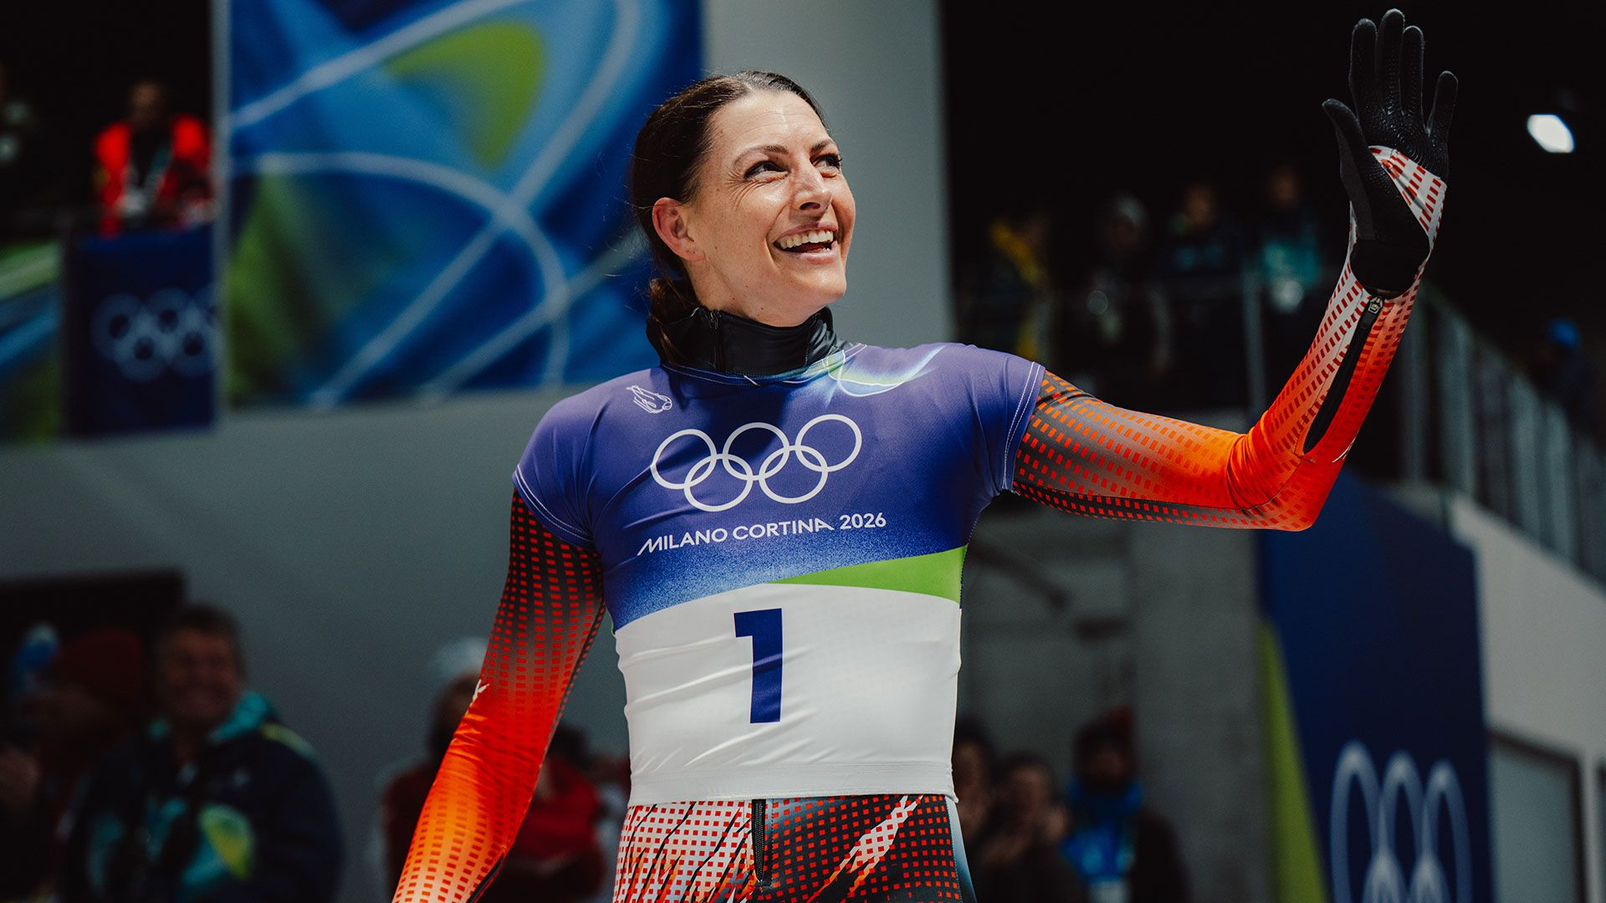
Notes:
Janine Flock, beaten to fourth in 2018; gold at 36 years oldest ever female skeleton medallist, fourth Olympics.

Slide 6
I want them to see me with medals around my neck. But I also want them to see me get knocked down, get back up and fight.
Notes:
41 and at 4th Olympic Games

Slide 7
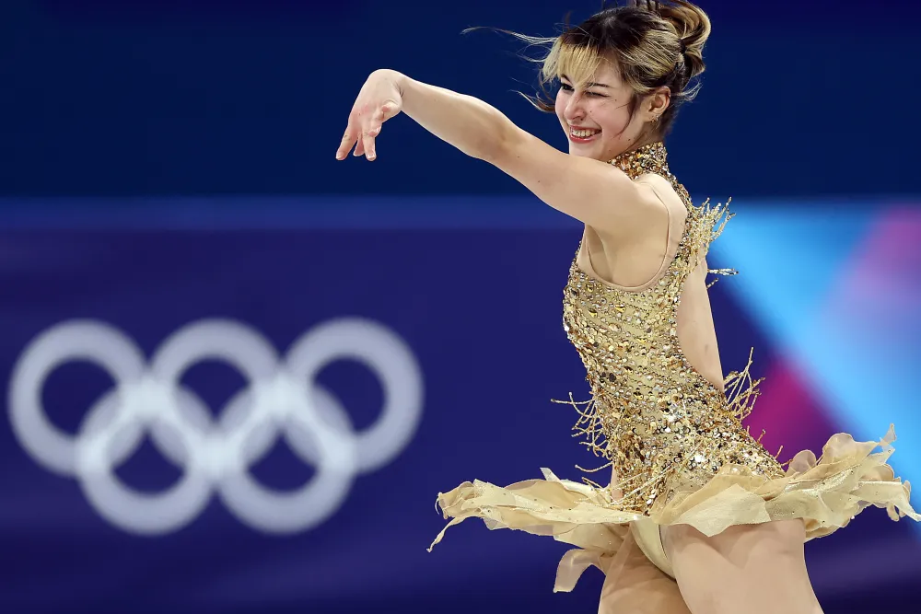
Winning isn’t all that and neither is losing. It’s just sometimes that happens. It’s an outcome. What matters is the input and the journey.
Notes:
USA 6 women’s golds (to 4 men’s)

Slide 8
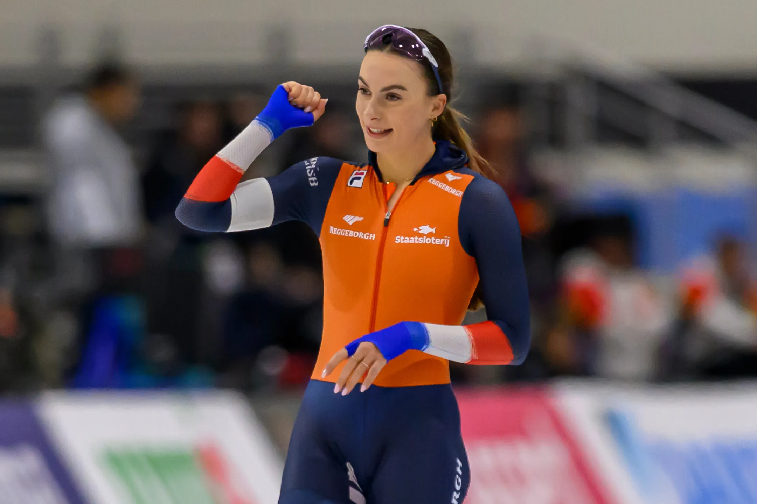
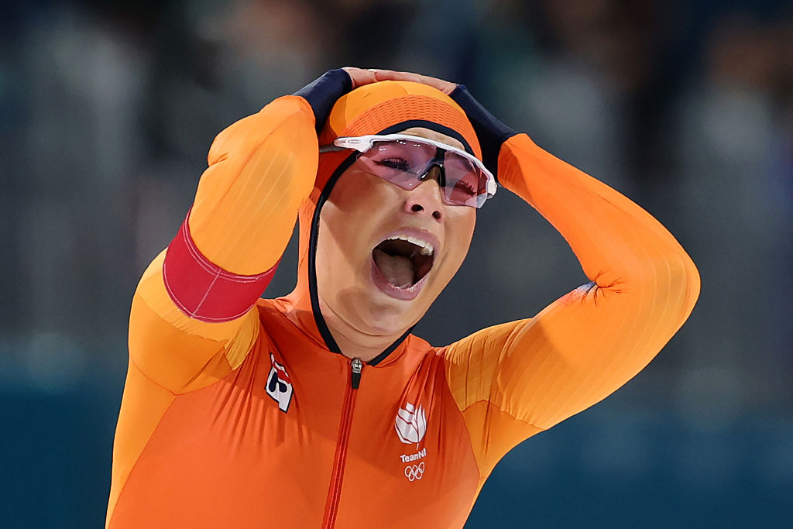
Notes:
50% of Netherlands' medals from women; 6 gold to 4 men’s

Slide 9
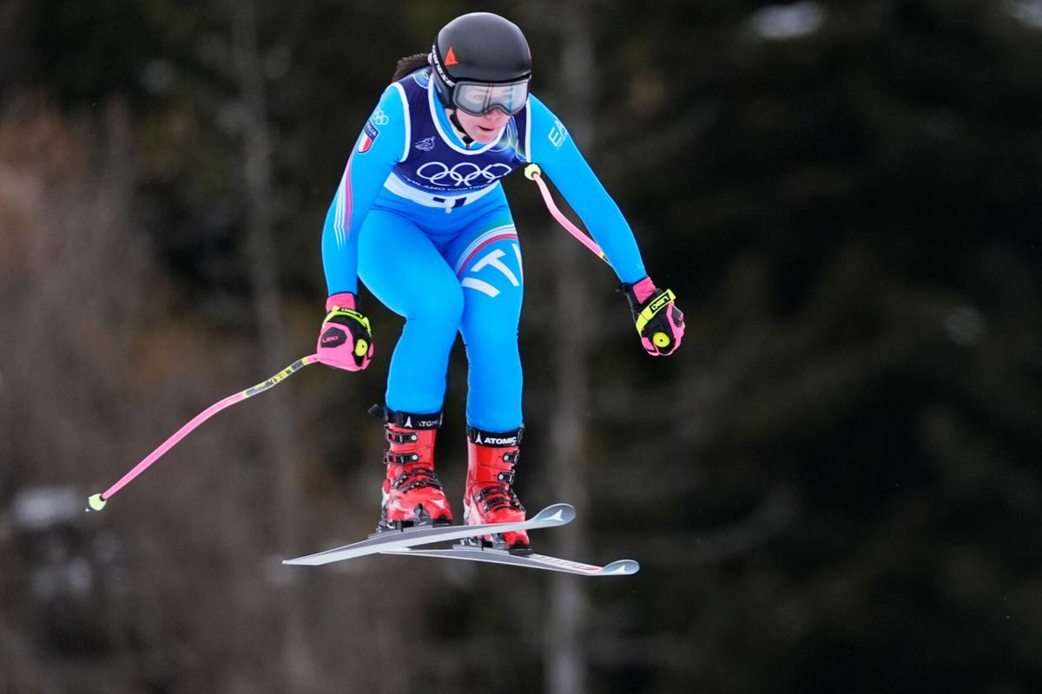
Notes:
50% of Italy’s medals women; 6 gold (to 3 men’s)

Slide 10
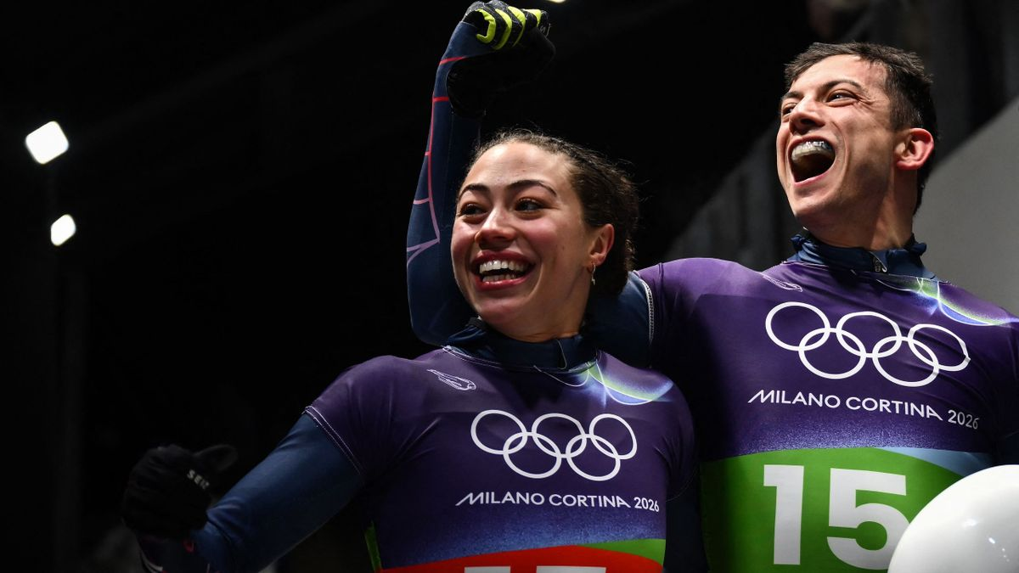
Crazy to think that moments like this can start a chain of events just like the one I had at the beginning of my journey with skeleton
Notes:
The golds won by mixed teams and women made it GBs best ever Winter Games. – aim to inspire future skeleton riders.

Slide 11
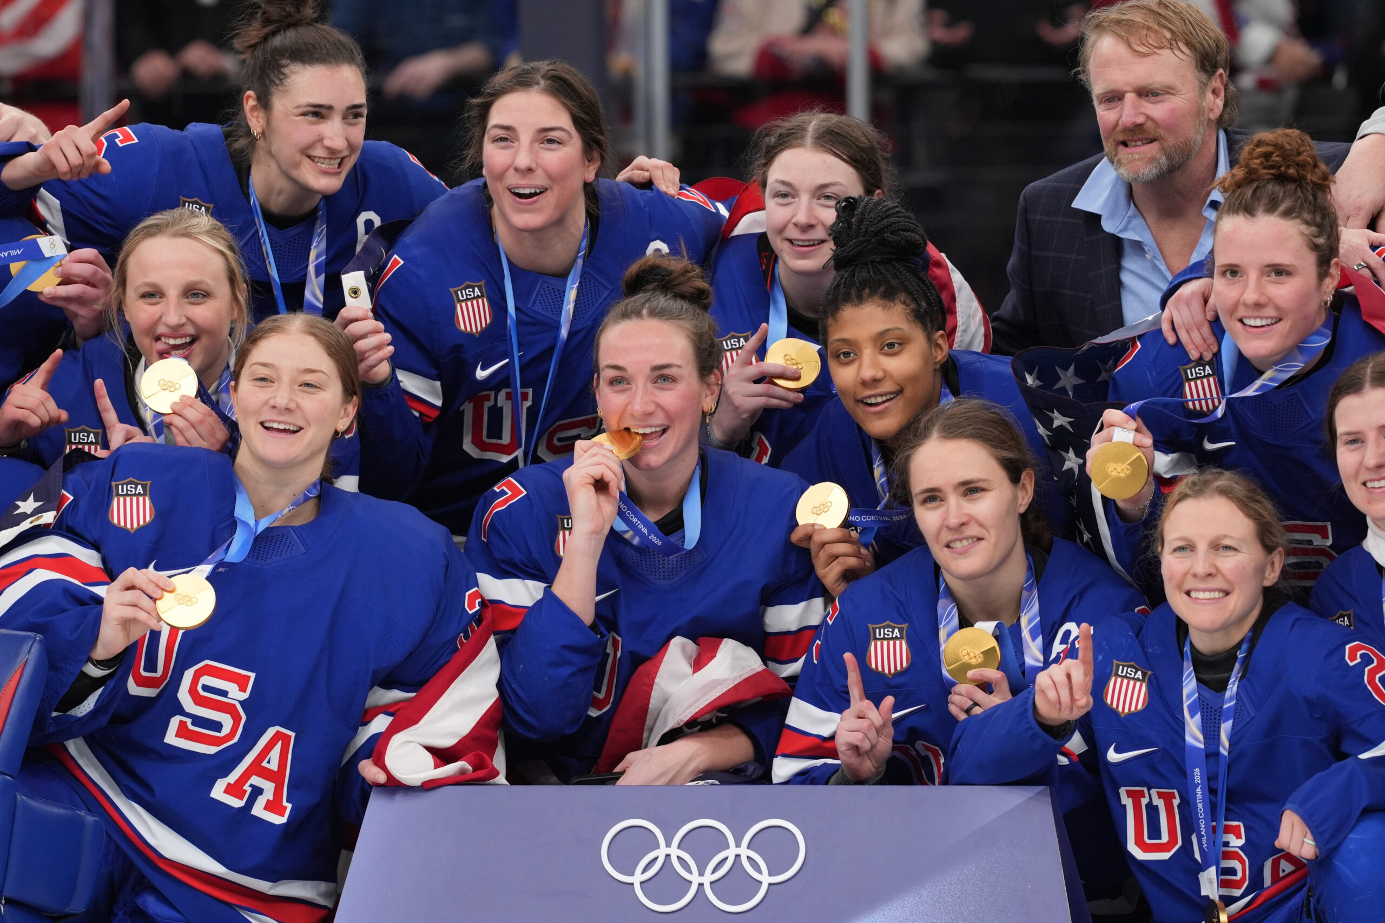
“…it's not my responsibility” to explain others' behaviour.
“It is never just locker room talk,”

