Slide 1
KYIVSKYI DISTRICT COURT OF ODESA
One of the largest local general courts in Ukraine

Slide 2
23 judges administer justice in the court

Slide 3
In 2020, judges of the Kyivskyi District Court of Odesa considered
41,000 cases

Slide 4
One of the top three courts in Ukraine in terms of workload

Slide 5
In 2015, the court was one of the first to pilot implementation of the e-court system

Slide 6
In 2017, the court conducted trainings on the e-court system for other courts from throughout Ukraine

Slide 7
Over 500 judges and court staff attended trainings

Slide 8
Launched innovative project “Establishment and Development of the Community Justice Center of Odesa” with the support of the USAID New Justice Program in 2018

Slide 9
The Community Justice Center of Odesa is a successful platform for providing legal assistance to the citizens of Odesa City and the broader region.

Slide 10
It is the only center in Ukraine that is court-annexed, offering a holistic approach to solving the legal problems of citizens not only from Odesa City, but the entire region

Slide 11
The Community Justice Center of Odesa offers a wide range of services

Slide 12
01.
02.
03.
primary legal aid
Legal awareness-raising of the public
Consultations with a notary and psychologist
04.
05.
06.
drafting of primary non-procedural documents (statements, appeals, complaints)
Extrajudicial settlement of disputes and settlement of conflicts through mediation
Referral of citizens to authorized public authorities, local self-governance bodies

Slide 13
The Community Justice Center of Odesa hosted visits by 14 international delegations from different countries

Slide 14
In 2019, representatives of the Kyiv District Court of Odesa studied lessons learned in establishing community justice centers in the United States with support from the USAID New Justice Program

Slide 15
During 3 years of operations, the Community Justice Center of Odesa established effective cooperation with over 30 governmental agencies and non-governmental organizations, including universities and the media

Slide 16
Capacity to provide various services within a short period of time is the advantage of the Community Justice Center of Odesa

Slide 17
Mediation is an integral component of the Community Justice Center’s work

Slide 18
Comprehensive approach to ensuring access to information and mediation services at the Community Justice Center
Access to mediation
Training for judges and court employees on offering mediation
Training for employees of the Community Justice Center
Information support for visitors of the court and Community Justice Center

Slide 19
Informing court visitors about mediation

Slide 20
Informing parties to a court case about mediation

Slide 21
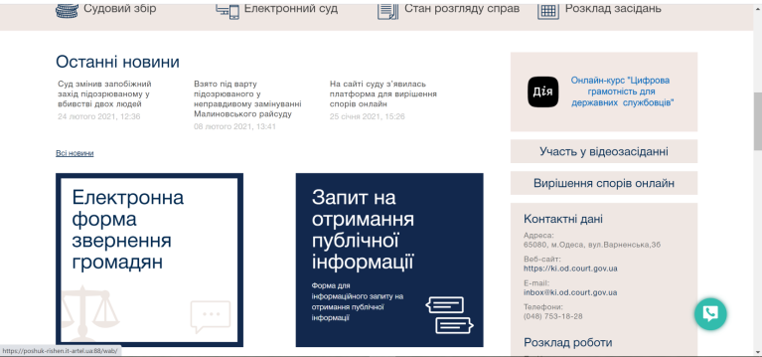
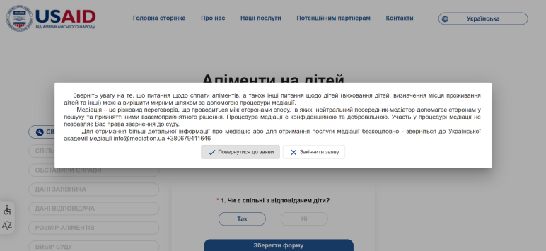
Online access to mediation at the Community Justice Center

Slide 22
Since 2018, 252 persons visited the mediation room, where 30 mediations were conducted

Slide 23
The School for Jurors at the Community Justice Center has been operational since 2020, providing training for current and future jurors

Slide 24
Ongoing trainings for jurors of Odesa City and region with the engagement of leading attorneys, judges, retired judges, and representatives of research institutions

Slide 25
Community Justice Center provides assistance to survivors of domestic violence

Slide 26
The Center provides survivors of domestic violence with consultations and support, including information about shelters and assistance with drafting required statements and related legal aid

Slide 27
The Community Justice Center of Odesa jointly with partners developed a roadmap for survivors of domestic violence

Slide 28
The roadmap will not only help anyone affected by domestic violence, but will also strengthen coordination of all key stakeholders

Slide 29
In 2020, the Community Justice Center established a network of volunteer mediators, psychologists, notaries, academics, and law students

Slide 30
Kyiv District Court of Odesa continuously conducts public outreach and awareness campaigns using websites, TV-channels, radio, and printed publications that inform about the work, activities, and types of services provided by the Community Justice Center of Odesa

Slide 31
The Court holds “Open House Days” at the Center for school children

Slide 32
Students participate in mock court hearings and engage in internships at the court

Slide 33
Since 2018, the Community Justice Center of Odesa served more than
6000 citizens

Slide 34
Over 700 persons received support online during Covid-19 related quarantine restrictions

Slide 35
Psychologists and mediators provided services using Zoom

Slide 36
The Community Justice Center has its own website, Facebook page, and Instagram profile

Slide 37
Compared to 2015, trust and satisfaction with the work of the Kyiv District Court of Odesa increased by 40%

Slide 38
Almost 94% of visitors are satisfied with the work of the Kyiv District Court of Odesa

Slide 39
This is demonstrated by the results of surveys conducted by the “International Foundation of Development”

Slide 40
Our goal is to create a successful Community Justice Center model for other courts in Ukraine to follow

Slide 41
Thank you!

