Slide 1
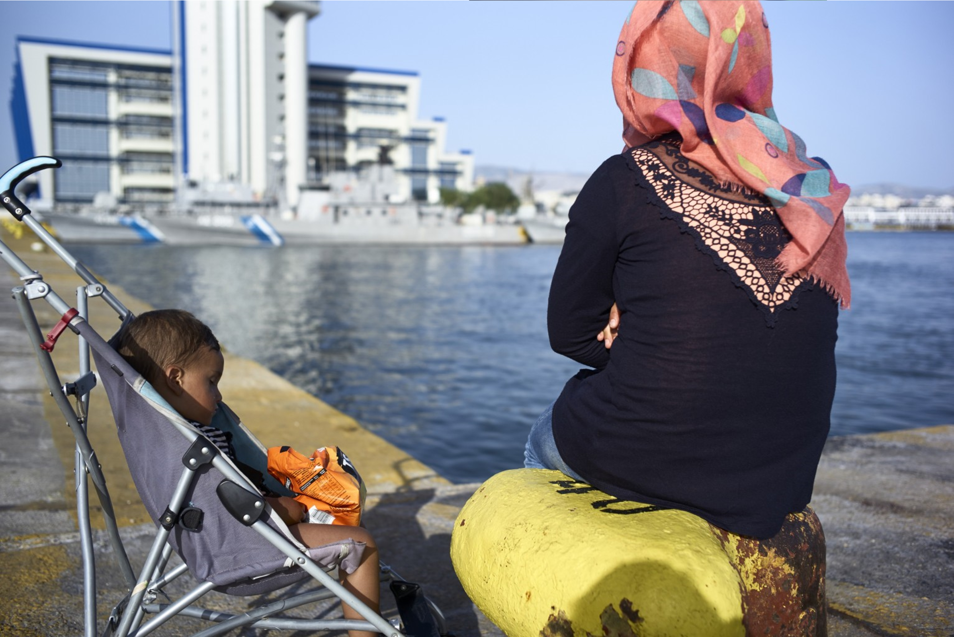
Council of Europe Action Plan on Protecting Vulnerable Persons in the Context of Migration and Asylum in Europe (2021-2025)
Adopted on 5 May 2021
PROGRESS ON IMPLEMENTATION

Slide 2
Implementation highlights
At the policy and standard setting level
Recommendation of the Committee of Ministers to member States on multilevel policies and governance for intercultural integration (Adopted by the Committee of Ministers on 6 April 2022)
New recommendation to protect the rights of migrant, refugee and asylum-seeking women and girls providing measures to better respond to needs and challenges that they face. (Adopted by the Committee of Ministers on 20 May 2022)

Slide 3
Ongoing work – policy and standard setting
CHILDREN
Draft an explanatory memorandum to CM/Rec(2019)11 on effective guardianship for unaccompanied and separated children in the context of migration
Draft explanatory memorandum of the draft Recommendation on Human Rights Principles and Implementing Guidelines on age assessment for children in migration
Thematic discussions on child-friendly approaches and procedures in migration within the Network of Focal Points on Migration
HEALTH
Guide to health literacy and recommandation on equity in healthcare
Guidance on the screening of drug addiction vulnerabilities of migrants
YOUTH
Development of user-friendly guide to support the implementation of the CM/Rec(2019)4 on supporting young refugees in transition to adulthood

Slide 4
Technical co-operation
EQPR – European Qualifications Passport for Refugees – 3rd phase – Poland and Moldova joined in May making in total 14 countries participating in the project. Total value of the programme EUR 750.000 – funding secured by Norway.
TOOLKID – Linguistic integration of migrant/refugee children – based on the programme for Linguistic Integration of Adult Migrants (LIAM) - adapted to children. Piloting country to be identified. Required funding in the amount of EUR 350.000
Building Futures, Sharing Good Practices: Migrant Children's Transition to Adulthood – focusing on Committee of Ministers´ Recommendation CM/Rec(2019)4 on supporting young refugees in transition to adulthood; Committee of Ministers´ Recommendation CM/Rec(2007)9 on life projects for unaccompanied migrant minors - implemented in Greece, Netherlands and Spain. Total value of the project EUR 666.665 – funded by the DG REFORM and CoE;
Regional Intercultural Integration Networks in Cyprus - developing and implementing integration policies in a range of areas including participation, citizenship, education, cultural and social life, urban planning, business and labour market. Total value of the project EUR 444.444 – funded by the DG REFORM and CoE. New project planned in Finland
Strengthening the human rights protection of migrants and victims of human trafficking in Türkiye - Migration component – implemented under Horizonal Facility programme. Current phase ending in December 2022 and new phase is being negotiated. Total value of the project EUR 1,2 million – funded by the European Union and CoE.

Slide 5
Relevance of the AP in the context of the current refugee crisis
Action Plan on Protecting Vulnerable Persons in the Context of Migration and Asylum in Europe (2021-2025) remains relevant also in the context of the current crisis
Action plan is a living strategic framework and it is well positioned to respond to the current crisis with concrete actions
It gathers know-how and expertise which can be engaged rapidly
It can be adapted to different contexts given the long lasting programmatic and technical expertise
Placing a focus on a limited number of identified priority areas where the Council of Europe can act on a short time basis
It takes into account the needs and wishes of each member State in line with the CoE mandate and in the framework of the current crisis
It complements the ongoing efforts of other international organisations and envisages sustainability and ownership elements on the side of the relevant authorities.

Slide 6
Concrete examples of support that can be provided within the Action Plan
Access to healthcare - restoration of psychological well-being of persons fleeing Ukraine
Child-specific vulnerabilities and child friendly justice
Gender related vulnerabilities (combatting trafficking and gender-based violence)
Education recognition and linguistic integration
Capacity-building activities for psychologists and social workers who work directly with refugees with specific focus on post-traumatic stress disorder and related substance use disorders
Support national authorities and other competent stakeholders to register children, including children without parental care, children with disabilities and children with other specific needs
Assisting relevant stakeholders in adapting and implementing the Council of Europe standards and guidance regarding women’s safety in transit and reception facilities relevant to the current context of the refugee crisis.
EQPR, LIAM and TOOLKID translated and adapted to the current contexts. Contain practical checklists and guides for professionals in providing language support and qualification recognition.
Integration and social inclusion

Slide 7
Concrete examples of existing tools
New Council of Europe HELP e-Desks on asylum/migration for lawyers assisting people fleeing the war in Ukraine: As of 1 March 2022, virtual Asylum/Migration HELP e-Desks were set up, managed by HELP tutors and legal experts to support lawyers assisting refugees from Ukraine
GRETA: Guidance note on addressing the risks of trafficking in human beings related to the war in Ukraine and the ensuing humanitarian crisis (4 May 2022)
GREVIO: Checklist that can be of help in designing and implementing measures in law, policy and practice to implement Articles 60 and 61 of the Istanbul Convention: https://rm.coe.int/conventionistanbularticle60-61-web/1680995244?msclkid=85b64797c7e011eca9ac021c423c2602
Lanzarote Convention checklist of obligations to protect children affected by the refugee crisis as set forth in its special report
Toolkit for language support for adult refugees: offers guidance and easy to-use teaching materials for educators and volunteers. The toolkit is available in 7 languages. Tools and guidelines adapted for children (for now focused on refugees from Ukraine)

Slide 8
OUTREACH
Developed and updated implementation page of the AP implementation of the SRSG website;
Regular distribution of newsletter and use of Twitter account
Carrying out the fact-finding visits and participation in the thematic conferences
Organisation of thematic/fundraising events (including two working breakfasts with the member States)
Recently closed call for experts in the field of migration and asylum within the framework of the Action Plan
Through the work of the Network of Focal Points and through regular exchanges between international stakeholders/partners

Slide 9
FINANCIAL OVERVIEW
Currently fundraised 3,5 million €
Total budget of the AP estimated at 9 million €
AP LEVEL
Monaco
Czech Republic
Türkiye
Andorra
Luxembourg
Cyprus
PROJECT SPECIFIC
European Union
Norway
Funding needs
Practical guidance on vulnerability - 250.000€
HELP courses - 350.000€
TOOLKID – 350.000€

Slide 10
Action Plan 2021-2025
Future work
Next steps
Increasing outreach/ fundraising efforts
Advancing with the guidance on vulnerability
Closely liaising with the NFPM and other international partners
Preparation of the mid-term review report
Following up on the fact-finding visits

Slide 11
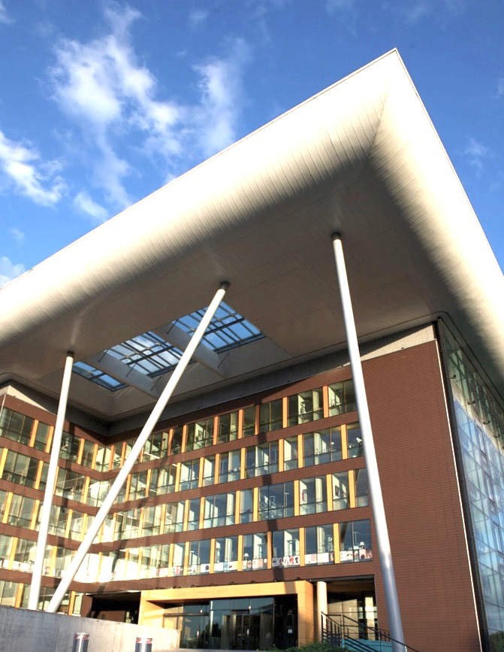
Thank you for your attention!
Websites
SRSG
https://www.coe.int/en/web/special-representative-secretary-general-migration-refugees/home
Action Plan
www.coe.int/en/web/portal/-/migration-and-asylum-council-of-europe-to-increase-protection-of-vulnerable-persons
https://www.facebook.com/CoEMigrationRefugees/
@CoESR_migrationration

