Slide 1
Ceremony for the Council of Europe Crystal Balance Award in Slovenia

Slide 2
FRENCH MINISTRY OF JUSTICE Directorate of Criminal Affairs and Pardons

Slide 3
PRESENTATION OF THE MISSION OF GOOD PRACTICES
PRESENTATION OF THE PUBLIC POLICY TO COMBAT DOMESTIC VIOLENCE
PRESENTATION OF THE CONVENTION BETWEEN CRIMINAL POLICE AND HEALTH PROFESSIONALS TO GATHER COMPLAINTS OF DOMESTIC VIOLENCE VICTIMS AT THE HOSPITAL

Slide 4
PRESENTATION OF THE MISSION OF GOOD PRACTICES
Objective : same as the one pursued by the Crystal Balance Award
To identify innovative practices that improve the efficiency and quality of justice : Procedure management/ court organization/ functioning of the justice system in general.
Valéry Morron
Magistrate – Head of mission dedicated to good practices – Directorate of criminal affairs and Pardons

Slide 5
We gather the existing mechanisms through exchanges with the courts and all the media at our disposal (from the press to the annual reports of the prosecutors)
We carry out expert assessments in order to propose only mechanisms that provide sufficient guarantees to be carried out efficiently at the national level
We promote them through different digital media

Slide 6
PRESENTATION OF THE PUBLIC POLICY TO COMBAT DOMESTIC VIOLENCE More than 100 women are killed each year and nearly 220,000 report being victims of violence
Liberate the speech of victims and promote the disclosure of violence, in particular via a 24/24 number -7/7
An enhanced initial and ongoing training course for law enforcement authorities in the dealing with female victims of domestic violence
A more protective justice

Slide 7
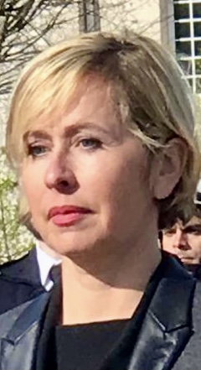
PRESENTATION OF THE CONVENTION BETWEEN CRIMINAL POLICE AND HEALTH PROFESSIONALS TO GATHER COMPLAINTS OF DOMESTIC VIOLENCE VICTIMS AT THE HOSPITAL
Origin
The convention between criminal police and health professionals, signed on December, 20, 2020, at the Hospital of Carcassonne is the result of a close collaboration led with the different actors in order to ensure an immediate care of the domestic violence victim.
Ensure the deposition of the victim’s claim
Possess the medical report detailing the injuries and confirming a complete inability to work, which is necessary for the penaliaztion of the offense
Florence GALTIER
State prosecutor - Carcassonne

Slide 9
Hurdles
Fear of retaliation
Situation of psychological grip
The will to preserve children from knowing about this situation
The fear of the image of neighborhood’s gossiping
Financial difficulties
(…)

Slide 10
Implementation of the process within the hospital
Necessity to ensure the application of all the victim’s rights with sufficient conditions of comfort, dignity and confidentiality : the hospital has a reserved room, with furniture and the necessary materials for the filing of the complaint.
Necessity to coordinate with other doctors : the head doctor of the Medical-Legal Unit coordinates with other doctors and plans frequent meetings of coordination, during which the cases of patients that have justified the filing of a complaint in the hospital are dealt with.
This staff knows that it is possible to resort to the investigation units and to call them to file a complaint of domestic violence directly at the hospital.

Slide 11
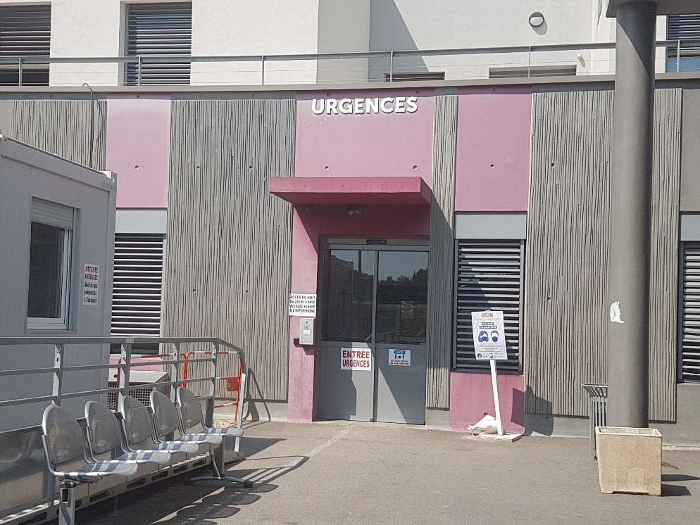
Implementation of the process with the police (1/2)
The investigation team behave as civilians with unmarked police vehicles.
For the heaviest cases and most severe violence, it is agreed that the referring doctor will invoke the family protection unit. It is made up of 6 investigators that have received a national specific training with a “knowledge code” and can be reinforced if needed.
Use of necessary tools for the hearing ;

Slide 12
Implementation of the process with the police (2/2)
Investigators can make good use of the moment of hospitalization of the victim as she is momentarily isolated from her aggressor to try to convince her to act before her potential return home.
In line with this, it is agreed that they steadily seek for the Medical-Legal team to perform medical and psychological assessments of the victim.

Slide 13
IMPLEMENTATION OF THE PROCESS OF FILING A COMPLAINT BY THE VICTIM AT THE HOSPITAL
One doctor has been appointed as the domestic violence contact at the hospital
The investigation team behave as civilians with unmarked police vehicles.
This staff knows that it is possible to report to the investigation units and to call them to file a complaint of domestic violence directly at the hospital.

Slide 14
CONCLUSION OF THE PROCEDURE
This procedure of complaint filing by the victims, directly at the hospital, is overall extremely well received by investigators and medical staff ;
They have also anticipated, in the context of the deployment of the digital penal procedure, the possibility for the victim to sign electronically ;
As most hospital structures already have adequate spaces for these procedures, they can easily be deployed throughout all countries of the EU.

