Slide 1
From Law to Practice:
Towards a roadmap to strengthen children’s rights in the era of biomedicine
Prof. Dr. Ton Liefaard
20th Anniversary of the Oviedo Convention
Council of Europe, Strasbourg, 24 October 2017

Slide 2
Leiden Study ‘From Law to Practice’
Children’s rights and biomedicine
Follow-up Uppsala Report
Addresses the challenges identified in the Uppsala study:
  Biomedical research
  Physical and mental health care
  Preconceptional and prenatal interventions
  Genetic techniques
  Gender modification techniques
  Transplantation care
  End of life decisions
Aim of the Leiden study

Slide 3
Children’s rights and biomedicine
United Nations Convention on the Rights of the Child
  European law relating to the rights of the child
Core human rights and children
  Dignity
  Autonomy (of children)
  Physical integrity and consent
  Non-discrimination
  Access to justice
Children as holders of human rights and fundamental freedoms
  General principles of the CRC
  Participation, evolving capacities, and role of parents
  Right to identity, right to privacy & confidentiality, right to highest attainable standard of health

Slide 4
Biomedicine standards and children’s rights
Many standards available at international and European level
*More general and specific – strong focus on research and care
*Hard and soft law
To what extent do they accommodate children and their rights?
*Strong focus on child in need of protection
*Some areas are weakly developed, particularly on children

Slide 5
Biomedical challenges and children’s rights
Closer look at Oviedo Convention and its additional protocols
Analysis of challenges and potential gaps in framework of children’s rights and biomedical standards
Specific recommendations related to:
  The status of children able to consent
  Participation
  Child-friendly information
  Parental authority
  Access to justice
  Additional guidelines and regulations

Slide 6
Specific focus I: privacy and confidentiality
Children’s right to privacy
Children’s privacy in the context biomedical care and research
Issues of discussion:
  Privacy: the child, medical professional and the parent/s
  Data collection and storage
RECOMMENDATIONS – examples.
Mapping on legislation and practices concerning age limits, privacy and confidentiality
Training of medical professionals to respect children’s right to privacy
Guidance from the CoE on privacy related standards (example: Genetic testing on persons not able to consent)

Slide 7
Specific focus II: consent and participation
Children’s autonomy, evolving capacities and consent
Protection and safeguards for children able to consent to biomedical care and research
Child participation in decision-making
RECOMMENDATIONS – examples.
Mapping legislation and practices concerning age limits, child consent, objections, and participation in the biomedical context.
Distinction between consent, objection and participation
Child-friendly biomedicine

Slide 8
Towards a roadmap
General (sets of) recommendations
  Additional standard-setting where gaps have been identified – assessment feasibility
  Mapping of legislation within 47 Council of Europe Member States
  Development of practical tools on the accommodation of evolving capacities of children
  Child-friendly biomedicine
  Information, education and training of domestic legislators, policy makers, medical professionals – with a focus on access to justice

Slide 9

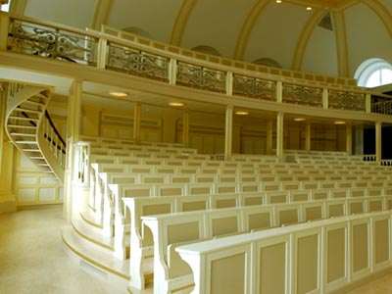
Prof. Dr. Ton Liefaard
Professor of Children’s Rights /
UNICEF Chair in Children’s Rights
Leiden Law School
E-mail: t.liefaard@law.leidenuniv.nl
Website: http://www.leeronskennen.leidenuniv.nl/en/ton-liefaard-engels/
Twitter: @tonliefaard
Conta

