Slide 1
Ewa Bartnik University of Warsaw/Institute of Biochemistry and Biophysics
Modification of the human genome – Action(s) to be undertaken at the intergovernmental level to address the identified challenges

Slide 2
Biotechnology. A prudent path forward for genomic engineering and germline gene modification
Baltimore D, Berg P, Botchan M, Carroll D, Charo RA, Church G, Corn JE, Daley GQ, Doudna JA, Fenner M, Greely HT, Jinek M, Martin GS, Penhoet E, Puck J, Sternberg SH, Weissman JS, Yamamoto KR. Biotechnology. A prudent path forward for genomic engineering and germline gene modification
Science. 2015 Apr 3;348(6230):36-8

Slide 3
Baltimore et al..1
„Strongly discourage…any attempts at germline modification for clinical application in humans while societal, environmental, and ethical implications of such activity are discussed among scientific and governmental organizations….This will enable pathways to responsible uses of this technology, if any, to be identified”

Slide 4
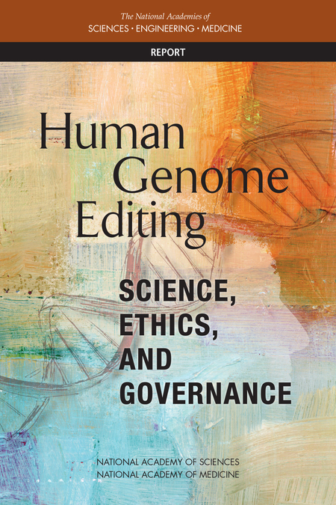
PDF]Genome editing: an ethical review - Nuffield Bioethics
nuffieldbioethics.org/wp-content/uploads/Genome-editing-an-ethical-review.pdf

Slide 5
Human Genome editing Science, ethics, and Governance
absence of reasonable alternatives;
restriction to editing genes that have been convincingly demonstrated to cause or strongly predispose to a serious disease or condition;
credible pre-clinical and/or clinical data on risks and potential health benefits;

Slide 6
Human Genome editing Science, ethics, and Governance
ongoing, rigorous oversight during clinical trials;
comprehensive plans for long-term multigenerational follow-up; and
continued reassessment of both health and societal benefits and risks, with wide-ranging, ongoing input from the public.

Slide 7
Deutscher Ethikrat
The document goes from “do not allow as long as the risks are not clear” to “Allow, when the risk can be better evaluated”

Slide 8
European Group on Ethics in Science and Technology
Inclusive debate on “acceptability and desirability” extending to civil society not limited to safety issues, potential health risks and health benefits
Dignity, justice, equity, proportionality and autonomy

Slide 9
Council of Europe Parliamentary Assembly – 5 steps
Member states should be urged to ratify the Oviedo Convention or at least implement ban on pregnancy with a modified embryo
A broad and informed public debate should be fostered
Council of Europe Committee on Bioethics should assess the ethical and legal challenges

Slide 10
Council of Europe Parliamentary Assembly – 5 steps
A common regulatory and legal framework should be developed
Member states should develop a clear national position on use of new genetic technologies “setting the limits and promoting good practices”

Slide 11
2016 and 2017
Exclusive: World’s first baby born with new “3 parent” technique – boy born April 2016 to mother with Leigh syndrome – via spindle transfer (in Mexico) < 1% of affected mtDNA
20 more babies planned for 2017

Slide 12
In 2016 and 2017
World-First in Ukraine as 'three-Parent' Baby Born to an Infertile Couple
“Three parents”, one baby, and a lot of controversy.
19 JAN 2017
No disease, failed IVF, pronuclear transfer
Second baby expected in March, also failed IVF

Slide 13
2017
Newcastle scientists get permission from HFEA: 5 years
5 procedures/year for 5 years

Slide 14
Problem of oversight
Mexican baby – “prepared” in US, then everything in Mexico
Problem of “genetic enhancement” tourism?

Slide 15
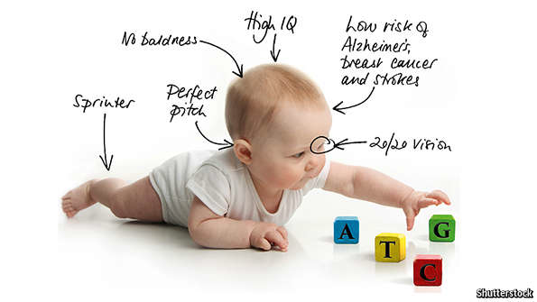
Editing humanity The Economist Aug. 22, 2015

Slide 16
Problem of education
GMOs, vaccines, stem cell treatments …
EDUCATION AND INFORMATION

Slide 17
CRISPR/Cas9-mediated gene editing in human tripronuclear zygotes
Protein & Cell
May 2015, Volume 6, pp 363-372,
Date: 18 Apr 2015
Puping Liang, Yanwen Xu, Xiya Zhang, Chenhui Ding, Rui Huang, Zhen Zhang, Jie Lv, Xiaowei Xie, Yuxi Chen, Yujing Li, …

Slide 18
Correction of a pathogenic gene mutation in human embryos
Ma H, Marti-Gutierrez N, Park SW, Wu J, Lee Y, Suzuki K, Koski A, Ji D, Hayama T, Ahmed R, Darby H, Van Dyken C, Li Y, Kang E, Park AR, Kim D, Kim ST, Gong J, Gu Y, Xu X, Battaglia D, Krieg SA, Lee DM, Wu DH, Wolf DP, Heitner SB, Belmonte JCI, Amato P, Kim JS, Kaul S, Mitalipov S. Nature. 2017 Aug 24;548(7668):413-419.

Slide 19
bioRxiv preprint first posted online Aug. 28, 2017; doi: http://dx.doi.org/10.1101/181255.
Inter-homologue repair in fertilized human eggs?
Dieter Egli 1,*, Michael V. Zuccaro2, Michal Kosicki3, George M. Church4, Allan Bradley3, and Maria Jasin 5,*

Slide 20
.
Protein & Cell pp 1–12| Correction of β-thalassemia mutant by base editor in human embryos; Puping Liang, Chenhui Ding, Hongwei Sun, Xiaowei Xi, Yanwen Xu, Xiya Zhang, Ying Sun, Yuanyan Xiong, Wenbin Ma, Yongxiang Liu, Yali Wang, Jianpei Fang, Dan Liu, Zhou Songyang, Canquan Zhou, Junjiu HuangE 23 September 2017

