Slide 1

Achieving Equal Opportunities for All Migrants Through Learning and Assessment

Slide 2
Language and ‘Knowledge of Society’ requirements, and human rights
Elana Shohamy,
Tel Aviv University
Nom de l’intervenant

Slide 3
Title of presentation
Critical Language testing
in the past two decades
Major criticism on the uses of language & KOS tests as conditions for mobility, visitations, residence, citizenship, work place and education.
Why language, why tests, why citizenship?
Between 2008-2010 several books and articles were published criticizing the phenomenon of language tests for immigrants from human right perspectives.

Slide 4
Some of the arguments
No formal learning/teaching opportunities, no interactions w/ speakers in ethnic communities, no homogenous definitions of language proficiency …RESULTING in inability to perform well on those tests (especially written), and hence test takers are ‘bound to fail’.
Failing is traumatic, leading to family expulsion, depressions, rejections, traumas.
It takes a long time (9-11 years) to acquire a new language and pass tests and immigrants in those years have no rights (health, social security, higher education and employment) .

Slide 5
And …
What about immigrants who have no literacy skills, or f those of older ages??
The KOS test requires L-2 knowledge in most of the cases. diverse families? and KOC gives a feeling of humility, difficult to identify with new values in first generation? Takes a long time for first generation. Women who spend time at home cannot afford to learn languages.
And how can we standardized ‘knowledge of society’ in a diverse world? participation?
And –
Why do all immigrants need to learn the national language? Should immigrants be forced to know it, why is it compulsory and condition and not a choice? Many people get along without being proficient in the national language and they are good people who pay their taxes, etc.

Slide 6
In the current report (2018)
“An additional reason why using language tests as gatekeepers prior to entry is a particularly problematic practice, is because not all migrants have had access to education or possibility to learn the language of the host country before entering the new country. There is a very real risk that pre-entry language tests are disproportionately disadvantageous to refugees, women or refugees from countries with a poor educational infrastructure”.

Slide 7
In the past decade: vast number of Immigrants, refugees, youth, arrived and all governments adopt these tests
On one hand, the phenomenon of language and KOS tests are spreading in Europe but also with opportunity to learn.
Yet, no research on consequences
On the other, major progress in sociolinguistics are taking place where many language varieties are recognized and legitimated, not only one correct language, denouncing the native and including non-natives, multilingualism and translanguages, are spreading widely.
.

Slide 8
From the current report (2018)
It seems paradoxical that an instrument developed to acknowledge and facilitate the idea of a multilingual Europe is employed as a means to legitimize monolingual policies based on the requirement of given national languages. For that reason, there is a growing concern that the CEFR is becoming an instrument to control and restrict immigration (Extra et al. 2009; Van Avermaet 2009; McNamara 2009; Fulcher 2010; Tracy 2017). (Bruzos et al., 2017: 423)
F

Slide 9
Agenda: Recommendations for changes from current report, 2018.
Responsible use of the CEFR
Responsible use of tests
Test quality paying particular attention to vulnerability
Promoting integration
Learning opportunities

Slide 10

One case of change:
Introductying Bi-Multilingual tests
driven by research

Slide 11
Point of exit
Immigrants and all second language learners do not leave their language behind and develop a bilingual version where language are being mixed. These are manifested in reading, writing, speaking and listening.

Slide 12
Sample
Grades 10 and 11
Four schools with Russian immigrant students
One Arab school in a heterogeneous city (Jaffa)
One Arab school in a homogenous city (Taibe)

Slide 13
Design
1. Two content tests (science and health) in a bilingual version (exp. group) and in a monolingual version (control)
2. Writing task: choice bet. writing in L-1, L-2 or mixed.
3. Attitude questionnaires
4. Focus groups
5. Think aloud protocols

Slide 14
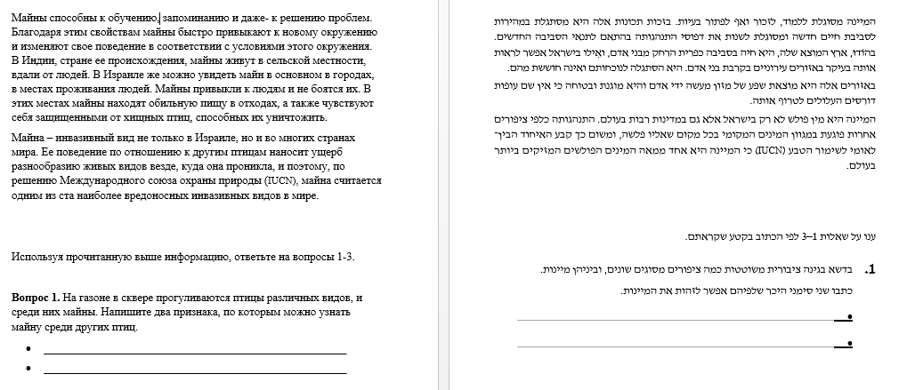
Example of bilingual version in Russian

Slide 15
.
10th and 11 grade immigrant students tested in the bilingual content test performed significantly better than those of the monolingual version content test

Slide 16
Russian Speaking Students
Significant results in favor of the experimental group in the achievement on the content test
Experimental group x̄ - 15.3
Control group: x̄ - 8.27
t= 5.01, df=23, p.<.000)
Many of the students selected the Russian version in both reading and writing but it varied by years of residence

Slide 17
Results : Arabic speaking students
Arabic speaking students in the heterogenous city (Jaffa)
  No significant differences between the monolingual and the bilingual exams in content areas; except in writing where many chose Arabic.
  (They stated that it is natural for them to use both languages)
Arabic speaking students in the homogenous city (Taibe)
No differences in content area. Many did not do the writing task at all.

Slide 18
Qualitative results: Arab students
Most students were in favor of the bilingual exams, because it gave them the freedom to choose the language that was more convenient for them. “some time one word can throw me off; the presence of Russian gives me confidence”.
Some Arab students wrote they were in favor of learning more educational materials in Hebrew language, because they would need it for their future in academic settings in Israel.

Slide 19
Focus Groups: Arab sector students
There were five categories detected, most of which indicated that the bilingual test experience was not unusual for the students.
Attitudes toward the bilingual test: overall positive; Some students said that they used it during the exam mainly "in words or terms that I did not remember then I wrote them in Arabic." There were students who said that although they did the whole test in Hebrew, the writing task they did in Arabic.
Hebrew is not a foreign language: Students note that they are very used to taking tests in Hebrew because they learn the subject in Hebrew language.
The freedom to choose in tests: Students saw great importance in the possibility to choose between the two languages. A test "in two languages means those who Arabic is easier for them, will use Arabic and those who Hebrew is easier for them, will use Hebrew.” It also gives us respect”.

Slide 20
Focus Groups: Arab sector students
Bilingual Learning environment and life: The presence of both languages in both the learning environment and their living environment. For example, students talk about how the teacher explains terms during the class both in Hebrew and in Arabic.
The desire to preserve the Arabic language: "Especially we Arabs, we know how to speak the Hebrew language and know terms in Hebrew, but we still have to keep the Arabic language within us, so to say, to know it well." In their opinion, the possibility of bilingual tests can help them improve their Arabic language, alongside the Hebrew language. For example: "We also seem to have to improve our writing and reading in Arabic."

Slide 21
Think Aloud: Russian immigrant students
Type A: A student tried to answer questions in Hebrew, looked at Russian to verify he understood the task correctly. When he noticed that he had misunderstood the question in Hebrew, he felt frustrated and switched to Russian only. At the writing task, he did not even try to write in Hebrew.
Type B: A student began the examination in Hebrew, could not understand all the questions and needed the Russian language in order to understand and answer in Hebrew. In the writing task he switched to Russian and explained that his Hebrew vocabulary is too poor to let him write him write freely.
Type C: A student showed confidence in Hebrew, answered the test and did the writing task in Hebrew. At the same time, he needed to look at Russian translation in order to be sure he understood everything correctly.

Slide 22
Think Aloud: Arab sector students
Type A: A student answered the test questions and did the writing task in Hebrew, and he had no need to look at the Arabic translation of the test or to use Arabic words during writing.
Type B: A student answered the test questions and did the writing task in Hebrew, but felt the need to look at the Arabic translation in order to understand certain words and terms.
Type C: A student answered the test questions in Hebrew and did the writing task in Arabic. Students in this type were from homogeneous city. They claimed that in a free expression of their thought and opinion, it was easier for them to use Arabic.

Slide 23
Multilingual tests: part of a new language policy
All the test takers who experienced the bilingual test version views the bilingual tests as a very positive strategy that can help them function in school and demonstrate their academic knowledge in a more accurate way that reflect their real knowledge.
We are planning to use these tests in a method which can be trusted in the new language policy.
Such cases, followed by research, provide effective opportunities to perform by building on what immigrants already know along with the new language. They reported they felt respected; It also shows the majority groups respect to the languages of the others and that these languages serve as valuable resources rather than liabilities and intrusions. A case of mutual respect and human rights.

Slide 24
Multilingual tests: part of a new language policy
All the test takers who experienced the bilingual test version views the bilingual tests as a very positive strategy that can help them function in school and demonstrate their academic knowledge in a more accurate way that reflect their real knowledge.
We are planning to use these tests in a method which can be trusted in the new language policy.

Slide 25
Such cases, followed by research, provide effective opportunities to perform by building on what immigrants already know along with the new language. They reported they felt respected; It also shows the majority groups respect to the languages of the others and that these languages serve as valuable resources rather than liabilities and intrusions. A case of mutual respect and human rights.

