Slide 1

Support Centre for Conservatorship
CEPEJ Crystal Scales of Justice Prize
9 October 2025 – Nicosia

Slide 2
Structure of the presentation
Justices of the Peace in Belgium
Conservatorship
Support Centre for Conservatorship
Video: functioning and website
Results and impact
Challenges
Inspiration for other countries?

Slide 3

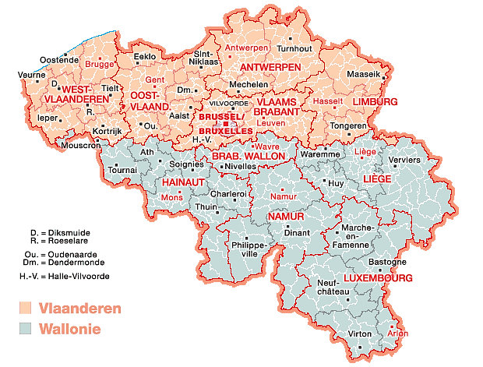
1. Justices of the Peace in Belgium
Overview
Belgium: almost 12 million inhabitants
162 Justices of the Peace
Local courts with conciliation hearings
Jurisdiction:
  General: small claims
  Exclusive jurisdiction (disputes between neighbours, co-ownership, rental disputes, …)
  Conservatorship

Slide 4




2. Conservatorship
Involves financial management and personal affairs
Ca. 150,000 people in Belgium today
Increasing due to an ageing population
Arises from incapacity (birth, accident, illness)
<
Justice of the Peace
Protected person
Third parties
Private institutions
Third parties
Public service
Conservator
Family, healthcare institution

Slide 5



3. Support Centre for Conservatorship – origin
Barriers and insufficient dialogue
Start in West Flanders on a voluntary basis in 2022
Multidisciplinary collaboration between Justices of the Peace, lawyers and the healthcare sector
Court
Healthcare
Lawyers

Slide 6
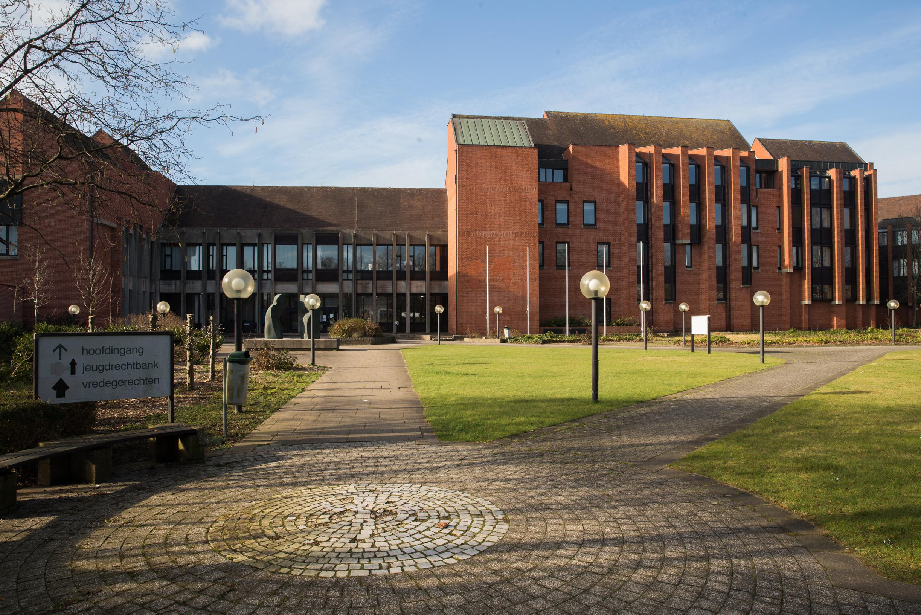



3. Support Centre for Conservatorship – mission
Accessible point of contact
Our mission is threefold…
Centre of
expertise
Partner at policy level

Slide 7


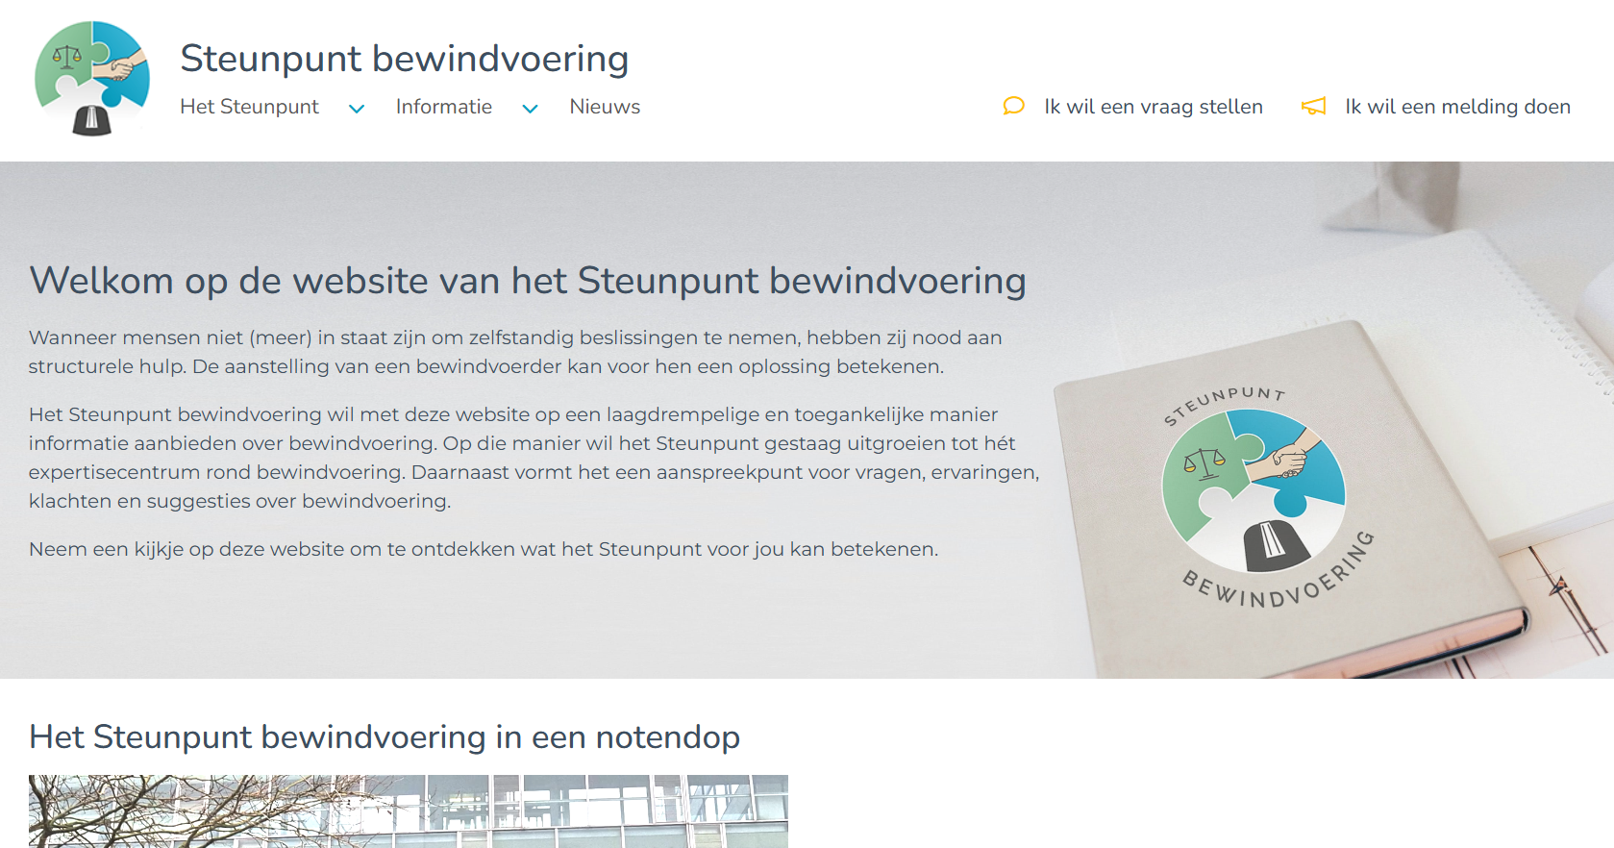
4. Video: functioning and website
Video
Website

Slide 8
5. Results and impact
Geographical expansion
Seminars & publications
Almost all of Flanders (ca. 7 million inhabitants) is covered.
Organisation of seminars & publication of a practical guide on conservatorship to strengthen expertise and support stakeholders.
Core business
Policy dialogue
Daily processing of questions and notifications: 500 in 2024.
Acting as a discussion partner for legislators, banks, and non-profit organisations, ensuring an effective flow of insights to the policy level.
Website
Annual report
Development of a performant website.
Publication of an annual report with recommendations for improvements.

Slide 9




6. Challenges
Voluntary basis
Committed people
Legal foundation
Legitimate basis for functioning
Expand to all judicial districts in Belgium
Everyday work

Slide 10





7. Inspiration for other countries?
PROXIMITY
  Importance of proximity
ANTICIPATING CONFLICTS
  Evolution from ‘cure’ to ‘care’
BOTTOM-UP APPROACH
  Bottom-up approach for detecting dysfunctions and input for better legislation
Multidisciplinary COOPERATION
Powerful medium for addressing complex challenges facing today's society globally

