Slide 1
32th plenary meeting of the CEPEJ
Strasbourg, 13 June 2019
Exchange of views with judges of the European Court of Human Rights

Slide 2
The “SATURN Centre for Judicial Time Management”:
Past and On-going Work
Giacomo Oberto
Chair of the Steering Group of the “SATURN Centre for Judicial Time Management”
of the CEPEJ

Slide 3
1. Introduction
The SATURN (Study and Analysis of judicial Time Use Research Network) Centre has been set up in 2007 by CEPEJ as a Centre for judicial time management. According to its terms of reference the SATURN Centre is instructed to collect information necessary for the knowledge of judicial timeframes in the member States and detailed enough to enable member states to implement policies aiming to prevent violations of the right for a fair trial within a reasonable time protected by Article 6 of the European Convention on Human Rights.
The Centre is aimed to become progressively a genuine European observatory of judicial timeframes, by analysing the situation of existing timeframes in the member States (timeframes per types of cases, waiting times in the proceedings, etc.), providing them knowledge and analytical tools of judicial timeframes of proceedings. It is also in charge of the promotion and assessment of the Guidelines for judicial time management.

Slide 4
The Centre is managed through a Steering group, established in accordance with article 7.2.b of Appendix 1 to Resolution Res(2002)12, under the authority of the CEPEJ. The Steering group works in particular for collecting, processing and analysing the relevant information on judicial timeframes in a representative sample of courts in the member states by relying on the network of pilot courts. Thus it must define and improve measuring systems and common indicators on judicial timeframes in all member states and develop appropriate modalities and tools for collecting information through statistical analysis.

Slide 5
2. Terms of reference
In order to implement the “Strategic plan for the SATURN Centre” (CEPEJ-SATURN(2011)5), the Steering group shall in particular:
periodically collect data on procedural times in member States at national and regional level, for all types of proceedings (civil, criminal and administrative) and for all courts (first instance, appeal and supreme courts);
verify the completeness and quality of the data collected in order to make improvements;
analyse the data collected and collate them with the principles relating to procedural times derived from the case law of the European Court of Human Rights;
define guidelines and standards relating to procedural times:
for all state organs concerned with justice: legislators, bodies vested with the administration of justice, court managers, judges, prosecutors, police officers;
for all types of proceedings (civil, criminal and administrative);
for all courts (first instance, appeal and supreme courts);

Slide 6
disseminate in member States the guidelines, the standards and the results of analysis of the data collected;
promote the use of judicial time management tools, particularly those developed by the SATURN Centre, in all member States to enable them to make their own analysis of the situation regarding judicial timeframes in their courts and apply their own remedies to any excessive procedural delays;
undertake within the member States most concerned by questions of procedural delays, and with their agreement, targeted actions to improve their situation (preventive or proactive measures) by implementing judicial time management tools in those countries;
rely on appropriate networks allowing the integration in the work and considerations of the judicial community, in particular on the network of pilot courts within the member States, to draw on innovative projects aimed at reducing and adjusting the timeframes operated by courts in member States;
organise and implement the court coaching programme (on a volunteer basis) for the effective use of the CEPEJ’s tools and guidelines, on the basis of the relevant SATURN Handbook (CEPEJ-SATURN(2011)9).

Slide 7
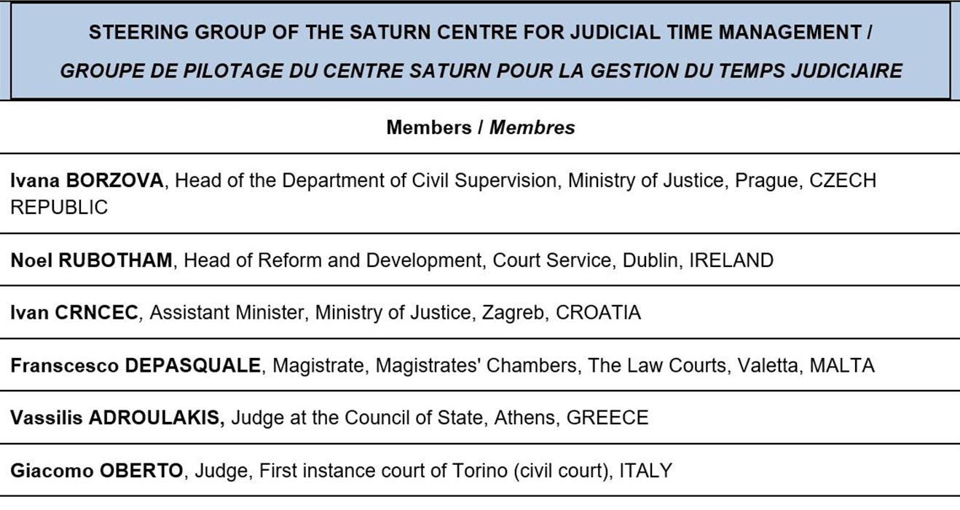
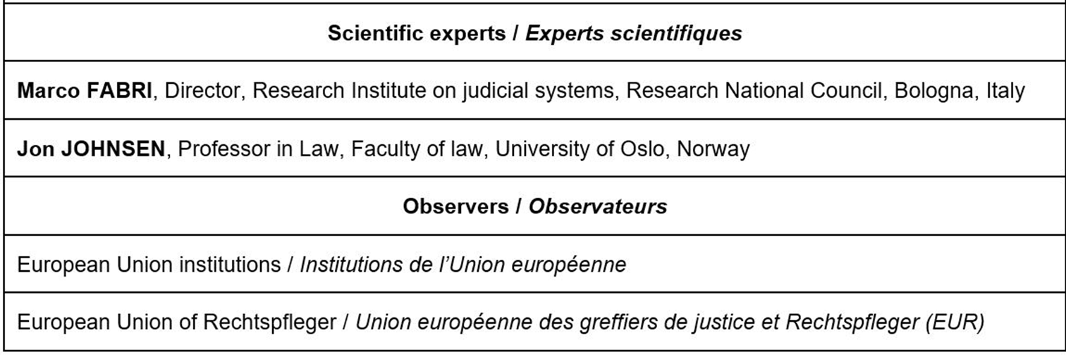
3. Composition

Slide 8
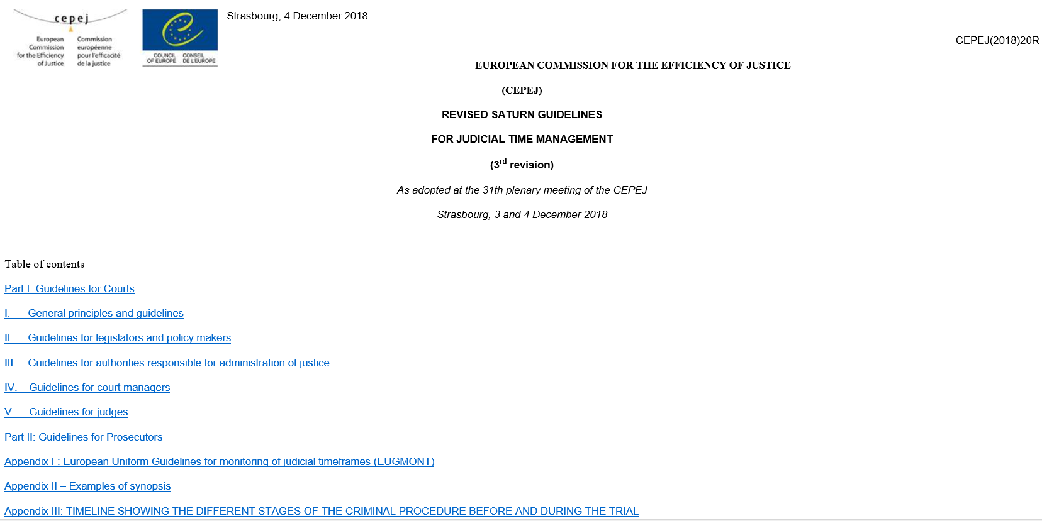
4. Main tools adopted
Main tools already adopted by SATURN are the following:
SATURN guidelines for judicial time management

Slide 9
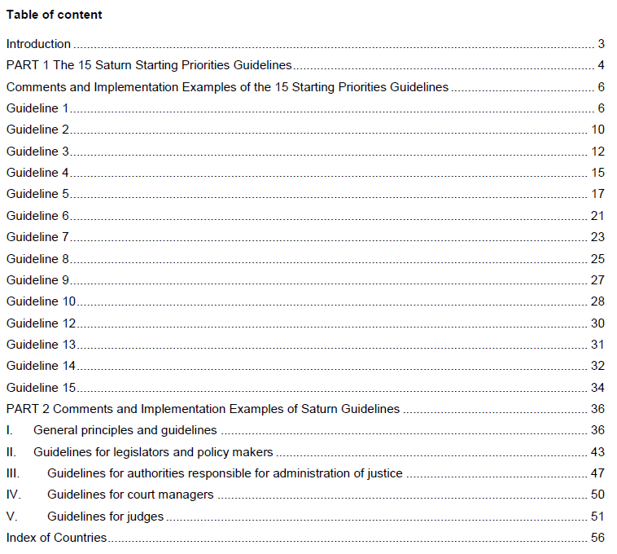
Comments and implementation examples of the SATURN guidelines

Slide 10
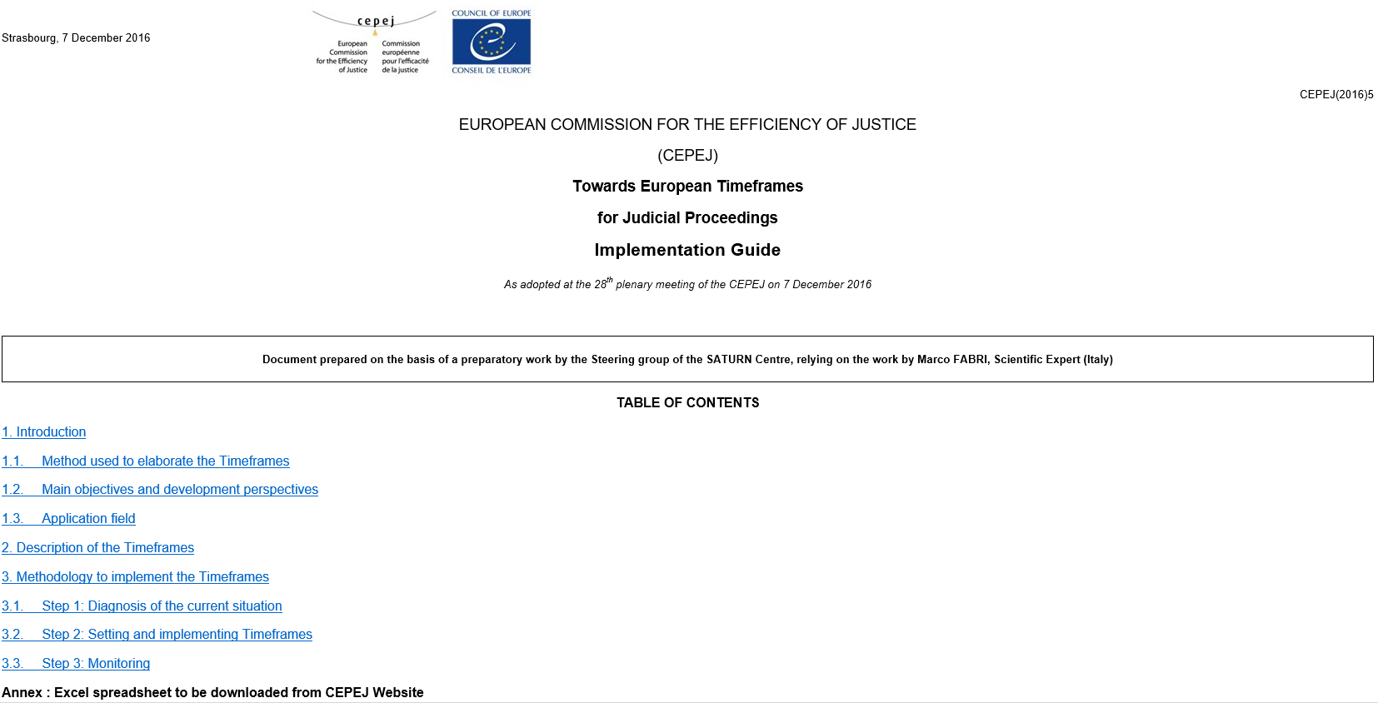
Implementation guide “Towards European timeframes
for judicial proceedings”

Slide 11
Guide for implementing the SATURN
management tools in courts

Slide 12
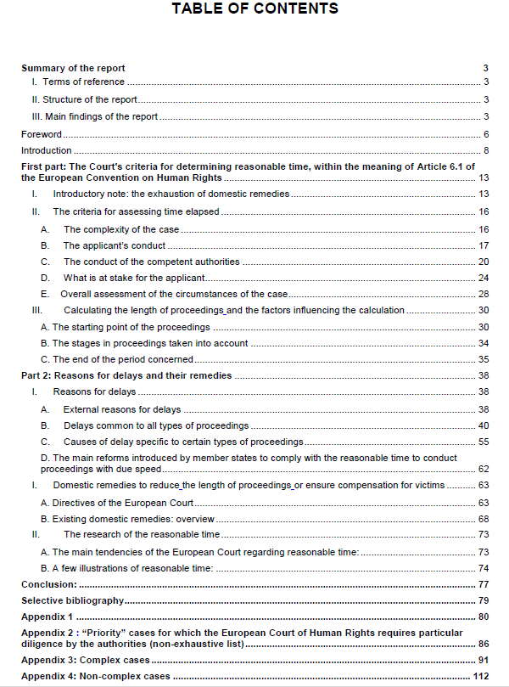
5. Main studies
Main studies that have already been done by impulse
and under the control of the SATURN Steering group:
Length of court proceedings in the member states
of the Council of Europe based on the case law of the
European Court of Human Right, by Ms Françoise
Calvez and Nicolas Regis, Judges (France)
3rd edition by Nicolas Regis - Cepej Studies No. 27

Slide 13
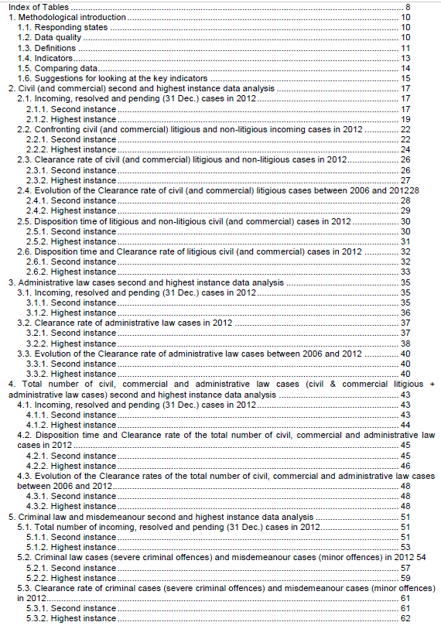
Study on Council of Europe Member States on Appeal and Supreme Courts’
Lengths of Proceedings (Report prepared by Marco Velicogna) IRSIG-CNR
and CEPEJ expert - CEPEJ Studies No. 17

Slide 14
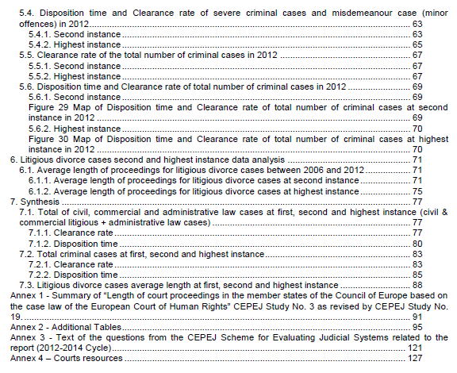

Slide 15
6. Ongoing works
On-going works and tools in preparation are the following:
Case weighting in European judicial systems
Aim is to attain a methodology which allows a Court to assess the complexity of cases.
We must present our work in a way that makes this analysis acceptable and accepted by judges. In order to do so, we must
make clear that this exercise is not intended to assess the work of judges or to put them in competition with each other, but
it is a way to assess and evaluate the needs of a Court, the division of works within a Court and the allocation of cases to judges, so that fairness is reached.
The SATURN Steering group is currently working (with the help of two scientifical experts) on a draft document, whose main features are:

Slide 16
Awareness of the fact that, in a nutshell, two different kinds of approaches are possible:
(a) the approach on the time implying a breakdown of the trial stages and
(b) the approach made of points based on criteria of complexity of the case
Experience acquired through a study visit to Israel, which studied and implemented a remarcable time-based method
Results acquired through a questionnaire spread among CEPEJ national correspondents

Slide 17
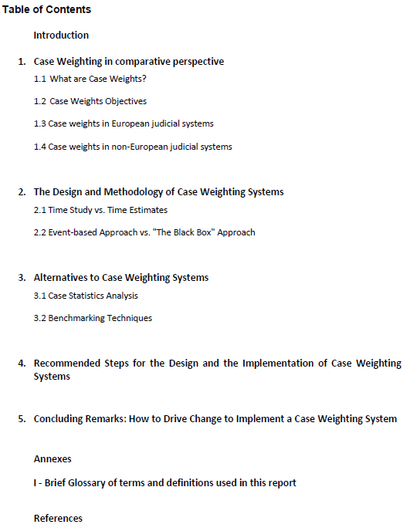
Draft table of contents:

Slide 18
Further on-going activities in the SATURN Steering group: Updating of the Implementation Guide “Towards European timeframes for judicial proceedings”, trying to collect (through a questionnaire sent to our Network of Pilot Courts) data on timeframes concerning some particular case categories, such as: Intellectual Property, Medical Malpractice and Car Accidents Lawsuits; Elaborating guidelines on how create Dashboards for court management; Elaborating tools, guidelines and IT instruments for the Management of judicial time regulations for criminal cases, according to EcvHR articles 5 and 6; Elaborating a Document on the Role of the parties and the practioners in preventing delays in court proceedings; Developing some Court-coaching programmes in Albania, Kosovo, Malta and Slovakia; Elaborating a contribution in the Updating of Recommendation Rec(86)12 concerning measures to prevent and reduce the excessive workload in the courts; Co-ordinate the works of the Network of the Pilot courts of the CEPEJ.

Slide 19
Thank you

Slide 20
The Working Group on quality of justice (CEPEJ-GT-QUAL)
The Working Group on quality of justice (CEPEJ-GT-QUAL) is instructed to develop means of analyse and evaluation of the work done inside the courts with a view to improving the quality of the public service delivered by the justice system, in particular vis-à-vis the expectations of the justice practitioners and the users, according to criteria of performance and efficiency meeting a large consensus.
In order to fulfil its tasks, the CEPEJ-GT-QUAL must in particular, while observing the principle of independence of judges:
collect necessary information on evaluation systems of the quality of judicial work existing in the member states;
improve tools, indicators and means for measuring the quality of judicial work;
draft concrete solutions for the policy makers and for the courts, allowing to remedy dysfunctions in the judicial activity and balance the obligations of the work of judges and its workload with the obligation to provide a justice of quality for the users.

Slide 21
COMPOSITION
Gilles ACCOMANDO, First President Cour d’Appel de Pau, FRANCE
Joao ARSENIO DE OLIVEIRA, Head of Department, Ministry of Justice, PORTUGAL
Nino BAKAKURI, Justice of the Supreme Court of Georgia, GEORGIA
Merethe ECKHARDT, Director of Development at the Danish Court Administration, DENMARK
Anke EILERS, Presiding Judge, Appeal Court of Köln, GERMANY
Ioannis SYMEONIDIS, Judge, General Commission of the Administrative Courts, GREECE
Observers
Council of the Bars and Law Societies of the European Union (CCBE)
European Expertise and Expert Institute (EEEI)
European Network of Councils for the Judiciary (ENCJ)
European Union institutions (EU)
European Union of Rechtspfleger (EUR)
International Union of Bailiffs (UIHJ)

Slide 22
Work done so far
European Ethical Charter on the Use of Artificial Intelligence in Judicial Systems
Guide on communication with the media and the public for courts and prosecuting authorities
Guidelines on how to drive change towards Cyberjustice
Structural measures adopted by some Council of Europe member states to improve the functioning of civil and administrative justice in addition to the effective domestic remedies required by Article 13 of the ECHR - Good practice guide
Measuring the quality of justice
Handbook for conducting satisfaction surveys aimed at Court users in the Council of Europe's member States
Guidelines on the organization and accessibility of court premises
Guidelines on the role of court-appointed experts in judicial proceedings of Council of Europe’s Member States
Checklist for court coaching in the framework of customer satisfaction surveys among court users
Questionnaire on the role of experts in judicial systems of the Council of Europe member States
Guidelines on the creation of judicial maps to support access to justice within a quality judicial system
Questionnaire for collecting information on the organization and accessibility of Court premises
Checklist for promoting the quality of justice and the courts
Study on the situation of the contractualisation and judicial process in Europe - CEPEJ Studies No. 16
Report on conducting satisfaction surveys of court users in Council of Europe member States - CEPEJ Studies No. 15

Slide 23
Future fields of works of CEPE-GT-QUAL
Videoconference (new approach)
Gender equality in the judiciary, especially in the recruitment and promotion of judges and prosecutors
The user as the centre of judicial procedures
Simplification of court language

Slide 24
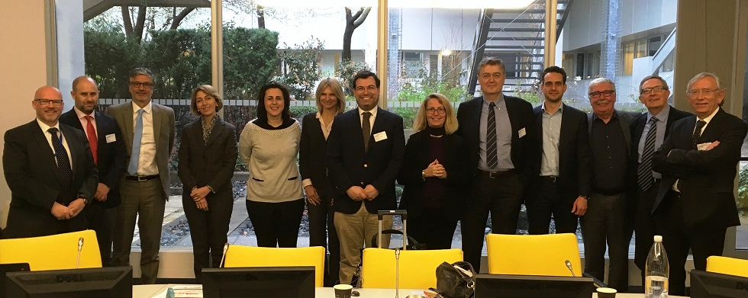
CEPEJ Working Group on Quality of Justice
João Arsénio de Oliveira
Chair of the CEPEJ-GT-QUAL

Slide 25
CEPEJ-GT-QUAL or the nickname for the Quality of Justice
João Arsénio de Oliveira
Chair of the CEPEJ-GT-QUAL
Obrigado
Strasbourg, june 13

Slide 26
CEPEJ Working Group on Evaluation of judicial systems
Jaša Vrabec
Head of the Office for Court Management Development at the Supreme Court of Slovenia and President of the Working group on the Evaluation of Judicial Systems within the CEPEJ – the Commission for the Efficiency of Justice at the Council of Europe

Slide 27
First of all I would like to express my full support to the exchange of views between the CEPEJ and the European Court of Human Rights. Especially today, when the basic European values of democracy, the rule of law and the independence of the judiciary are at stake.
The judicial branch of power is the most stable branch of power and as such it must guarantee the preservation and development of the most important values of the Council of Europe. It is by reflecting together on our work and by devoting ourselves even further to these values that we can help our societies improve and be more just.
I am sure the debates we will have will be fruitful and that our collaboration will have a positive effect on our daily tasks in our respective institutions.

Slide 28
Presentation of the work of the CEPEJ, the work of the Working group on Evaluation and our main product, the Report on European Judicial Systems
For more than 15 years, CEPEJ has been actively engaged in promoting and supporting improvements in the efficiency and quality of justice in Europe. The statute of the CEPEJ emphasizes the comparison of judicial systems and the exchange of knowledge on their functioning. The scope of this comparison is broader than ‘just’ efficiency in a narrow sense: it also emphasizes the quality and the effectiveness of justice.

Slide 29
The Working group on the Evaluation of Judicial Systems aims at evaluating in an objective manner the functioning of judicial systems in Europe.
We support member States in improving the quality of their judicial statistics and developing their statistical system.
We facilitate the exchange of experiences and knowledge between national judicial systems and share good practices.
We identify and develop indicators, collect and analyse quantitative and qualitative figures and define measures and means of evaluation.
The long-term objective of the evaluation process, carried every two years since 2004, is to define a core of quantitative and qualitative key data to be regularly collected and dealt with in a similar manner in all States and entities, bringing out shared indicators on the quality and the efficiency of court activities in the member States of the Council of Europe and highlighting organisational reforms, practices and innovations with a view to further improve the services provided to court users.

Slide 30
The result of our work is the Report that compares judicial systems of 47 Member states from various perspectives: their budget, efficiency, productivity, timeliness, quality, etc.
I will not go into details of the Report, present our methodology or the results. I would like to invite you all to visit the interactive website of the CEPEJ named CEPEJ-STAT, which will be presented to you very soon.
The national replies on judicial systems are easily accessible to all citizens, policy makers, law practitioners, academicians and researchers.
The questionnaire is evolving – some questions are added, some transformed or even omitted. In the recent past special attention has been given to questions relating to IT and to gender issues.
The explanatory note that helps understand the questions better has just been updated and expanded. We are working on new ways of presenting the data in a clear and understandable way.
We know that the quantity of data is enormous, that is why we are constantly trying to provide useful and user-friendly information on trends and common features of different judicial systems.

Slide 31
The expertise of CEPEJ is recognised by the European Commission, as we collaborate on various levels.
The Working group on Evaluation provides every year the majority of the data for the preparation of the EU Justice Scoreboard.
Last year, close collaboration has started with the European Commission in order to prepare a similar document for the countries of the Western Balkans. We look forward to the start of this exercise in October 2019.
I would like to point out two things that in my opinion are very important for our work.
Firstly, I would like to stress that comparing is not ranking. What the CEPEJ does is compare. The comparison of quantitative data from different countries with various historical, geographical, economic and legal situations is a delicate task. It should be approached with great caution by the experts writing the report and by the readers consulting it, interpreting it and analysing the information it contains.

Slide 32
In order to compare the various States and their systems, the particularities of the systems, which might explain differences in data from one country to another, must be borne in mind.
We have different legal history, different judicial structures and different use of statistical tools to evaluate the systems.
One of the main tasks of the Working group on Evaluation is to try to streamline this diversity of data into comparable figures. To this end the Working group has concluded peer review visits in various member states, where together with the people responsible for providing data we constantly improve the quality of our Report.
I guess it is in a way similar with your work and the concept of the margin of appreciation left to the national authorities.
It is only through the respect of our mutual differences that we can learn from each other and help our judicial systems and societies move forward. And the European Court of Human Rights can and must be the most important institution that protects and evolves human rights and basic freedoms for the countries of the Council of Europe.

Slide 33
The second thing that I would like to stress is the importance of trust in the judicial system and its institutions.
Courts are based on the trust of the citizens. It is therefore of paramount importance to ask ourselves what our users really need and expect from us and try to reach to them.
The CEPEJ sees the relation with the users of the judicial system as a cornerstone of the legitimacy of courts in the eyes of the citizen. Providing users with the information and services they need and expect in a polite and collaborative way, showing respect and dignity through procedural fairness reinforces the link between the judicial power and the people.
It is up to every member State and to everyone of us together to improve the perception on justice among people. It does not mean that courts have to give judgments people want and expect, but that they must be aware of the fact that judgments are pronounced in the name of the people and that judicial power and judicial services should be run for the people.

Slide 34
We would like to include more data on the work of the European Court of Human Rights into our evaluation of judicial systems. Data on important issues like fair trial and freedom of speech. Together with the Secretariat we will carefully analyse the report of your Court to consider new questions we might add to our questionnaire. Questions that contain information that could be useful to justice professionals consulting our report in shaping better and more just judicial systems.
Ladies and Gentlemen, honourable judges, I thank you for your attention and for coming to our meeting and taking the time to exchange our views and ideas. I look forward to hearing your ideas and proposals and to our future collaboration.

Slide 35
The Working Group on Mediation (CEPEJ-GT-MED)
Information on the on-going work of the CEPEJ working group of mediation experts
by Dr Rimantas Simaitis,
Chairman of the CEPEJ-GT-MED

Slide 36
Members
Nina Betetto, Slovenia
Maria Oliveira, Portugal
JUDr. Anna Márová, Czech Republic
Jean A. Mirimanoff, Switzerland
Dr. Rimantas Simaitis, Lithuania (chairman)
Jeremy Tagg, United Kingdom
Scientific experts:
Leonardo D’Urso, Miglė Žukauskaitė, Mjriana Visentin

Slide 37
Mandate for 2nd convocation from 2017
To facilitate the implementation of the Recommendations of the Committee of Ministers to Member States concerning mediation/ADR and, in particular:
assess the impact in the States of the existing CEPEJ Guidelines on penal mediation (CEPEJ(2007)13), on family and civil mediation (CEPEJ(2007)14), and on alternatives to litigation between administrative authorities and private parties (CEPEJ(2007)15), and update these Guidelines, where appropriate
draft, if appropriate, further tools aimed to ensure an effective implementation of existing recommendations and guidelines
contribute, where appropriate, to the implementation of the relevant co-operation programs

Slide 38
Completed activities in 2017-2019 (1)
Survey and report assessing impact in the Member States of the existing CEPEJ Guidelines on mediation/ADR
Roadmap for the CEPEJ-GT-MED based on the abovementioned survey and report
Designed ten tools for the Mediation Development Toolkit ensuring implementation of the CEPEJ Guidelines on mediation
Note on feasibility study for a European Mediation Convention
Review of the mediation part for the GT-EVAL grid
Review of the mediation part/ADR/ODR of the draft study for use of AI in courts prepared by the GT-QUAL
Review of CEPEJ definitions related to mediation
Support for designing and in implementation of cooperation projects/programmes

Slide 39
Mediation Development Toolkit (1) Ensuring implementation of the CEPEJ Guidelines on mediation
Tools already adopted by CEPEJ in 2018
1. Establishing a Court Mediation Pilot: management checklist
2. Mediation Pilot Monitoring Checklist
3. Guide to the Judicial Referral to Mediation
4. Basic Mediator Training Curriculum (elaborated jointly with the IMI)
5. Frequently Asked Questions (FAQ) on Mediation: A Guide for judges, non-judge staff of courts, mediators, mediation services, legal and other professionals and mediation stakeholders and users of mediation
6. Guide to Mediation for Lawyers (elaborated jointly with the CCBE)

Slide 40
Mediation Development Toolkit (2) Ensuring implementation of the CEPEJ Guidelines on mediation
Tools already adopted by CEPEJ in 2018
7. Baseline Grid for Mediation Key Performance Indicators (Baseline Mediation Statistics)
8. European Code of Conduct for Mediation Providers
9. Standard Mediation Forms: - Model Agreement to Mediate - Model Mediation Settlement Agreement - Model Mediation Feedback Questionnaire - Model Mediation Contract Clause

Slide 41
Mediation Development Toolkit (3) Ensuring implementation of the CEPEJ Guidelines on mediation
Tools submitted for adoption by CEPEJ at this Plenary
1. European Handbook for Mediation Lawmaking with explanatory memorandum
2. Guidelines on Designing and Monitoring Mediation Training Schemes (elaborated jointly with the IMI) upgrading and replacing tool No 4 “Basic Mediator Training Curriculum“

Slide 42
On-going work in 2019
Further elaboration of mediation development tools for the Toolkit:
Mediation related training curricula for (i) judges, (ii) lawyers, (iii) notaries, and (iv) enforcement officers
(activities in cooperation with GEMME, EJTN, CCBE, CNUE and UIHJ)
2. Feasibility study on the European Mediation Convention
Dissemination and promotion of the Mediation Development Toolkit
Implementation of the Road Map of the CEPEJ-GT-MED approved by CEPEJ:
promotion of Council of Europe (bi-)annual conference on mediation
preliminary work for establishment of CEPEJ network of mediation contact persons in all Council of Europe member states

Slide 43
Thank you
E-mail: rimantas.simaitis@cobalt.legal

