Slide 1

Gender Equality Strategy
2024-2029

Slide 2


Progress
But...
Higher legislative and policy standards to address sexism and violence against women
Prevalence of sexism and gender stereotypes
New forms of violence, including technology-facilitated violence
Better representation of women in politics and leadership positions
Obstacles to women’s access to justice and rights
Unequal share of unpaid care and domestic work
Increased participation of women in the labour market
Gender pay and pension gap

Slide 3

Overarching approches
Overview
The Council of Europe Gender Equality Strategy 2024-2029...
... has been adopted in line with the Reykjavik Declaration
... to address persisting and emerging challenges
... with a greater emphasis on
  intersectionality, to ensure a gender-equal Europe for everyone : this means better understanding and addressing interactions between gender, sex and other personal characteristics/statuses and the compounded forms of discrimination
  involvement of men and boys as agents and beneficiaries of change: gender equality is not just a women’s issue, it should be addressed by society as a whole

Slide 4



6 Strategic Objectives
6 Strategic Objectives
Gender Equality Strategy 2024-2029
Preventing and combating gender stereotypes and sexism
  Promoting and implementing the Recommendations on sexism and on hate speech
  Addressing gender bias in AI systems
  Collecting sex-disaggregated data
  Continue addressing gender inequality in education and in the media
Preventing and combating violence against women and girls and domestic violence
  Implementing recommendations from the monitoring of the Istanbul Convention
  Addressing technology-facilitated violence against women and girls
  Developing strategies and action plans and exchanging good practices, including in relation to perpetrator programmes
Ensuring equal access to justice for women and girls
  Increasing capacities to remove barriers and obstacles to women’s access to justice
  Collecting sex-disaggregated data and conducting research

Slide 5

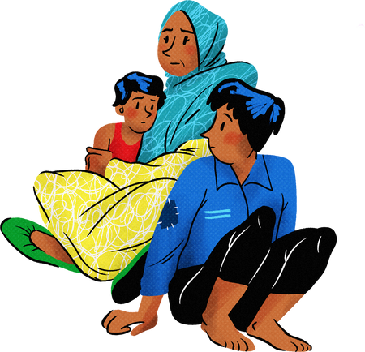

6 Strategic Objectives
6 Strategic Objectives
Gender Equality Strategy 2024-2029
Achieving balanced participation of women and men in political, public,
social and economic life
  Ensuring equal participation of women and men in political and public decision-making
  Supporting women’s equal access to the labour market and the equal distribution of unpaid care and domestic work
  Ensuring effective access to sexual and reproductive health and rights, and to healthcare services
Ensuring women’s empowerment and gender equality in relation to global and geopolitical challenges
  Implementing the Recommendation on migrant, refugee and asylum-seeking women and girls
  Adopting a gender-responsive approach in the prevention and mitigation of all forms of crisis
  Countering anti-gender narratives in co-operation with relevant stakeholders
Achieving gender mainstreaming and including an intersectional approach in all policies and measures
  Gender mainstreaming throughout all policy, programming and budgetary processes, ensuring awareness and inclusion of intersecting forms of discrimination

Slide 6

Overarching approches
Partnerships
The Strategy 2024-2029 will ...
... be implemented in partnerships with other regional and international organisations, civil society organisations and a wide range of stakeholders
... integrating a youth perspective
  an Attitude – Think with Youth
  an Experience – Learn from and with Youth
  a Skill – Participate with Youth
  an Action – Act with and for Youth
... and it starts TODAY !

Slide 7


Thank you!

