Slide 1
THEMATIC VISIT ON ROMA AND TRAVELLERS’ ACCESS TO JUSTICE
Helsinki, 22th March 2018
Alessandro Pistecchia - UNAR – Italy
(a.pistecchia@governo.it)

Slide 2
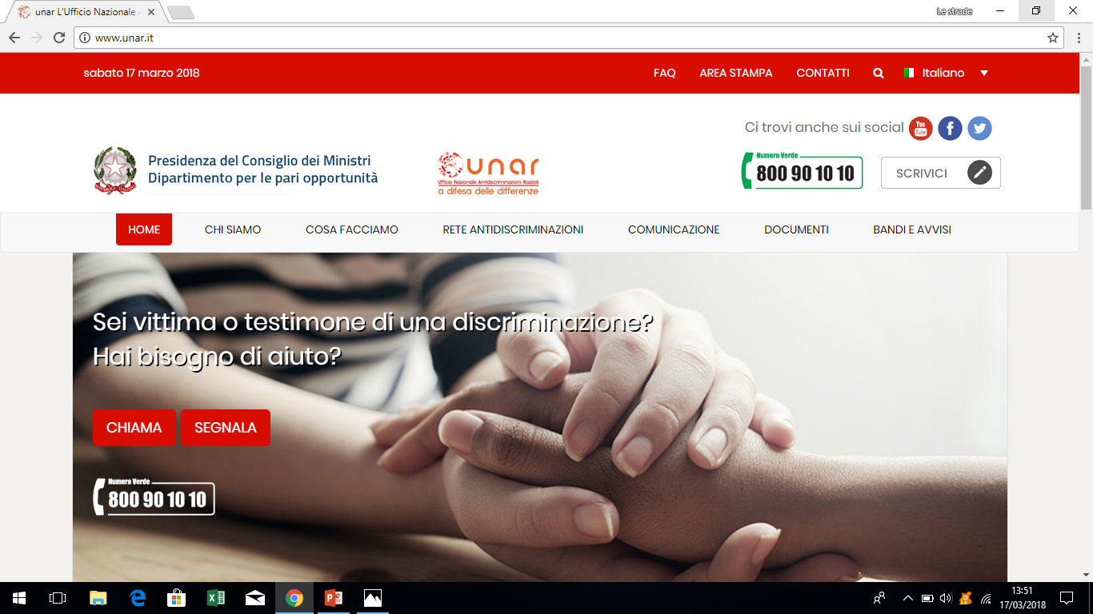

Slide 3
National Roma Contact Point
National Office against discrimination (UNAR) is Italy's National Contact Point for Roma Inclusion
coordination of the Strategy
synergies and exchange with Central, Regional and Local Administrations
cohesive function
Roma community - non-governmental organizations active on these issues (79 Platform-25 Forum RSC).

Slide 4
RSC Italy background
In Italy Roma, Sinti and Caminanti (RSC) are estimated to be around 170.000/180.000 (0,2 %)
Italian citizens Roma and Sinti (approximately 70,000 people)
Roma people from the Balkan region arrived in Italy in the 70’s and after the disintegration of the former Yugoslavia (about 60.000 non-EU and EU citizens).
The third and more recent macrogroup of migration is made of Roma people with Romanian and Bulgarian nationality

Slide 5
Critical elements
RSC vulnerable to intersectional forms of violence and discrimination (living in outskirts and settlements), at risk of exclusion (even from measures)
strong discrimination/antigypsyism and hate speech reflecting imagines created mostly on prejudices (protests on migrant presence and distribution, risks of violence escalation)
“Homelessness” status – problem to have alternative measures by Law

Slide 6
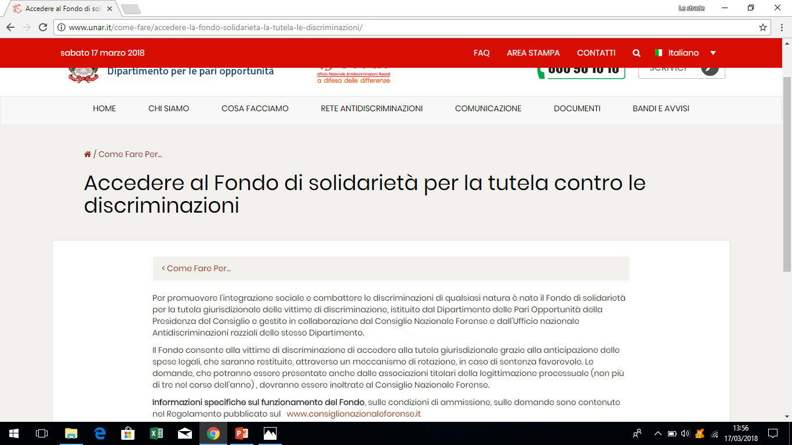
Solidarity Fund for the legal assistance of the victims of discriminations.

Slide 7
Fondo di solidarietà
The Fund (200k) allows to the victims the access to the legal system anticipating legal fees, returned afterwards through swing mechanism if concluded by a favorable judgment of the Court
Facilitate equal access to legal aid or other free legal services
better protection of rights of the victims of discriminatory events
Tackle under-reporting/raise awareness

Slide 8
Cases examined
About 45 cases (2015-2017)
50% individual discrimination.
50% collective discrimination
proceeding against Municipalities (local Ordinance anti-immigrant, begging or posters, billboards with discriminatory messages);
Municipalities had withdrawn the contested acts (ordinances) before the first hearing on court.
Deterrent effect or reform carried out by the financed judgements

Slide 9
Hate speech
“Scum of Society”
three separate requests of access with regard to the same event with in connection with disparaging and discriminatory statements against Roma woman during a TV programme.
Strong reaction in this case of multiple discrimination (ethnic and gender)

Slide 10
Institutional cooperation
With OSCAD (Observatory for the protection against discriminatory acts)
awareness of law enforcement on all the provisions prohibiting racial discrimination (9500 officers trained since 2012)
forwarding any case of discrimination liable for prosecution (i.e. all crimes aggravated in accordance with Mancino Act -1993)

Slide 11
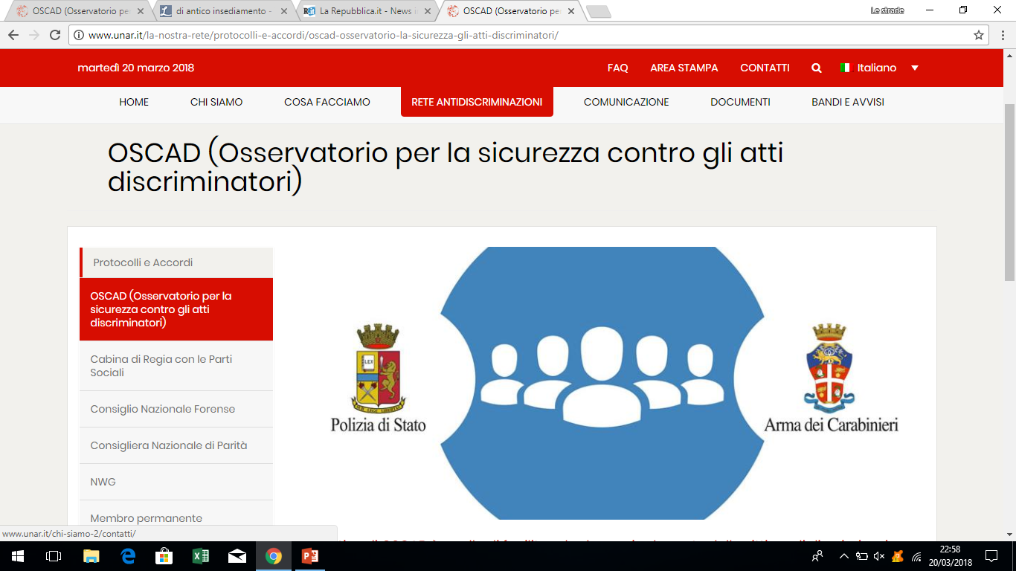

Slide 12
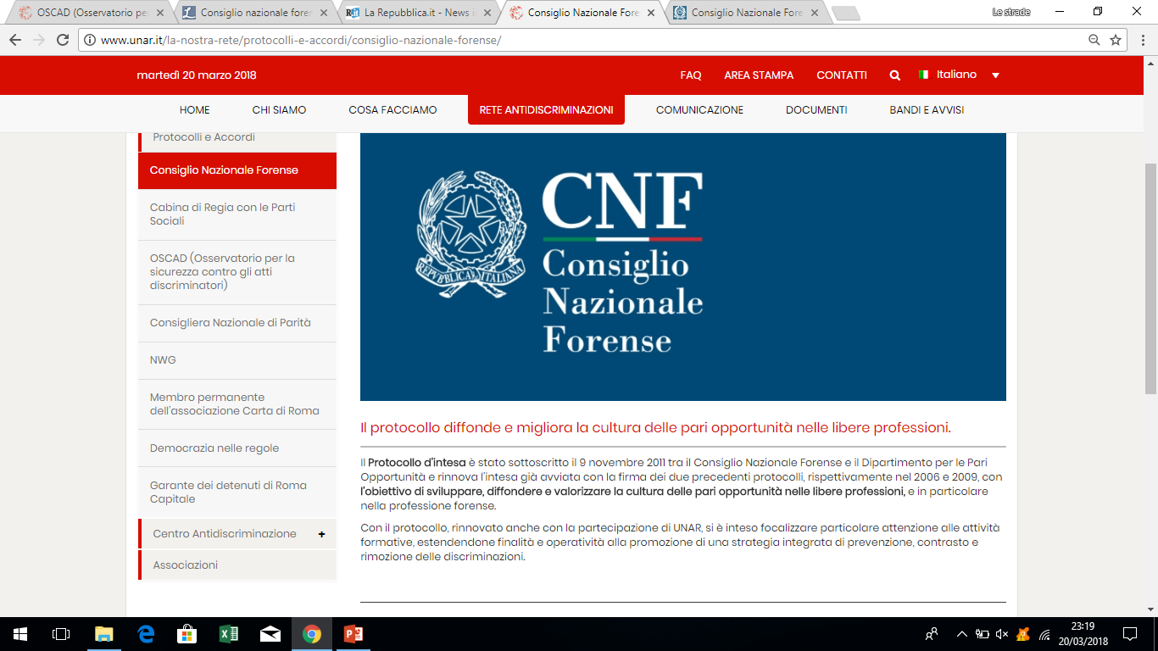
Institutional cooperation
With CNF (National Legal Council) for the management of solidarity Fund

Slide 13
Civil society/Facilitate equal access to legal services
increasing capacity building of NGOs with specific interest on justice (7 NGOs of Platform with specific background on Roma and justice)
Limiting non professional approach and frauds
Probono Activities + Legal training of NGO’s and Bar NGO
Publication and diffusion (Netkard, Thematic report CAHROM, etc)

Slide 14
Improve legal-advice and legal-aid systems
Project APAD (2018): awareness and training for social workers of Municipalities on Roma legal status and access to services
residence: the issue of registrations in official records (Municipality level): relevant!
related to the access to territorial services (health, social services, social housing, training and work orientation, etc)
Related to the access to specific and target measures in line with national Strategy fictitious addresses

Slide 15
Conflict resolution, including ADR
In the ESF - PON INCLUSION 2014-2020 “Mediation and awareness raising actions” are included “social mediation activities in relation to conflict resolution” (3 Mln)
UNAR is the beneficiary of the Funds - link with other lines of funding

Slide 16
Experiences (centers of juvenile justice)
La differenza siamo noi: targeting Roma boys subject to criminal proceedings (for stalking crimes, sexual harassment, cyberbullism, threats to women) – implemented in Penal Institute for minors
Essere donna: targeting Roma girls subject to criminal proceedings
Educational paths, training programs, laboratories on the status of Roma girls
Scholarships, job grants, etc

Slide 17
Government’s contribution to the joint programme
Launch event and presentation
participation to the meetings
diffusion and networking (web, Platform - Forum , Roma Youth)

Slide 18
Future plans in the area of access to justice and proposal
Principle of Complementarity aimed at
supporting marginalized people involved in programmes and projects
improving the governance system with a focus on processes and concrete effects
Strong coordination of plularity of stakeholders and bodies involved in public actions

Slide 19
Thank you!
Nais tuké!
Kiitos!
Grazie!

