Slide 1
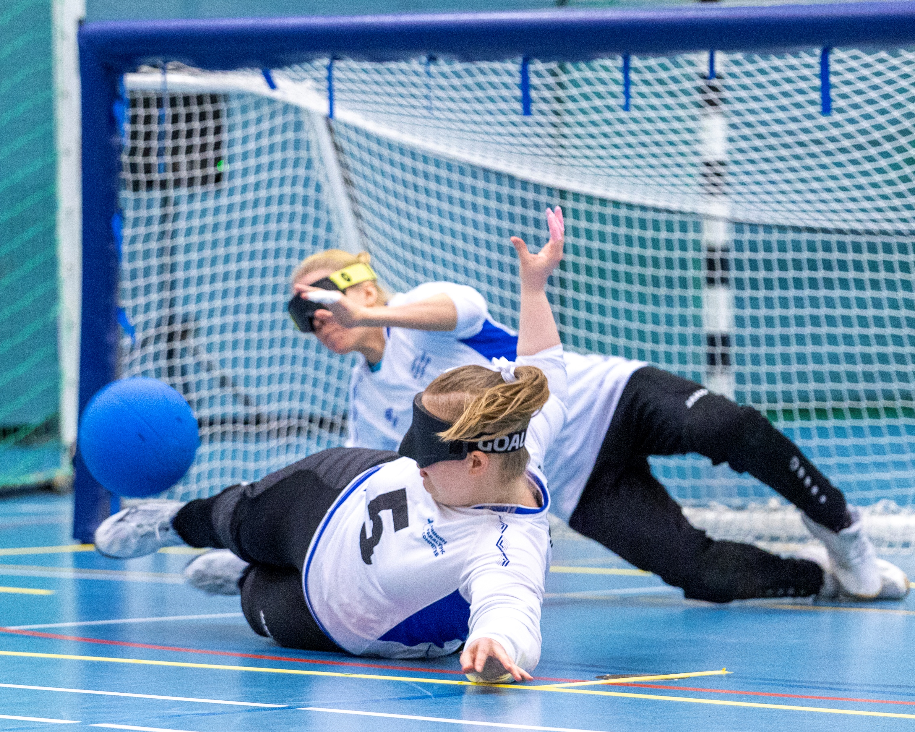
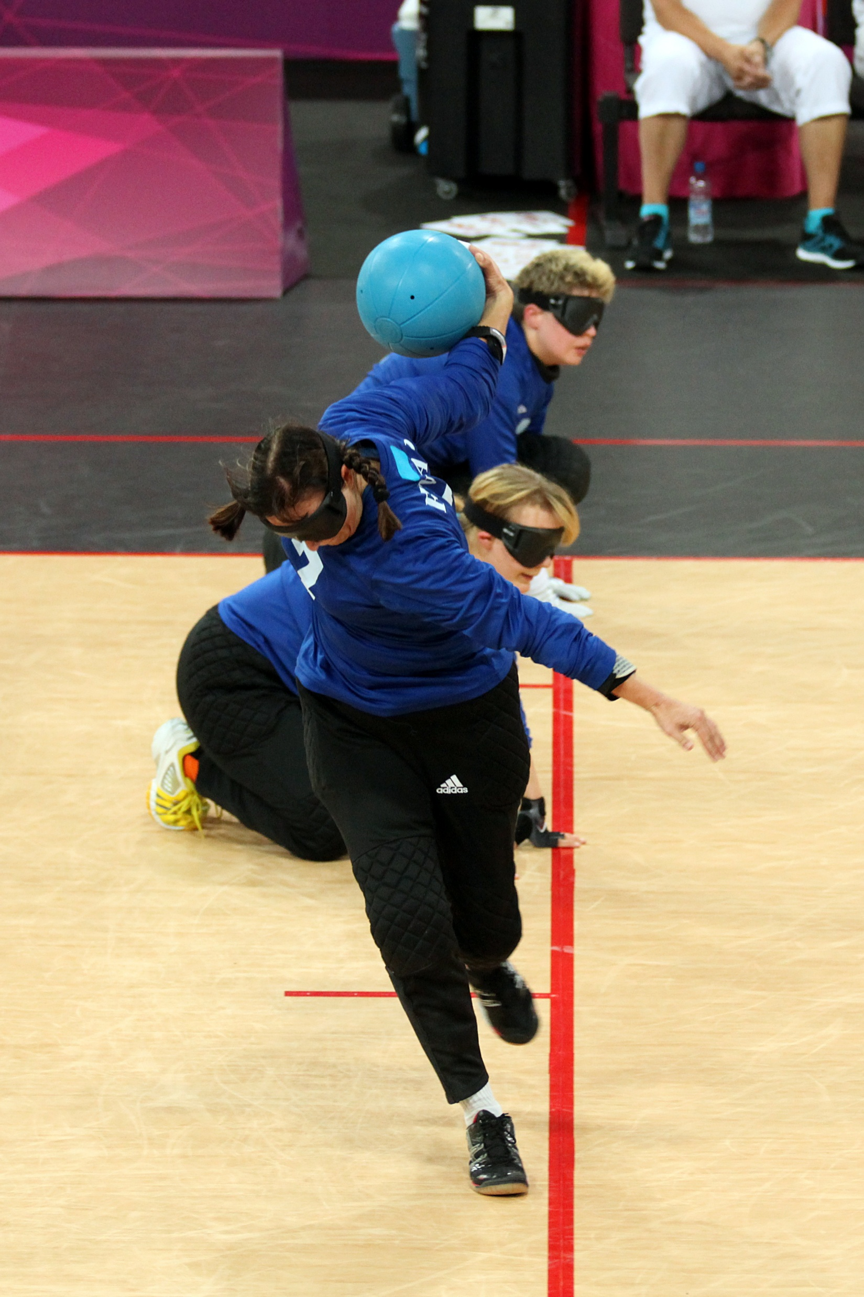
Inclusive environments in sports- Retaining girls and women with disablities
Goalball
Women
From
Finland

Slide 2
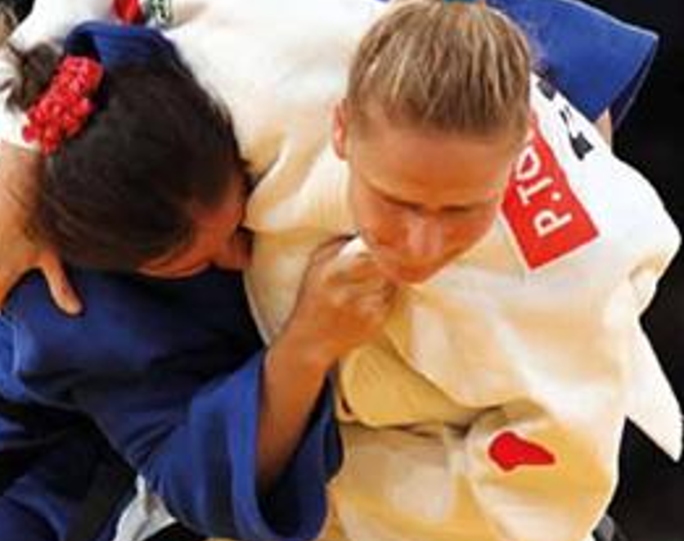
About the speaker
Päivi Tolppanen (FIN) is a former parasport athlete in judo and goalball. In judo, she has achieved bronze twice in European Championships and fifth place in the Paralympics 2012. In goalball, she is both European and World Champion and took 4th place in the Paralympics 2000 and 2004. As a coach, she has led the way for the Finnish women´s national goalball team. In judo, she has coached both VI and able-bodied judokas. Currently, she is also a vice president of the Finnish Paralympic Committee and a member of the classification Committee of IBSA (International Blind Sports Assiciation).

Slide 3
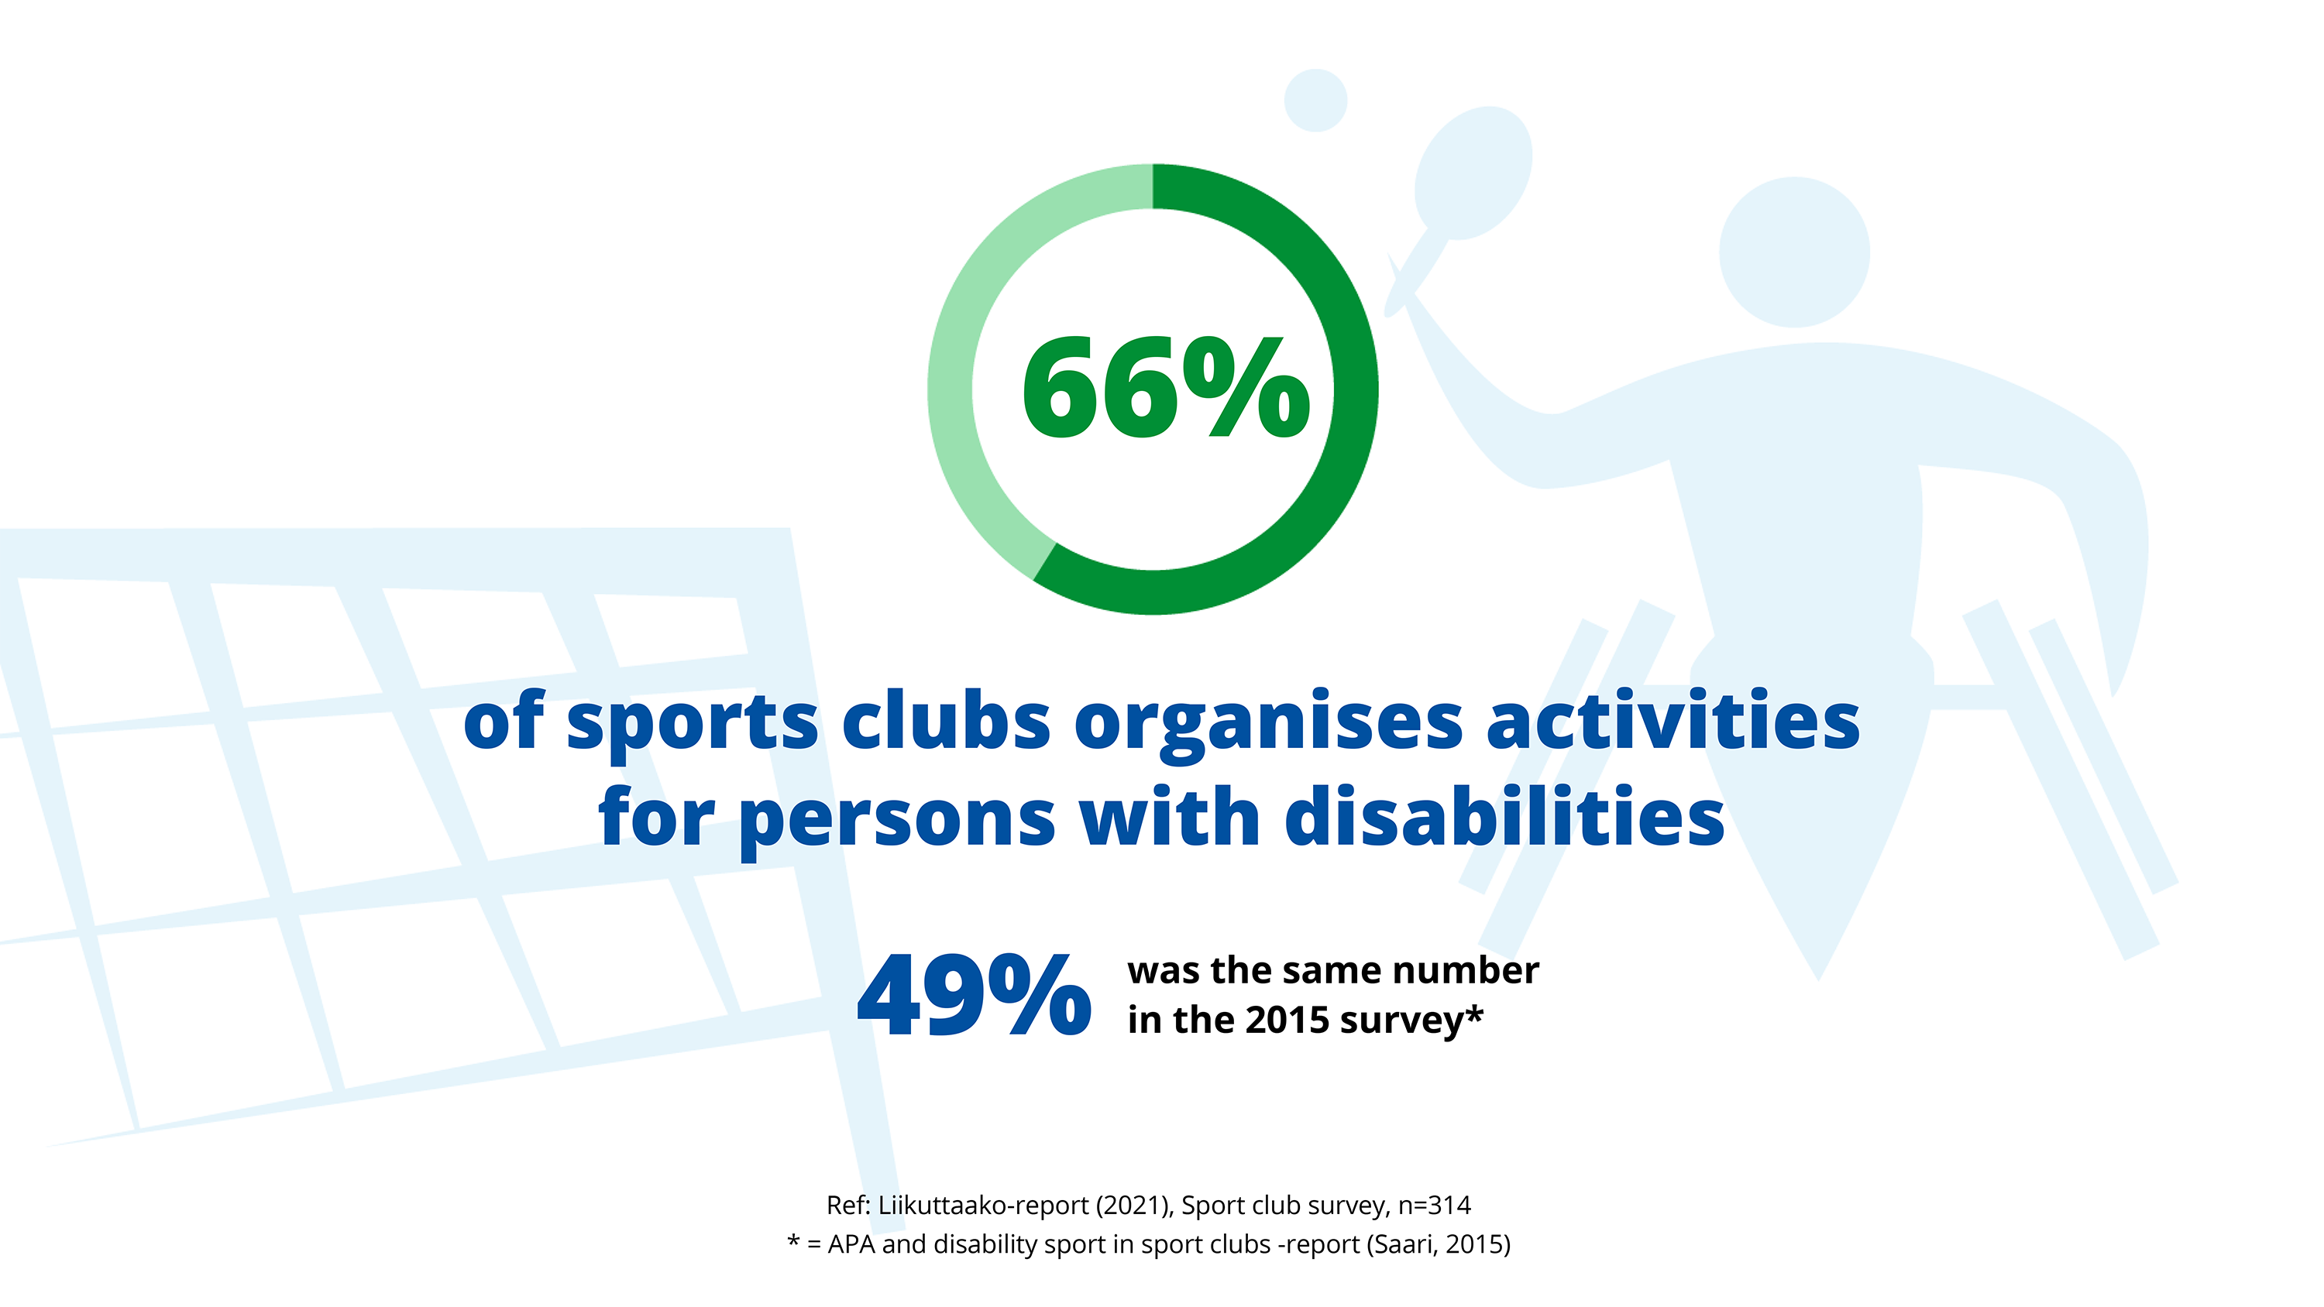

Slide 4
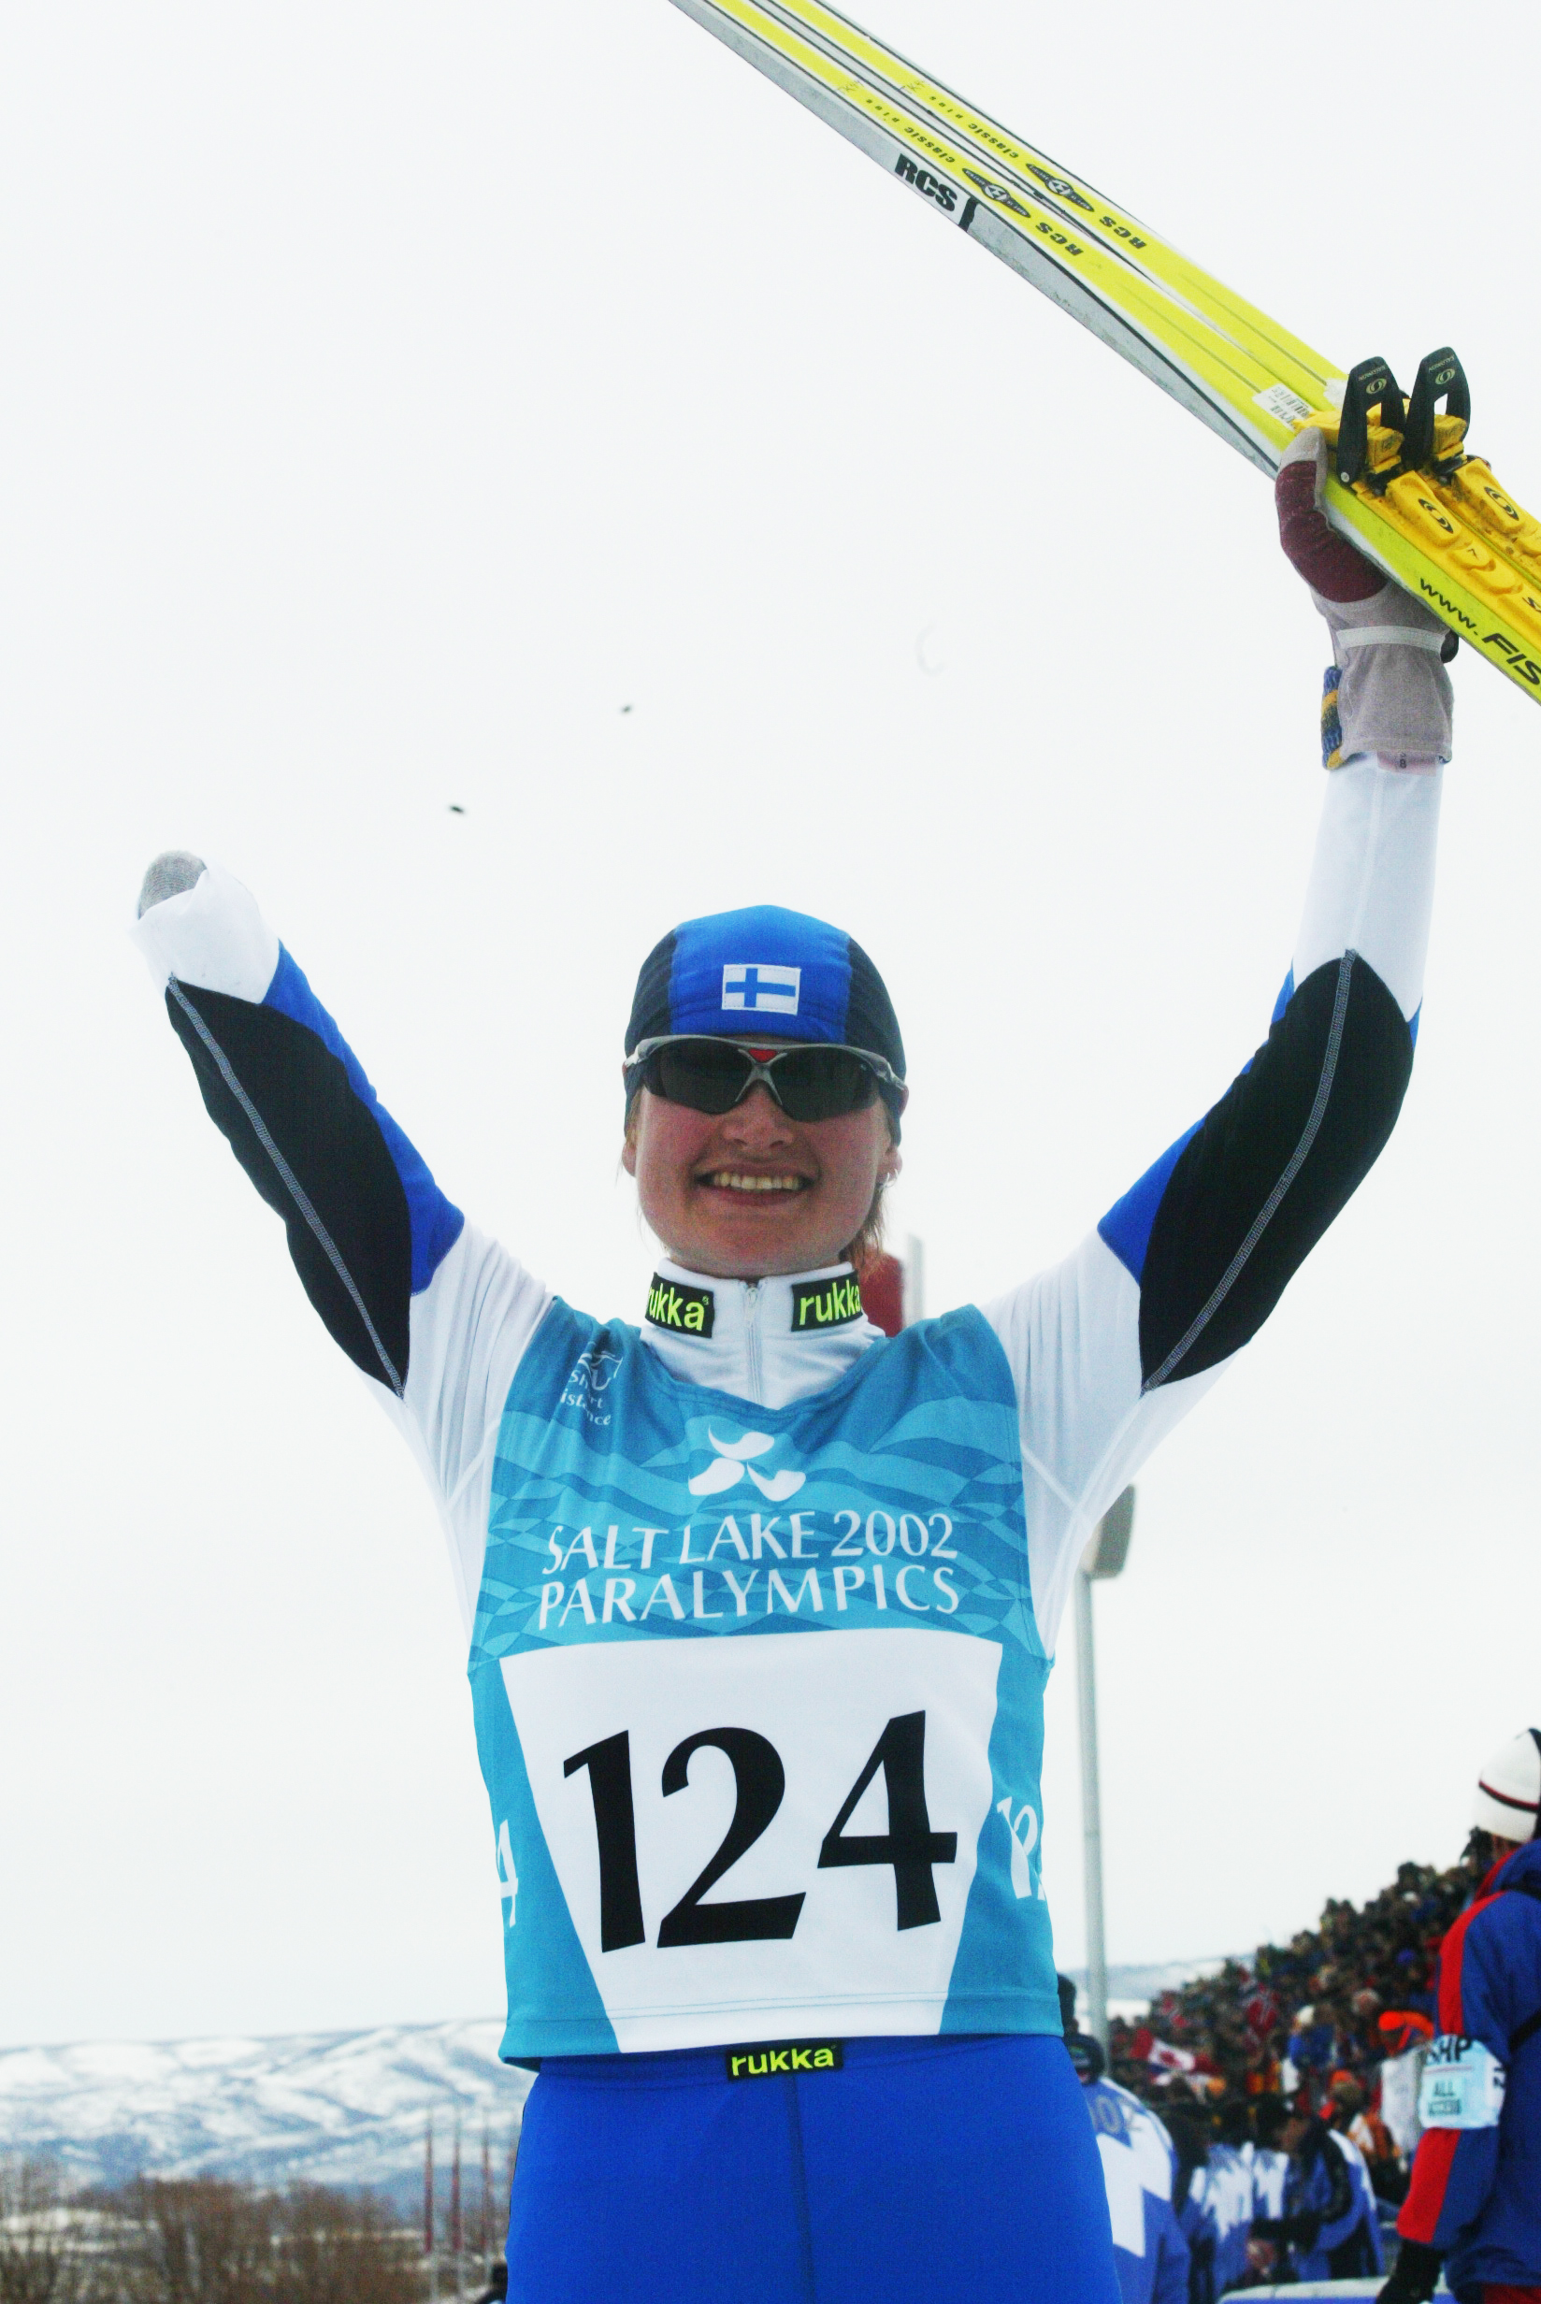
PARTICIPATION IS POSSIBLE:
Open- to- all mindset of the sport clubs
Feeling that you are welcome
Possibility to function
Accessability of the sports facilities
Background support team:
Transpotation or possibility to learn the route to the sporting venue
Allowig the assistant to participate
Adaptive sports equipments (In Finland some can be borrowed or hired)
Etusivu | Paralympiakomitean Apuvälineiden vuokrauskalenteri

Slide 5
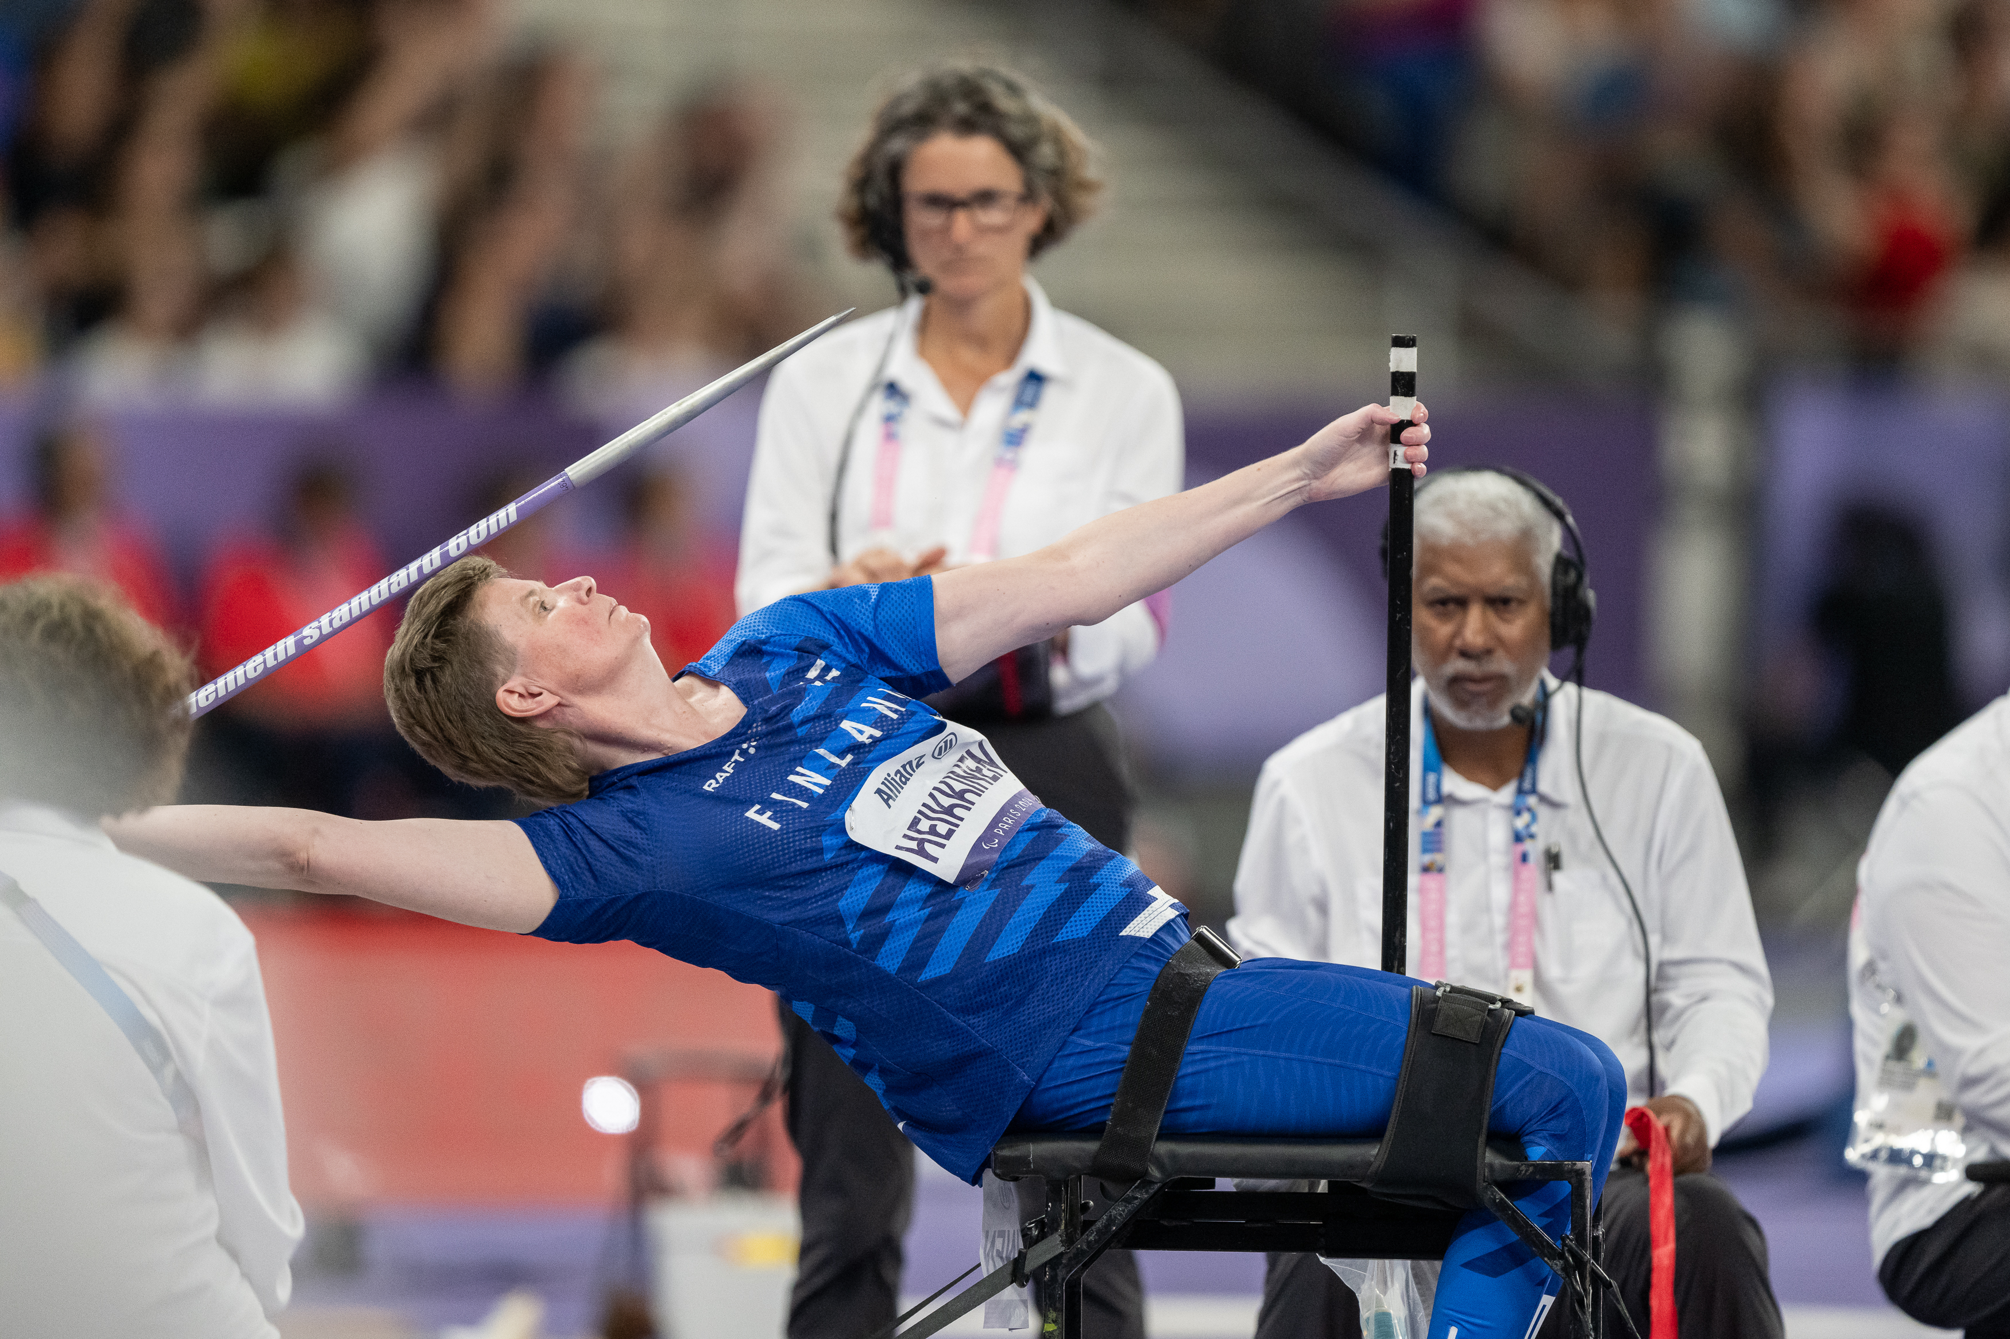
National Paralympic Committees are willing to provide a kno- how for the sport clubs and national sports federations. In Finland: Project Open Doors 2.0
  List of clubs providing inclusive sports
  Sport spesific educational materials for different disability groups
  Special Know- how for example: classification

Slide 6
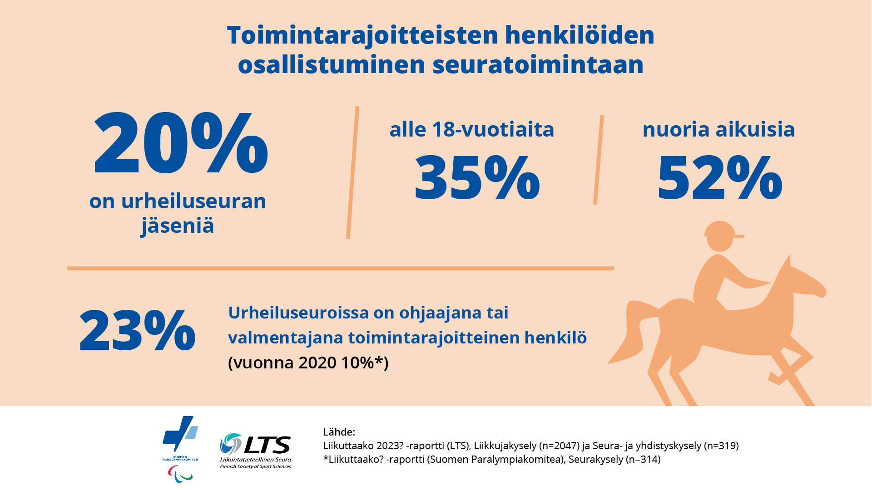

Slide 7
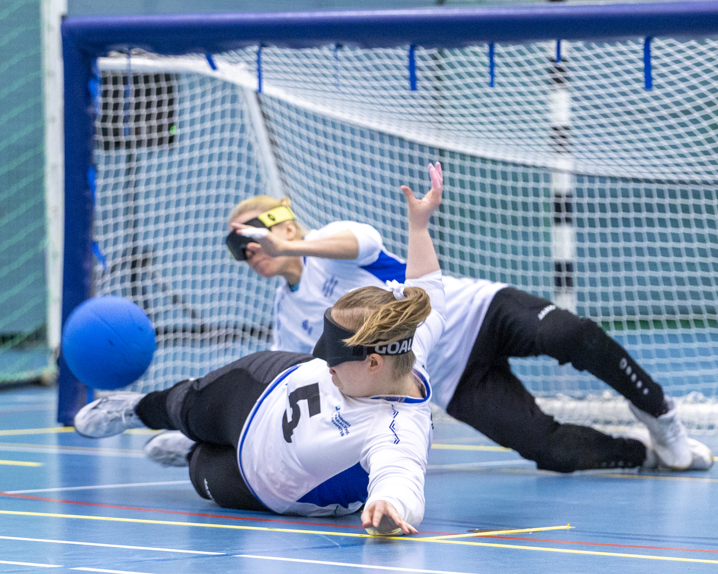
https://paralympiakomitea.kuvat.fi/kuvat/Paralympialaiset/2012%20Lontoo/Maalipallo/Maalipallo%20naiset/IMG_8109.jpg

Slide 8
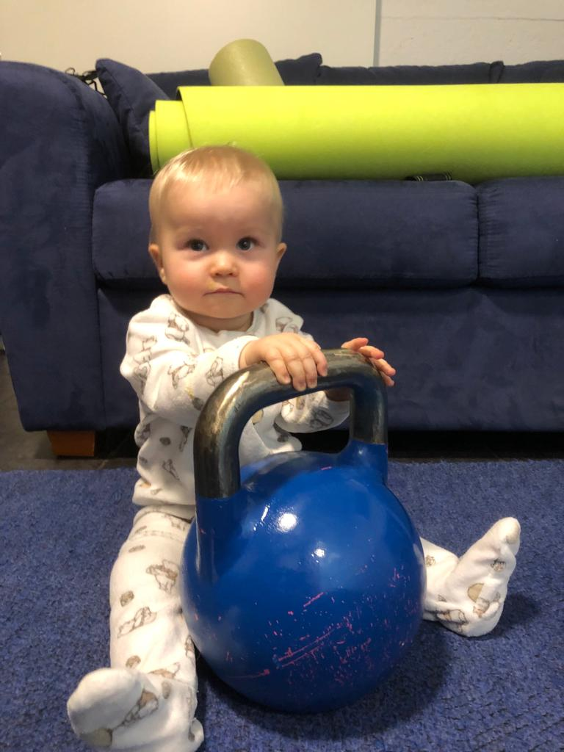
When the career is over as an athlete.
A career can begin as a coach, support personel,
Classifier, volunteer, referee.
The best way to make sure we do´t lose female athletes
Know- how, Is to tell them they are wanted and needed
nevertheless if they need a support team or for example
Maternity leave
My daughter, who was born 3 days after I got home from the national teams training camp and who has been around the sports ever since

Slide 9
https://www.paralympia.fi/uploaded/section_files/Materiaalit/Tutkimusraportit/liikuttaako_raportti-1.pdf
Abstract
Liikuttaako? A report for the survey on physical activity for persons with a disability and the related survey conducted with sports clubs. Aija Saari (ed.), Finnish Paralympic Committee 2021
https://www.paralympia.fi/uploaded/section_files/Materiaalit/Tutkimusraportit/kaikille_avoimen_liikuntakulttuurin_esteet_ja_nosteet_2011.doc
Summary
Promotors and Hindrances of Open-For-All Sports and Physical Activity
Phase Report of Finnish Sports Federations
Abstract Liikuttaako? A report for the survey on physical activity for persons with a disability and the related survey conducted with sports clubs. Aija Saari (ed.), Finnish Paralympic Committee 2021 T

Slide 10
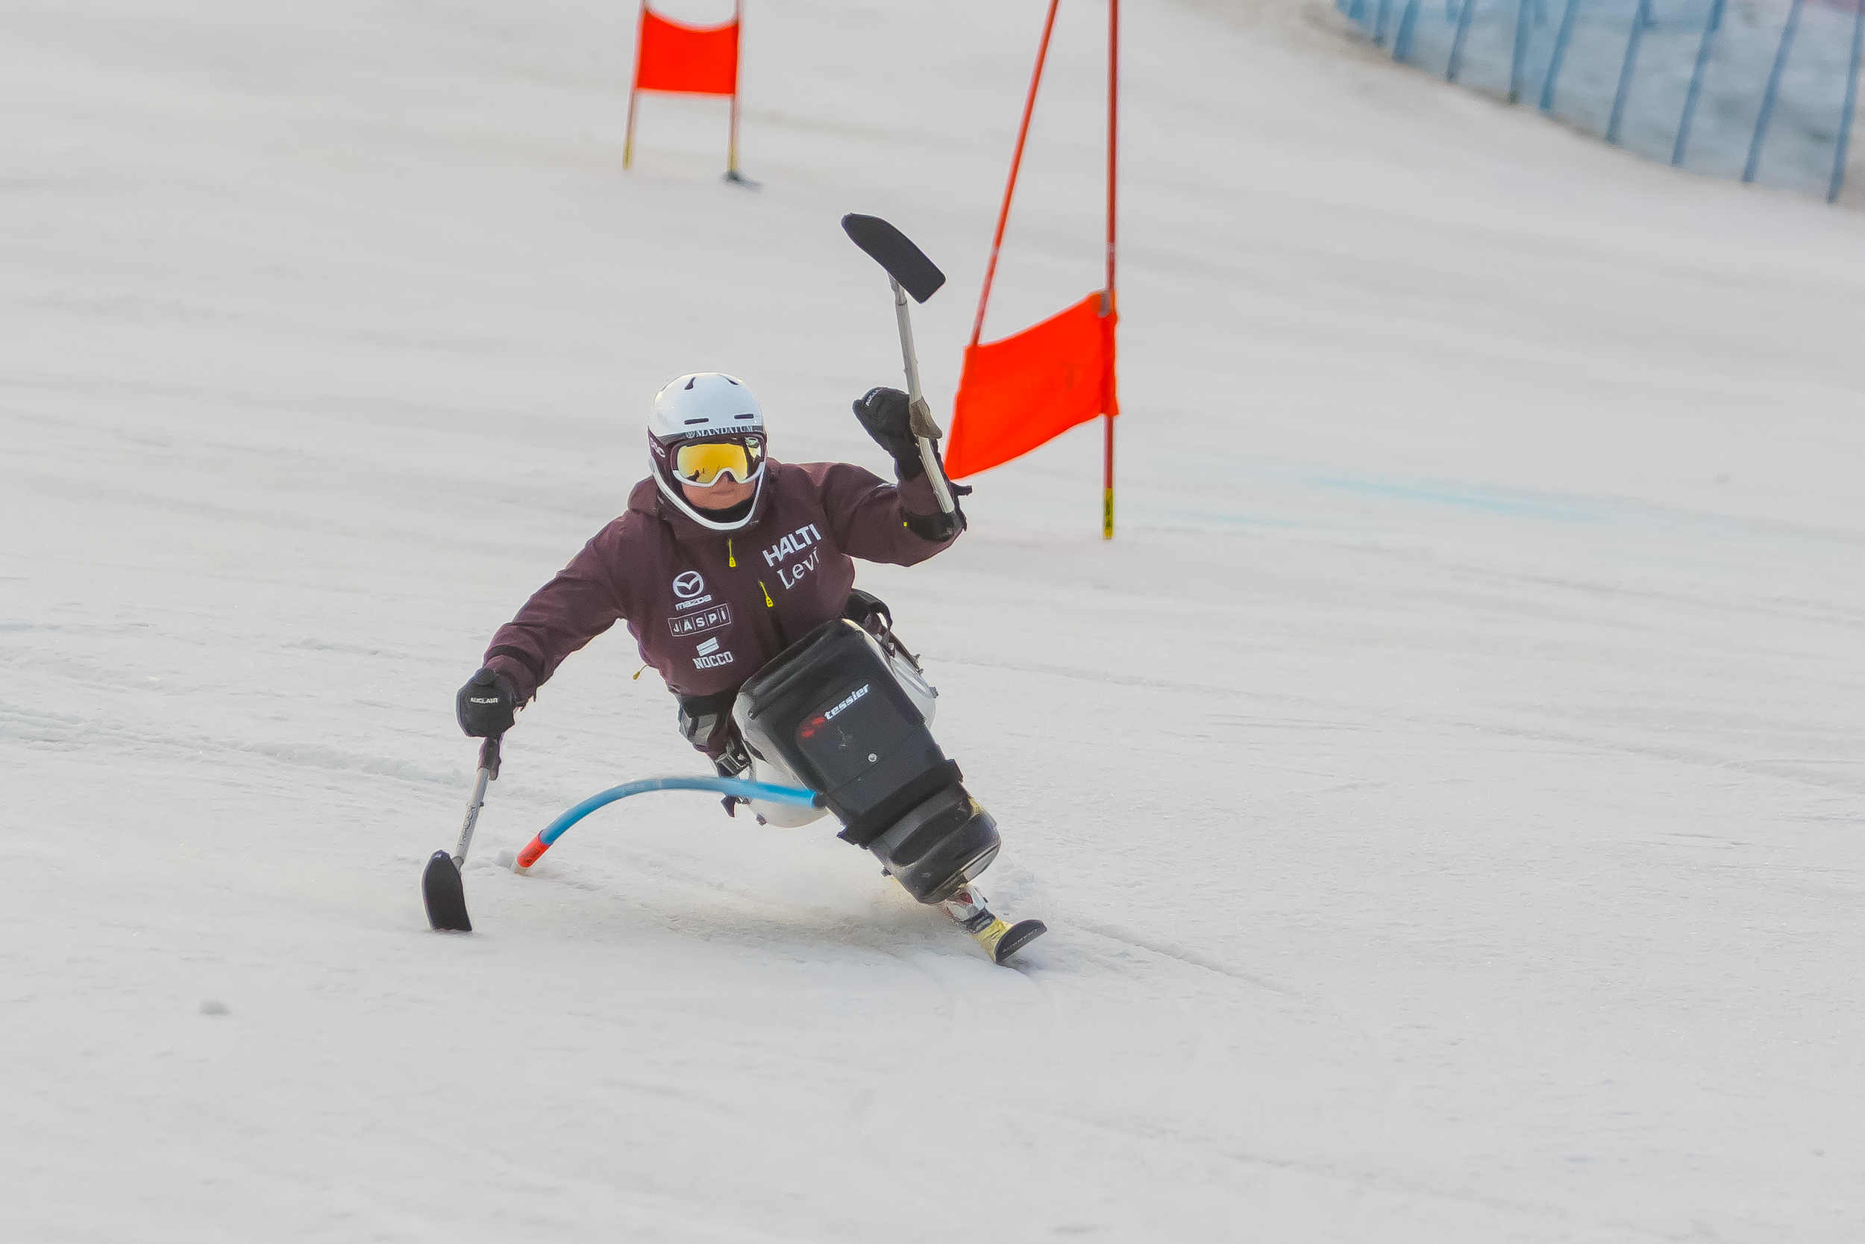
Pictures: Finnish Paralympic Committees media archives

