Slide 1
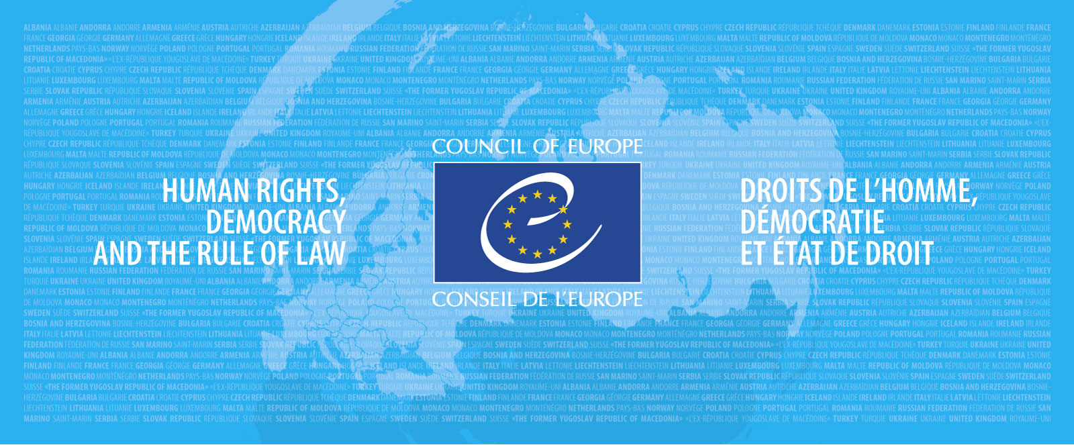
HELP module on trafficking in human beings for the purpose of labour exploitation
Petya Nestorova
Executive Secretary of the
CoE Convention on Action against
Trafficking in Human Beings

Slide 2
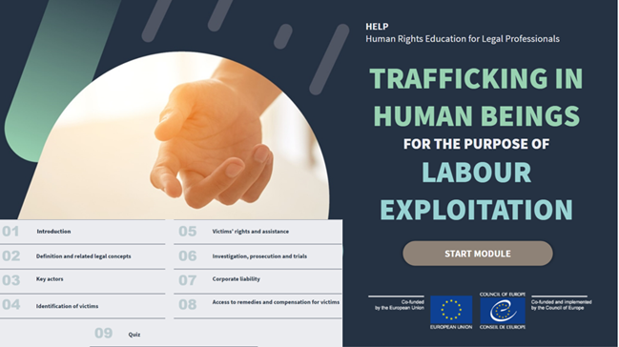

Slide 3
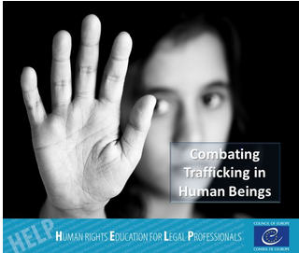
HELP course on combatting trafficking in human beings and protecting its victims
Context
Trafficking for labour exploitation is a major challenge in Europe
Relevant both for combating trafficking in human beings and for protecting labour rights
Reflects the work of GRETA, ECtHR and European Committee on Social Rights
Notes:
The free online course on Combatting trafficking in human beings and protecting its vicims was developed jointly between the Council of Europe Convention on Action against Trafficking in Human Beings and the HELP Programme.
Trafficking in human beings is a serious crime. It is also a grave violation of human rights, which affects thousands of victims every year, also in Europe.
Trafficking in human beings, with the entrapment of its victims, is the modern form of the old worldwide slave trade. It treats human beings as a commodity to be bought and sold, and to be put to forced labour, usually in the sex industry but also, for example, in the agricultural sector, declared or undeclared sweatshops, for a pittance or nothing at all.
Most identified victims of trafficking are women but men are also victims of trafficking in human beings. Furthermore, many of the victims are young, sometimes children.
Action to combat this persistent assault on humanity is one of a number of fronts on which the Council of Europe is battling on behalf of human rights and human dignity.
The course is designed to equip judges, prosecutors, lawyers, law enforcement officials and other (legal) professionals to effectively apply the standards developed under the Council of Europe Convention on Action against Trafficking in Human Beings (the CoE Convention) in their daily work. It introduces the users to the definitions and legal concepts of human trafficking and provides an overview of other relevant international instruments. It is build up from a human rights perspective and focuses on victim protection.

Slide 4
Learning objectives
Legal definition and concepts
Key actors
Indicators
Challenges of identification
Victims’ rights
Investigation, prosecutions and trials
Corporate liability
Compensation and other remedies

Slide 5
Case studies
Agriculture (grapes harvest, France)
Domestic work
Pallet factory in Belgium
Role of labour inspectors
Multi-disciplinary cooperation
Recruitment agencies (abuses)
Indicators for the identification of victims
Collection of evidence

Slide 6
Relevant case-law of the European Court of Human Rights
V.C.L. and A.N. v. United Kingdom
Chowdury and others v. Greece
Compensation and other remedies
Non-punishment provision

Slide 7
HELP course on combatting trafficking in human beings and protecting its victims
Course outline
Introduction and legal framework
Definitions and legal concepts
Identification of victims of human trafficking
Assistance for victims of human trafficking
The non-punishment provision
Investigation, prosecution and victims’ rights
Sentencing
Compensation for victims of trafficking
Return and repatriation
Notes:
The course is composed of 9 modules (details for each module in following slides):
Introduction and legal framework: the human trafficking problem, the Council of Europe response, the CoE Convention and its monitoring.
Definitions and legal concepts: the definitions and legal concepts contained in the CoE Convention and other relevant international instruments.
Identification of victims of human trafficking: the importance of victims’ identification, the States’ duty to identify victims, the cooperation with NGOs in victims’ identification.
Assistance for victims of human trafficking: rights of victims to assistance and support and the related States’ obligations, the effects of trauma and victimisation on the physical and mental health of victims, minimum standards of care that States must provide to the victims, right to recovery/reflection period and the rules for its application, minimum conditions for granting a temporary residence status to victims of trafficking.
The non-punishment principle: the legal nature and scope of the non-punishment principle, the difference of its application to children’s cases and to adult cases, the meaning of compulsion, States’ obligations to apply the principle.
Investigation, Prosecution and victims’ rights: the peculiarity of investigation and prosecution in human trafficking cases, the relevance of the protection and assistance of victims and witnesses, the relevance of seizing and securing assets from the outset.
Sentencing: criteria that should be taken into consideration when deciding on the severity of sanctions: retribution, general prevention, special prevention and reparation.
Compensation for victims of human trafficking: the relevance of compensation in human trafficking cases, the material and immaterial damages covered by compensation, the source of compensation (the perpetrator or the State).
Return and Repatriation: international standards, safe, dignified and preferably voluntary return, requirements for returning child victims, the non-refoulement principle.

Slide 8
HELP course on combatting trafficking in human beings and protecting its victims
Structure of the modules
Aims of each module
Legislative framework
Definitions
Typical difficulties and solutions
Case law
Practical examples
Additional materials
Knowledge text

Slide 9
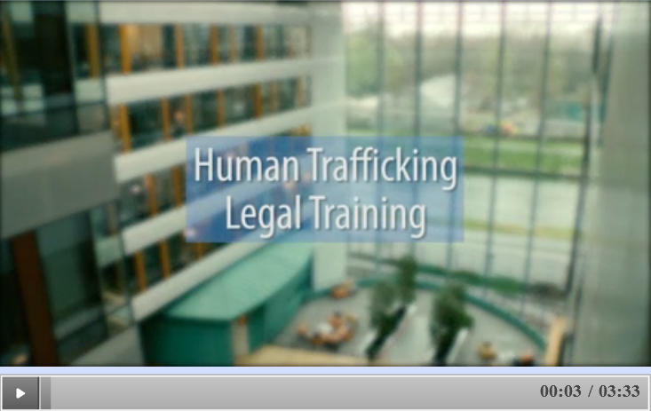
HELP course on combatting trafficking in human beings and protecting its victims
Notes:
Bridget O’Loughlin – Executive Secretary of the Monitoring Mechanism of the Council of Europe’s Instanbul Convention

Slide 10
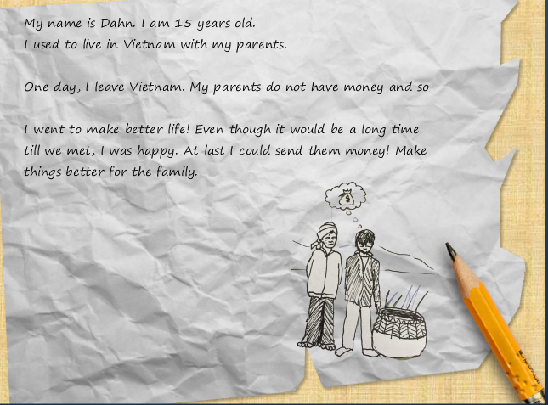
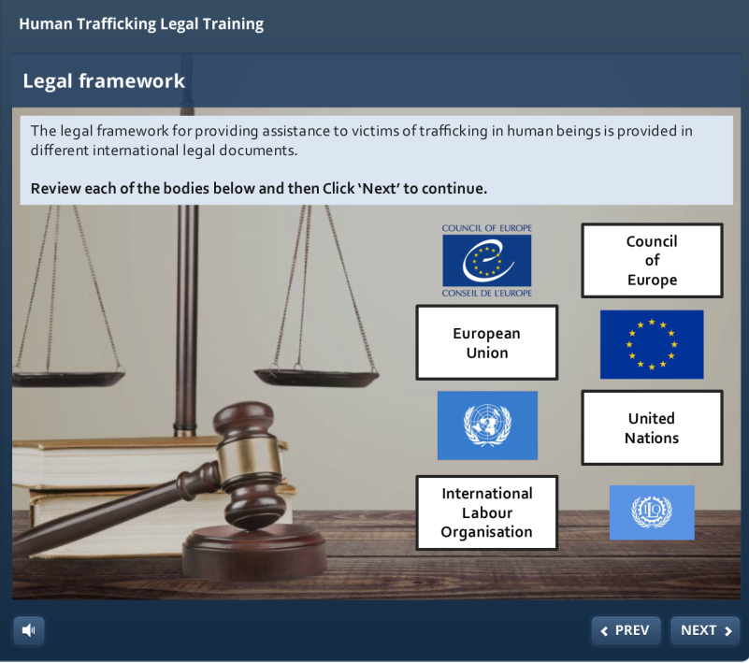
Module 1 : Introduction and Legal Framework
1.Introduction
Human trafficking as a criminal offence and a human rights violation
Legal Framework:
UN, ILO Conventions
Focus on the CoE response, the CoE Convention and its monitoring.
European Convention on Human Rights

Slide 11
Modules 2 and 3
2. Definitions and legal concepts: contained in the CoE Convention and other relevant international instruments
3. Identification of victims of human trafficking:
States’ duty to identify victims
Co-operation with NGOs
Children

Slide 12
Modules 4 and 5
4. Assistance for victims of human trafficking:
rights of victims to assistance and support and related States’ obligations
effects of trauma and victimisation on physical and mental health
minimum standards of care provided by States
right to a recovery and reflection period
granting a temporary residence permit to victims of trafficking
5. The non-punishment principle:
legal nature and scope
particularities in the case of children and adults
compulsion
States’ obligation to apply the principle

Slide 13
Course videos
Notes:
In this video, CoE’s Commissioner on Human Rights coments on how VAW is spread in European countries and how damaging gender stereotypes are.
Interview with Feride Acar, President of the Group of Experts on Action against VAW and DV (Grevio).

Slide 14
Modules 6 and 7
6. Investigation, prosecution and victims’ rights
Pro-active investigations
protection and assistance of victims and witnesses
seizing and securing assets from the outset
International co-operation
7. Sentencing:
Criteria when deciding on the sanctions
aggravating/mitigating
circumstances
factors which should not be
taken into account

Slide 15
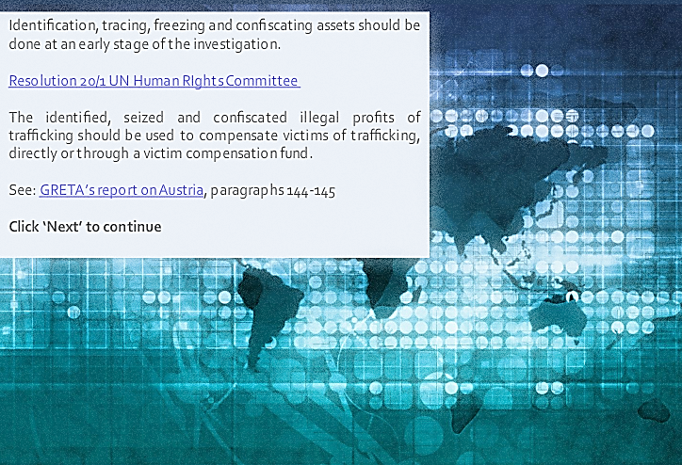
Modules 8 and 9
8. Compensation for victims of human trafficking:
Material and immaterial damages
Source of compensation (the perpetrator or the State)
9. Return and repatriation:
International standards
Safe, dignified and preferably voluntary return
Returning child victims
Non-refoulement

Slide 16
HELP course on combatting trafficking in human beings and protecting its victims
Relevant case-law of the European Court of Human Rights
Siliadin v. France (26 July 2005)
Rantsev v. Cyprus and Russia (7 January 2010)
C.N. v. United Kingdom (13 November 2012)
C.N. and V. v. France (11 October 2012)
L.E. v. Greece (21 January 2016)
Chowdury and others v. Greece (30 March 2017)

Slide 17
HELP
Good training for good judgments
Thank you very much for your attention!
CoE Convention on Action against THB: Petya.Nestorova@coe.int
HELP Head of Unit: Eva.PASTRANA@coe.int
HELP - Universities: Ana.MEDARSKA-LAZOVA@coe.int

