Slide 1
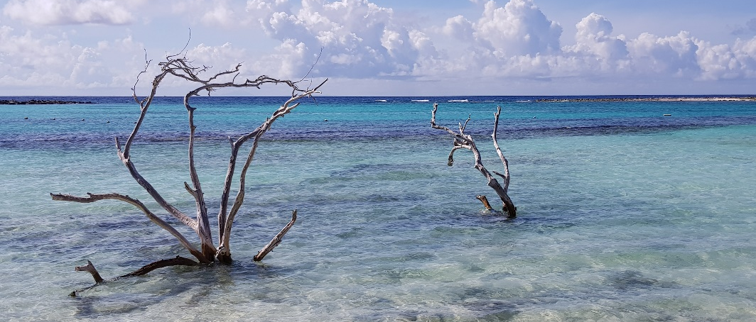
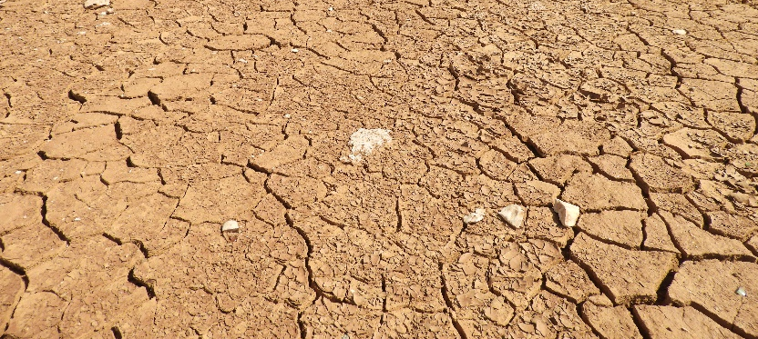
Nature-based solutions and management of protected areas in the face of climate change
Results, conclusions and recommendations resulting from a survey of policy and actions by Contracting Parties to the Bern Convention carried out in 2022
Prepared by: Lawrence Jones-Walters

Slide 2
Introduction and context
Biodiversity loss and climate change are driven by human economic activities and mutually reinforce each other.
Neither of them can be resolved unless they are tackled together.
Contracting Parties have been tasked to take action to adapt to the impacts of climate change on biodiversity
Both in relation to protected areas and for the realisation of nature-based solutions.

Slide 3
The survey
Recommendation No. 206 (2019) of the Standing Committee to the Bern Convention “the Contracting Parties should report in 2022 on the progress made on the implementation of the Recommendation”.
To assist the Contracting Parties with the reporting, Secretariat developed a questionnaire on biodiversity and climate change.
The survey was completed in March 2022.

Slide 4
The headings of the report:
Policy and strategy (Questions 1-6)
Nature-based solutions in the face of climate change (Questions 7-16)
Management of protected areas in the face of climate change (Questions 17-30)
Communication and capacity building (Questions 31-43)

Slide 5
Overview
4 topics
43 questions in total
Sent to 51 Contracting Parties
20 provided responses
39%

Slide 6
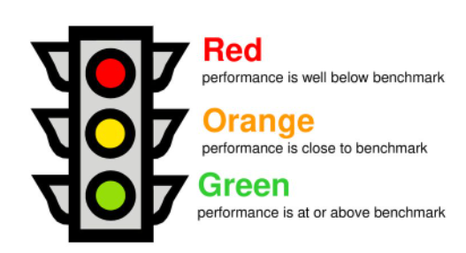
Performance
A traffic light system has been used to indicate performance in relation to the various sections of the report.
The position of the arrow indicates performance.

Slide 7
Outcomes & Recommendations

Slide 8
1. Policy and strategy (Summary)
Performance is close to the benchmark

Slide 9
1. Policy and strategy (Outcomes)
All countries are planning to develop a strategy which addresses climate change and biodiversity.
Almost 80% have a ratified strategy, a completed strategy waiting for ratification, or a strategy in development.
Among the ratified strategies, all of them have targets that should be delivered within 10 years or sooner.
However, the delivery of actions and the achievement of targets is highly variable.

Slide 10
1. Policy and strategy (Potential areas for action)
Initiate training in content and best practice in relation to the development of strategies linking climate change and biodiversity for officers at national, regional and local level.
Target cross ministry (or cross departmental within ministries) training and where possible use local experts to deliver content. (If appropriate use guests from different countries to give masterclasses).
Raise awareness of politicians and senior decision makers of economic and social benefits of taking measures for climate change and biodiversity.

Slide 11
2. Nature-based solutions in the face of climate change (Summary)
Performance is below benchmark

Slide 12
2. Nature-based solutions in the face of climate change (Outcomes - 1)
Action required for future reviews to improve the majority of national climate change strategies that have poor (or no) measures for biodiversity.
National level studies and initiatives are needed to generate greater knowledge of patterns of shifts in species distributions, and which species are most vulnerable to climate change. Improving strategies, resulting in more focused action.
There is relatively good integration of nature-based solutions in both climate change and biodiversity strategies and, in some countries, they are already being delivered in practice.

Slide 13
2. Nature-based solutions in the face of climate change (Outcomes - 2)
Cultural ecosystem services such as tourism/ecotourism and recreation may improve under a changing climate.
Most programmes enhancing nature-based solutions and ecosystem services are supported by financial subsidies to some extent.
In terms of values associated with biodiversity and ecosystem services being integrated within economic analysis and decision-making processes most countries also said that this takes place to some extent.
Agricultural subsidies were cited as damaging to biodiversity by every country. Subsidies associated with fisheries and forestry policy, transport and energy sectors were also mentioned as having a negative impact.

Slide 14
2. Nature-based solutions in the face of climate change (Potential areas for action)
Initiate national review of climate change strategies in relation to inclusion of measures for biodiversity.
Promote national level studies and initiatives to generate greater knowledge of the patterns of shifts in species distributions, and which species are most vulnerable to climate change. (Could be linked to training and the involvement of experts).
Initiate national reviews of damaging subsidies to see if measures can be introduced to reduce or neutralise their impact (for instance through the promotion of nature inclusive components, particularly in relation to agriculture and fisheries).

Slide 15
3. Management of protected areas in the face of climate change (Summary)
Performance is well below benchmark

Slide 16
3. Management of protected areas in the face of climate change (Outcomes - 1)
Generally, there little progress has been made in relation to monitoring of the impact of climate change on protected areas. Sites, habitats and species under particular threat or pressure have not yet been identified.
In most cases management plans are not updated to respond to changes caused by climate change; and whilst national strategies are seen to contain detailed goals for addressing climate related issues, in many cases they have yet to be implemented.
In relation to the implementation (already carried out or not) of measures to adapt to climate change in protected areas, the integration of these aspects is in general insufficient.

Slide 17
3. Management of protected areas in the face of climate change (Outcomes - 2)
In most cases there is no assessment of how the network of protected areas responses to climate change and there are very few programmes in place to adapt the network of protected areas to climate change.
However, most countries have plans to extend the network and improve the connectivity of their protected areas. Ecological corridors are largely integrated in land use planning processes and there is evidence of good cross-country cooperation on biodiversity and climate change.
Problems include the lack of human and financial resources and the absence of sufficient data and information, especially on which species should be assessed.

Slide 18
3. Management of protected areas in the face of climate change (Potential areas for action)
Initiate programmes for the review/update of protected area management plans in relation to the need to respond to changes caused by climate change. (This needs to be combined with awareness raising and training).
Explore and evaluate methods for monitoring the impact of climate change on protected areas. Begin at biogeographical level to establish generic issues and solutions for national level implementation.
Initiate national level programmes to monitor the impact of climate change on protected areas.
Address the absence of sufficient data and information on which species should be assessed should be addressed as a priority.

Slide 19
4. Communication and capacity building (Summary)
Performance is at or above benchmark

Slide 20
4. Communication and capacity building (Outcomes - 1)
There is much awareness raising activity amongst the majority of countries, and there are broad public awareness campaigns.
Mainly: 1) national initiatives; 2) regional-local initiatives; 3) project-related initiatives. In countries with limited resources communication via projects and programmes is particularly important.
Where there are indigenous peoples their knowledge is integrated within biodiversity / climate change programmes.
For education there is existing activity in relation to both school curricula and higher education programmes.
Agriculture and forestry are two sectors that have received attention in relation to awareness-raising campaigns.

Slide 21
4. Communication and capacity building (Outcomes - 2)
In relation to the training of practitioners, the majority were carrying out or were planning to carry out training.
Training is often a component within funded projects and programmes - and this has is an important vehicle for awareness raising.
The responses to questions in relation to participation were generally positive. In some cases, legislation requires public participation but many countries recognise the important role that local communities play in the management of protected areas.
The majority of countries have had national programmes encouraging the participation of local communities in the designation and management of protected areas.

Slide 22
4. Communication and capacity building (Potential areas for action)
Establish the extent to which training programmes are in place for practitioners and officials. On this basis explore and/or initiate programmes targeted at the most urgent sectors/groups.

Slide 23
Learning points from the questionnaire
ISSUES
39% response for this survey is ‘reasonable’ but perhaps disappointing.
However, the analysis shows that the responses cover a broad spectrum of situations ranging from sophisticated and long-established approaches to the very early stages of strategy development and implementation.
In this respect the survey can be seen to provide a representative cross-section of the current situation among countries.
In some cases, in particular when the questions were relatively technical, respondents used the “don’t know” answers. This was also seen in the bar chart responses when the orange columns, a neutral “neither agree nor disagree” answer, often dominated.
LEARNING POINTS
In terms of improving the response to future surveys, particularly if the information is important for future policy and decision-making, consider virtual (online, telephone) or face-to-face interviews in future. This could also be for a representative cross-section of the countries involved.
Perhaps there could be ‘advanced warning’ of the questionnaire so that respondents could block time in (already busy) agendas. If senior staff are aware of the questionnaire, they may also be able to help their staff to plan and can encourage them to complete/check on completion.
In future with the bar charts it might be more valuable in terms of results to have only ‘agree’ or ‘disagree’ options (strongly or otherwise) and a ‘don’t know’ option – rather than a neutral option.

Slide 24
Three potential areas for ‘closer attention’
Protected areas: lack of adaptation measures in management plans & monitoring of climate change impacts
Data and information: lack of sufficient knowledge on vulnerable habitats and species at country level
Strategy Implementation: is poor, could explore potential to exchange best practice and initiate targeted training and communication

Slide 25
Thank you for your attention
Questions & discussion

