Slide 1
Cybercrime Programme Office of the Council of Europe (C-PROC)
HELP Course
on Cybercrime and Electronic Evidence
2nd Additional Protocol to the Budapest Convention

Slide 2
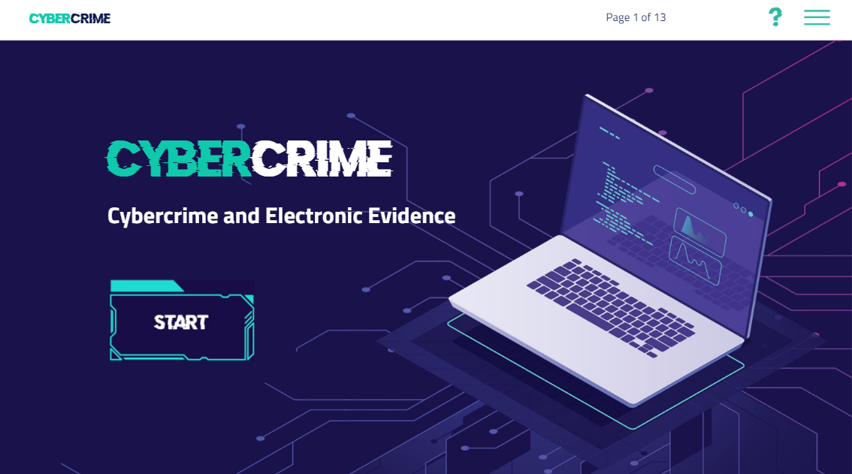
HELP Course on Cybercrime

Slide 3
HELP Course on Cybercrime:
Feedback received
HELP Course on Cybercrime:
Feedback received
The effort put on the developing of this course is noteworthy
The course improved my practical knowledge on how to apply human rights law at the national level. Thank you for this lesson.
Thank You so much for the creation of this course and a possibility to pass it. It is of great importance for legal practitioners nowadays, It challenged me to pursue my education (even after 10 of law practice) and to search for LLM in IT-law and Cyber-law, which are definitely the future of law profession. Best regards!

Slide 4
HELP Course on Cybercrime:
Authors

Slide 5
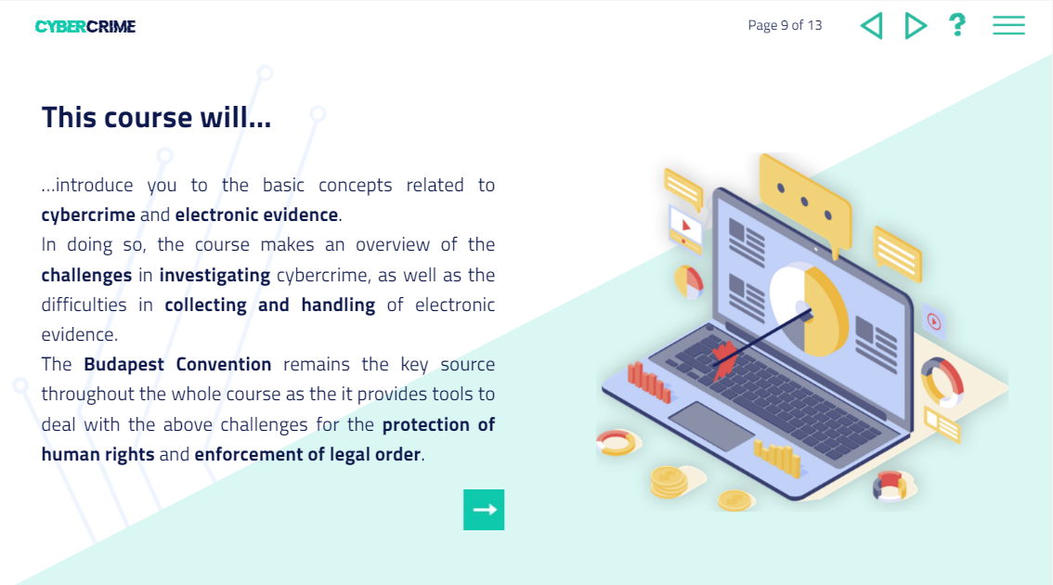
Objectives

Slide 6
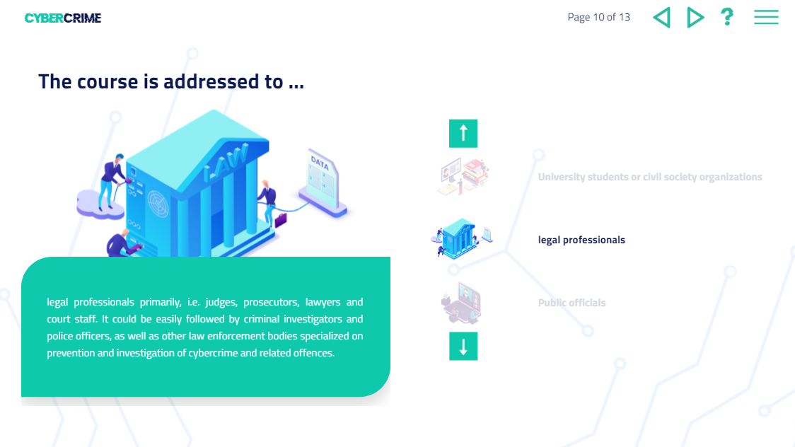
Target audience
criminal justice authorities worldwide, legal practitioners, defence attorneys, professionals for child protection, and anyone willing to improve their knowledge on cybercrime and electronic evidence.

Slide 7
Structure of the course
Module 1: Introduction to computers, networks and cybercrime
Module 2: Introduction to the Budapest Convention on Cybercrime
Module 3: Substantive provisions
Module 4: Electronic evidence and the BC procedural provisions
Module 5: International cooperation provisions
Module 6: Cybercrime in practice and Human Rights
Module 7: The Second Additional Protocol to the Budapest Convention

Slide 8
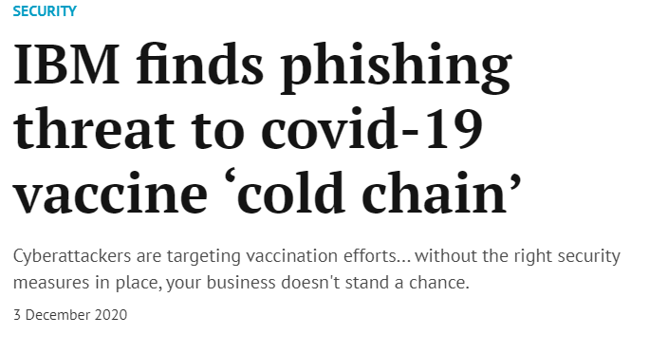
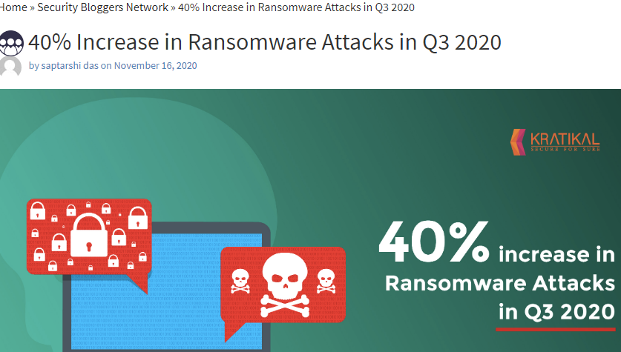
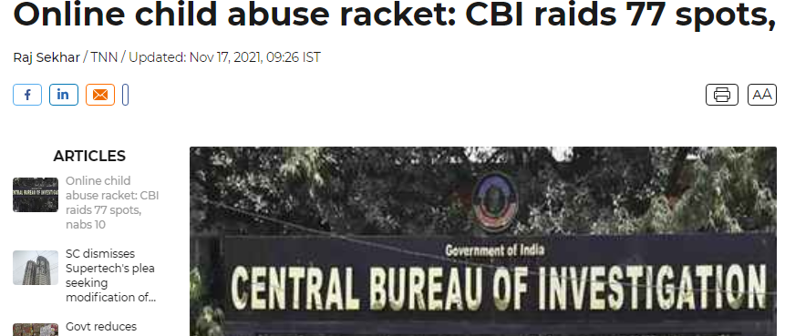
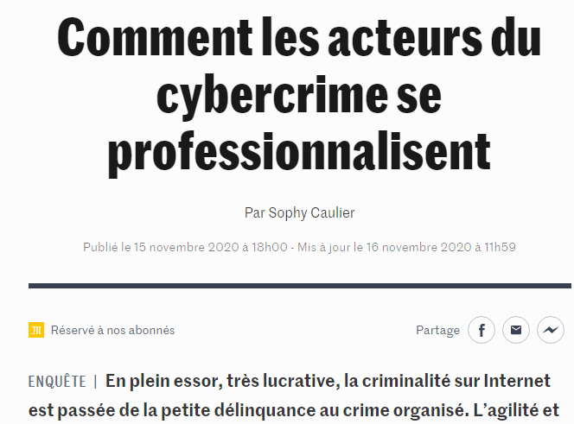
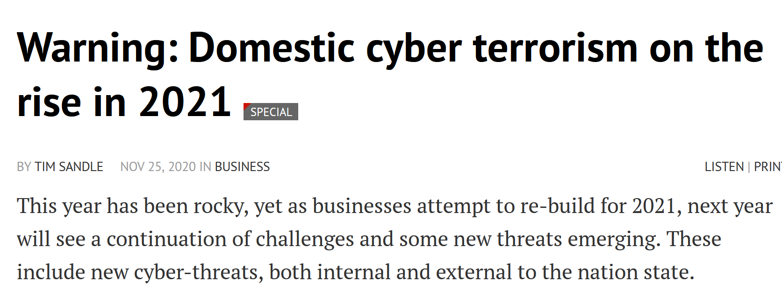
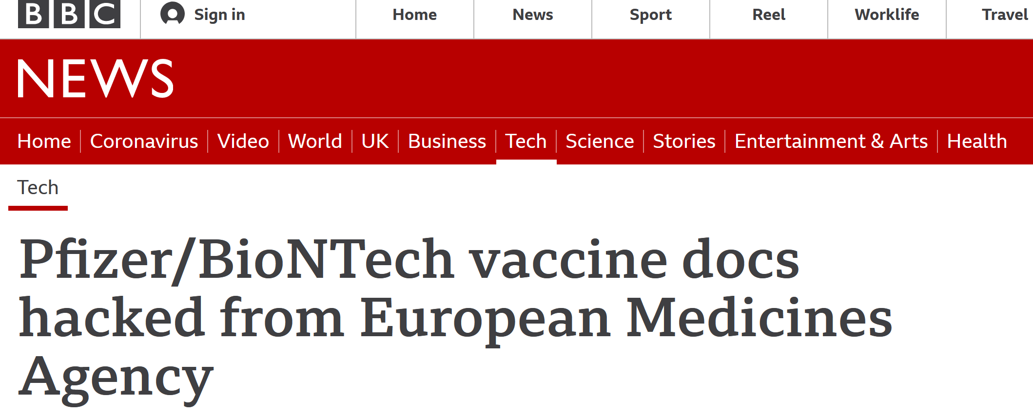
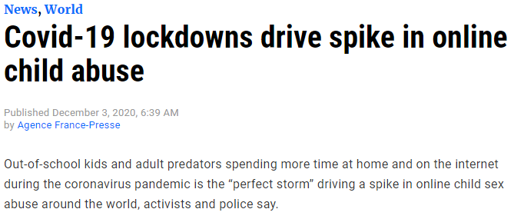
Reminder: the problem of cybercrime …
Cybercrime
Offences against and by means of computers

Slide 9
… and e-evidence re all types of crime
COVID-19 related crime
Online sexual violence against children
Violence against women
Evidence on a computer system
Election interference
ANY CRIME
Terrorism
Medicrime
Money laundering
Hate crime
Kidnapping
Drug trafficking
Murder
Corruption
Fraud

Slide 10
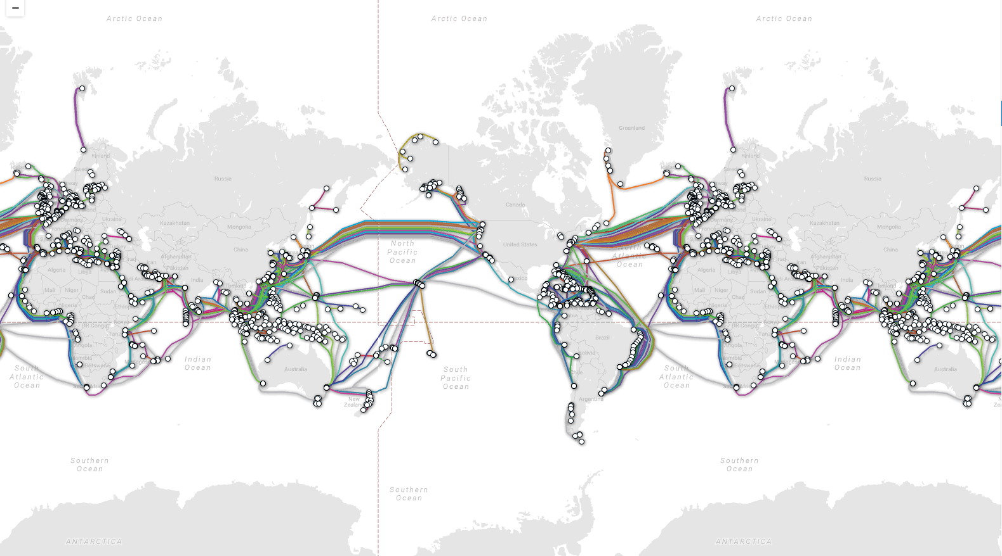
Where is the evidence?
Where is the crime?
Where is the data, where is the evidence?
Who has the evidence?
Where is the boundary for LEA powers?
►Transnational nature of cybercrime and e-evidence
►Crime and jurisdiction in cyberspace
►Need for public/private and international cooperation
www.coe.int/cybercrime
10

Slide 11
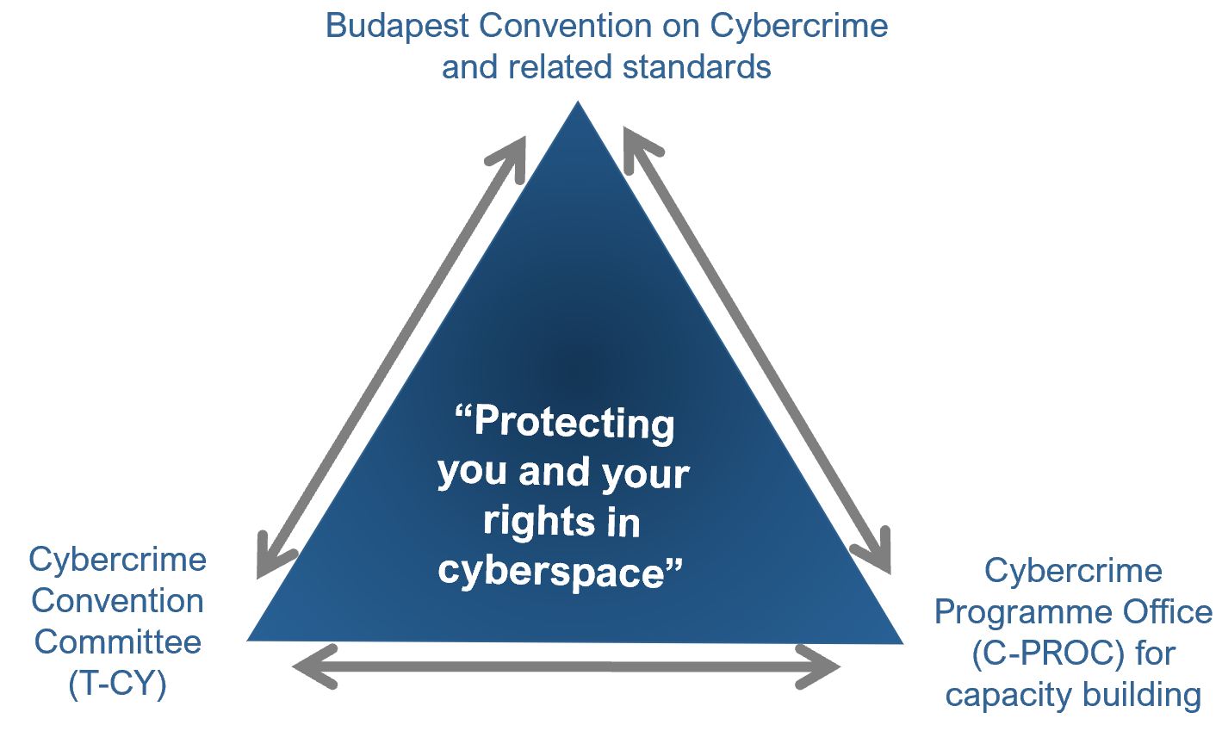
The mechanism of the Budapest Convention
Budapest Convention on Cybercrime (2001):
Specific offences against and by means of computer systems
Procedural powers with safeguards to investigate cybercrime and collect electronic evidence in relation to any crime
International cooperation on cybercrime and e-evidence
+ 1st Protocol on Xenophobia and Racism via Computer Systems
+ Guidance Notes
+ Protocol on enhanced cooperation on cybercrime and electronic evidence
By now : 66 Parties and 15 Observer States

Slide 12
Budapest Convention: scope
Criminalising conduct
Illegal access
Illegal interception
Data interference
System interference
Misuse of devices
Fraud and forgery
Child pornography
IPR-offences
+
Procedural tools
Expedited preservation
Search and seizure
Production order
Interception of computer data
Conditions, safeguards
+
International cooperation
Extradition
MLA
Spontaneous information
Expedited preservation
Trans-border Access to Data
MLA for accessing computer data
MLA for interception
24/7 points of contact
Procedural powers and international cooperation for ANY CRIMINAL OFFENCE involving evidence on a computer system!
www.coe.int/cybercrime - 12 -
Notes:
Access the whole or any part without rights
Non-public transmission of computer data to, from, within a computer system
Damaging Deletion, deterioration, alteration or suppression of computer data
Hindering of the functioning of a computer system by inputting, transmitting, damaging, deleting, deteriorating, altering or suppressing computer data
Production and possession of computer systems that do the above
Inauthentic data with the intent that it be considered or acted upon for legal purposes as if it were authentic
Input, nterference with dishonest intent of procuring economic gain
Producing, Offering, Distributing, Procuring, Possessing
IPR
Expedited preservation of computer data and traffic data
Partial disclosure of traffic data to identify the provider and the path
Production order to persons (computer data) and service providers (subscriber information)
Search and seizure of computer data (computer and any storage)
Real time collection of traffic data and interception of computer data
Criminal offences deemed to be included as extraditable offences
MLA - one another mutual assistance to the widest extent possible for the purpose of investigations or proceedings concerning criminal offences related to computer systems and data, or for the collection of evidence in electronic form of a criminal offence
Voluntary disclosure
Expedited preservation of computer data, disclosure of preserved traffic data
MLA to ask seizure, no authprization to access computer systems from home (ART 32)
24/7 points of contact (one, for investigation purposes, 24/7, expeditious collaboration and readiness to requests, trained personnel)

Slide 13
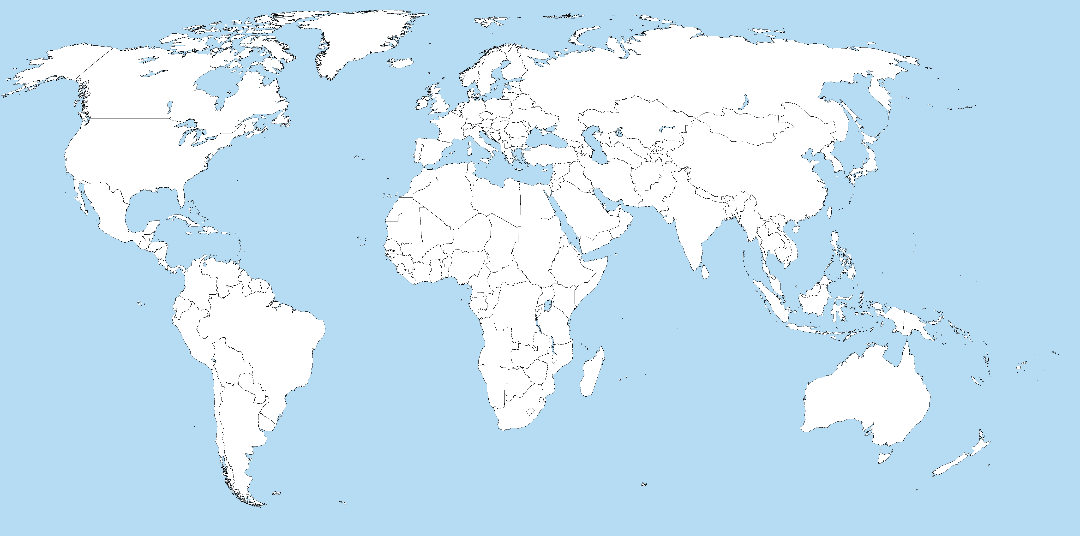
Reach of the Budapest Convention
For country-specific information see the Octopus Community at
www.coe.int/cybercrime
150+
Indicative map only
Parties: | 66
Signed: | 2 |  | Other States with substantive laws broadly in line with Budapest Convention: | 45+
Invited to accede: | 13 |  | Further States drawing on Budapest Convention for legislation: | 30+
= | 81 |  | = | 75+

Slide 14
Rationale: Why a 2nd Additional Protocol to the Budapest Convention?
Problem:
Proliferation of cybercrime
Any type of crime now involving e-evidence
Territoriality and jurisdiction: Evidence somewhere in foreign, multiple, shifting or unknown jurisdictions
MLA and e-evidence
Effective means not available to obtain the disclosure of e-evidence
Less than 0.1% of offences in cyberspace lead to prosecutions and convictions
Do victims obtain justice?
2nd Protocol to help address these challenges
www.coe.int/cybercrime

Slide 15
Rationale: Why a 2nd Additional Protocol to the Budapest Convention?
How to obtain subscriber information efficiently?
How to cooperate directly with a service provider in another Party?
How to obtain WHOIS data (domain name registration information) from registrars?
How to obtain stored data, including content, in an emergency situation?
How to make mutual assistance more effective?
How to reconcile efficient and effective measures with rule of law and data protection requirements?
www.coe.int/cybercrime

Slide 16
2nd Additional Protocol to the Convention on Cybercrime:
the process of negotiations
Prepared by Protocol Drafting Plenary and Drafting Groups established by the Cybercrime Convention Committee September 2017 to May 2021. Opened for signature on 12 May 2022
91 sessions of the PDP, PDG and PDG subgroups
75 States and several international organisations participated with over 620 experts
Data protection experts participated in negotiations
6 rounds of stakeholder consultations
= Carefully calibrated text designed to be consistent with the acquis of the Council of Europe but also to meet the requirements of all other Parties to the Budapest Convention

Slide 17
2nd Additional Protocol to the Convention on Cybercrime:
Key features
Tools of the Second Additional Protocol
Direct requests to registrars in other jurisdictions to obtain domain name registration information
Direct co-operation with service providers in other jurisdictions to obtain subscriber information
More effective means to obtain subscriber information and traffic data through government-to-government co-operation
Expeditious co-operation in emergency situations
Joint investigation teams and joint investigations
Video conferencing
+ a strong system of human rights and rule of law safeguards, including for the protection of personal data

Slide 18
THANK YOU
and
ENJOY THE COURSE!

