Slide 1
Romania’s experience in the translation and dissemination of the Judgments of the European Court
Laura Mihăilescu
Translation Coordination Unit
European Institute of Romania
www.ier.ro

Slide 2
Content
a very short presentation of the European Institute of Romania;
translation, revision and dissemination of the ECHR case-law:
what has been done
what could be done

Slide 3
European Institute of Romania
a public institution which began its activity in January 2000;
mission: provide expertise in the field of European Affairs to the public administration, the business community, the social partners and the civil society;
key areas: studies, training, translation, communication;
At present:
under the coordination of the Ministry of Foreign Affairs;
deeply involved in the preparation of Romania's Presidency of the Council of the European Union: training, communication, studies.

Slide 4
Romania: translation of the ECHR case-law
Legal basis:
set up of the European Institute of Romania (Government Ordinance 15/1998)
”c) to improve the access to Community law, to the case-law of the European Court of Human Rights and to the Romanian law relevant to the field of European affairs, as well as their understanding and implementation; […]
c) to ensure the translation into Romanian, as well as the linguistic and legal revisions of the acquis communautaire adopted before Romania’s accession to the European Union and of the case-law of the European Court of Human Rights, as well as the translation of Romanian legal texts into other official languages of the European Union, through terminological unification and coordination of the translations at national level;”
Protocol concluded between the EIR, the Superior Council of Magistracy and the Government Agent for the ECHR from the Ministry of Foreign Affairs (signed 6 April 2011)
Protocol between EIR – Superior Council of Magistracy (signed 17 July 2008)
Notes:
The ECHR case-law first mentioned in the Protocol between EIR – SCM (signed 17 July 2008)

Slide 5
Romania: translation of the ECHR case-law
since January 2009;
2009 - September 2018: 1494 documents translated/revised/sent (= 30 100 standard pages)
Notes:
Including updated documents (such as factsheets)

Slide 6
Romania: ratio of translated/revised ECHR case-law

Slide 7
Romania: translation of the ECHR case-law
translation requests (the Court, national authorities, party in a case against Romania, citizens)
priorities decided by the Government Agent for the ECHR from the Ministry of Foreign Affairs (common list with the Superior Council of Magistracy; EIR - available human resources);
translation and revision done by EIR;
documents sent to the MFA and to the Superior Council of Magistracy;

Slide 8
Romania: translation of the ECHR case-law
the Government Agent for the ECHR from the MFA decides which documents are to be published in the Monitorul Oficial;
the Government Agent for the ECHR from the MFA gives feedback to the EIR & sends the Romanian translations to Monitorul Oficial, to the Court in order to be published on HUDOC or on the ECHR site;
Some translations published on the site of the European Institute of Romania:
Factsheets
Guides
Country profiles – Romania
Publications: ECHR selection of cases; translation guide

Slide 9
Romania: translation of the ECHR case-law
each document included in the translation list is verified and registered in the database;
documents are downloaded and put in an editable format if necessary;
documents are pre-translated (eTranslation, SDL Trados) – if possible;
documents are translated (translators aided by server-based CAT tool);
documents are revised (by persons which graduated a Faculty of Law);
terminology issues are discussed and the result is included in SDL MultiTerm;
documents are sent to the MFA and to the SCM (some documents are also published on the EIR site);
in-house databases are updated (documents; server-based translation memory and terminology);

Slide 10
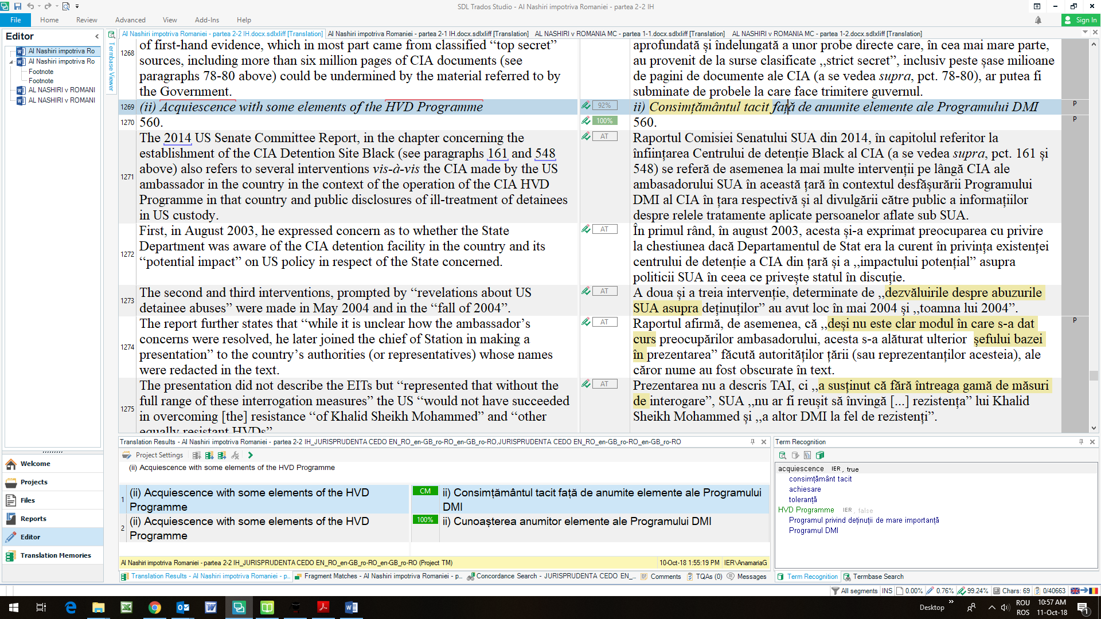

Slide 11
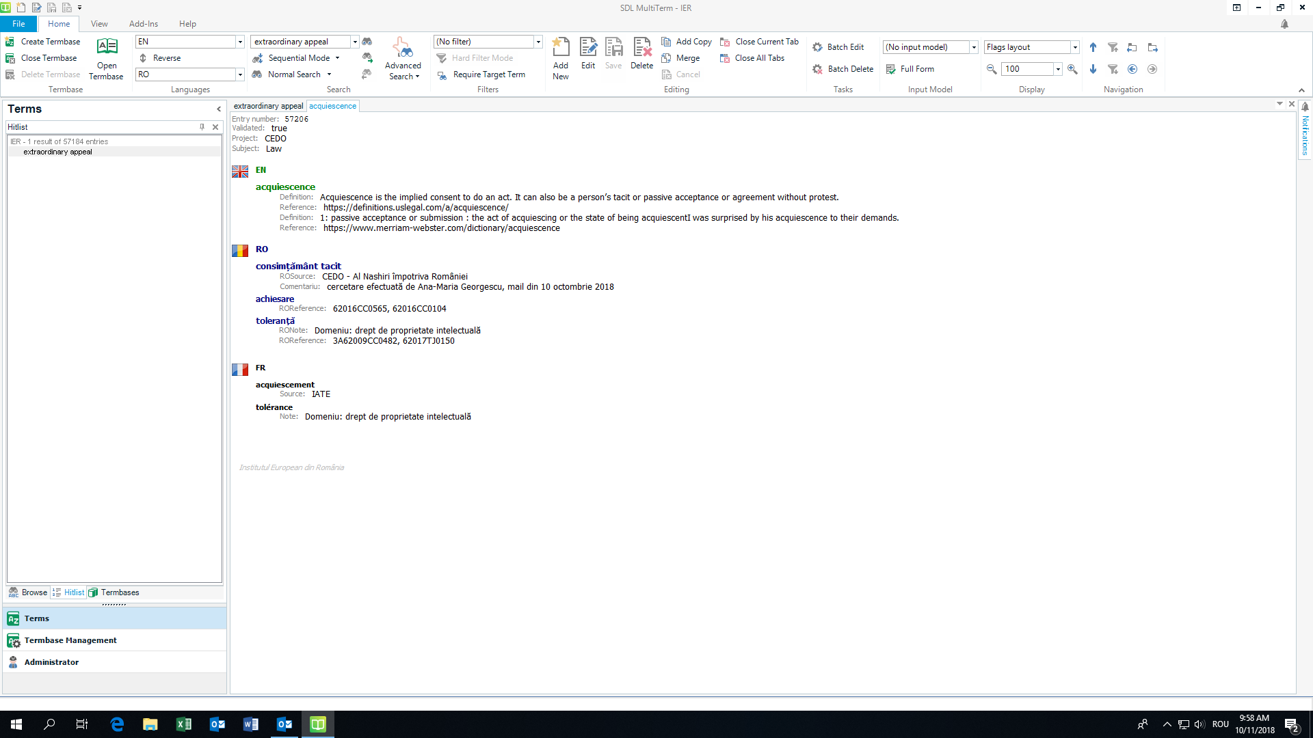

Slide 12
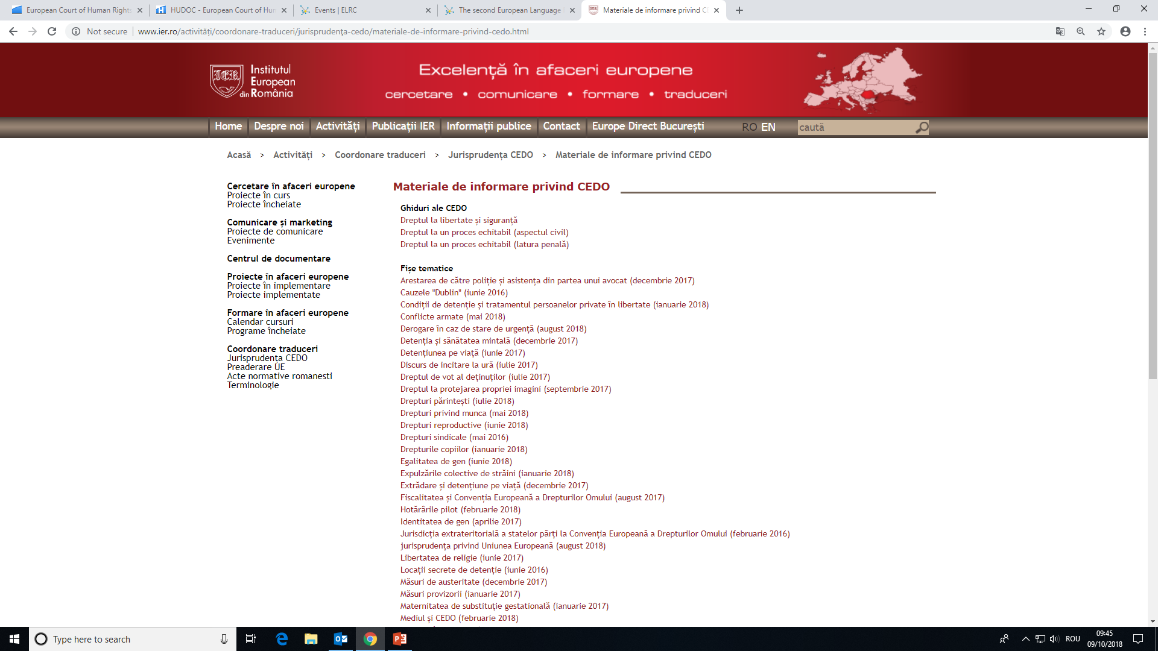

Slide 13
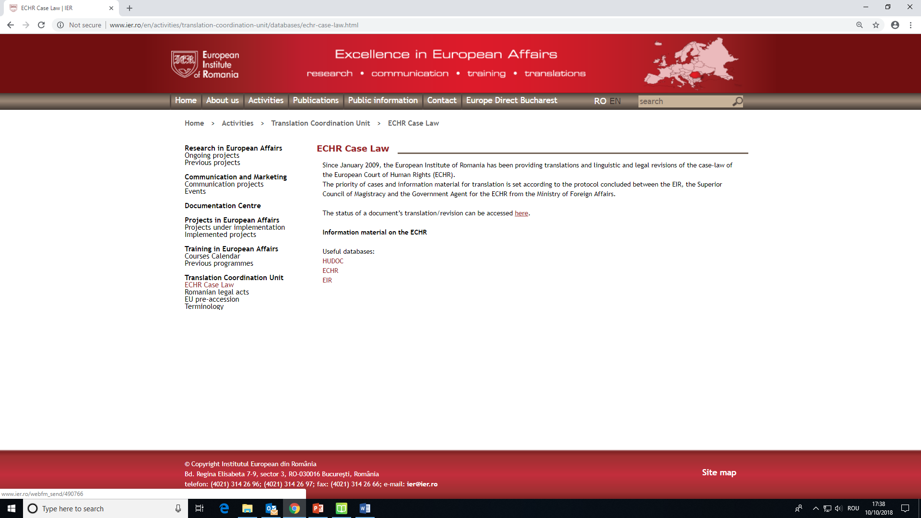

Slide 14
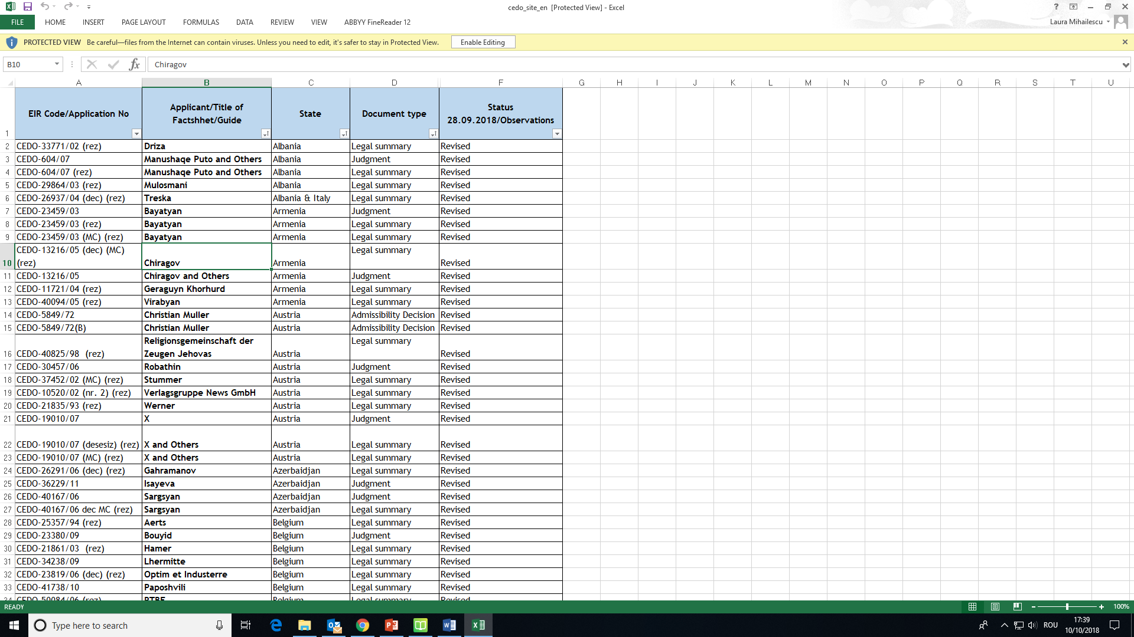

Slide 15
Romania: translation of the ECHR case-law - Challenges
limited human resources;
expensive CAT tools and training;
lack of time for training;
terminology issues;
citations;
some ECHR case-law documents only available in pdf format or time consuming to obtain them in an editable format;
translation is an underrated activity, in general;

Slide 16
What could be done
translation lists available online;
case-law available also in editable format (Word);
common identifier for case-law documents (legal summaries, judgements – final or not, judgements – Grand Chamber, guides, factsheets etc.);
raising awareness of the importance of translated case-law (which should be available online, free of charge);
training in the case-law (not only translators, revisers, terminologists and lawyers), but also the general public (school curriculum);
a national centralised unit translating and revising the ECHR case-law, in each country (with the financial means to do it);
regular exchange of good practices.

Slide 17
Thank you for your attention!
Laura Mihăilescu Translation Coordination Unit European Institute of Romania www.ier.ro
laura.mihailescu@ier.gov.ro

