Slide 1
CASE FLOW DATA ANALYSIS AND RESULTS

Slide 2
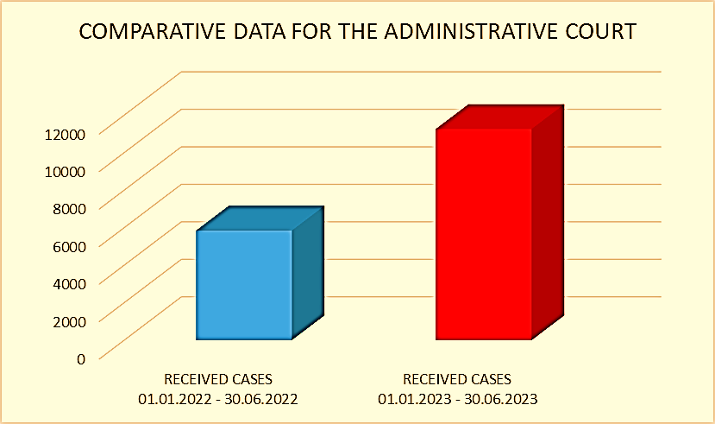
SPECIFIC CHALLENGES RELATED TO COURT EFFICIENCY
Improving the efficiency of the court is crucial for building public confidence in the judicial process.
the first half of 2022-5856 cases were received
the first half of 2023-11267 cases were received
92,40%

Slide 3
HIGH COURT IN PODGORICA
AT THE BEGINNING OF 2022, ALMOST ALL JUDGES IN THE FIRST-INSTANCE CRIMINAL DIVISION CEASED THEIR FUNCTIONS
SELECTED TO A HIGHER COURT
A JUDGE WHO ACHIEVED SIGNIFICANT RESULTS HAS BEEN APPOINTED TO ANOTHER POSITION

Slide 4
MEASURES FOR IMPROVING THE EFFICIENCY OF THE COURT
IMPROVING THE EFFICIENCY OF COURT IS IN THE JURISDICTION OF THE COURTS
COURTS CREATE A PLAN AND PROGRAM FOR RESOLVING BACKLOG CASES EACH YEAR
STRATEGY FOR JUDICIAL REFORM 2024-2026 AND ACTION PLAN FOR THE IMPLEMENTATION OF THE JUDICIAL REFORM STRATEGY

Slide 5
DATA COLLECTED IN THE JUDICIARY FOR THE PURPOSE OF MONITORING AND ANALYZING CASE FLOW

Slide 6
STATISTICAL OVERVIEW OF THE WORK OF COURTS
TOTAL NUMBER OF JUDGES
DELEGATED
UNRESOLVED AT BEGINNING
AVERAGE RESOLVED PER JUDGE
TOTAL
OLD ( OLDER THEN 3 YEARS )
UNRESOLVED AT THE END
RECEIVED
TOTAL
OLD
AVERAGE MONTLY INFLUX PER JUDGE
AVERAGE UNRESOLVED PER JUDGE
TOTAL OF PENDING CASES
TOTAL
OLD
RESOLVED
TIMELINESS RATE
TOTAL
MERITORIOUS
OLD

Slide 7
EFFICIENCY OF THE WORK OF COURTS UPON CEPEJ INDICATORS
•TOTAL NUMBER OF EMPLOYEES
•UNRESOLVED AT BEGINNING OF THE REPORTING PERIOD
•TOTAL RESOLVED IN REPORTING PERIOD
•RESOLVED BACKLOG IN REPORTING PERIOD
•UNRESOLVED AT THE END OF THE REPORTING PERIOD
•THE CASES FLOW COEFFICIENT
•TIME NECESSARY TO RESOLVE CASES
•EFFICIENCY RATE
•TOTAL NUMBER OF BACKLOG CASES
•TIME NECESSARY FOR RESOLVING TOTAL NUMBER OF BACKLOG CASES(IN MONTHS)

Slide 8
TIME FRAMES THAT DEFINE THE BACKLOG
BACKLOGS ARE CASES THOSE IN WHICH MORE THAN THREE YEARS HAVE PASSED SINCE THE INITIATION OF PROCEEDINGS AND THEY ARE GIVEN PRIORITY IN RESOLUTION.
IT ISN’T IN LINE WITH CEPEJ METHODOLOGY

Slide 9
TRAINING ON TOOLS FOR IMPROVING EFFICIENCY
ANALYSIS OF THE EFFICIENCY OF JUDICIAL INSTITUTIONS
RECOMMENDATIONS FOR IMPROVING THE EFFICIENCY OF COURT FUNCTIONS
23.11.2023. PRESENTATION OF THE ANALYSIS

Slide 10
THANK YOU FOR YOUR ATTENTION!
Do you have any questions?
nadja.nenadovic@sudstvo.me
+382 69 659 605
www.sudovi.me
Please keep this slide for attribution

