Slide 1
Harmonization of processes: a response that reconciles the efficiency of the public service of Justice and wellbeing at work
1st instance court of Luxembourg, Belgium
Moldova State University, Law Faculty
Cristal Scales - Junior Edition
2020 Edition

Slide 2
Outline
Project analysis
Harmonization of Processes
Key elements of Harmonization of Processes
Benefits of the harmonization
Possible implementation in Republic of Moldova
Conclusions

Slide 3
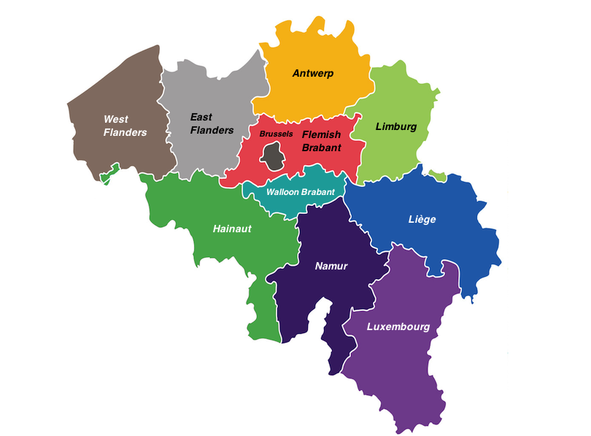
1. Project analysis
In 2014 the Belgian justice reform aimed at reducing the number of judicial districts
This was the case for the Arlon, Neufchateaux and Marche that merged to create the Luxembourg tribunal of first instance
The reform aimed at reducing the number of court workers

Slide 4
2. Harmonization of Processes
To this end all work procedures had to be analysed in order to adapt them to the new structure of the newly created Luxembourg tribunal of first instance.
Creation of different working groups that analysed the relevant working procedures and created a scheme of all the processual stages that a case follows.
This was done for all the different cases, starting with the family, civil and criminal cases.

Slide 5
3. Key elements of Harmonization of Processes
1. Judge rapporteur
2. Working group from 3 courts
3. Common analysis of the existing working procedures
1. Presentation of a common harmonized working procedure
2. Consulting the harmonized working procedure
3. Implementing suggestions
1. Presenting the harmonized working procedure after the implementation of the suggestions
2. Choosing the best option after the consultations
1. Applying the agreed harmonized process in practice
2. Identifying possible improvements
The best harmonized process is chosen
The best practices are applied
The analysis of the existing process
The harmonized process is analysed

Slide 6
4. Benefits of the harmonization
This allowed for a deep revision of the daily activities of the 3 concerned courts.
This was done to make good use of the human resources and increase the efficiency of the work.
At the same time the guides represent a very useful tool in the daily activity of the court workers that where able to consult them and present them to newly employed workers

Slide 7
5. Possible implementation in Republic of Moldov
The steps of harmonizing the working procedures in Moldavian courts is very much possible following the next steps
Using and adjusting the pre established methodology developed by the workers of the Tribunal of first instance of Luxembourg
Creating working groups, in Moldavian courts that will bring together the professional workers of the respective courts and allow them to decide over the working procedures
Implementing different working procedures and choosing the best one as the final one
Support from the central authorities with adjusting the legal framework to fit the changing process
Creating guidelines that will help court workers

Slide 8
6. Conclusions
Harmonization of processes is based on the initiative of the court workers that best understand their daily tasks and activities
A success story on how working procedures can be improved in order to overcome the challenges of insufficient human resources and an increasing amount of work
Using the same methodology other countries can apply the harmonization of processes in order to overcome the same challenges
The active involvement of the court workers was the key element that contributed to this success together with the support of the central authorities

Slide 9
Thank You !

