Slide 1
Level 5 qualifications
in the French Community of Belgium

Slide 3
Wallonia
French Community
Compulsory education
Higher education
Adult education

Slide 4
Higher education
Full-time higher education
Adult higher education
Universities
6
University colleges
20
EQF : 6-7-8
EQF : 6-7
EQF : 5-6-7

Slide 5
Adult education:
Some figures
158 Continuing Education Institutions

Slide 7
Aims of Adult education:
To enhance individual fulfilment by promoting a better professional, social, educational and cultural integration;
To meet training needs and demands from companies, public administrations, education and more generally socio-economic and cultural sectors.
Agreements with public or private partners.

Slide 8
Audience and its needs
Individuals from different generations (from 15), with various educational backgrounds, various life or professional experiences, wishing to acquire, develop, update their skills;
Initiation, remediation, qualification, completion, reorientation, retraining,...

Slide 9
Study levels:
Certificates or degrees :
either of lower education level (from level 1 to 4 of the European qualification framework)
or of higher education level (from 5 to 7).
Study programmes of adult education : organized as a coherent modular system of course units that students can capitalize.
It allows both flexibility in the organization of their studies and national and international mobility.

Slide 10
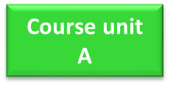
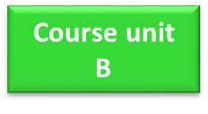
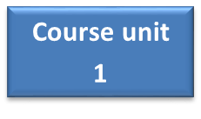
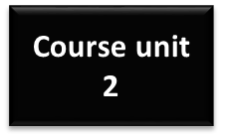
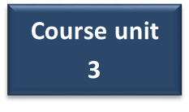
Modular system:
1 section

Slide 11
Organization
Autonomy of each institution;
Dynamic training process enabling people to combine studies and career throughout their life;
Continuous or occasional and evening or day courses;
The students attend the suggested courses planning of the academic year or can customize it in accordance with their personal or professional constraints and previous acquired experience / skills (90 ECTS MAX - 30 to be attended).

Slide 12
Quality assurance (1)
Adult education quality assurance system is based on the articulation of 4 guidelines set by the Governments:
Legislations
European quality frameworks (EQF, /EQAVET, ESG)
The internal quality management system of the institutions
External evaluation bodies (Administration Audit Service,
Inspection Service, AEQES (Agence pour l’Evaluation de la
Qualité de l’Enseignement Supérieur).

Slide 13
Quality assurance (2)
AEQES is an independent public sector agency, practicing formative evaluation based on a dialogue between all stakeholders within the French Community of Belgium. Fully embedded in the European context, the Agency is responsible for assessing the quality of higher education and working for its continuous improvement.

Slide 14
Adult Higher Education
From level 5 to level 7 in EQF;
Professionally-oriented higher education (“short-cycle” higher education);
Academic-oriented higher education (“long-type” higher education);
The only type of education organising and issuing qualifications corresponding to level 5 of the EQF, namely the “Brevet de l’enseignement supérieur” (BES) (Associate degree -Higher education diploma) .

Slide 15
Brevet de l’enseignement supérieur (BES)
(Associate degree -Higher education diploma)
Creation in 2010: approval in May 2010 by the Government of the French Community of the 1st pedagogical file “commercial unit manager”.
2013: positioning of the BES in the legislation of the higher education system.
Background:
Conversion of specific certifications into academic degrees (Bologna Process);

Slide 16
Brevet de l’enseignement supérieur (BES)
(Associate degree -Higher education diploma)
Creation of an intermediate certification (between upper secondary and bachelor) for targeted types of jobs (in response to requests from the sectors and the professional world - from the identification of needs for specific job profiles).

Slide 17
Brevet de l’enseignement supérieur (BES)
(Associate degree -Higher education diploma)
Example:
Skills levels associated with the jobs in the electrotechnical sector:
Polytechnicians
1 2 3 4 5
Installers
Monotechnicians
Assemblers

Slide 18
Brevet de l’enseignement supérieur (BES)
(Associate degree -Higher education diploma)
Enables target adult audiences to acquire a shorter higher education degree than the Bachelor one.
Characteristics:
First cycle of higher education;
Professional – oriented, corresponding to a specific profession;
Corresponds to level 5 of EQF;
120 credits;
Organised over a period of at least two years;
Only awards the degree to students who have reached the age of 22.

Slide 19
Brevet de l’enseignement supérieur (BES)
(Associate degree -Higher education diploma)
Descriptors (1)
The BES is awarded to students who:
have acquired diversified theoretical knowledge and practical skills in a given professional field which follows and is based on training at the upper secondary level;
can manage projects that require the resolution of problems including many factors, some of which interact and cause unpredictable changes, and to develop know-how in such a way that they can produce strategic and creative responses in the search for solutions to well-defined concrete and abstract problems.

Slide 20
Brevet de l’enseignement supérieur (BES)
(Associate degree -Higher education diploma)
Descriptors (2)
can collect, analyse and interpret data in a relevant way - exclusively in their field of study - in order to formulate opinions, critical judgments or artistic proposals that integrate reflection on technical, artistic or ethical issues;
can convey ideas in a structured and consistent way using both qualitative and quantitative information;
can identify their learning needs necessary to continue their training pathway .

Slide 21
Brevet de l’enseignement supérieur (BES)
(Associate degree -Higher education diploma)
Trainings
9 BES leading to well-identified jobs:
literacy trainer
general stage manager
commercial unit manager
advisor in personnel administration and management
tour guide - regional guide
webdesigner
webdeveloper
socio-professional integration advisor
animator in collective political, cultural and social action

Slide 23
Brevet de l’enseignement supérieur (BES)
(Associate degree -Higher education diploma)
Strenghts (1)
Contributes to the valorisation of vocational and technical studies;
Allows the recognition of certain high-level technical training
courses;
Better meets the skills needs of certain sectors or of specific jobs;
Promotes technical and scientific professions;
Fosters partnership and the search for complementarities through collaborations between training and teaching operators.

Slide 24
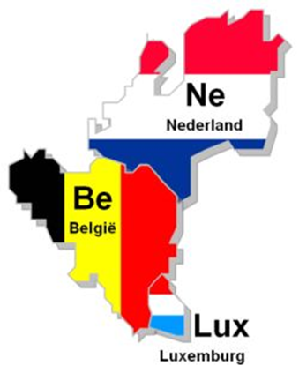
Brevet de l’enseignement supérieur (BES)
(Associate degree -Higher education diploma)
Strenghts (2)
Shorter and professional training but at a higher level;
Opens the door to higher education to a public that cannot (directly )access level 6 > transition?;
Automatic mutual generic level recognition in
the Benelux: 25th January 2018
Notes:
Automatic: without administrative formalities
Mutual: in each system
Generic: not specific (versus academic recognition:
NO recognition of the content nor professional qualifications)

Slide 25
Brevet de l’enseignement supérieur (BES)
(Associate degree -Higher education diploma)
Strenghts (2)
Weaknesses
Still challenging: baremic valuation in the public and private sectors;
Not well known and not developed by full-time higher education
stakeholders.

Slide 27
Any Questions?
www.fw-b.be
0800 20 000

