Slide 1
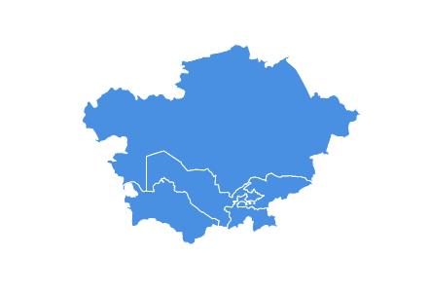
HELP in Central Asia

Slide 2
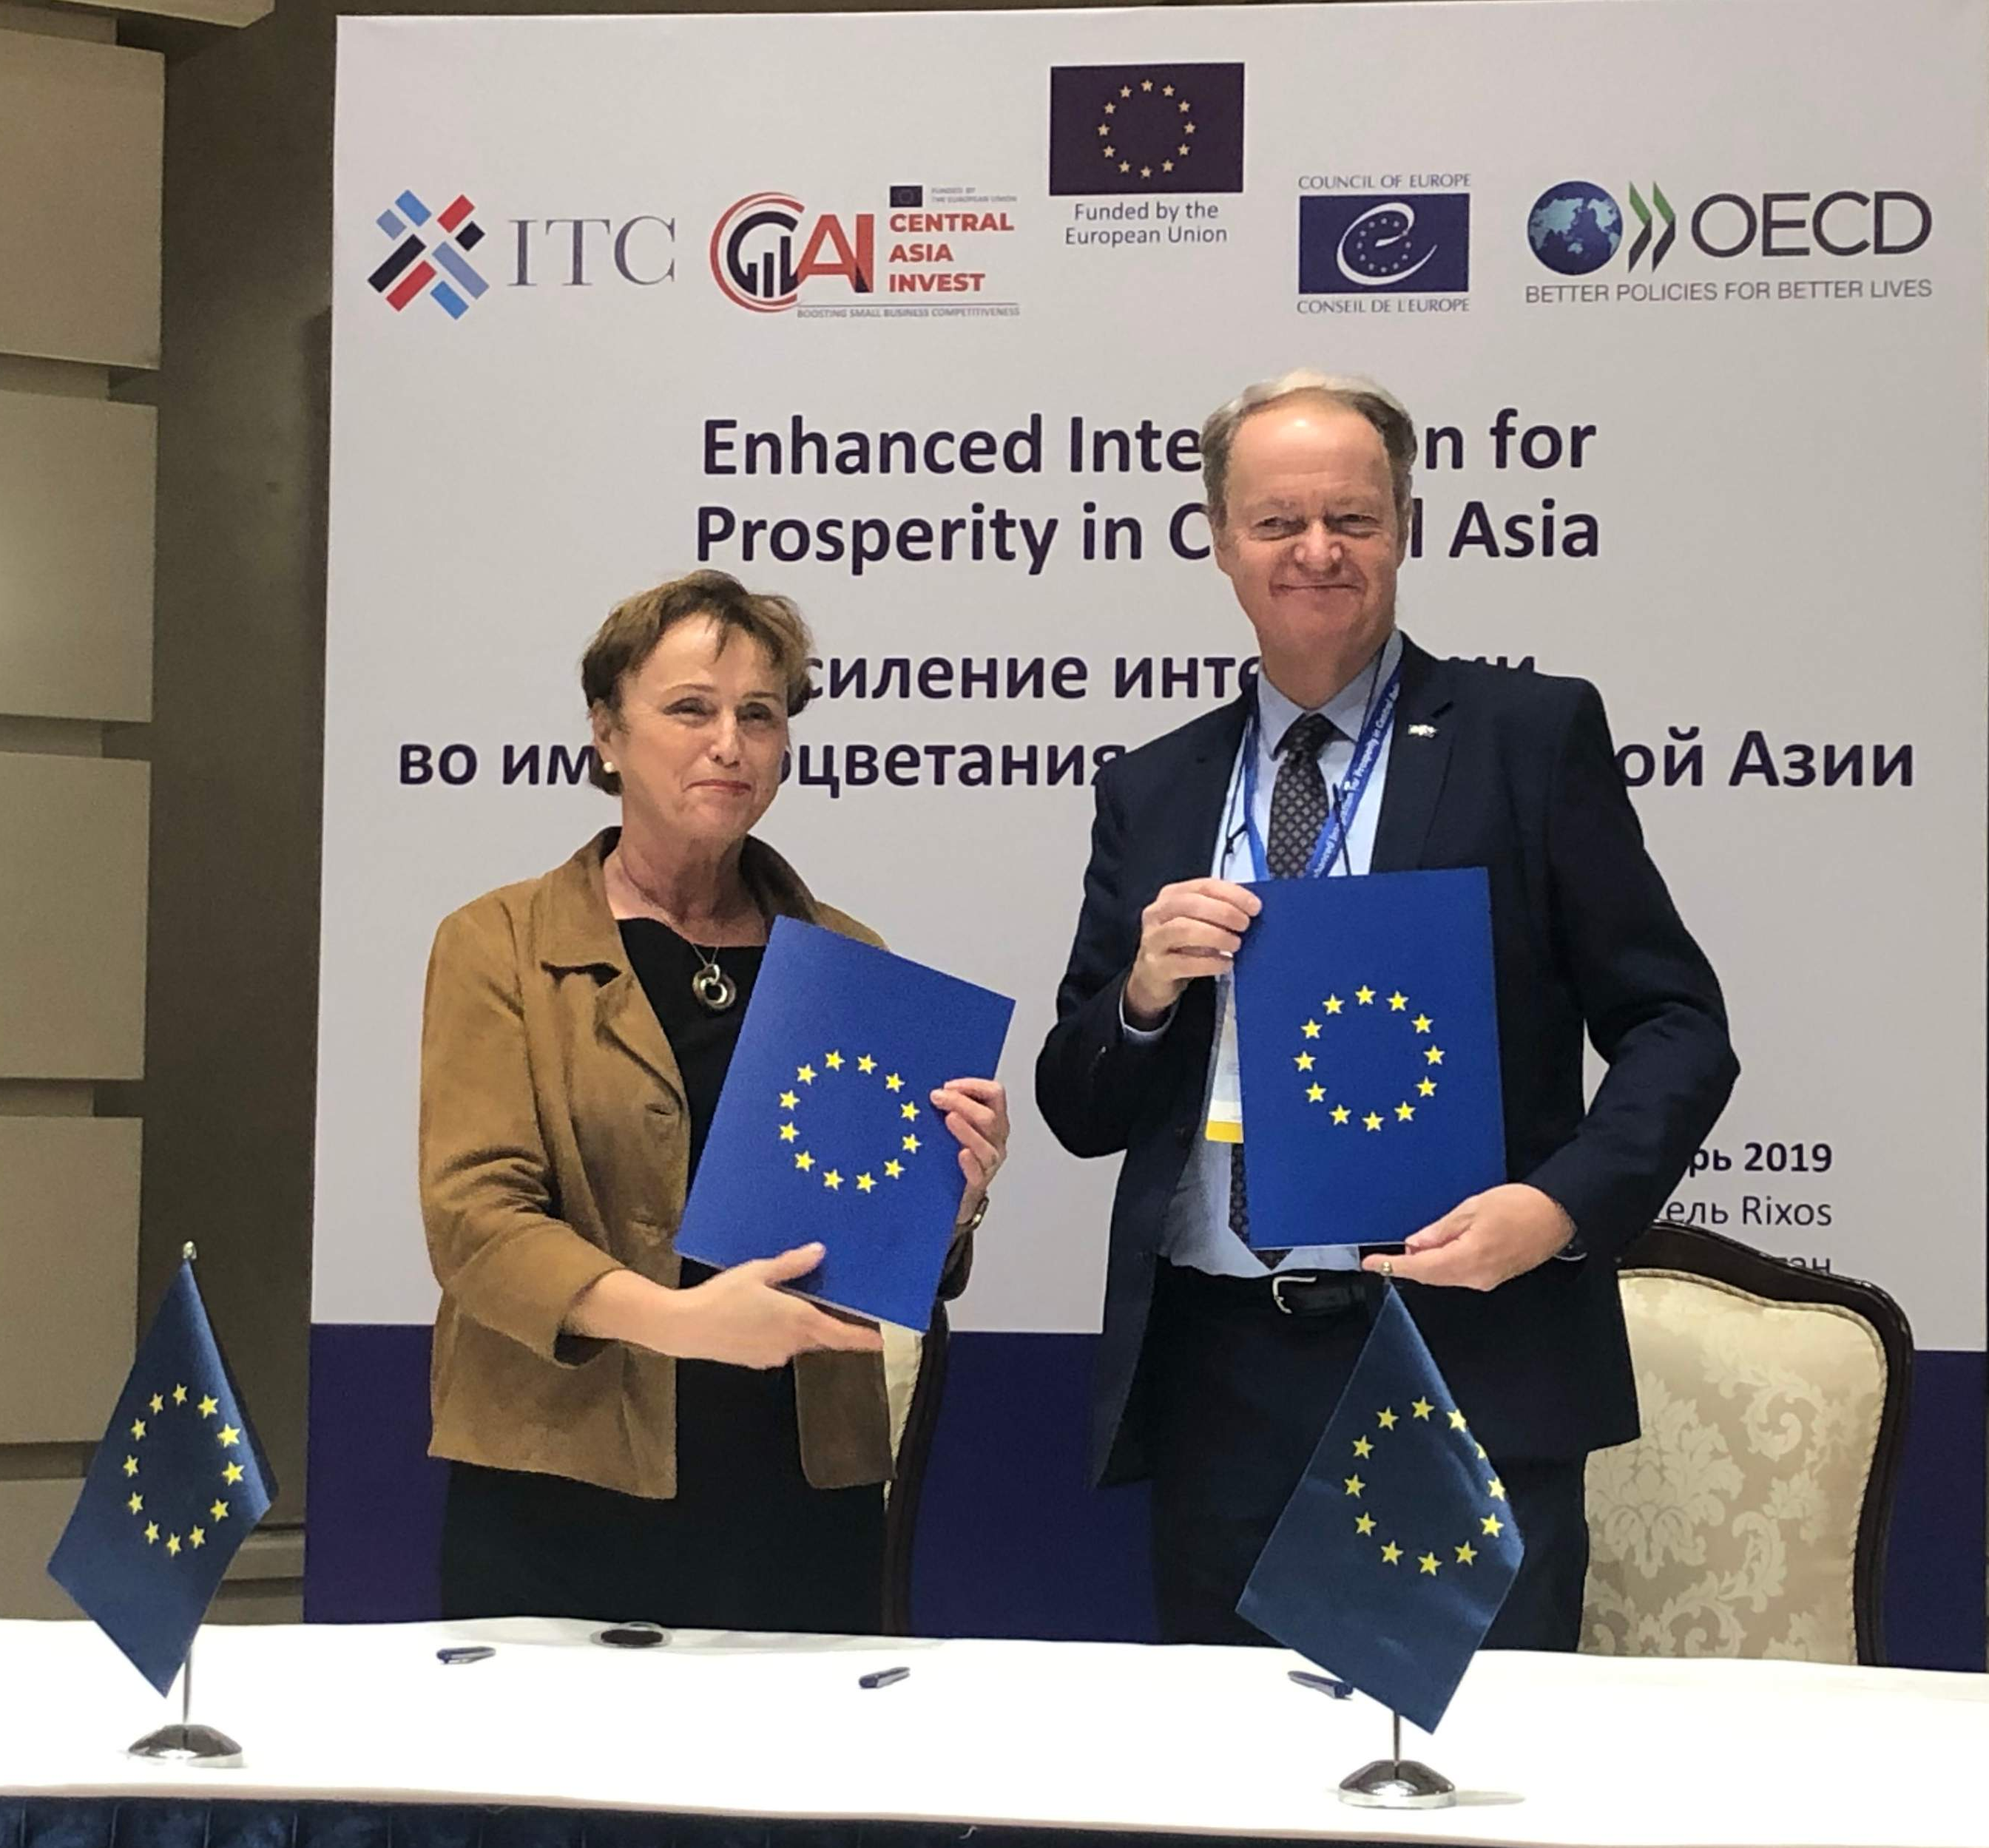
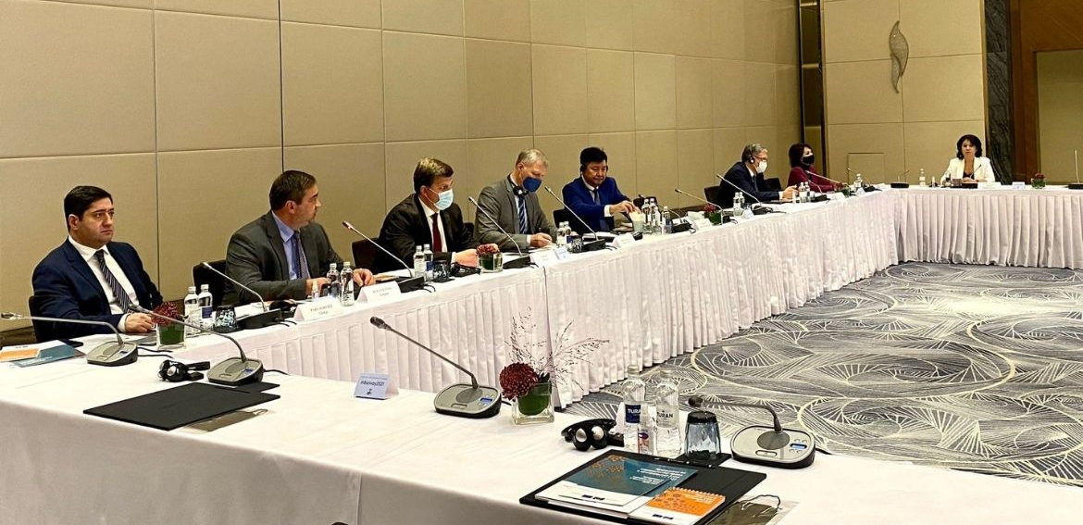
Central Asia Rule of Law Programme
Launched in 2019 - 3 Actions:
1. Facilitating the creation of a common legal space between Europe and Central Asia and enhancing human rights protection.
2. Promoting transparency and action against economic crime.
3. Promoting efficient functioning of state institutions and public administration.

Slide 3
423
CENTRAL ASIA HELP USERS

Slide 4
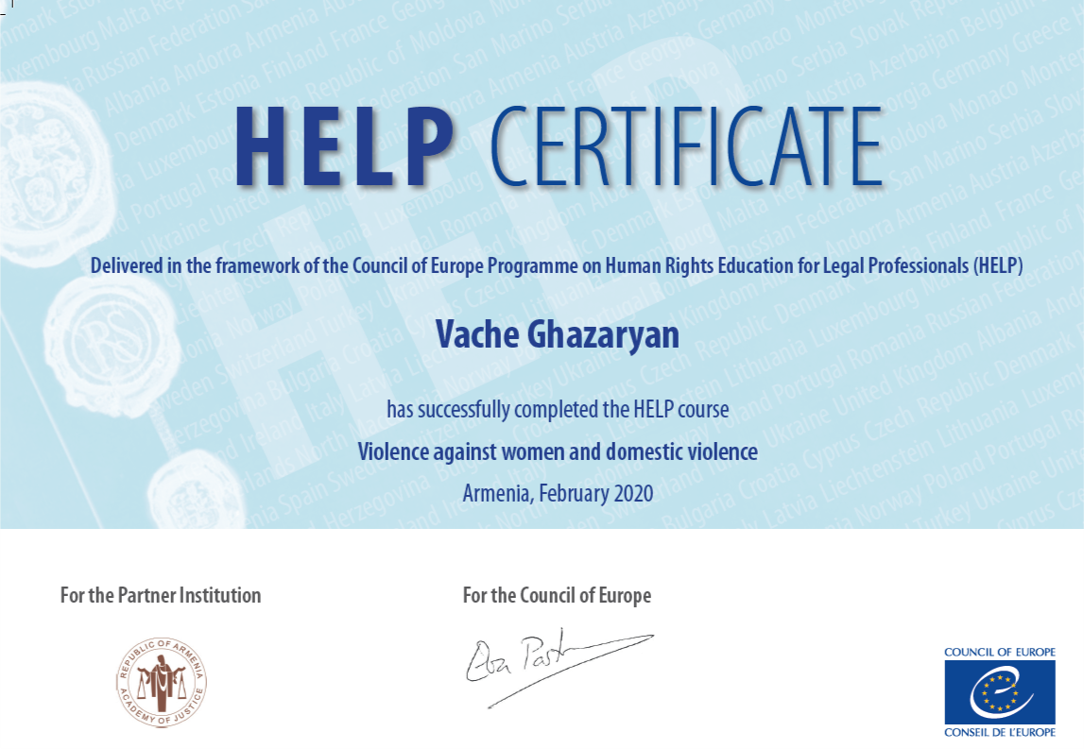
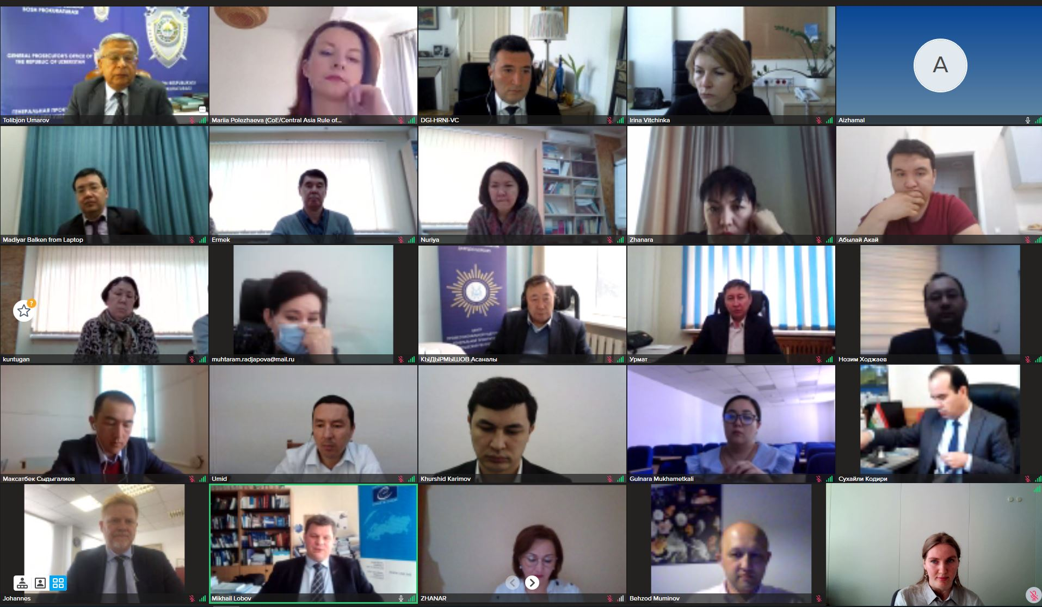
HELP in Central Asia
Two regional HELP Trainings-of-Trainers took place for 72 legal professionals from Kazakhstan, Kyrgyzstan, Tajikistan, Turkmenistan and Uzbekistan in April 2021 and May 2022.
25
Certified tutors + new are to be certified

Slide 5
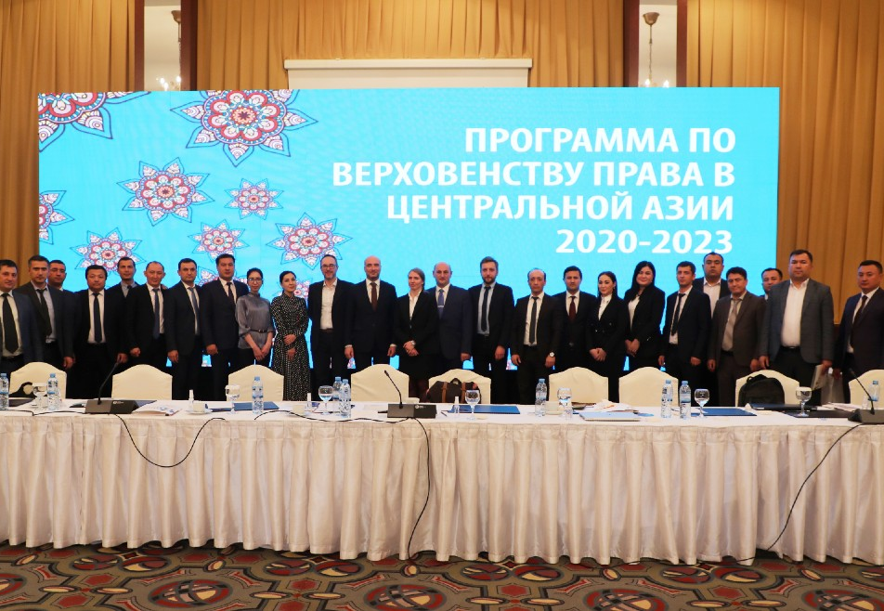
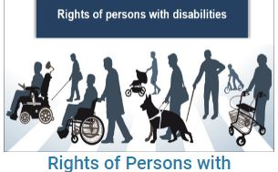
Uzbekistan
3 HELP courses in the Uzbek language.
National adaptation and translation of the course “Rights of persons with disabilities” launched for 25 judges of the National School of Judges in Uzbekistan.
2 HELP courses translated: “Combatting trafficking in human beings” and “Violence against women and domestic violence”
National adaption ongoing with the Academy of the General Prosecutor’s Office.
International co-operation in criminal matters – to be translated and adapted

Slide 6
Kazakhstan
HELP Course “Ethics for judges, prosecutors and lawyers” translated into the Kazakh language. To be launched in the autumn of 2022 and adapted with the Academy of the General Prosecutor’s Office.
Seminars on European human rights standards, including those relating to law enforcement, in co-operation with the Human Rights Commission under the President of the Republic of Kazakhstan and the Institute Sorbonne-Kazakhstan.

Slide 7
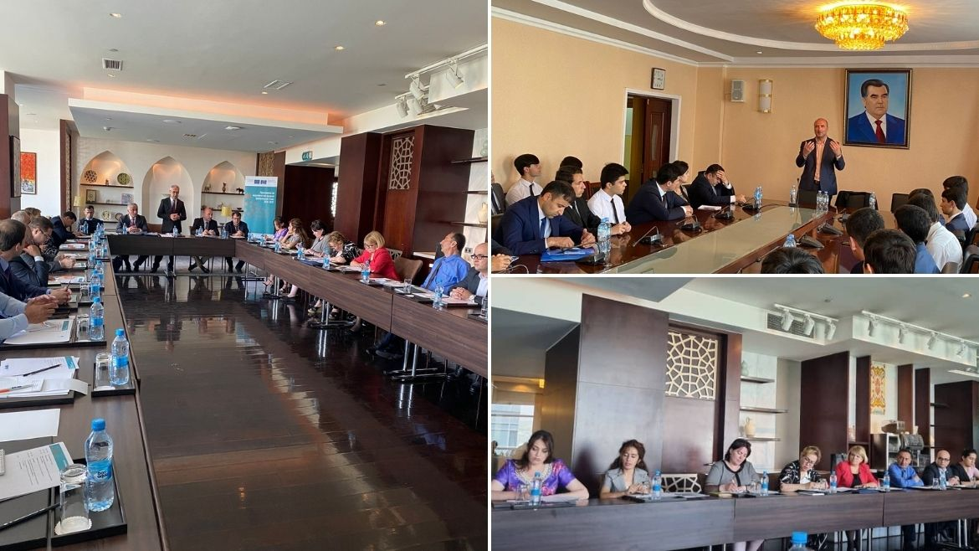
Tajikistan
Seminar for 27 lawyers on the Right to a fair trial and the case law of the European Court of Human Rights in May 2022.
Public lecture on the European Convention on Human Rights for law students and the law faculty of Tajikistan National University.
Further activities planned.

Slide 8
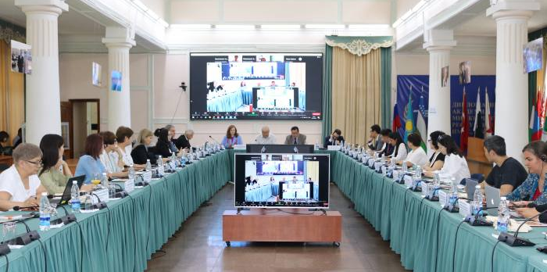
Kyrgyzstan
Seminar on the Right to a fair trial for judges with the High school of Justice.
Workshop on Child friendly justice.
HELP course on Child friendly justice to be translated and adapted.
Round table on Rule of Law in co-operation with the Ministry of Foreign Affairs of the Kyrgyz Republic and the Diplomatic Academy of the Ministry of Foreign Affairs.

Slide 9
Turkmenistan
Participation of representatives from national training institutions in HELP Training-of-Trainers.
Co-operation to be pursued further as safety measures due to the pandemic have been lifted.
Ongoing dialogue on engagement, activities and outcomes.

Slide 10
Future: Diverse methods, more topics, devoted teams, concrete results – and HELP ongoing

Slide 11
Thank you for attention.
Спасибо за внимание.

