Slide 1
Case Management Information System
CMIS
Challenges in data collection, quality control and availability of data from source institutions
November 21, 2023 Budapest Hungary
Notes:
Dear…
As per the instructions provided for todays meeting, we have prepared the presentation for our CMIS system. We will provide information about our experience, methodologies that we have applied, and results achieved and we are very shore that we have very interesting information to share with you during the day.

Slide 2
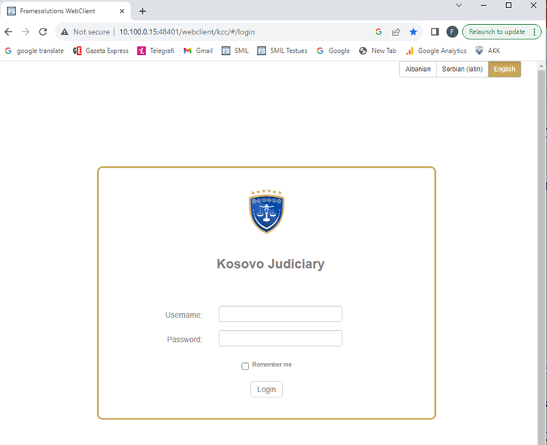
Case Management Information System - CMIS
CMIS is the only source of Judicial data
Trend of cases
Efficiency
Performance evaluation
Data quality is ensured only through
Structured data/ Metadata

Slide 3



Task Based Oriented System
Interoperable with other systems
Tasks Based Oriented System
Interoperability with Other Systems
Data Structure
Case registration
Unique Case Number:
2021:00325 (format)
Work Processes
Civil Registry
Templates
Business Registry
Managing Sessions
Calendar
Case Classified:
Case type
(Civil, Criminal, Economic etc.)
Court instance
(Basic, Appellate, Supreme)
POLICE
Decisions
Statistics
PROSECUITON
Archiving

Slide 4
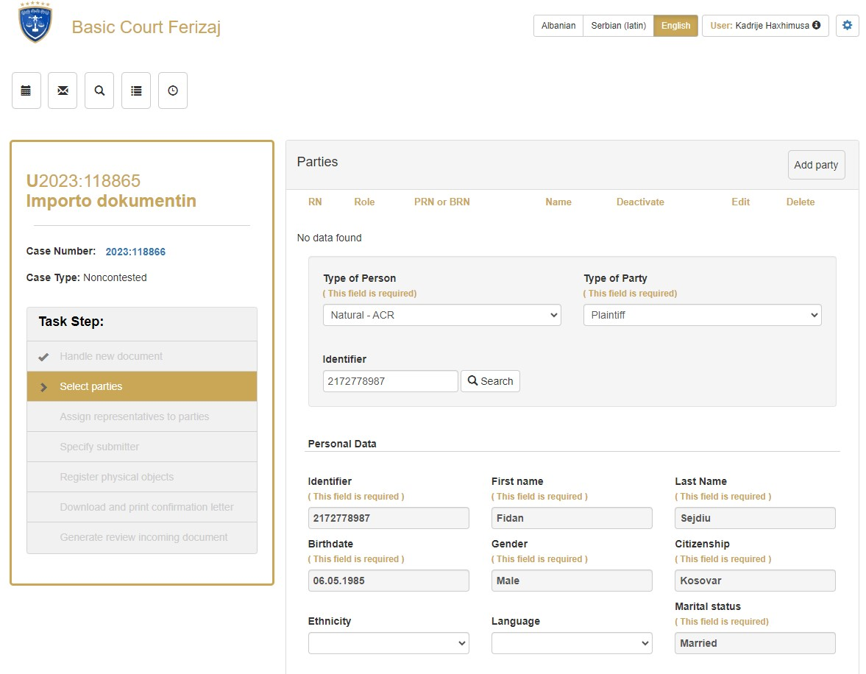
Case registration
Data of the parties from CRA

Slide 5
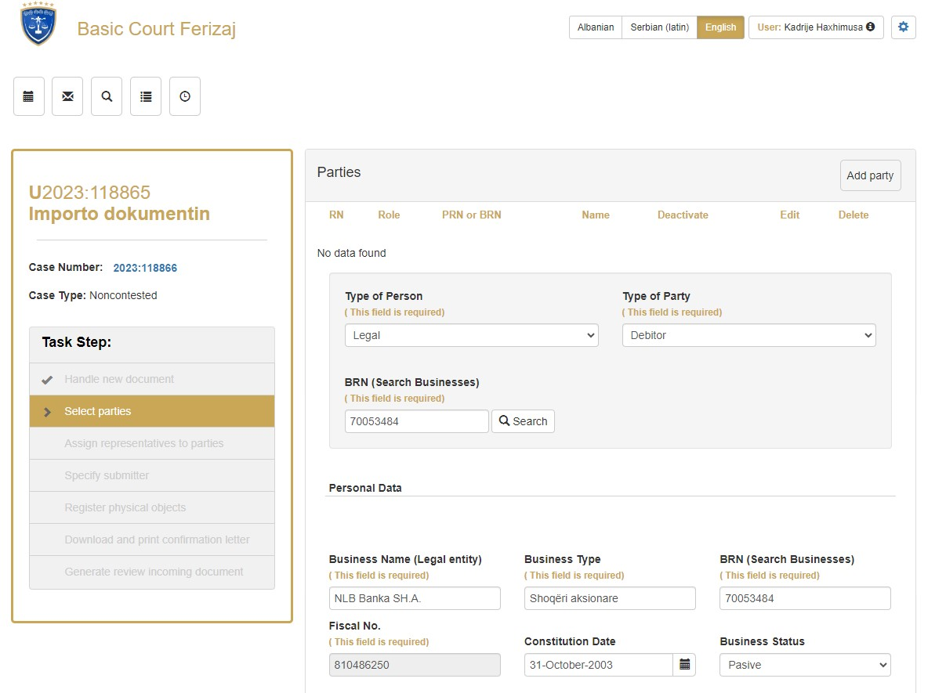
Case registration
Data of the businesses from BRA

Slide 6
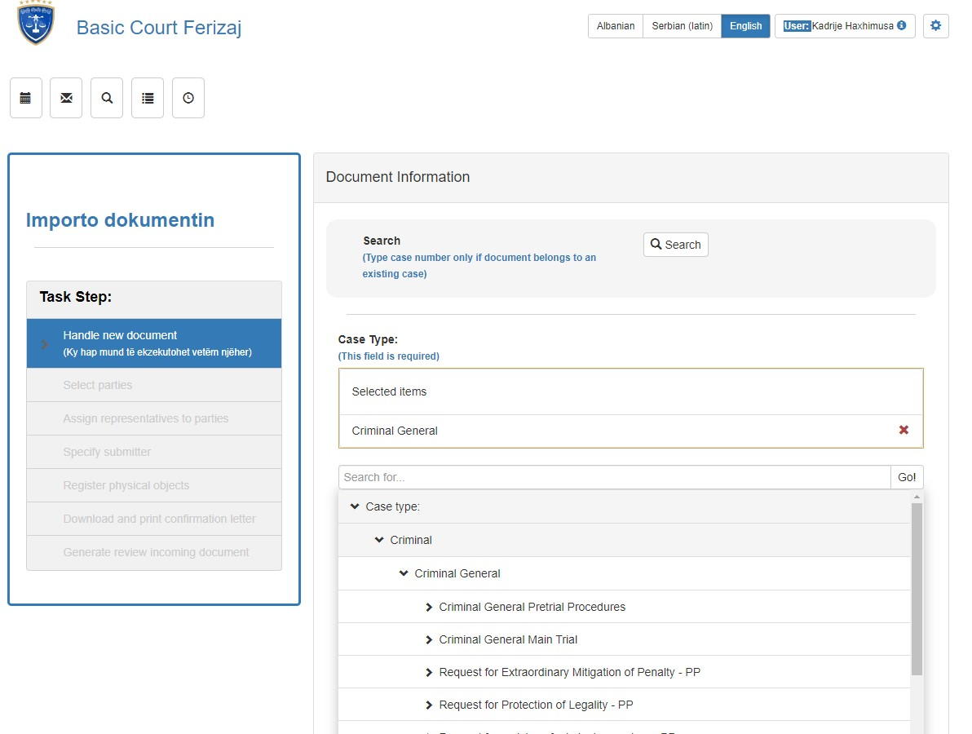
Case registration
Selection of the case type

Slide 7
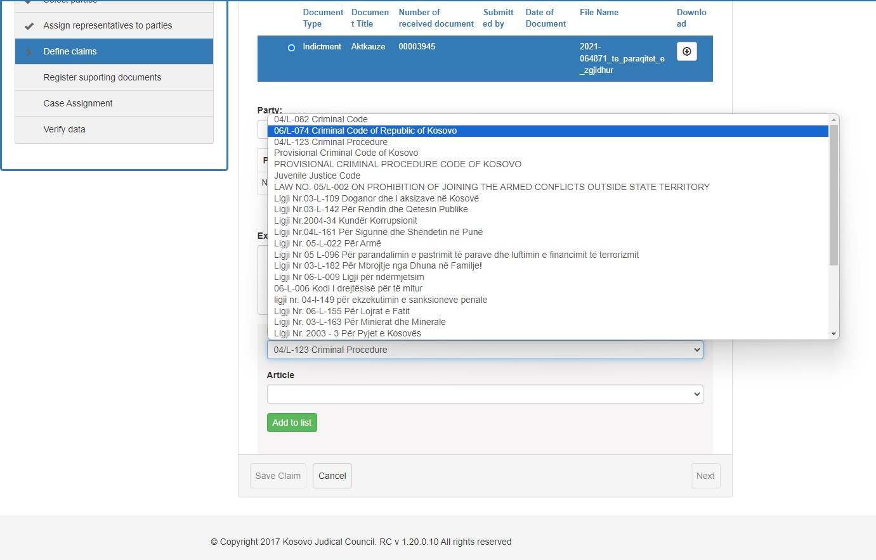
Case registration
Selection of the legal base

Slide 8
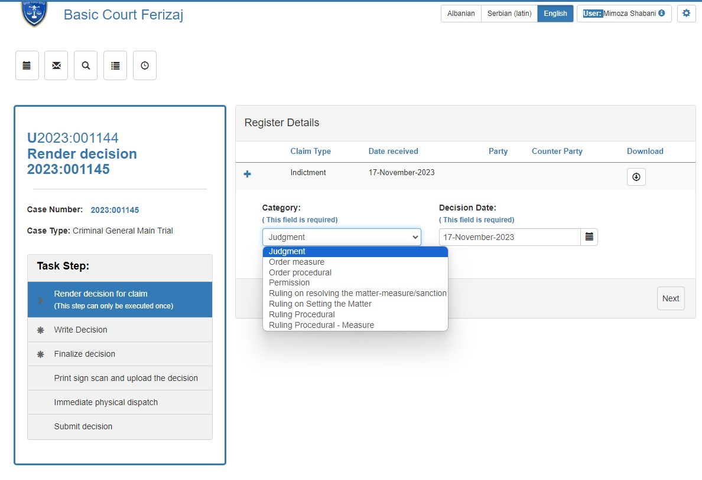
Rendering decision
Selection of the type of decision

Slide 9
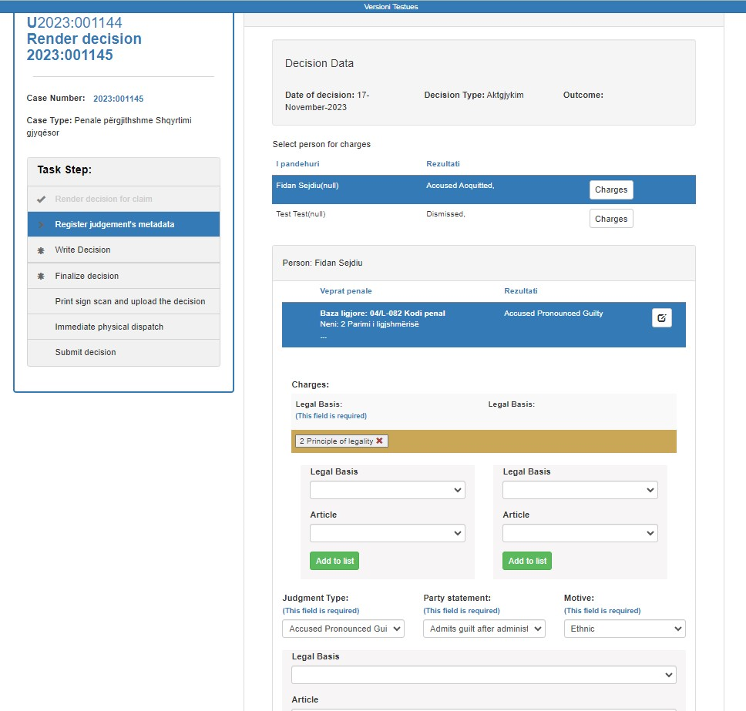
Rendering decision
Defining the legal base

Slide 10
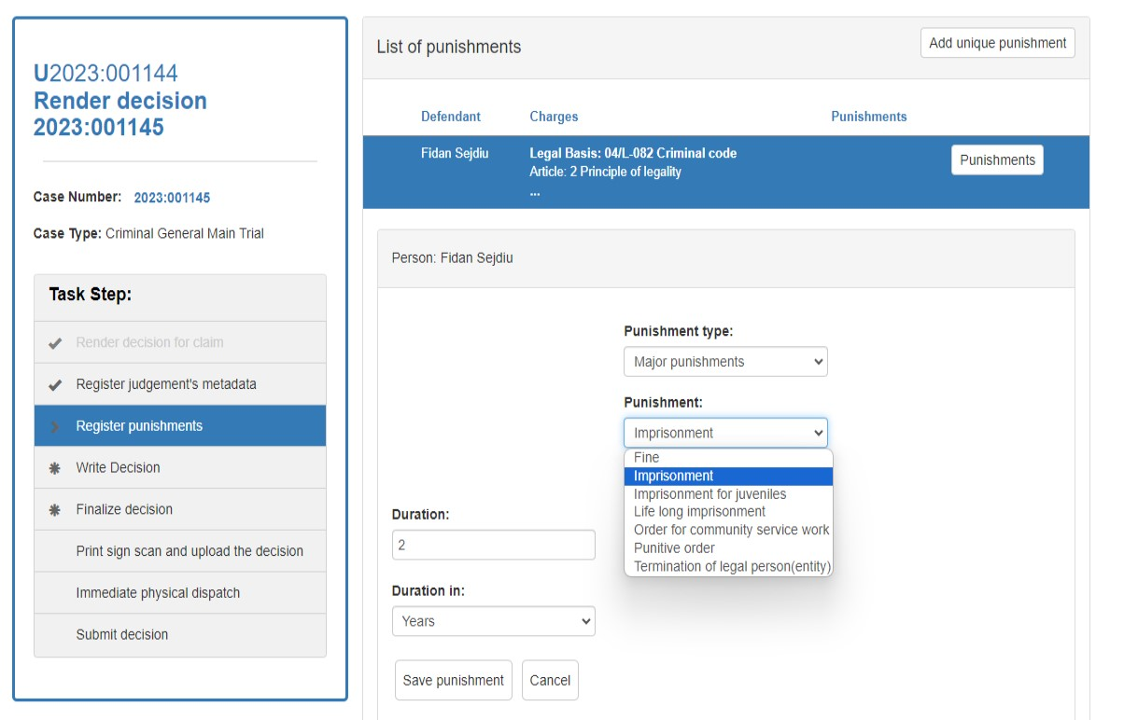
Rendering decision
Data of the punishment

Slide 11
CMIS Statistical Reports
CEPEJ Tool (Indicators)
1. Flow of cases,
2. Duration of proceedings,
3. The Clearance Rate (CR)
4. The Disposition Time (DT)
5. Age of pending cases,
6. Average length of proceedings,
7. Cases older than 2 year,
Basic Courts: 8 reports
Appellate Court: 5 reports
Supreme Court: 5 reports

Slide 12
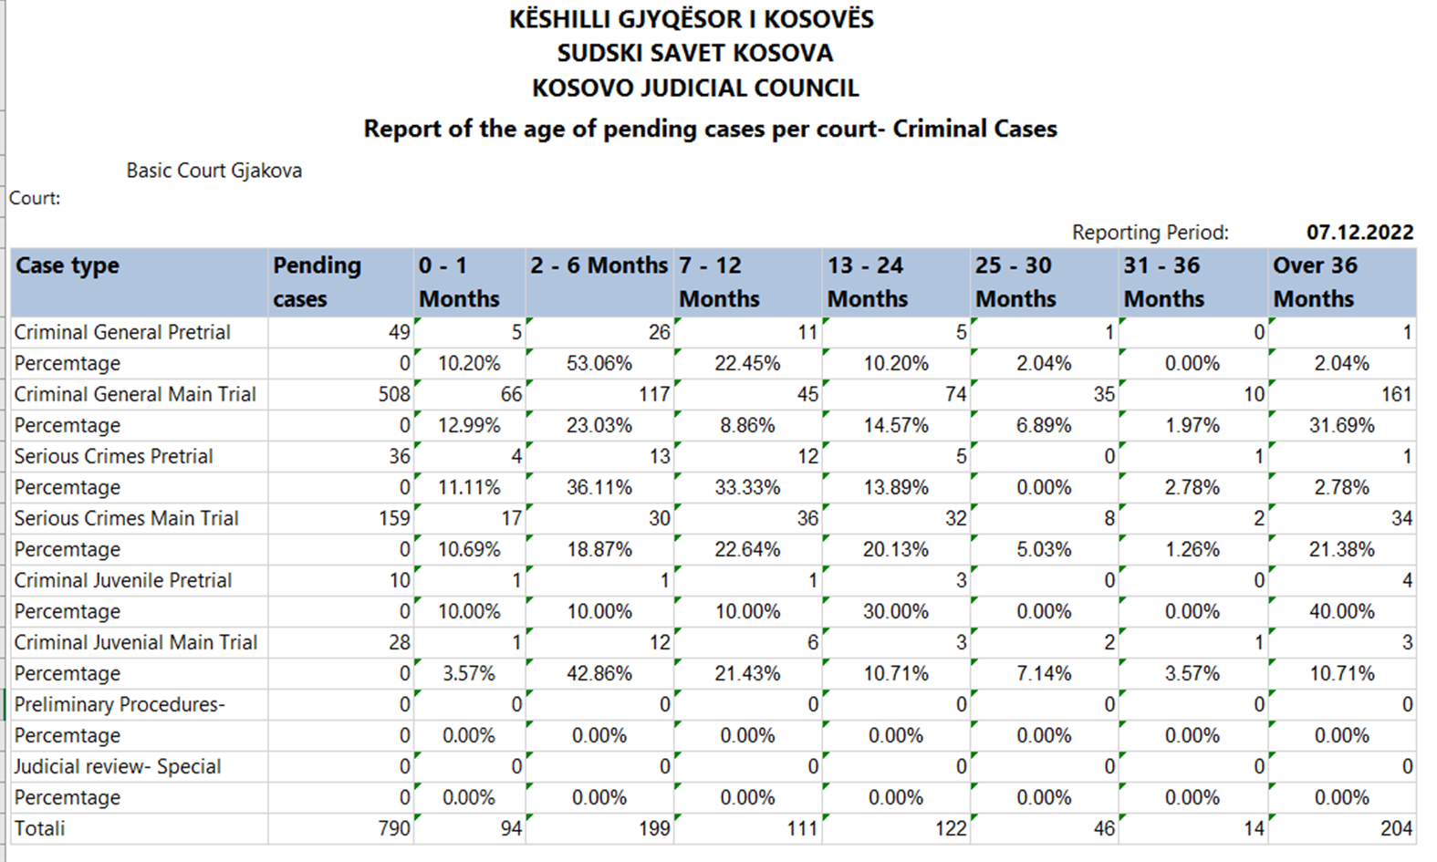

Slide 13
Dashboards graphs
CMIS Dashboards
Basic Court Dashboards
- Court Dashboard
- Judge Dashboard
Appellate Court Dashboards
- Court Dashboard
- Judge Dashboard
Supreme Court Dashboards
- Court Dashboard
Judge Dashboard
Data: One year data, Q base
Updates: every Q
1. Case flow (last quarter)
2. Trend in No. of pending cases
One year, (Q bases)
3. Age of pending cases
4. Average of No. of cases/ judge
5. Decision on appeals made (last Q)
6. Clearance Rate (CR)
7. The Disposition Time (DT)
8. Court sessions held/canceled

Slide 14
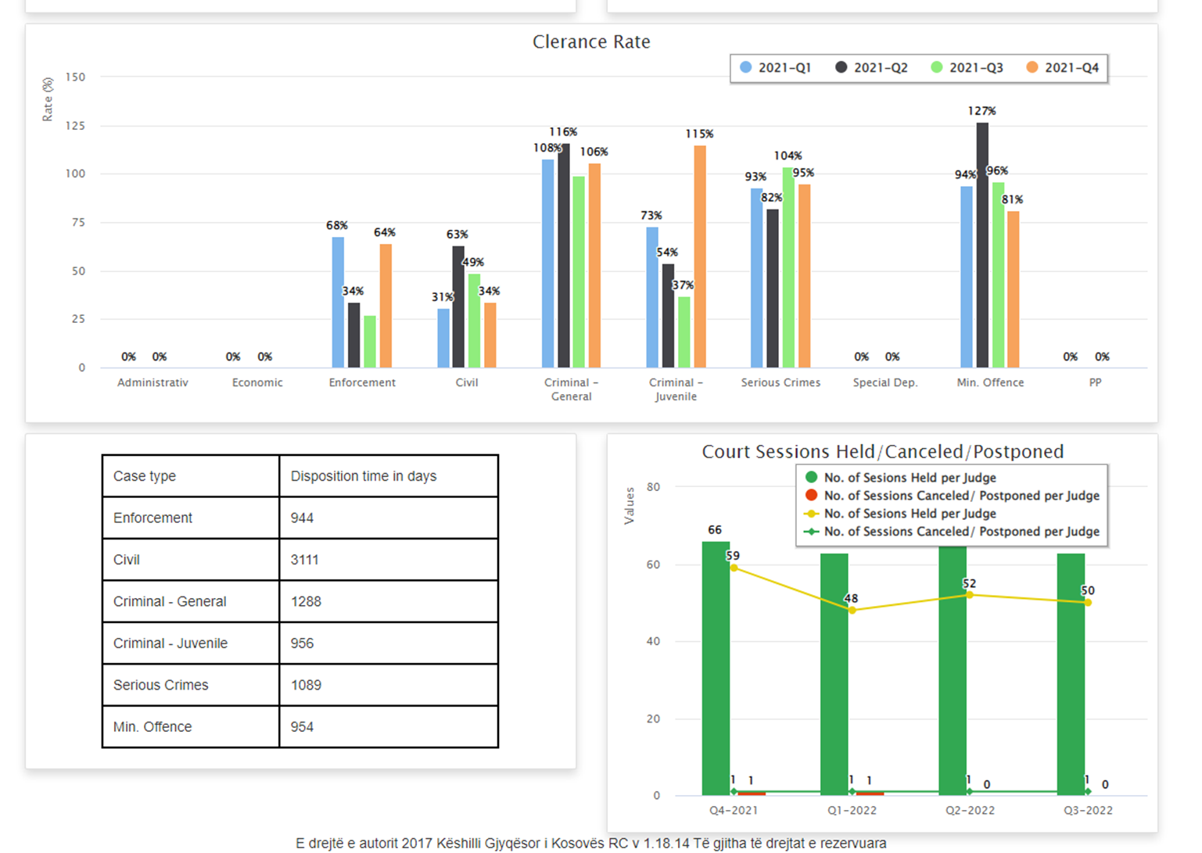
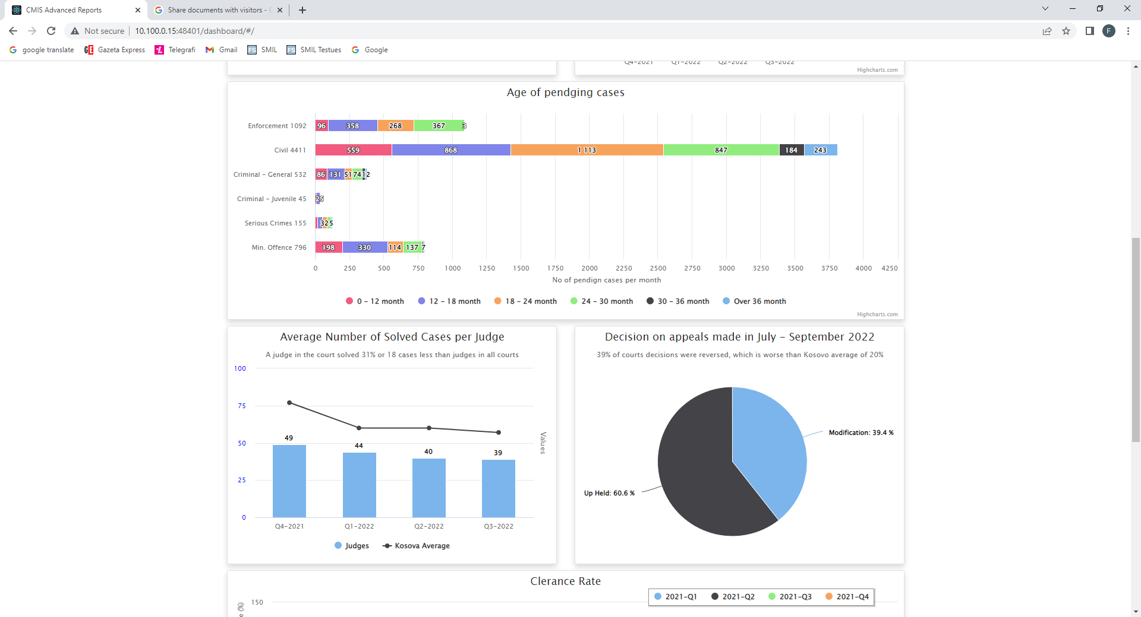
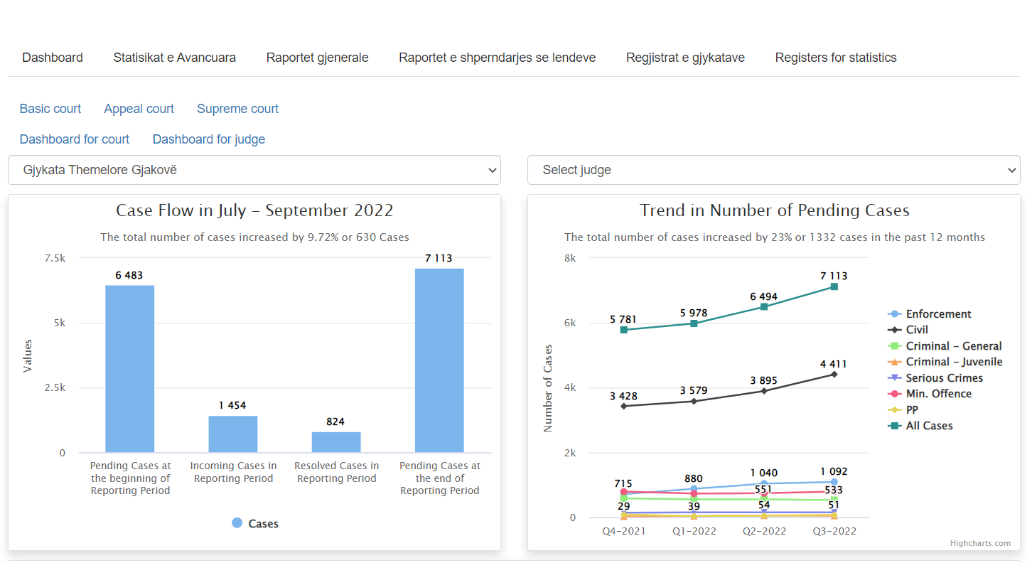
CMIS Court Dashboards

Slide 15
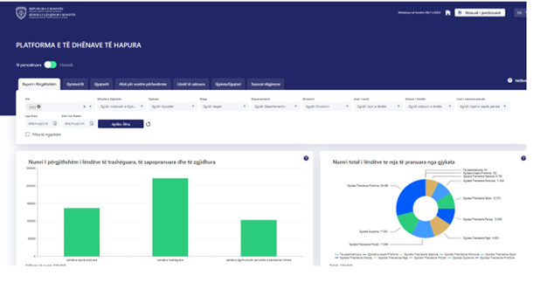
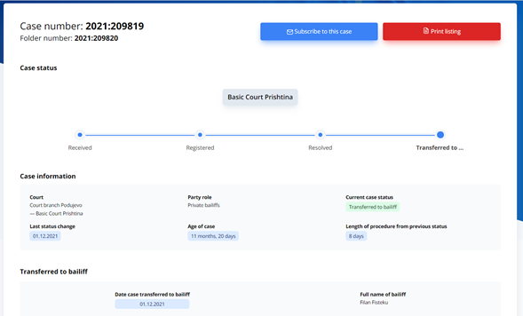
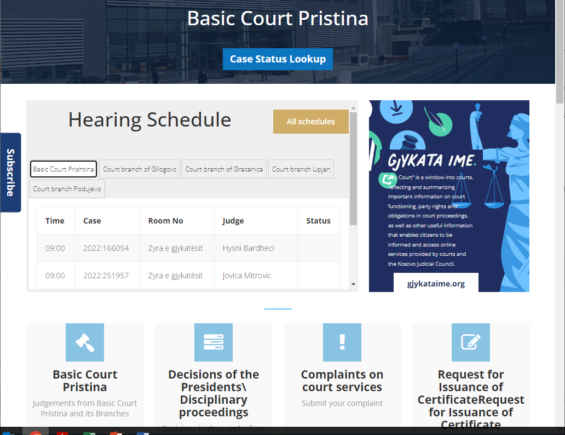

Slide 16
Challenges & Data Quality
Entering the data in real-time of the actions with the case
Resistance from changes
Transparency

Slide 17

KOSOVO JUDICIAL COUNCIL
Thank You for your attention

