Slide 1

Key concepts in the CEFR Companion volume: What might these mean for teaching?
Brian North

Slide 2
Key concepts in the CEFR CV:
What might these mean for teaching?
Workshop format
Presentation 30 mins
Discussion in plenary 20 mins
Breakout groups 60 mins
Reports and Discussion in plenary 30 mins
Conclusion 10 mins

Slide 3
Key concepts in the CEFR CV:
What might these mean for teaching?
Presentation
From a linear, inert perspective to a complex, integrative, agentive perspective:
Key aspects of the CEFR Companion Volume

Slide 4
Key concepts in the CEFR CV:
What might these mean for teaching?
Presentation
From a linear, inert perspective to a complex, integrative, agentive perspective:
Key aspects of the CEFR Companion Volume

Slide 5
Key concepts in the CEFR CV:
What might these mean for teaching?
Integrative perspective:
No 1-to-1 relationship between words and meaning (“The Language Myth”) → construction of meaning
From analytical (discrete items/skills)
to holistic (situated learning → multistep tasks & scenarios / integrated skills → mediation)
Language repertoire is holistic and integrated embracing all languages, varieties, registers → plurilingualism

Slide 6
Key concepts in the CEFR CV:
What might these mean for teaching?
From a linear vision…
Traditionally, communication and language learning have been seen as linear and monolingual:
learn to communicate a message in one language, learn in the class in order to apply out of the class (language + culture)
Enrica Piccardo

Slide 7
Key concepts in the CEFR CV:
What might these mean for teaching?
… to a complex vision
Now (action-oriented approach) both communication and language learning are complex:
learn to (co)construct content and communication, linguistic and cultural repertoires, class as real social context
Enrica Piccardo

Slide 8
Key concepts in the CEFR CV:
What might these mean for teaching?
Complex, ecological perspective:
Things are connected in unpredictable ways;
there is no linear “IF …. THEN …”
Phenomena (including learning) emerge
Learners react to affordances they notice in action
Complexity should be embraced: scaffolding (with authenticity) not dumbing down (simplified readers)
Complexity of: real life (situations); tasks (multistep, challenge); language (complexity, accuracy, fluency)

Slide 9
Key concepts in the CEFR CV:
What might these mean for teaching?
Agentive perspective:
Learning occurs when leaners engage, take ownership
Agency is impossible without clearly defined goals and success criteria
Agency is about more than making choices: it’s about planning and monitoring: feed-forward and feedback
Competence is shown when people (are permitted to) mobilize and combine all their resources creatively
Iterative approach: draft/redraft; rehearse/several takes → confidence and self-efficacy

Slide 10
Key concepts in the CEFR CV:
What might these mean for teaching?
Presentation
From a linear, inert perspective to a complex, integrative, agentive perspective:
Key aspects of the CEFR Companion Volume

Slide 11
Key concepts in the CEFR CV:
What might these mean for teaching?
Key Concepts
The user/learner as social agent
Mediation (of texts, concepts, communication)
Plurilingualism
Transparency and coherence
➔ The action-oriented approach

Slide 12
Key concepts in the CEFR CV:
What might these mean for teaching?
Key Concepts
The user/learner as social agent
Mediation (of texts, concepts, communication)
Plurilingualism
Transparency and coherence
➔ The action-oriented approach

Slide 13
Key concepts in the CEFR CV:
What might these mean for teaching?
Social agents
acting in the language together with others → collaboration in relation to a purpose/mission
taking the initiative, making decisions,
operating within conditions and constraints
mobilizing all their resources (cognitive, emotional, linguistic and cultural)
developing strategies in iterative cycles
planning, producing results, and monitoring their action.

Slide 14
Key concepts in the CEFR CV:
What might these mean for teaching?
Key Concepts
The user/learner as social agent
Mediation (of texts, concepts, communication)
Plurilingualism
Transparency and coherence
➔ The action-oriented approach

Slide 15
Key concepts in the CEFR CV:
What might these mean for teaching?
Mediation
Through mediation, language serves different purposes:
creating plurilingual/pluricultural space for communication and learning;
reducing affective blocks/tensions;
building bridges towards the new, the other;
(co-)constructing new meaning;
passing on information (and simplifying, elaborating, illustrating or adapting);
acting as intermediary.
In the CEFR Companion Volume
Mediation is the pivot of a holistic, ecological view of language use and learning

Slide 16
Key concepts in the CEFR CV:
What might these mean for teaching?
Mediation
Mediating concepts
Mediating communication
Mediating a text
Mediation strategies
The new CEFR Companion Volume (CoE, 2020) operationalizes this new vision into calibrated and validated descriptors

Slide 17
In the languaging process various dimensions emotional, cognitive, intrapersonal and interpersonal, cultural, textual come into play in different combinations and at different stages.
Key concepts in the CEFR CV:
What might these mean for teaching?
in Mediating concepts, social agents are languaging as they think things through together
in Mediating communication they are languaging in the process of self-other regulation
in Mediating a text they are languaging to find formulations that enable understanding of the text itself for themselves and for or with others.
Notes:
The social agent mediates while languaging, because languaging is the manifestation of mediation. If we think of the three main categories in which mediation is presented in the CEFRCV, in Mediating concepts, social agents are quite obviously languaging as they think things through together, in Mediating communication they are languaging in the process of self-other regulation, and in Mediating a text they are languaging to find formulations that enable understanding of the text itself for themselves and for or with others. In this languaging process, all the various dimensions that we discussed earlier – emotional, cognitive, intrapersonal and interpersonal, cultural, textual – come into play in different combinations and at different stages.

Slide 18
Key concepts in the CEFR CV:
What might these mean for teaching?
Key Concepts
The user/learner as social agent
Mediation (of texts, concepts, communication)
Plurilingualism
Transparency and coherence
➔ The action-oriented approach

Slide 19
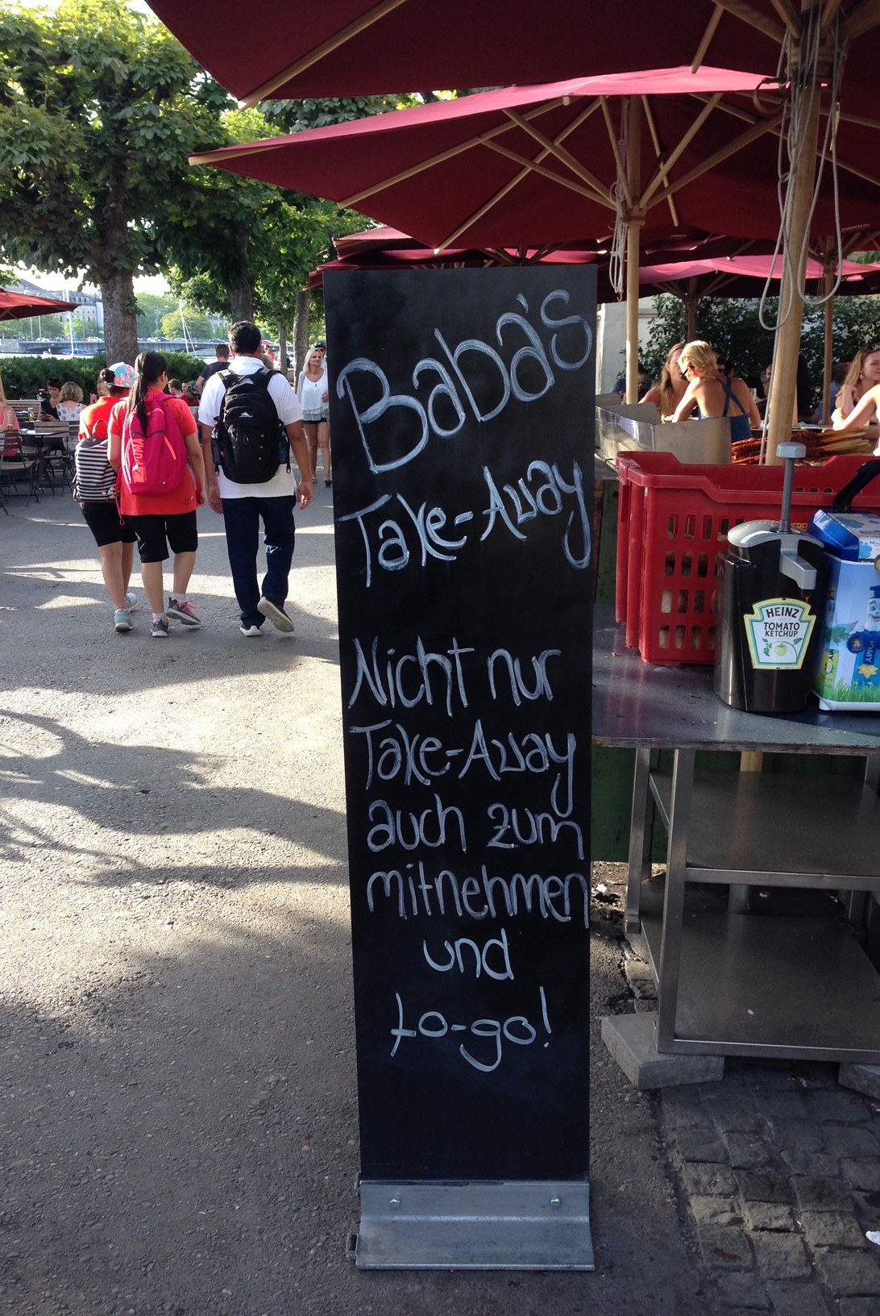

What’s the difference?
Key concepts in the CEFR CV:
What might these mean for teaching?
Plurilingualism
Multilingualism
A street in Toronto
A stroll in Zürich
Enrica Piccardo

Slide 20
Key concepts in the CEFR CV:
What might these mean for teaching?
Plurilingualism
Single, integrated, holistic linguistic repertoire that develops throughout life
Language education across the curriculum
Valorisation of full linguistic repertoire (heritage lang.s)
Openness to new languages/cultures (additional lang.s)
Valorisation of partial competences
Learners mobilizing all their resources (cognitive, emotional, linguistic and cultural) in tasks / in life

Slide 21
Key concepts in the CEFR CV:
What might these mean for teaching?
Plurilingualism
Single, integrated, holistic linguistic repertoire that develops throughout life
Language education across the curriculum
Valorisation of full linguistic repertoire (heritage lang.s)
Openness to new languages/cultures (additional lang.s)
Valorisation of partial competences
Learners mobilizing all their resources (cognitive, emotional, linguistic and cultural) in tasks / in life

Slide 22
Key concepts in the CEFR CV:
What might these mean for teaching?
Key Concepts
The user/learner as social agent
Mediation (of texts, concepts, communication)
Plurilingualism
Transparency and coherence
➔ The action-oriented approach

Slide 23
Key concepts in the CEFR CV:
What might these mean for teaching?
Transparency and coherence
“Planning, implementation and evaluation decisions should be consistent and interdependent rather than undertaken in a lockstep or piecemeal approach.” (Graves, 2008: 148)

Slide 24
Key concepts in the CEFR CV:
What might these mean for teaching?
Constructive alignment (Biggs, 2003: 2)
Alignment
teacher creates “a learning environment that supports the learning activities appropriate to achieving the desired learning outcomes.”
“teaching methods used and the assessment tasks, are aligned with the learning activities assumed in the learning outcomes.”
Constructive:
“refers to the idea that students construct meaning through relevant learning activities … meaning is not something imparted or transmitted from teacher to learner but is something learners have to create for themselves”
CEFR Descriptors:
provide transparent outcomes
show learners what they are aiming for (signposting)
inspire teachers/materials developers to create tasks
provide basis for assessment of success in the task

Slide 25
Key concepts in the CEFR CV:
What might these mean for teaching?
Key Concepts
The user/learner as social agent
Mediation (of texts, concepts, communication)
Plurilingualism
Transparency and coherence
➔ The action-oriented approach

Slide 26
Key concepts in the CEFR CV:
What might these mean for teaching?
An action-oriented approach
includes purposeful, collaborative tasks that:
allow initiative, so learners can purposefully and strategically exert their agency
have a defined mission for the learners (often require a product, an artefact)
require co-construction of meaning through mediation in interaction
set conditions and constraints
specify ‘language policy’ (when to “plurilanguage”, when to use a specific language)

Slide 27
Key concepts in the CEFR CV:
What might these mean for teaching?
To summarise: Action-oriented Approach
Backwards design of modules → can-do aims/outcomes
Acceptance of complexity, with scaffolding as necessary
Authenticity/credibility of a scenario for a task/project; autonomy to research different source materials
A unifying task – several phases → (co-)production of an artefact → a reflection phase
A pluri-/ intercultural focus ; integration of languages
Agency to make decisions; co-construction of meaning through mediation of concepts and/or communication
Feedforward & feedback → self-efficacy → awareness
(Self-)assessment of the outcomes
Notes:
Integration of additional languages, in terms of openness to learners’ linguistic (and cultural) resources and support to plurilanguaging within and beyond the language classroom

Slide 28
Key concepts in the CEFR CV:
What might these mean for teaching?
Workshop format
Presentation 30 mins
Discussion in plenary 20 mins
Breakout groups 60 mins
Reports and Discussion in plenary 30 mins
Conclusion 10 mins

Slide 29
Key concepts in the CEFR CV:
What might these mean for teaching?
Questions & Discussion
The Social Agent
Mediation (of texts, concepts, communication)
Plurilingualism
Transparency and Coherence
The Action-oriented Approach

Slide 30
Key concepts in the CEFR CV:
What might these mean for teaching?
Workshop format
Presentation 30 mins
Discussion in plenary 20 mins
Breakout groups 60 mins
Reports and Discussion in plenary 30 mins
Conclusion 10 mins

Slide 31
… but also in textbooks
(ex: English G21 - Cornelsen)
Key concepts in the CEFR CV:
What might these mean for teaching?
Breakout Groups c 60 mins
Discuss the activity (Activities 1-8) for your group:
To what extent and how does this activity reflect the different key aspects highlighted in the PADLET. How does this compare to activities you generally use?

Slide 32
Key concepts in the CEFR CV:
What might these mean for teaching?
Handout

Slide 33
… but also in textbooks
(ex: English G21 - Cornelsen)
Key concepts in the CEFR CV:
What might these mean for teaching?
Breakout Groups - preparation
Find in the chat the links to the PADLETs
COPY them all in a Word file

Slide 34
… but also in textbooks
(ex: English G21 - Cornelsen)
Key concepts in the CEFR CV:
What might these mean for teaching?
Find in the chat the links to the PADLETs
COPY them all in a Word file

Slide 35
… but also in textbooks
(ex: English G21 - Cornelsen)
Key concepts in the CEFR CV:
What might these mean for teaching?
Breakout Groups - preparation
Open the first link
Test padlet:
https://padlet.com/brianjohnnorth3/kxr65qhoh8mk6gfx
2. Play with the tablet – write anything
3. Come back !!!

Slide 36
… but also in textbooks
(ex: English G21 - Cornelsen)
Action-oriented plurilingual mediation in collaborative tasks
Breakout Groups - task
Open the link for your group:
Decide:
  a group moderator – who will guide discussion and report on your discussion afterwards, using your PADLET
Discuss:
To what extent and how does this activity reflect the different key aspects highlighted in the PADLET. How does this compare to activities you generally use?
If you have time: choose another activity you like – repeat the discussion – open the PADLET for that activity
(PADLET Group 1 = Activity 1, Group 2 = Activity 2 etc.)

Slide 37
Key concepts in the CEFR CV:
What might these mean for teaching?
Breakout Groups

Slide 38
Key concepts in the CEFR CV:
What might these mean for teaching?
Handout & Padlets

