Slide 1




KDYS-
Presentation by
Mr. Tim O’Donoghue, KDYS CEO
to COE 9th Platform Meeting,

Slide 2
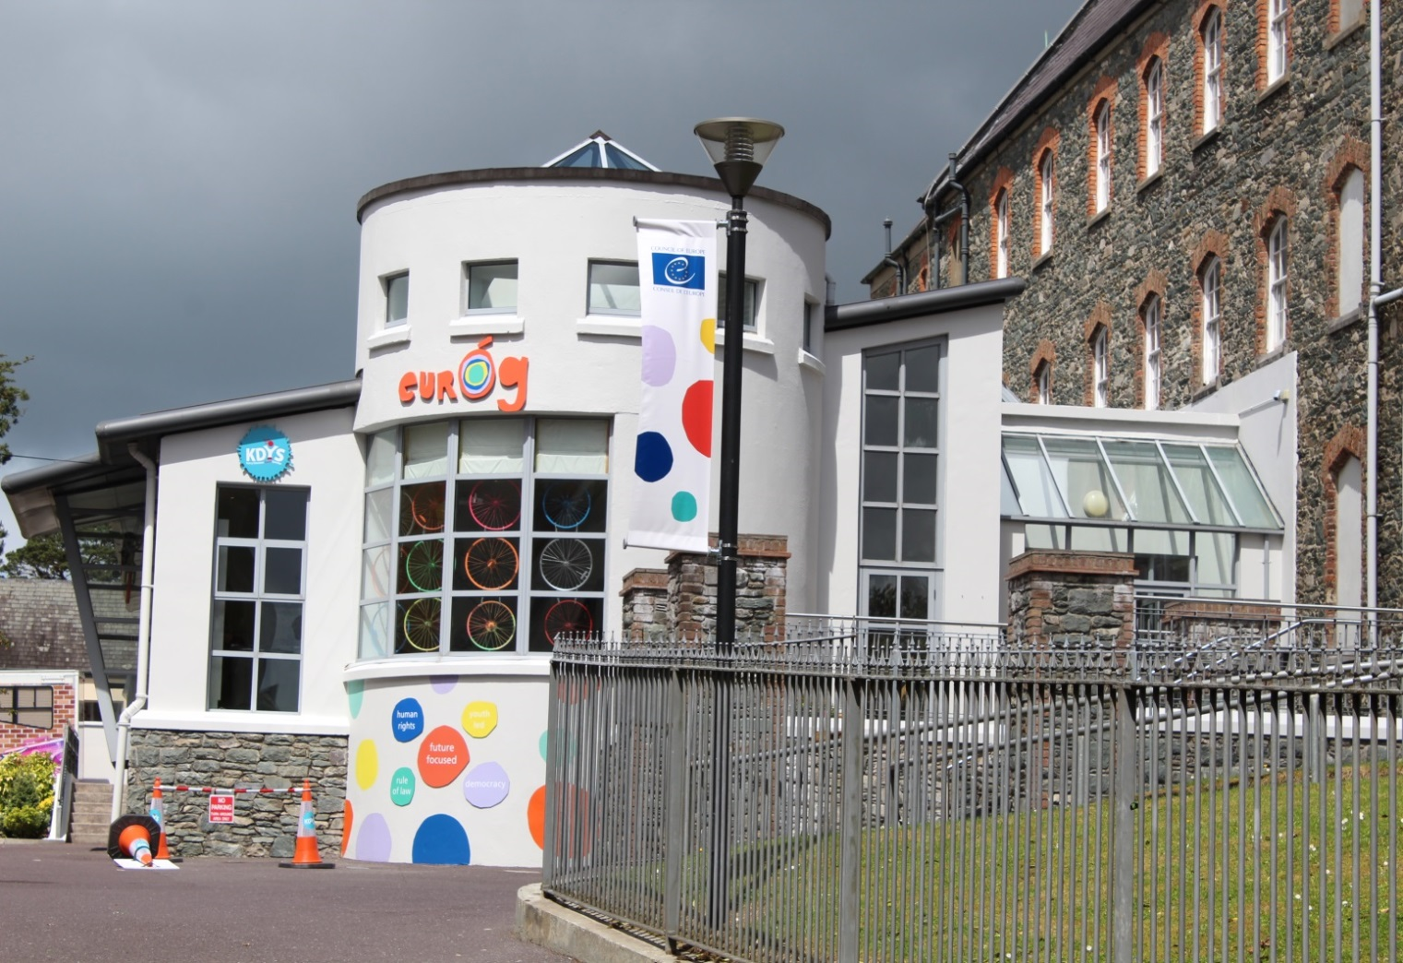

KDYS EurÓg

Slide 3
KDYS –OUR APPROACH
KDYS Mission
To empower all young people to grow to their full potential by enabling them to acquire the knowledge, attitudes, and skills necessary for their wellbeing and the enrichment of their communities
Youth Work Approach
An inclusive approach to working with all young people aged 10-25 years informed by four pillars:

Slide 4
Description of EYC
EYC Killarney
Focus on Youth Participation & Empowerment
Pedagogical Laboratory for developing, implementing and evaluating activities and programmes for children and young people
Social Innovation/centre as a Social Enterprise
Dedicated facility for young people

Slide 5
EYC Programmes
KDYS
Youth Justice
Family Supports
Volunteers
Professional & Community Networks
Youth Clubs
Youth Participation Fora
Education & Training
Prevention of Drugs & Alcohol Misuse
Youth Information
In School & Out of School Supports
Mentoring
Youth Centres & Hubs

Slide 6
Practice of Exchange between
Youth Workers &
Young people
In order to become knowledge, this exchange must be Organised, Documented & Shared.
Exchange happens :
  Informally: young people calling to the EYC looking for information, guidance, advice or training
  Formally: young people get involved in services provided in the EYC. Exchange happens on a structured basis e.g. 1:1. group work etc.

Slide 7
Practice of Exchange between Youth Workers & Young people
Exchange elicits:
Needs of young people
What is working well/not well
Gaps/deficits
Suggestions for development
Innovation in practice/new services

Slide 8
QUESTION for KDYS
PRACTICE IS BASED ON SERVICE DELIVERY
Services are delivered to respond to youth needs
Are based on youth work principles and approaches
Exchange takes place through the lens of a project or programme; the parameters of which are largely determined by the funder.
Exchange informs programme/service delivery
Information used to account for youth work delivery
KDYS has evolved from a mission led Youth Organisation to a Youth Service – 96% of funding derived from state contracts.

Slide 9
DRIVERS UNDERPINNING PRACTICE
KDYS
State funded contracts
Accountability
VfM
KDYS- delivery Agent
Return on investment
Compliance

Slide 10
REFLECTION ON PRACTICE
Analyse needs
Plan response
Implement
Reflect
Repeat

Slide 11
REFLECTION ON PRACTICE
Built into programme delivery
An opportunity for youth workers to learn from each other and from young people
Is generally within the parameters of service delivery and “what can be done” accordingly.
Is not always connected to the broader organisation

Slide 12
VOICE OF YOUNG PEOPLE
The KDYS Strategic Plan 2015-2018 states the core values of KDYS which include:
  Young people at the heart of everything we do
  Commitment to working in partnership with young people.
  Commitment to youth participation and to build capacity of young people through:
  Youth participation training
  Dedicated staff role to develop a Youth Participation Strategy and Young People’s Charter
  Work in partnership with young people to develop events, services, & responses
  Development of structures to embed this across KDYS

Slide 13
INNOVATION & POLICY DEVELOPMENT
EurÓg
Young people
Services
Practice
Integrated service
KEY Service
National policy development
Co-design by young people
Erasmus + opportunities

Slide 14
STRUCTURES
Executive Director
EYC Programme Co-ordinator
Technical Team
Educational Team
Administrative Team

Slide 15
CHALLENGES
Drive to service state contracts has placed an increased administrative burden on KDYS.
Funding is restricted in terms of usage and delivery must be within the parameters outlined in the contract.
Our ability to engage with young people more broadly is restricted as funding is mainly for work with targeted young people
KDYS needs to develop unrestricted sources of funding to enable development and return to mission as a youth organisation

Slide 16
OPPORTUNITIES
Source new funding lines to develop new work
Develop KDYS structures independent of funding requirements
Co-design & co-creation
Support return to mission
Embed exchange of practice through EYC
Enhance youth participation & influence

