Slide 1




KDYS- “Working with young people to reach their potential”
Presentation by
Mr. Tim O’Donoghue, KDYS CEO
to COE 8th Platform Meeting, 28th June 2017

Slide 2

KDYS – A SNAP SHOT
A voluntary Youth Work Organisation located in the South West of Kerry, working with over 6000 young people annually.
Recently awarded the CoE Quality Label for EurÓg European Youth Centre Centre in Killarney, which is based on four pillars
  - human rights and learning,
  - co-design and co-creation,
  - creating and connecting opportunities,
  - giving young people the knowledge, skills and expertise to create their own path.

Slide 3
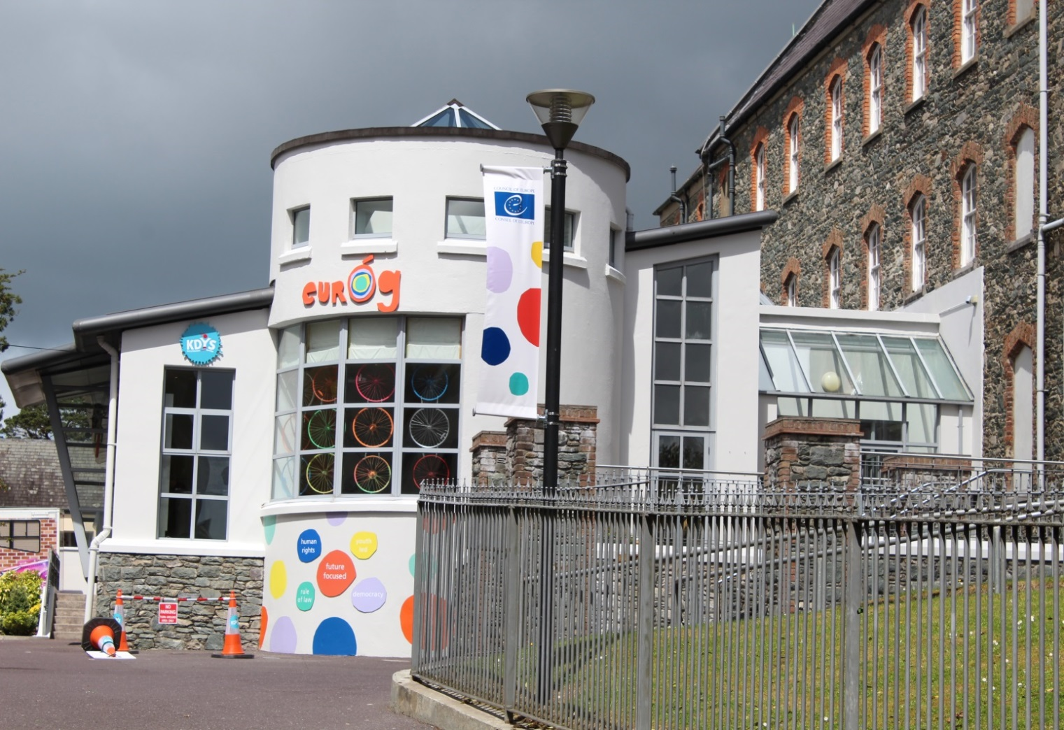
KDYS EurÓg

Slide 4
KDYS –OUR APPROACH
KDYS Mission
To empower all young people to grow to their full potential by enabling them to acquire the knowledge, attitudes, and skills necessary for their wellbeing and the enrichment of their communities
Youth Work Approach
An inclusive approach to working with all young people aged 10-25 years informed by four pillars:

Slide 5
KDYS- HOW WE WORK
Youth Workers engage with local communities to assess youth needs, to identify issues and to develop appropriate responses.
Outreach work in communities develops relationships, builds trust and over time, encourages and facilitates access to Youth Services by young people who may be difficult to engage.
Through the building of trusting relationships with youth workers, young people may be referred to other KDYS services, which can provide specialist supports at a time when they need it.
Youth workers also train and support volunteers to enable them to develop the skills, confidence and resources to respond to youth needs in their own area.
As a service operating in local communities since 1971, KDYS has built up a track record of working with and for young people, particularly those who are marginalised or socially excluded.

Slide 6
KDYS SERVICES
Young Person
Second chance education
Family support
Youth Justice Work
Youth Information
Youth Clubs
Mentoring services
Youth Centres
Drugs & alcohol services

Slide 7
KDYS SERVICES
MAINSTREAM SERVICES- open to all young people
Youth clubs
Youth Cafes
Youth Information
Youth Centres
Youth Projects
TARGETED SERVICES-more specialist services for vulnerable young people
Second Chance Education
Family support
Mentoring services
Drugs and alcohol services
Youth Justice

Slide 8
PROCESS OF ENGAGING
YOUNG PEOPLE
Mainstream youth work services provide an space for all young people to mix socially and to engage in a programme of non- formal education.
If there are underlying issues or concerns for young people, they can be referred or sign posted to more targeted interventions if these are required.

Slide 9
PROCESS OF ENGAGING
YOUNG PEOPLE AT RISK
Mechanisms of referral to KDYS Targeted Services:
KDYS TARGETED SERVICES
Statutory services
Self referrals
KDYS Mainstream services
Police, health services, schools etc
Youth Workers
Young people, parents

Slide 10
PROCESS OF ENGAGING
YOUNG PEOPLE AT RISK
Principles informing our work with young people:
Empowerment of young people.
Equality and inclusion.
Rights based approach underpinned by a culture of respect and dignity for all young people.
Involvement of young people in decision-making.
Partnership with the young person.
Starts where young people “are at”
Voluntary participation.

Slide 11
CASE STUDY
KDYS Youthreach Programme
The aim is to equip young early school leavers with the knowledge, skills and confidence to participate fully in society and progress to further education, training and employment.
It combines a youth work approach, with the provision of an education programme and emphasis on vocational training opportunities.
Youthreach offers an integrated approach to the creation of a nurturing environment that reduces risk and enhances protective factors so as to improve the lives and life chances of young people

Slide 12
KDYS Youthreach Programme
Delivered by KDYS under an SLA with the state
Combines formal and non formal education in a youth friendly environment.
Informed by the principles of youth work.
Opportunities to engage with other KDYS services are provided.
Aimed at young people aged 15-20 years.

Slide 13
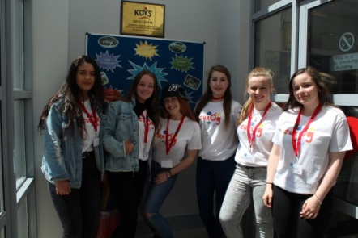
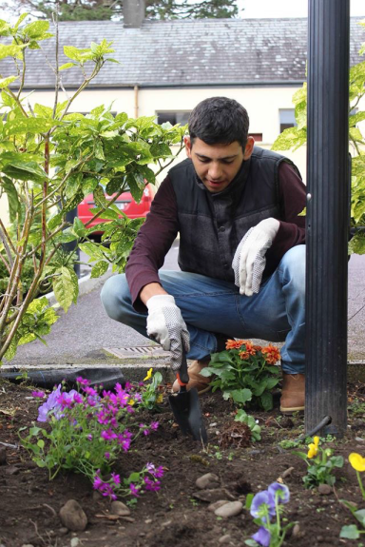
CASE STUDY
KDYS Youthreach Programme
Youth work
Education
Training

Slide 14
KDYS Youthreach Programme
Young Person
Certification
Holistic approach
Positive youth development
Learner centred
Soft skills development

Slide 15
Profile of Participants
Educational
Personal
Social
Poor literacy numeracy
Poor or no qualifications
Struggling within formal education system
Anxiety
Mental health concerns
Alcohol /drug misuse
Anger management
Antisocial behaviour
Struggling with identity
Bullying
Isolation
Family circumstances
Young people may have a number of the above issues/difficulties

Slide 16

CASE STUDY
In trouble with the law
Missing school
Drug & alcohol issues
Socially Isolated
Behavioural issues

Slide 17
CASE STUDY
A young person, age 15, was referred to the KDYS Youth Justice project 8 months ago because of public order offences.
The Youth Justice worker has worked on a 1:1 basis to build up trust with the young person and to support young person to set goals.
He has engaged with the process and built a good relationship with the Youth Justice worker. In the course of the work, other issues have emerged.
He is currently not attending school and is increasing his use of cannabis. There is concern that he is isolating himself from his friends.
The Youth Justice worker has referred him to the KDYS Community Drugs worker for support around substance misuse issues.
He also has been referred to the KDYS Killarney Youthreach Programme
The above staff will work in a holistic manner with the young person to help him achieve his potential in a supportive, empowering environment
Engagement by the young person is on a voluntary basis.

Slide 18
WORKING WITH YOUNG PEOPLE
AT RISK
Developing a relationship with the young person
Assessment of strengths & needs is carried out with young person
Young person sets goals and targets and an individual plan developed
Plan is implemented & reviewed regularly with the young person
Young person progresses
Young person centred approach at all stages.

Slide 19
CURRICULUM
Educational
Maths
Personal
1:1 contact time
Community
Access to counselling
Sports/outdoor education
Work experience
Community based activities
Personal development
Mindfulness
Literacy
ICT
Health related fitness
Food & nutrition
Career preparation
Art & design
Mentoring
Paired reading
Community parades
No Hate Campaign
Access to other KDYS services
Volunteering opportunities
Development of youth spaces
Leadership roles in KDYS events
The curriculum is tailored to suit the needs of the group

Slide 20
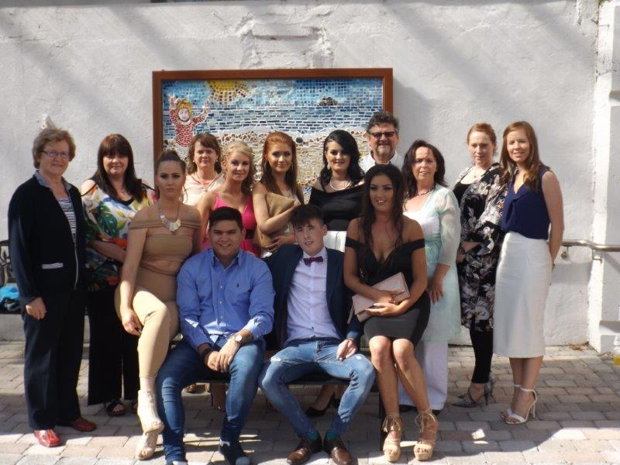

Outcomes
Increased resilience
Enhanced personal and social skills
Attainment of Qualifications
95% Progression onto further education/training/work
Improved relationships with peers and family
Improved self of wellbeing
Addressing issues impacting on wellbeing
More confident and engaged

Slide 21
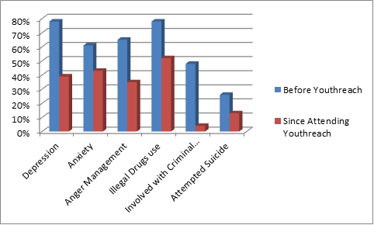
IMPACT
Source: “A profile of learners in Youthreach Research study report”, National Educational Psychological Service (February 2017) Dr. Mary Gordon.

Slide 22
SUPPORTS UNDERPINNING
THE WORK
Integrated services
KDYS services working in partnership to ensure seamless service delivery for young people
Internal and external collaboration to respond to youth needs
Data analysis
Ongoing analysis of data collated from services to inform service delivery
Identification of trends and patterns in the work informs opportunities for development
Youth Participation
Role of young people as co-designers in determining programme and service development
More vulnerable young people require more supports to empower them to articulate their views and take on leadership roles.

Slide 23
Youthreach in a European Context
The EU has committed to reducing the average share of ESLs to less than 10% by 2020 and agreed on a framework for coherent, comprehensive and evidence-based policies to tackle early school leaving.
The Youthreach programme is described as a compensation measure under this EU framework. However, it could just as easily be thought of as a prevention and intervention measure because its’ function is to retain young people in full time education until they achieve recognised qualifications.
A key challenge is how to attract and retain young people within Youthreach until they have acquired the knowledge, skills and confidence they need for their future wellbeing and independence.

Slide 24
Context for working with
At Risk Young People
Engagement in KDYS Services is providing opportunities for young people who are deemed to be vulnerable or at risk, to develop the capacities, competencies, skills, knowledge and resilience to be active agents in their own development and become active citizens.
The importance of this is reinforced by Recommendation to the Council of Europe member states on youth work, adopted by the Committee of Ministers on 31 May 2017, which says that:
Young people are a key resource for building a social and just Europe, and providing them with structured support is an important investment Europe has to make for its present and future.
“The sustainability of European identity and the Council of Europe’s core values – human rights, rule of law and democracy – relies on the creativity, competences, social commitment and contribution of young people, and on their confidence in the future,” the Committee of Ministers said.
Challenges of transition from childhood to adulthood and autonomy, as well as the decline in opportunities for young people as a result of increasing unemployment, poverty, discrimination and social exclusion, put European youngsters into an uneasy situation. “Societies are at high risk of undermining stability and social cohesion if they allow the current difficult circumstances to create a ‘lost generation’ of disillusioned and disengaged young people,” the Committee of Ministers warns.
Provision of quality youth work is vital in this endeavour, as it develops critical thinking, increases the sense of belonging, and strengthens young people’s capacity to resist negative influences and behaviour: this is core to KDYS Youth Work Provision.

