Slide 1
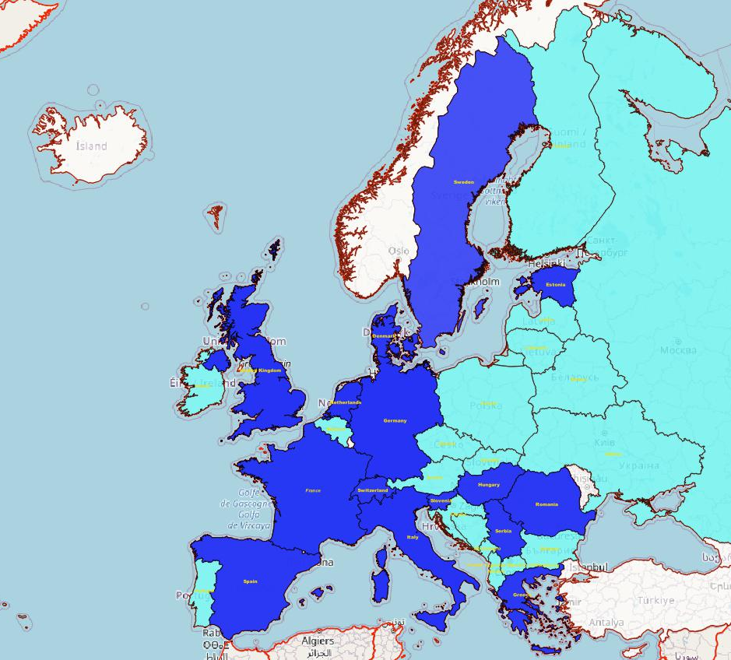
Last meeting of SEH CC in Wolverhampton – 22nd ECH 9. September 2023.
Societas Europaea Herpetologica - SEH Conservation Committee
Balint Halpern (MME BirdLife Hungary)
11th Meeting of Group of Experts on the Conservation of Amphibians and Reptiles
1.
Chair: Bálint Halpern, Vice Chair: Katja Poboljšaj
14 full members + 8 corresponding members - representing 15 countries (dark blue)
additional country representatives – 28 countries (light blue)

Slide 2
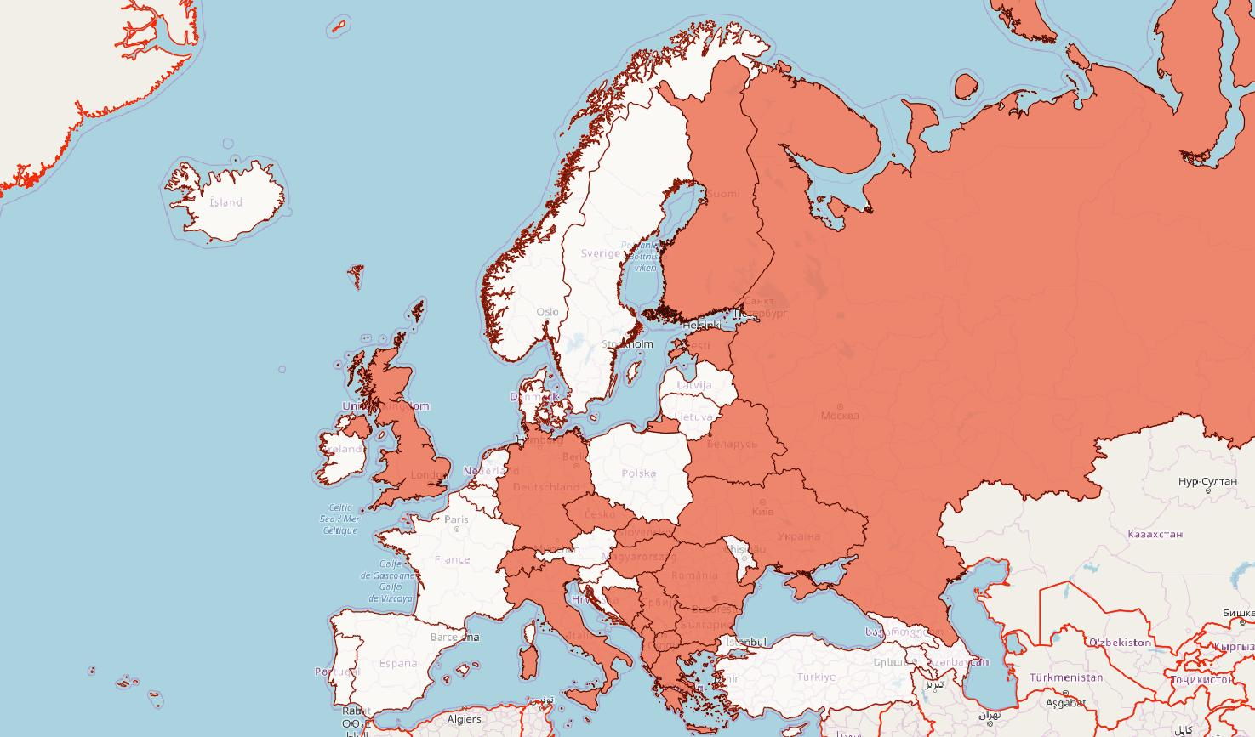
Country reports – received from 20 countries
Societas Europaea Herpetologica - SEH Conservation Committee
Balint Halpern (MME BirdLife Hungary)
11th Meeting of Group of Experts on the Conservation of Amphibians and Reptiles
1.

Slide 3
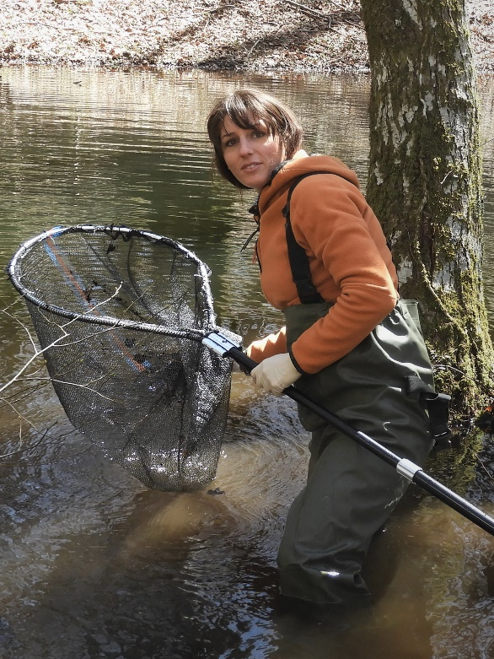
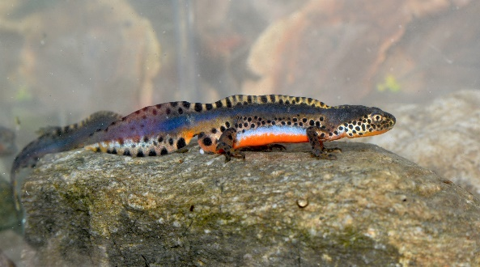
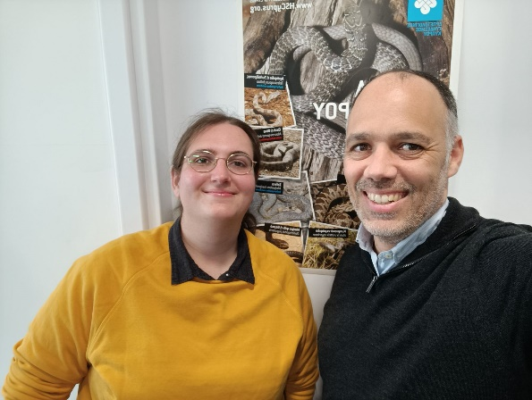
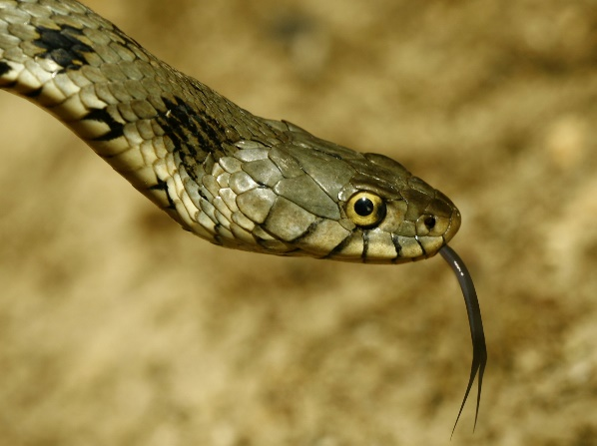
SEH Grant in Herpetology – Conservation https://www.seh-herpetology.org/seh-grants
SEH Conservation Committee
Annual grants:
up to 2 per year
up to 5.000 EUR per grant
Conservation Grant for 2023:
Ilaria Bernabò - Allochthonous fishes and endemic newts: a road map for a conservation strategy – Italy
Marilena Stamatiou, Savvas Zotos - Monitoring the population of the endemic Cyprus grass snake at Paralimni lake – Cyprus

Slide 4
Continuous activities
SEH Conservation Committee
European Red-list (re)assessment of Amphibians and Reptiles, participation of many members
Bern Convention Group of Experts on Amphibians and Reptiles – SEH represented by Bálint Halpern
European Habitat Forum – SEH represented by Bálint Halpern
Hydropower Europe – SEH represented by Bálint Halpern, Dan Cogalniceanu, Jelka Crnobrnja-Isailovic

Slide 5
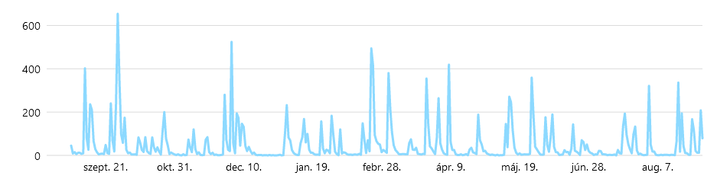
Currently 1470 followers on Facebook
SEH Conservation Committee
Facebook posts’ daily reach 2022 - 2023
https://www.facebook.com/SEHConservationCommittee/

