Slide 1
Elements of effective alternatives to immigration detention
Jem Stevens, International Detention Coalition
Strasbourg, 4 April 2019

Slide 2
International Detention Coalition
The International Detention Coalition (IDC) is :
A global network of over 400 civil society organisations and individuals in almost 90 countries working towards a world without unnecessary immigration detention.

Slide 3
Definition of alternatives
The IDC defines alternatives to immigration detention as:
Any law, policy or practice by which persons are not detained for reasons relating to their migration status.

Slide 4
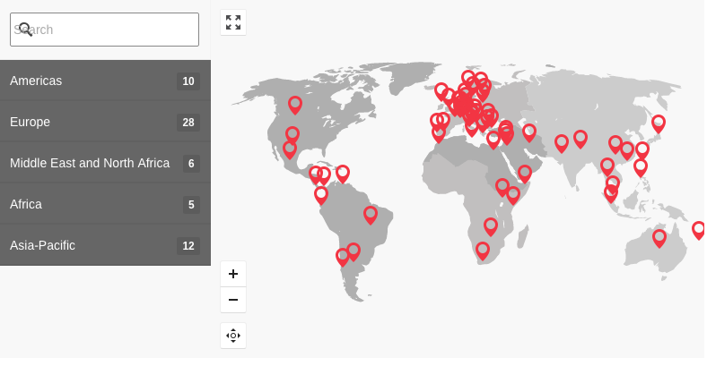
Our research identified over
250 examples in 65 countries researched.

Slide 5
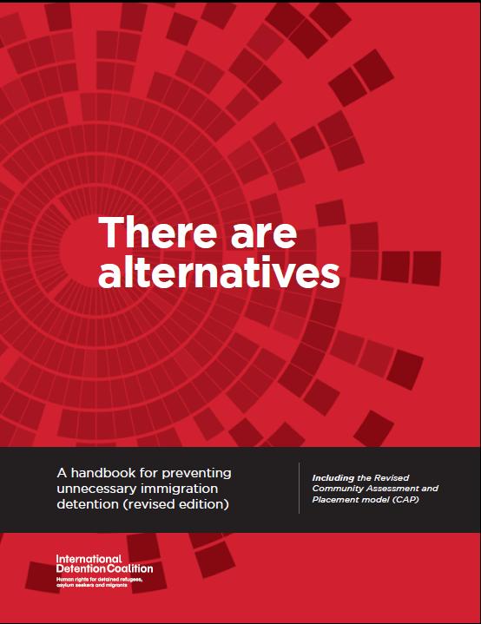
The most effective alternatives:
Build trust and support migrants to engage in immigration processes, in particular through tailored case management.

Slide 6
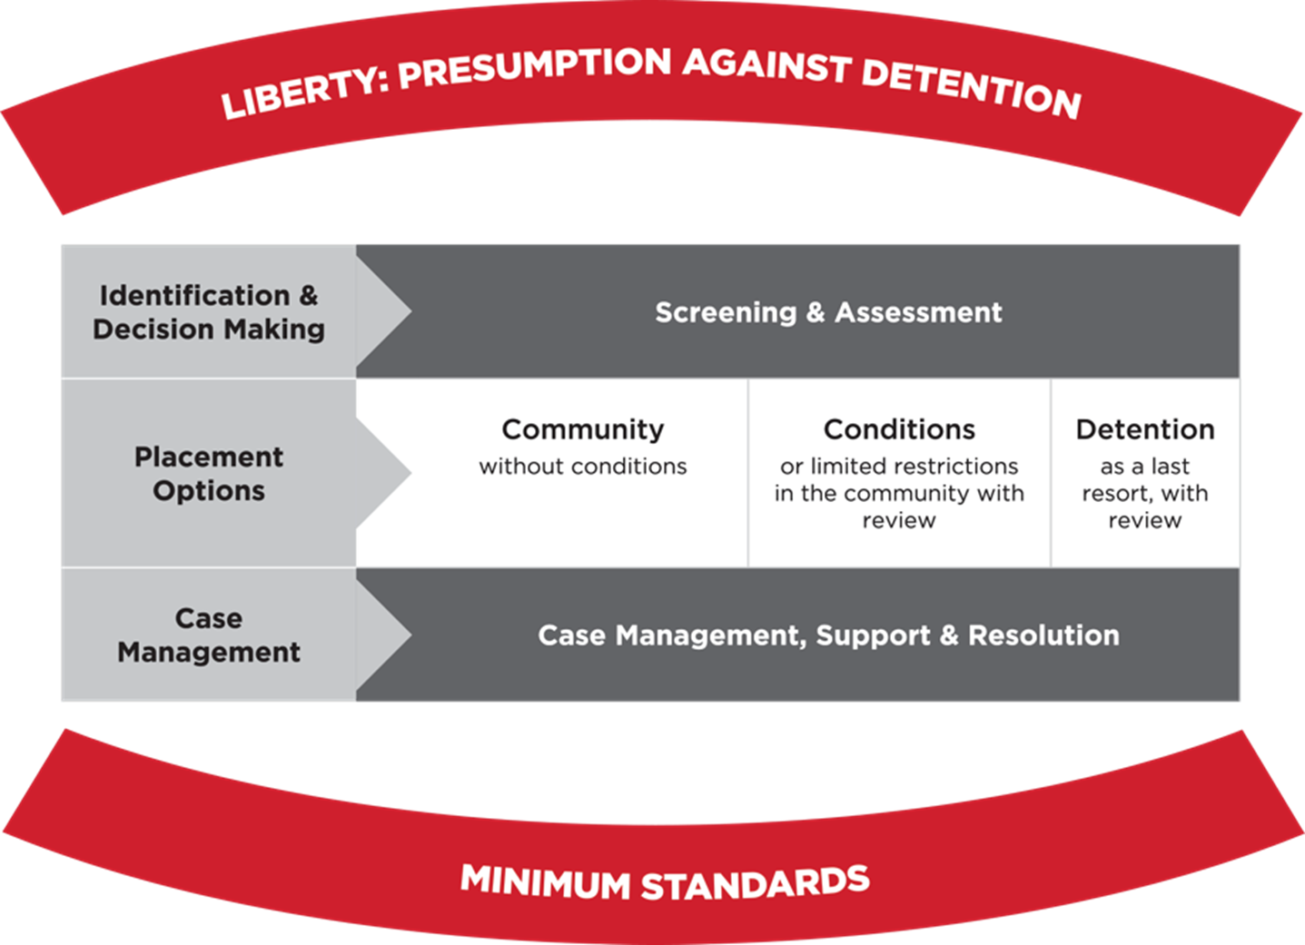
Building blocks for effective ATD:
The revised Community Assessment and Placement (CAP) model
Elements of successful alternatives
Using screening and assessment to tailor management and placement decisions
Providing holistic case management focused on case resolution
Focusing on early engagement
Ensuring individuals are well-informed and trust they have been through a fair and timely process
Ensuring fundamental rights are respected and basic needs are met
Exploring all options to remain in the country legally and all avenues for voluntary or independent departure
Ensuring any conditions imposed are not overly onerous

Slide 7
A wider range of alternatives in Europe
Scope to develop a wider range of alternatives in Europe, with a focus on approaches which have an evidence base in effectiveness
Opportunity to draw on growing guidance, practice and learning on engagement-based alternatives in the region

Slide 8
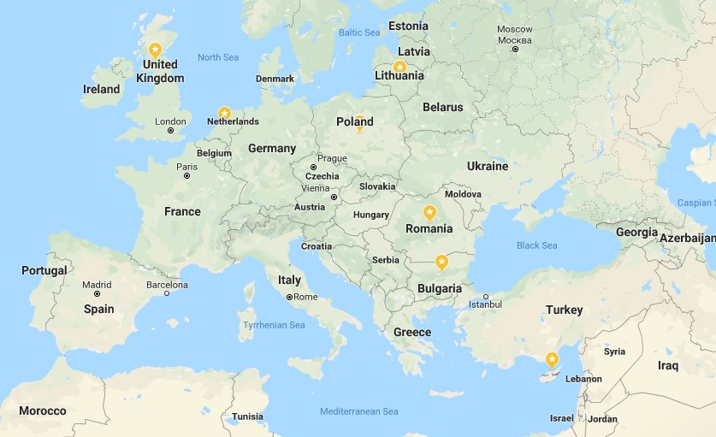
Growing practice and guidance on engagement-based ATD
Council of Europe: Legal and Practical Aspects of Alternatives to Detention (2017) and draft Handbook on ATD implementation
European Commission: Return Handbook (2017)
UK – pilot project to support vulnerable women in the community, who would otherwise be at risk of detention (2018)
Netherlands – agreement between national and city governments to pilot shelter and professional guidance to find durable solutions for people without the right to stay in the Netherlands (2018)
Lithuania – community-based placement with case management for asylum seekers (2018)
Increasing interest and involvement of stakeholders including municipalities and civil society organisations

Slide 9
Set up in 2017, the European Alternatives to Detention (ATD) Network links NGOs running case management-based alternative to detention pilot projects in four European countries - Bulgaria, Cyprus, Poland and the UK- with the International Detention Coalition (IDC) and PICUM.
The Network aims to:
Collectively build evidence and act as a hub of learning on effective alternatives to detention.
Practical implementation, and qualitative and quantitative evaluation
To initiate discussions and collaboration between stakeholders to support further development of ATD.
www.atdnetwork.org

Slide 10
Insights from case managers
Cyprus Refugee Council – working since 2017 with people in detention and at risk of being detained including asylum seekers, refused asylum seekers, irregular third country nationals and people considered to be unremovable.
Community Support Project (UK)- working since 2014 with young male ex-offenders with barriers to removal, to reduce the risk of absconding and reoffending and assist them to meet the conditions of their release and avoid long-term detention.

Slide 11
Opportunities for developing effective alternatives to detention
Opportunities to develop pilot projects providing case management to a defined categories of migrants, to test models tailored to the specific national context.
Through qualitative and quantitative evaluation, adjust approaches to improve effectiveness.
Collaboration between a range of stakeholders, including national and local governments and civil society around shared objectives can strengthen alternatives.
European funding opportunities e.g. ERRIN and AMF.

