Slide 1
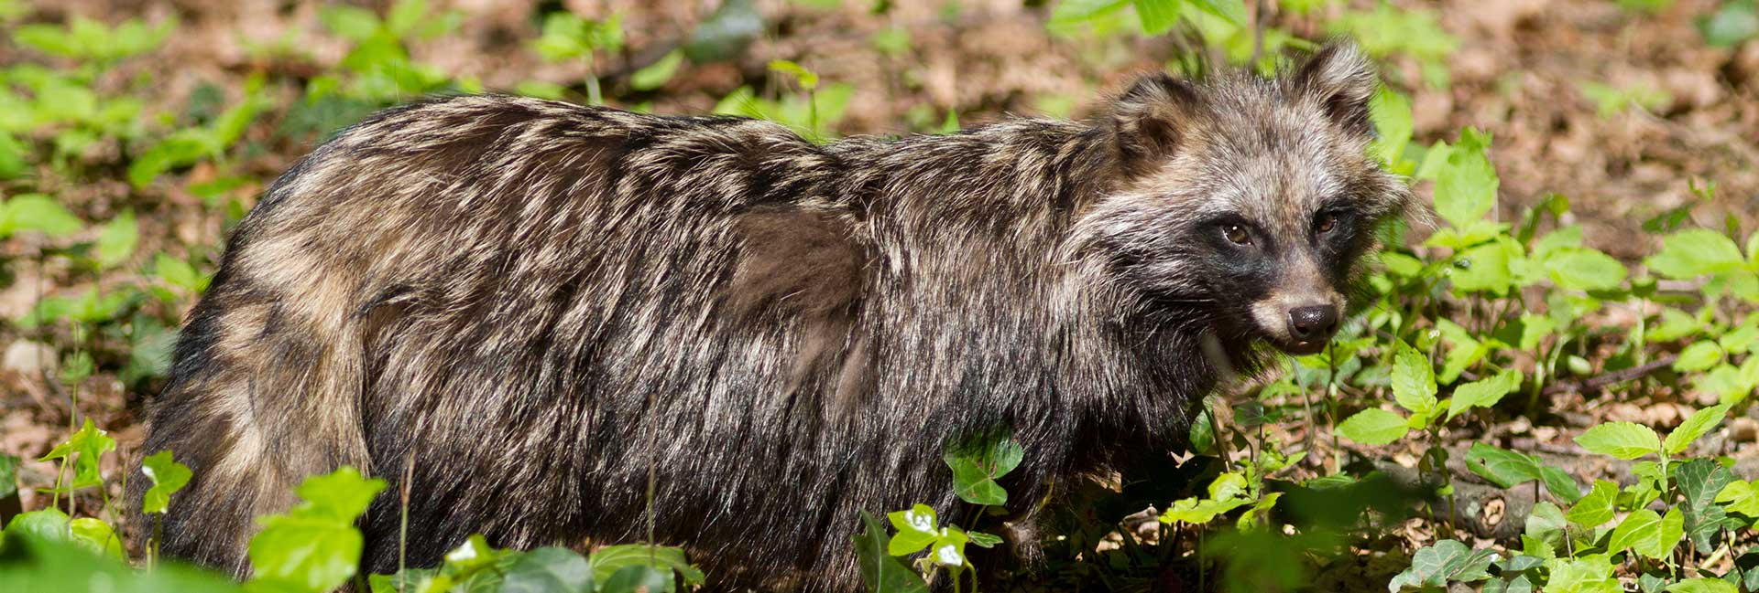
The key role of hunters in the management of IAS - Cooperation with the BC Sabrina Dietz Wildlife Policy Officer European Federation for Hunting and Conservation (FACE)

Slide 2
FACE: who we are and what we do
International non-profit-making non-governmental organisation (iNGO)
37 members
Representation in the EU institutions and stakeholder platforms
Member of the International Union for Conservation of Nature (IUCN) since 1987

Slide 3
FACE Biodiversity Manifesto
The Biodiversity Manifesto is a substantial database of hunting-related conservation projects
Dedicated section on IAS

Slide 4
2013 – THE EUROPEAN CODE OF CONDUCT ON HUNTING AND IAS
Developed by the BC with support from FACE
Adopted at the 33rd Standing Committee of the BC
Based on 7 principles
Improve the sustainability of hunting by supporting IAS management and preventing the release of IAS

Slide 6
2017 – REPORT ON THE IMPLEMENTATION OF THE COC ON HUNTING AND INVASIVE ALIEN SPECIES
Presented at the 37th Standing Committee
Second implementation report
Range of practical solutions and concrete examples
10 countries
Detailed chapter by IAF on principle 5

Slide 7
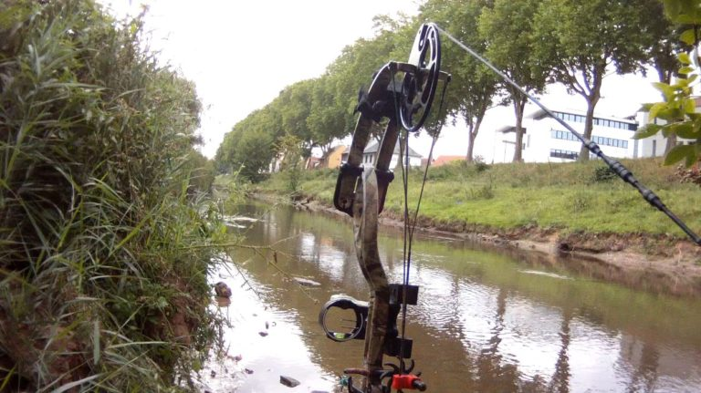
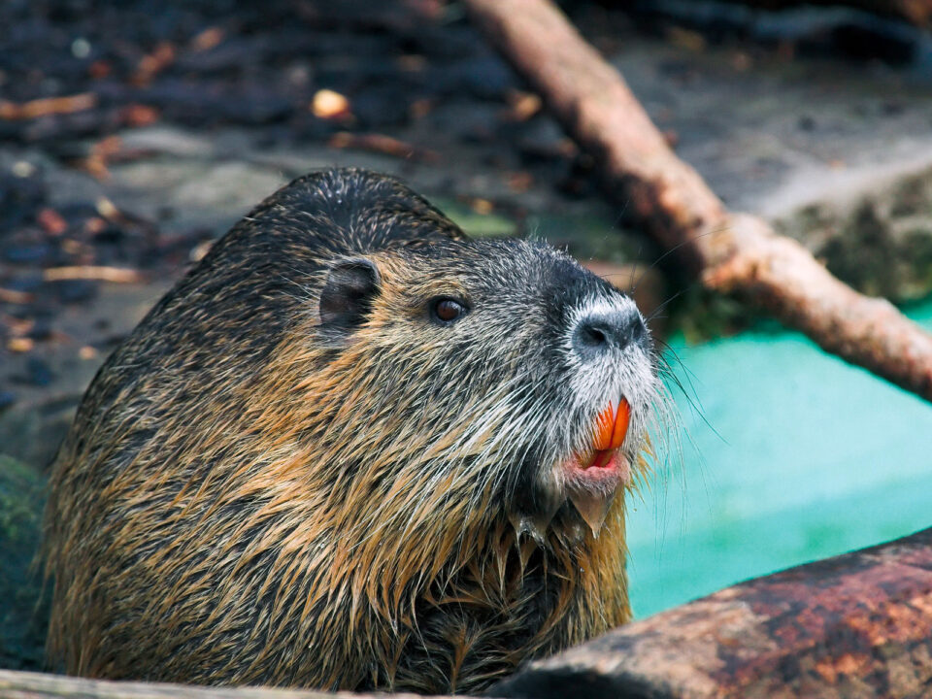
2021 – PLANNED UPDATES
Updating 10 current countries
Minimum 2 new countries
Presenting innovative and new solutions by hunters
Updating chapter by IAF on principle 5

Slide 8
Sabrina Dietz Wildlife Policy Officer sabrina.dietz@face.eu
Thank you for your attention!
EUROPEAN CODE OF CONDUCT ON HUNTING AND IAS
2017 - REPORT ON THE IMPLEMENTATION OF THE CODE OF CONDUCT ON HUNTING AND INVASIVE ALIEN SPECIES

