Slide 1

Hyperautomation of the order for payment procedure
Crystal Scales of Justice Prize awarding ceremony
(Nicosia, Cyprus)
9 October 2025
CEPEJ

Slide 2

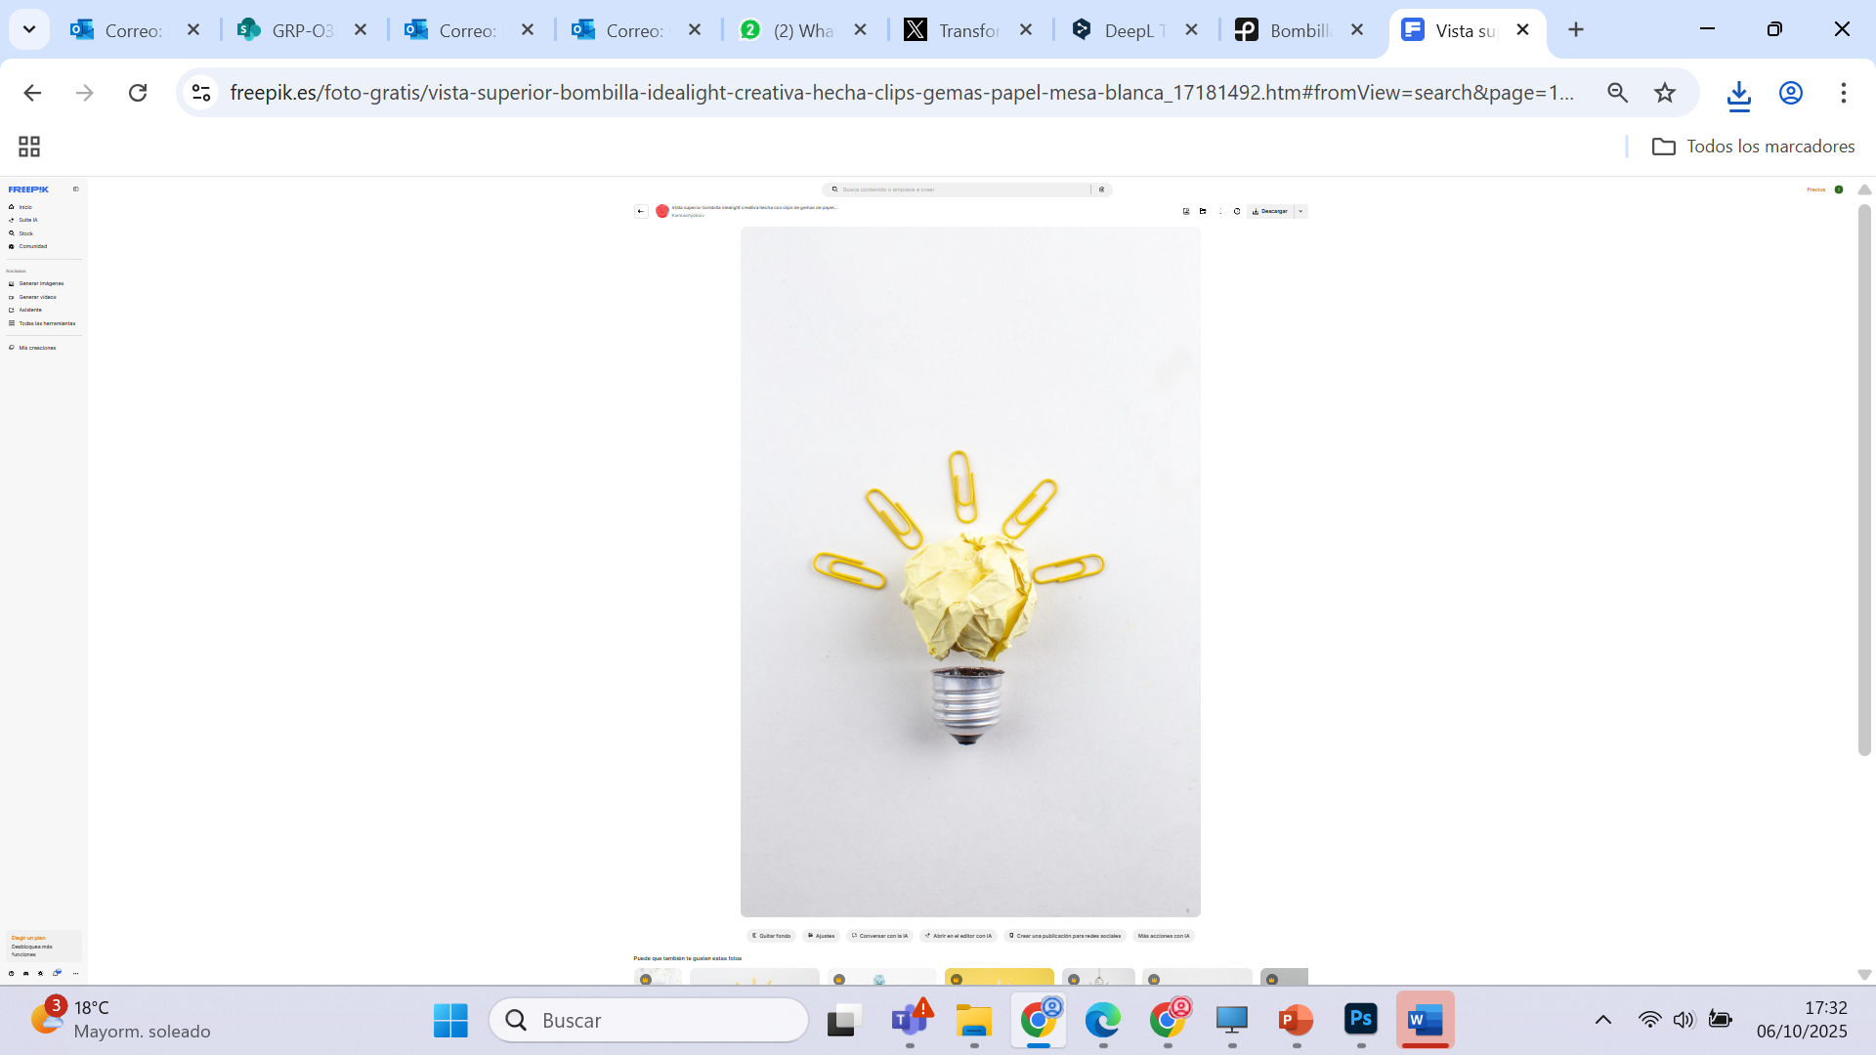



01 The scene
Slow processing means
slow public justice service
Judicial staff should be focused on higher value-added tasks
Mechanical, simple tasks can be automated
High workload in the courts
e.g. order for payment procedures
account for up to 60% of civil cases
Data orientation allows for more efficiency and better decision making

Slide 3

02 What if we (hyper)automate processes?
>181,000 operations, meaning >€221 million
Estimated time savings of >25,000 working hours
Order for payment procedures
Cancellation of criminal records
>1,000,000 operations
Estimated time savings of >10,000 working hours
Nationality processes
>4,000,000 operations
Estimated time savings of >390,000 working hours
3

Slide 4


03 Ongoing initiatives on automation and AI
Classification of documents prior to submission to courts and Public Prosecutor’s Office
Extraction of data and information from documents
Virtual agents that help with routine and repetitive tasks
Summary and anonymisation of documents
Weekly publication
of FAT records
(Fairness, Accuracy, Transparency)
to ensure an ethical use of AI
4
4

Slide 5

04 Taking the order for payment to the next stage
Order for payment is a massive, but typically simple case
Almost the entire procedure has been automated using RPA and AI.
+85 % of cases initiated in the CMS use this new form (Jun-Sep 2025)
From a free format document to a standardised data-oriented form in LexNET (mandatory since 2025)
Also available for integrated companies by web services
Automatic classification of annex documents in LexNET
Massive and predictive processing, with automated admission criteria and rule-based decisions
5
5

Slide 6





05 The benefits
Reduction of up to 100 days in resolution times
Less errors and higher efficiency (from 100 to 500 decrees in a day)
Greater legal certainty and fairness

Slide 7




06 An unstoppable process
  More time for what it really matters
  thanks to the use of automation and AI.
7

Slide 8
Directorate-General for Digital Transformation of the Administration of Justice
Ministry of the Presidency, Justice and Parliamentary Relations

