Slide 1
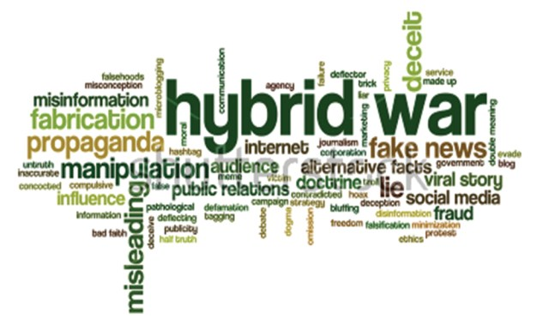
Source: Ukraine Analytica

Slide 2
Hybrid Threats
Difficult characterization
Multidimensional actions
Not always interconnected
Fluid, reticular and transnational
Without an obvious identification of the proposer.
Traditional threats were centered on state security. HT emerge slowly. Sometimes its causes and effects are not easily verifiable.
The results are not always immediate

Slide 3
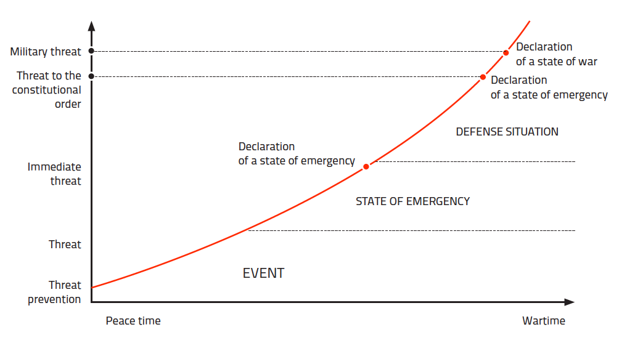

Slide 4
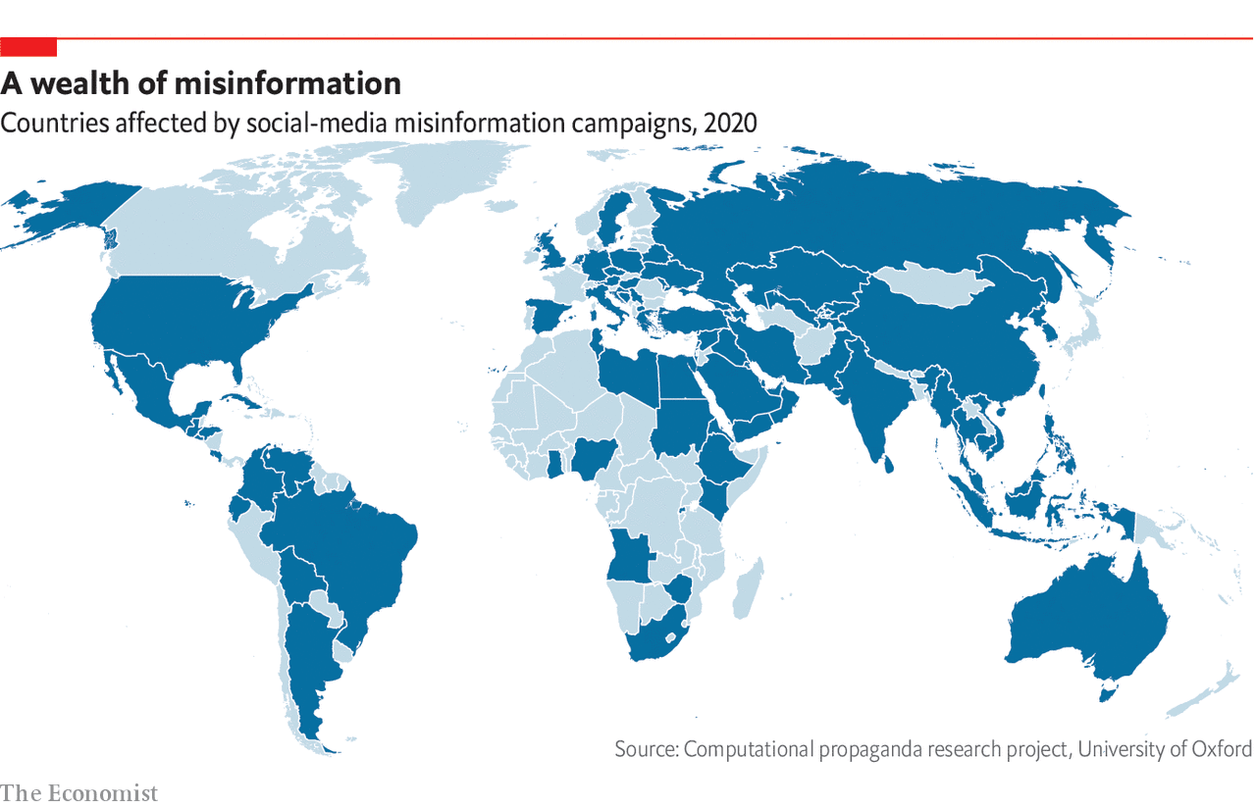

Slide 5
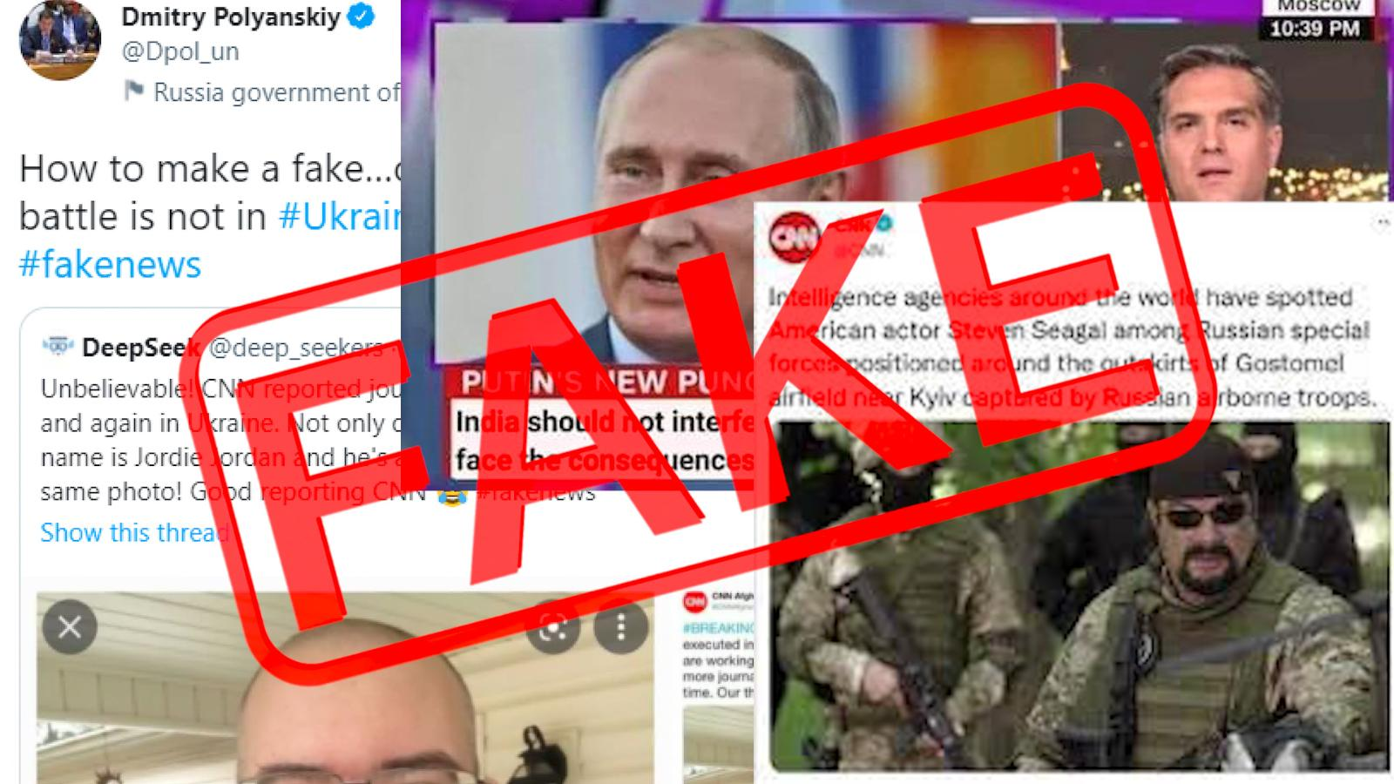

Slide 7
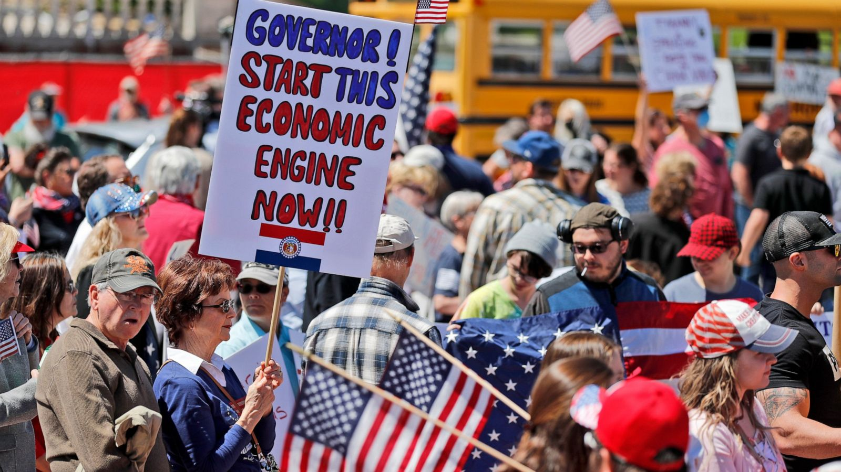
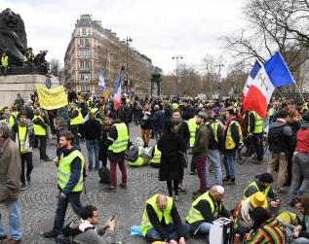
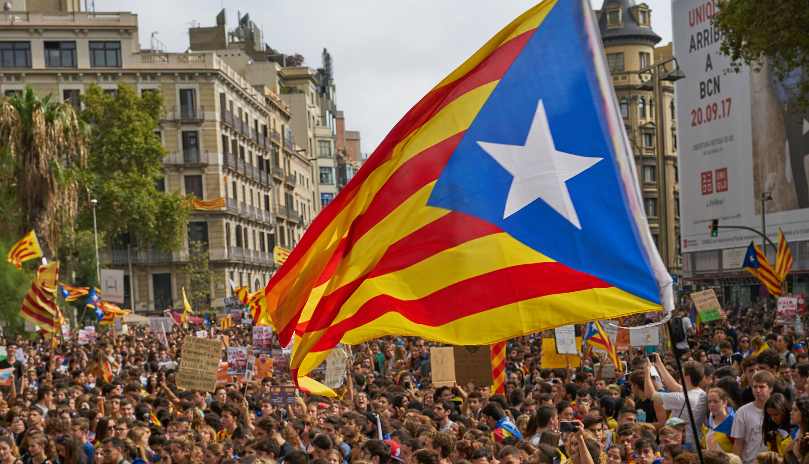

Slide 8
Hybrid Warfare (fSource:U.S Department of Defense, National Military Strategy 2015.

Slide 9
Non-Linear Warfare (Source: graphic from Gerasimov article in Voyenno-Promyshlennyy Kurier, 26 February 2013, translated by Charles Bartles , 2016)

Slide 11
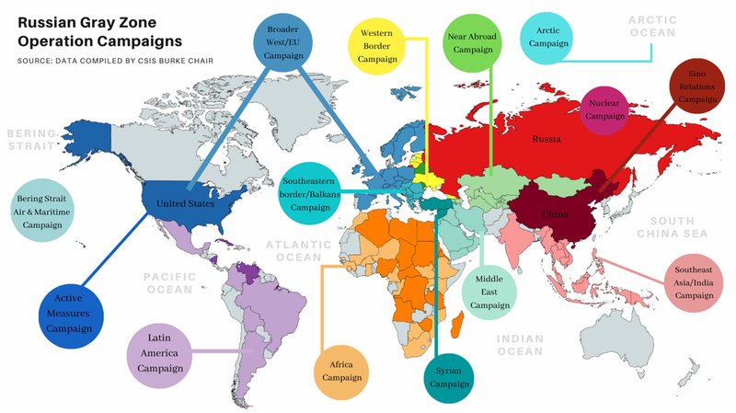

Slide 12
Typology of the Threat
Kinetic
Proxies
Non-declared conflicts
Paramilitary groups
Non-Kinetic
Narrative Led Operations e Weaponization of Social Media
Propaganda, Disinformation and Counter-information
Strategic Leaks
Parastatal news agencies
Financing (think tanks, political movements, NGO’s...)
Economic Pressure (conditioning international political positioning)
Cyber ​​attacks (as targets or as platforms)

Slide 13
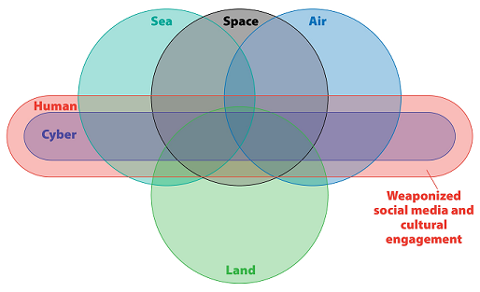
Source: adsciblog.tradoc.army.mil
Source: Modern War Institute

Slide 15
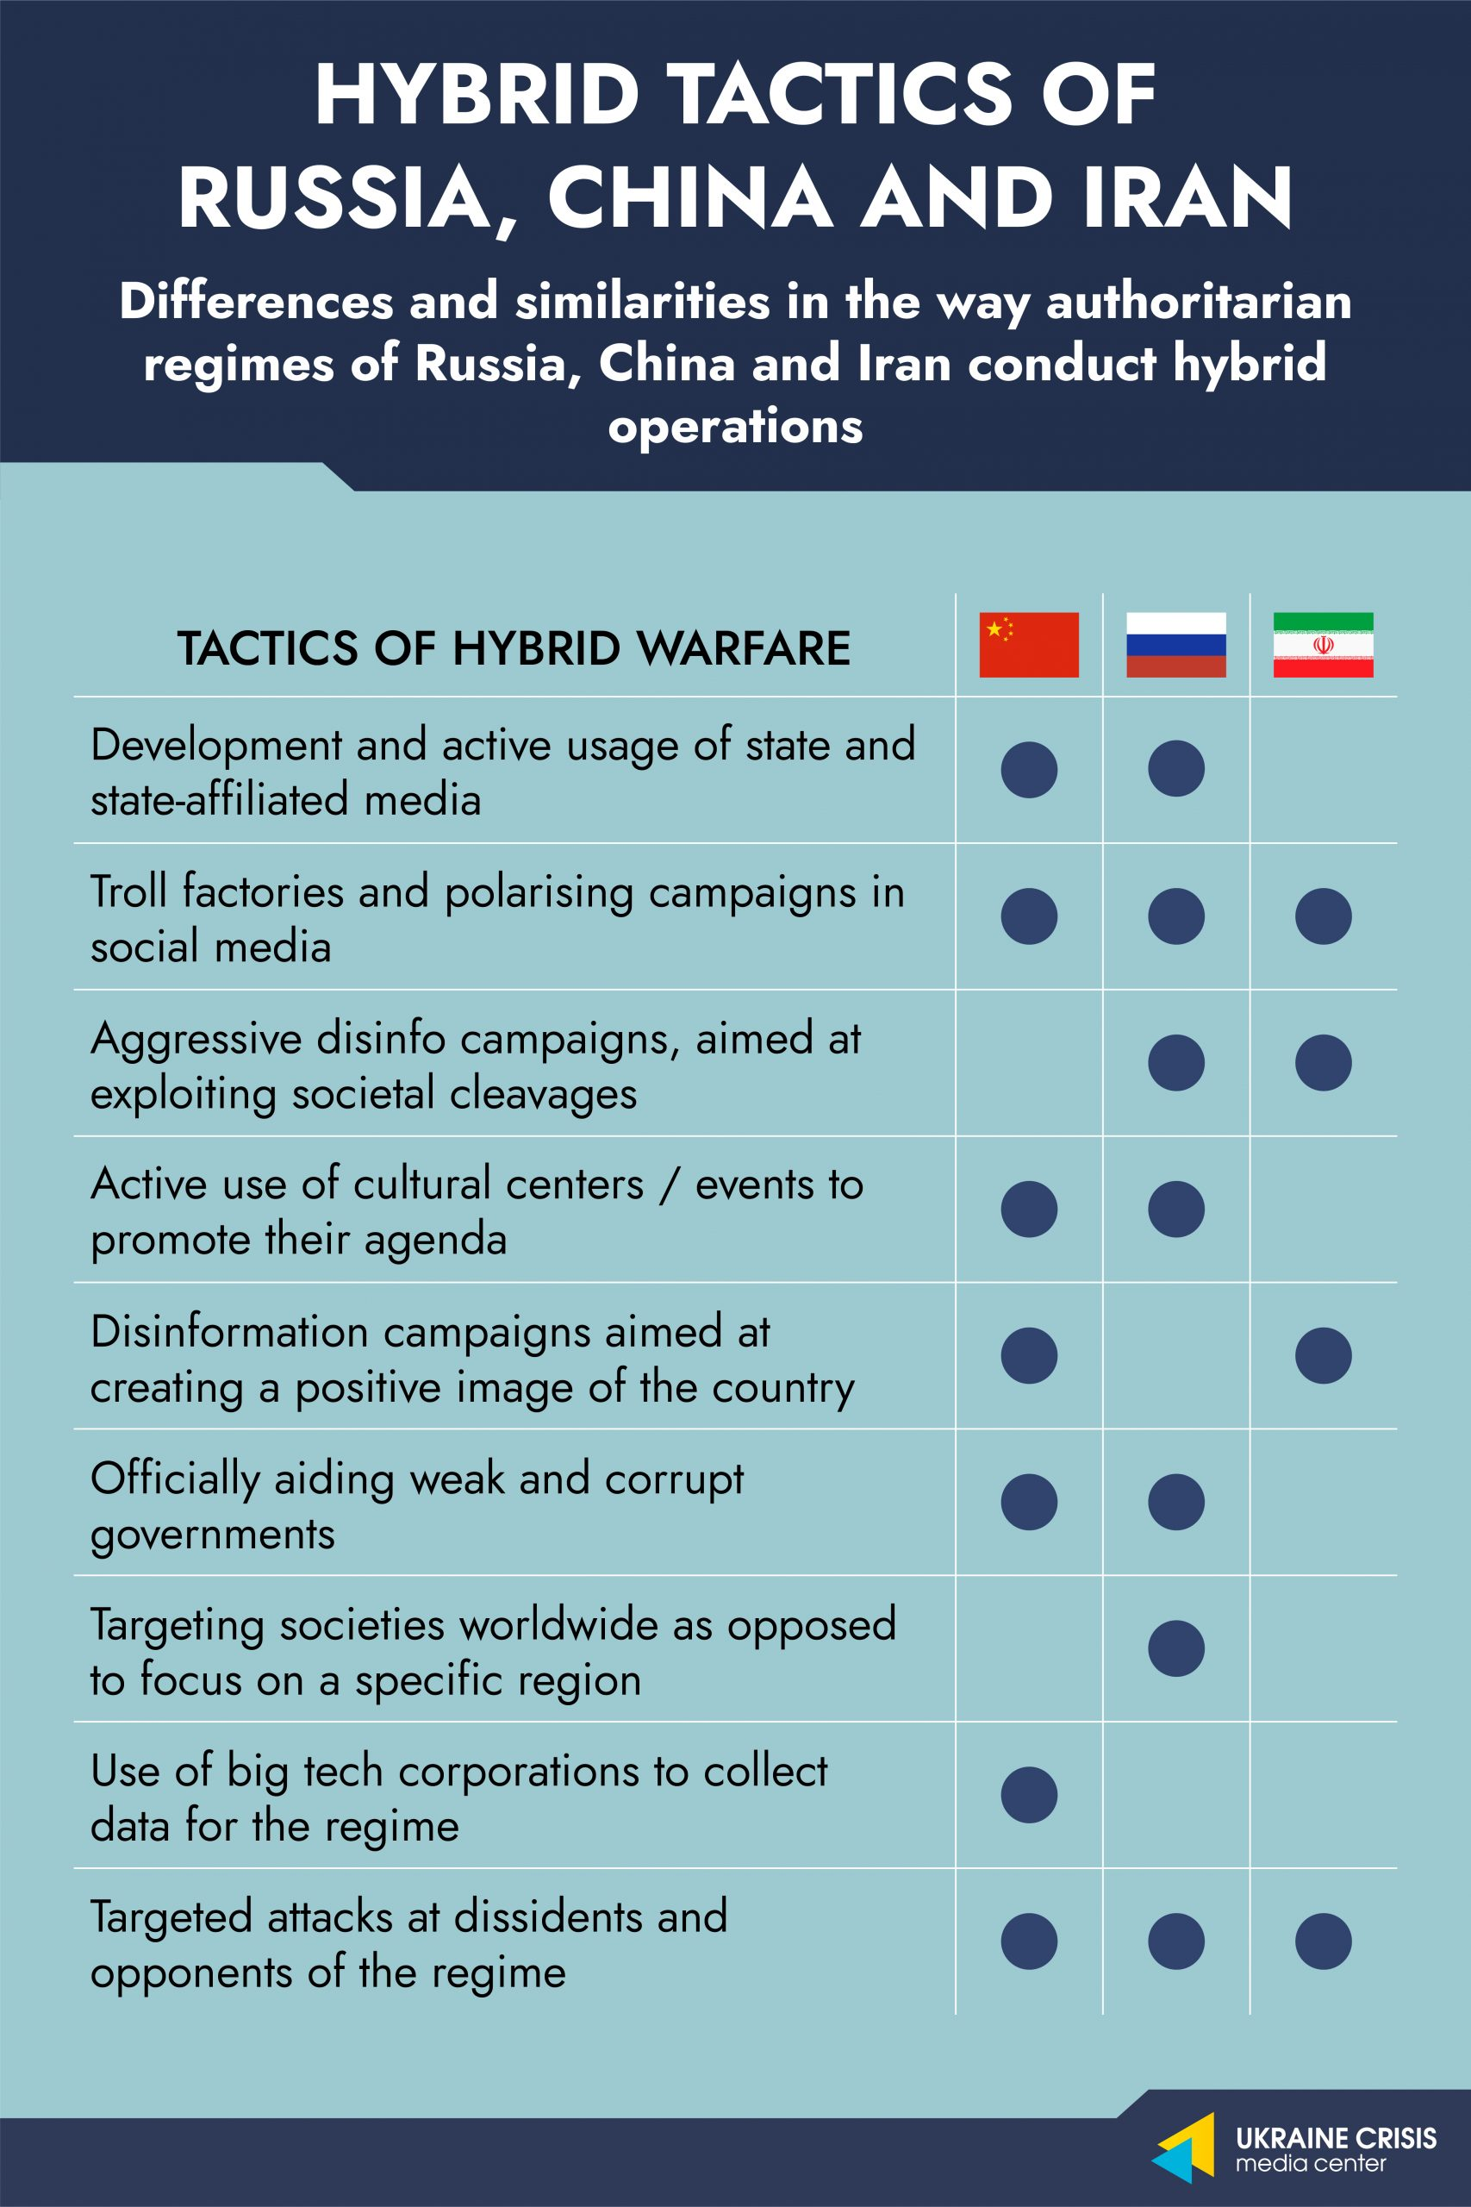

Slide 16
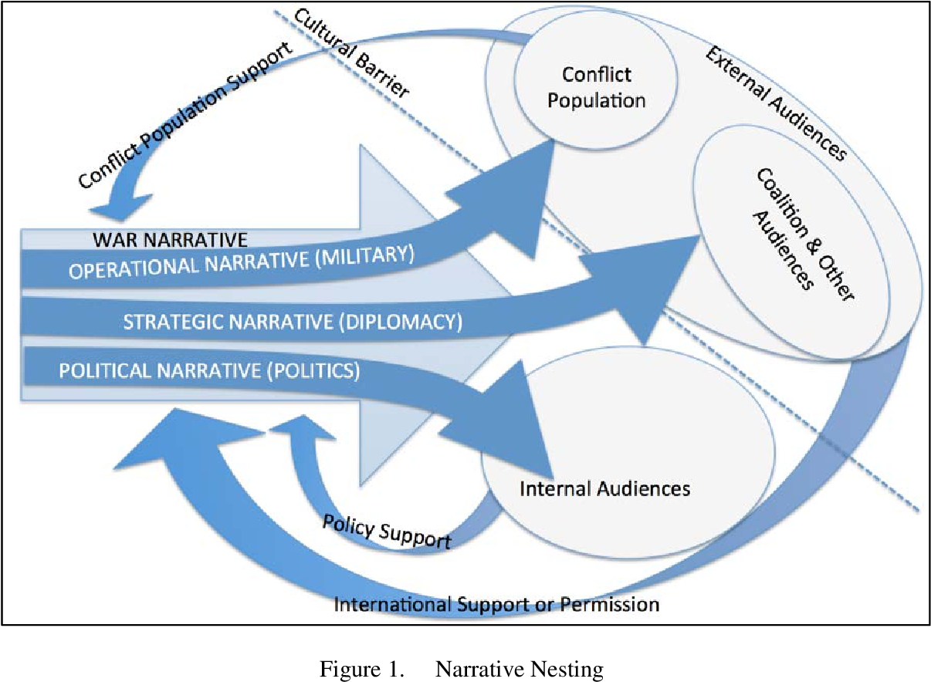
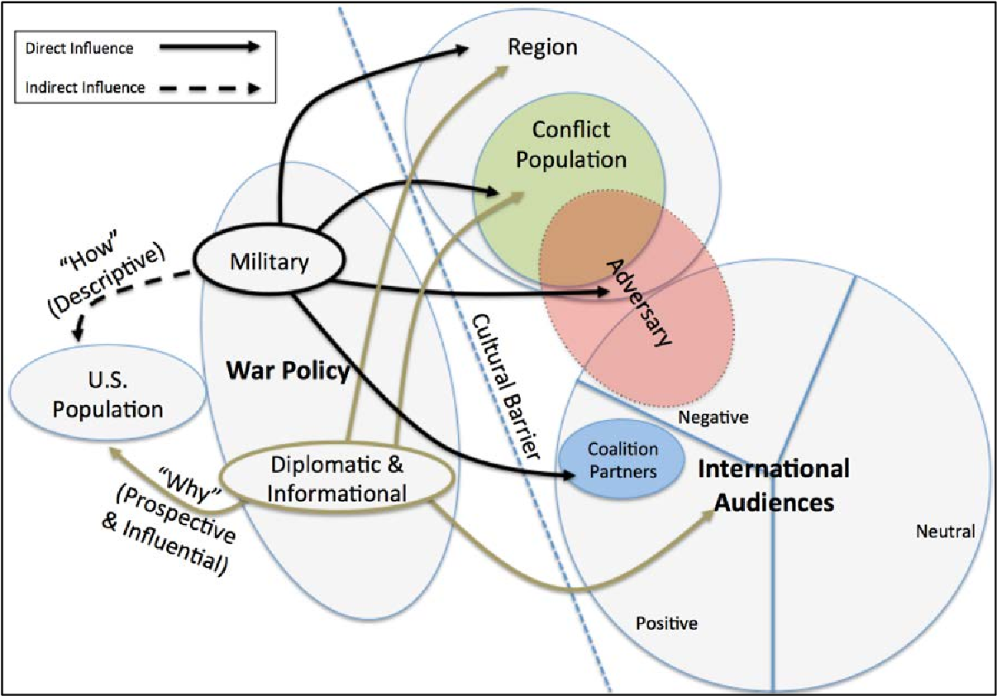

Slide 17
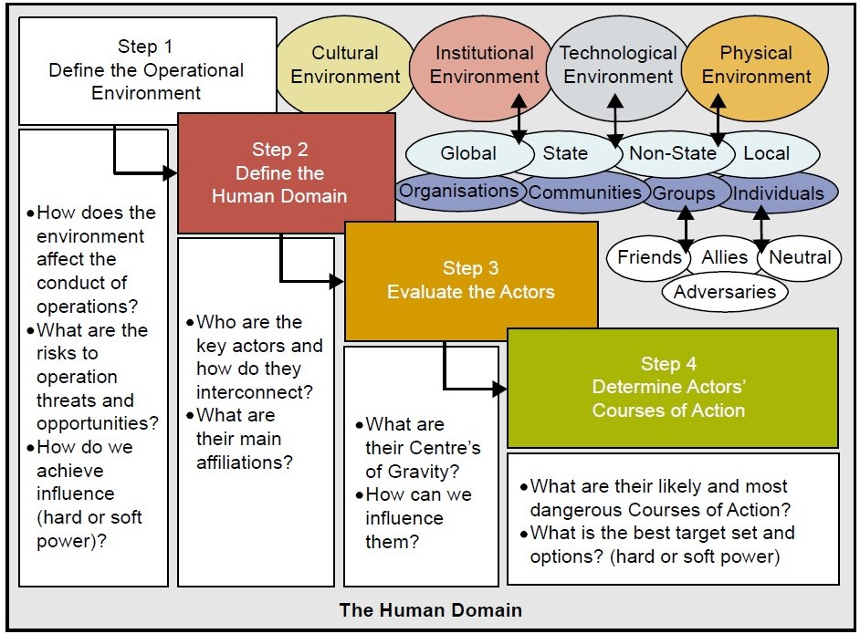

Slide 18
