Slide 1

HRE NRTCs
2017-2019
Evaluation summary

Slide 2
128 days
for Human Rights Education

Slide 3
26
14
Surveys, discussions
Reports by national organisers
Reports by trainers appointed by the Youth Department
With the programme stakeholders (CDEJ, organisers, trainers, YD)

Slide 4
Organisers
1
Countries, duration, support from the Council of Europe

Slide 5
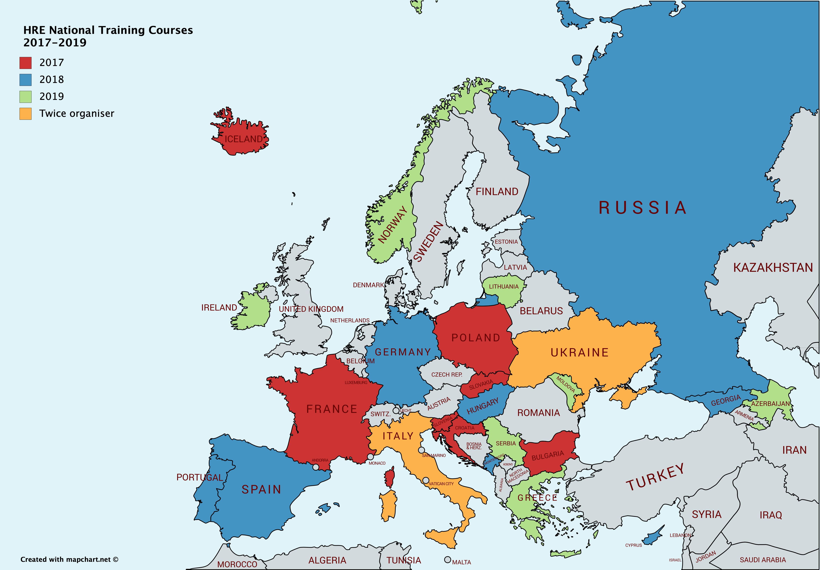

Slide 6
Notes:
9 courses had a duration of 4 days (could have been also a formula of 2+2 more days later on)
12 courses had a duration of 5 days
3 courses had a duration of 6 days and
2 courses had a duration of 7 days

Slide 8
Participants
2
Profile, number, gender balance

Slide 9

Profile of participants
Approx. 1300 applicants
As capacity-building activities, the national training courses aim at developing the competences (knowledge, skills, attitudes and values) of key multipliers for human rights education such as youth leaders, youth workers, trainers, human rights activists, teachers and teacher trainers.
Approx. 550 participants

Slide 11
Notes:
No data from 2 countries (just the total, this is why the total is higher)

Slide 12
Why, to what end
3
Objectives, competences developed

Slide 13
Promoting human rights/a universal culture of human rights, in particular social rights; democratic values and specifically
Working on values associated with human rights, such responsibility, justice, solidarity cooperation
Getting insights on the history of human rights, contemporary human rights concepts, institutions and fundamental documents for the protection of human rights at the global level
Developing competences for activism and lobbying for human rights at national level
Exploring what it means to be youth with fewer opportunities in relation to human rights
Using tools for promoting an understanding and respect for human rights online
Mapping challenges to human rights in a certain national context
Promoting human rights education with young people and specifically
Contributing to its mainstreaming in a particular national context.
Aims

Slide 14
Training key multipliers (youth workers, youth leaders, teachers, university students, human rights activists, trade union activists, non-formal education specialists/trainers, peer-to-peer educators, police officers etc) in human rights education with young people, and in particular
Developing the competences of the participants in planning, designing, implementation and evaluation of HRE activities
Creating or strengthening existing national network of organisations working for human rights education, with an emphasis on
Creating partnerships for human rights education between youth organisations, schools and police
Building partnership between youth workers coming from different governmental and non-governmental organizations and design partnership-based projects in human rights education
Objectives

Slide 15
Generate or raise quality of national actions for human rights education (improve knowledge, skills, attitudes) / To support participants in undertaking concrete actions for human rights education, with a focus on the following particular contexts
In youth centers
By youth in the communities
In rural areas and small towns.
Objectives

Slide 16
The following supporting elements were part of the aims of courses organized between 2017-2019:
Developing awareness about and competences to use the manual Compass and other educational resources such as Mirrors, Bookmarks, We can!; learn how to adapt methods to one’s own context and target group
Promoting the EDC/HRE Charter of the Council of Europe (promote awareness of it, put it in practice, work together with local authorities in promoting HRE)
Some training courses aimed specifically at:
Combating all forms of discrimination among young people, both online and offline
Combating hate speech (including online)/ develop competences in this sense
Link with the Council of Europe’s No Hate Speech Movement, national campaigns and local activists, including developing competences related to building strategic partnerships, advocating for support; empower organisations and individuals in the movement etc.
Combat radicalisation, (national) extremism
Combat antigypsism (explore the concept of antigypsism, its manifestations today and develop possible ways of fighting it; explore practices of different organisations, initiatives and individuals in HRE with a focus on challenging antigypsism; encourage participants, organizations and networks to use and disseminate toolkits on combating antigypsyism such as Mirrors; encourage working together between Roma and non-Roma trainers and consolidate networking)

Slide 17
In particular, certain training courses aimed at exploring possibilities for:
Enhancing the quality of the interethnic relationships between groups (the role of human rights education in the process of social inclusion of minority groups)
Creating a link between formal and non-formal education in the field of human rights, and particularly:
Adapting the methodology for human rights education in formal education system and non-formal learning settings
Exploring how teachers can actively engage in issues concerning human rights violations within schools
Helping educators to accept and deconstruct their own prejudices, and provide them with tools on how to combat those of their students
Increase youth employability through non-formal education

Slide 18
Notes:
In this regard, 12 countries out of 26 explored the topic of democracy and also discrimination, xenophobia. The second most worked upon topic was education (11 courses), followed by citizenship, gender equality and social rights (10 courses), media (7), children, human security, peace and violence (4), globalisation (3), health, remembrance, disabilism (2) and environment, sport, poverty, culture and terrorism being a priority for single courses.

Slide 19
Other
general human rights, hate speech, freedom of speech/expression, LGBT rights, migration, antigypsism, online participation
National priorities?

Slide 20
Contributions to the development of human rights education in the country
the activity introduced and promoted the concept of HRE, among youth workers, youth leaders, representatives of non-governmental organisations, teachers and other trainers organising educational activities, in various regions of the countries and created connections among these regions
the activity introduced and promoted the concept of HRE to a new target group
the activity created or reinforced networks of educators in HRE
the activity generated links between formal and non-formal education sectors (see next slide)
the activity triggered a more systemic approach to human rights education in the country

Slide 21
Formal education & non-formal
reflecting on how to include elements of human rights education in school curriculum, or
how to adapt the methods specific to non-formal learning settings to the narrower time frame of school classes, while also harmonising the learning outcomes with the competences to be developed according to the national curriculum.

Slide 22
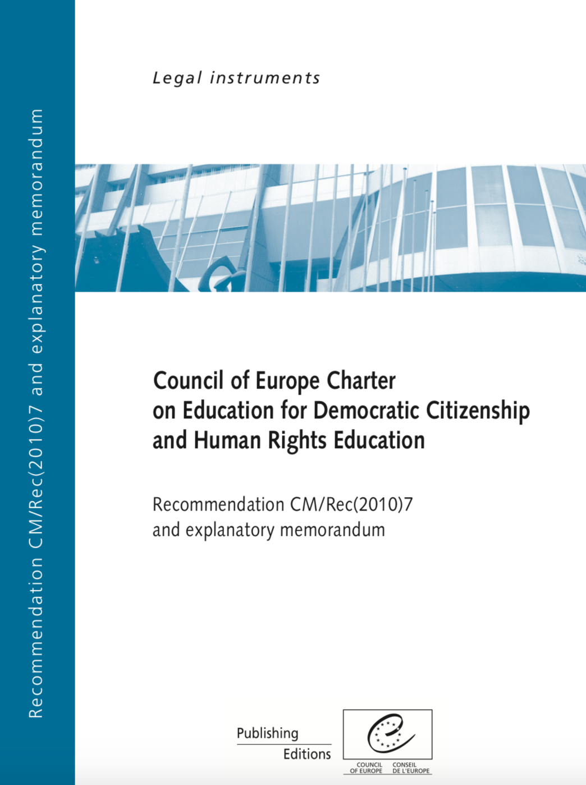
Contribution to the implementation of the Council of Europe’s Charter for EDC/HRE
Raising awareness for the existence of this document, and thus each participant becoming a promoter for the Charter
Disseminating the definitions of HRE and EDC in national languages
Providing access to EDC/HRE, especially to discriminated groups
Implementing an educational programme that allowed participants to develop their knowledge, skills and attitudes with regard to HRE and based on active participation of learners
Empowering learners with knowledge and readiness to act for human rights, through concrete follow-up projects
By organising evaluation of the trainings and getting feed-back from learners
Taking into consideration the role of both formal and non-formal education settings and actors and offering possibilities for both to develop their competences in HRE
Promoting intercultural dialogue, equality, respect
By encouraging dialogues and partnerships within all possible stakeholders for HRE in the organizing countries (non-governmental organisations, youth organisations, schools, parents, media, public authorities, education professionals etc)
Linking in particular formal and non-formal education stakeholders
By creating opportunities for teachers to review and enhance the role of HRE in school education curriculum
By promoting HRE among future professionals (future teachers, currently in higher education)
By ensuring a multiplying effect as participants shared their experience with their organisations and in wider networks
By creating networks of HRE professionals within countries

Slide 23

Knowledge
Skills
Outcomes
Attitudes
Understandings

Slide 24
improved of knowledge about human rights in participants (over 550 people) and direct organisers (26 organisations from 24 Member States of the Council of Europe)
improved competences of participants/trainers about HRE and its educational approaches
using Compass and other educational materials such as Bookmarks, Mirror, We can!, Gender matters etc as tools for HRE and the multiplied knowledge, skills and attitudes that using these will generate, while working with young people
a significant number of activities and projects on HRE will be run by the participants to the trainings (if only one activity per person, then approximatively 550 new activities aiming at promoting human rights, democracy, equality, tolerance, respect, solidarity, non-violence, mutual understanding, intercultural sensitivity etc). The further results of such activities in the case of a campaign, of a photographical exhibition, of a street action, of integrating human rights education into the school curriculum are harder to quantify.
a considerable number of new trainings, seminars, conferences, gatherings of human rights activists and human rights education specialists
more projects competently designed for human rights and more funding for the field
more networking and cooperation between various organisations and institutions working for human rights
dialogue between national organisations and the Council of Europe, and a reinforcement of the co-management system based on which the European young people and youth structures co-decide together with public authorities on youth related issues, decisions, policies
dialogue between majorities and minorities, between various generations, between different ethnic groups divided by history.

Slide 25
Use of educational materials
Developed competences about HRE
Improved knowledge about HR
Follow-up projects
More projects for HR and HRE
Networking between field actors
Towards a culture of human rights

Slide 26
Follow-up
What follow-up do they expect participants to undertake as a result of the course?
How do they intend to support participants in their future projects or follow-up activities?
How will the organisations follow-up on the training course?

Slide 27
Follow-up by participants
They plan:
To organise or be involved in HR and HRE related workshops and lectures
To organise various trainings
Integrate a human rights education dimension (in large scale) activities organised regularly
To use and promote the educational resources
Peer to peer education
To organise human rights related movie screenings
Getting involved in other Council of Europe activities (No Hate Speech)
Writing new project for human rights education

Slide 29
Follow-up by organisers
Keep the group active and connected. Offer professional support and consultation opportunities to former participants, or involve them in concrete HRE related activities
Organise other trainings in the future, about or related to HRE
Becoming (more) active for HRE and contributing to networking and partnerships in HRE

Slide 30
How
4
CDEJ, trainers, how else

Slide 32
Before
CDEJ members should be aware/informed of such activities
Preparation
CDEJ members can contribute in spreading the call for participation to national and local NGOs, linking different actors and networks involved on the topic of the call
CDEJ can advise and co-design the programmes of national training courses
During
Making themselves available to attend the activities, where they could
- present Council of Europe’s standards, approaches and instruments for the youth policy development
- share good practice/their experience
- advocate for the Council of Europe’s work in the youth field in general, and HRE in particular
Promotion, follow-up
CDEJ can support the national organisers’ efforts for human rights education in the countries by organising new campaigns, conferences, projects, trainings etc.
Not least, CDEJ can be a promoter of national courses results by informing their networks on the existing activities, organisations, projects, tools created etc.
- make resources available for the activities (like spaces, infrastructures, communications, promotional materials etc.)

Slide 33
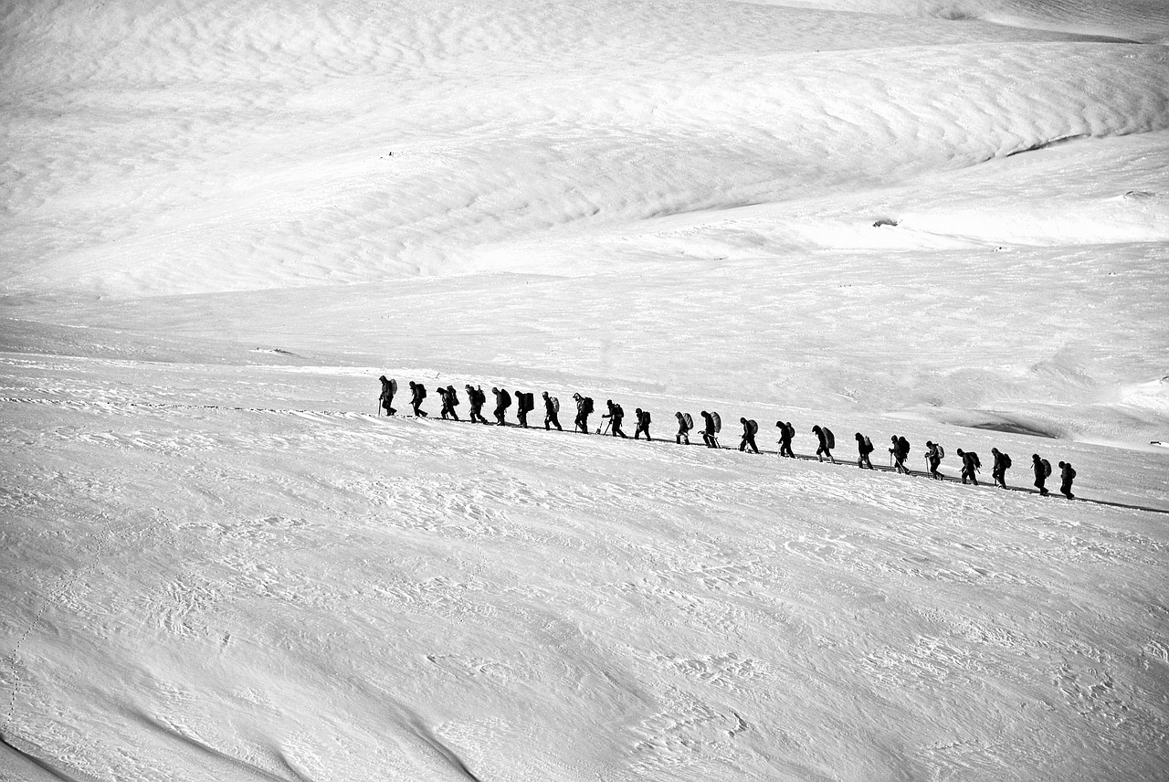
What about the trainers?

Slide 34
What about the trainers?
Present
Equal team member
Advisor, resource person
Leading
Guest expert

Slide 35
Trainers found challenging the following aspects
Too ambitious aims and objectives in relation to the duration of the training
The high number of cancellations, without warning (on a side note, this is an aspect that challenge all trainings taking place in Europe, as result of a massive offer for trainings and intensive mediatisation of many educational activities taking place)
Having more participants from the same institution, which can carry into the training the hierarchy from the organisation
The limited duration of trainings. Trainers feel that one extra day would have been beneficial for the group to go deeper in certain topics.
The financial compromise on not organising the training as a residential activity, which diminished the contact between participants outside of the sessions and thus did not create additional informal learning opportunities
The quality of the working space - sometimes too small, inappropriate for the interactive nature of non-formal learning activities (lacking fresh air or natural light has an undoubtable negative effect on the way participants are ready to get involved during the average 10 hours of training activities per day)
Lack of Compass, no access to Compass online
Lack of gender balance
Too long training days.

Slide 36
Suggestions from trainers
The communication between the Council of Europe trainer and the organiser should start earlier (for this, the selection of trainer should be done as soon as the NTCs are approved)
Organisers should be clearly informed that it is better to coordinate the participants recruitment in consultation with the trainer appointed by the Council of Europe (and furthermore have clear criteria for participants selection, in order to ensure transparency and accessibility to all potential participants)
The Council should Europe should underline that the application ought to reach out to disadvantaged young people and their organisations, so that they could be represented in national training courses.
Info Pack

Slide 37
Suggestions by the organisers
Shorter delays in processing the administrative aspects related to the course
Timely reception of all documentation
To make sure that the 80% advance payment of the grant is paid ahead of the training, because some youth organisations do not have the necessary funds to advance the costs for the training, in order to be reimbursed afterwards
More frequent/better communication between funder and organiser
Earlier information about financial and educational support
Contacting the local translators of Compass and providing the national organisers with copies of Compass for each participant

Slide 38
Need for further support from CoE
to disseminate the information regarding the result of the local activities that the participants realised
to countersign a support letter for the follow up plan of participants, which would increase their chances for implementing it
to support the participants with tools, manuals or other pedagogical materials
to provide funding for the follow-up projects
to sign memorandums of cooperation with local organisers and authorities
to increase the funding for this type of activities altogether (currently the budget for 2020 is of 45 000 euro, which allows supporting between 7-10 national trainings)
the Youth Department’s endorsement to strengthen the national network for Human Rights Education that was started as a result of the national training course, to make it recognised by national institutions and civil society stakeholders

Slide 39
Keep providing guidance well in advance for both qualitative and quantitative evaluation, for both trainers and organisers.
Harmonising data from both reports (organisations and trainers) could be enriching as mirror-effect type of exercise
Evaluating the activity starting from the quality standards for educational activities would help trainers give feed-back more concretely, would also allow comparisons and graphic analysis and would furthermore facilitate the larger scale periodical reporting
Including questions that allow the development of comparative indicators among countries could be useful in the realisation of long term impact study of the programme
What other tools could be envisaged for measuring the undoubtedly massive impact of the programme?
Support organisers in undertaking quality EDC/HRE studies in the member states, to provide a more in-depth analysis of the situation (as a follow-up funding to the training/ via the European Youth Foundation?)
How could funding for follow-up activities be ensured? Mere visits to participants’ projects and organisations would consolidate their results.
National vs regional courses – should the programme prioritise better integration of HRE into national reality and policy or encourage more ties beyond borders? (solidarity, common youth issues needing common political responses)
What is an effective way to report about activities, so that the experience becomes an example of good practice for future organisers?

Slide 40

Thanks!
Any questions?
You can find me at
elizabeth_kasa@yahoo.com

