Slide 1
HOW TO USE CEPEJ-STAT “Dynamic database of European judicial systems”

Slide 2
What is CEPEJ-STAT?
How is CEPEJ-STAT organised?
How CEPEJ-STAT functions?
Where to find what?
Hints to find data - hierarchy

Slide 3
What is CEPEJ-STAT?
an interactive database that contains data collected by CEPEJ biannually since 2010, especially:
all the data published in the printed versions of the CEPEJ Evaluation Report,
all other data collected but not published in the printed report
an access to the specific data needed for detailed analysis and policy decisions
a complex set of data and comments that offers a plethora of information and various search methods.

Slide 4
2. How is CEPEJ-STAT organised?
DASHBOARDS
EXPLORERS
Dashboards organized by theme using different interconnected visual data presentations(charts/tables/KPIs)
Tables (bar chart or a map) for all countries that include all the quantitative data (numeric).
Frequency charts for qualitative data with individual country replies presented on a map.
Database of all questions and reform plans.

Slide 5
2. What are the different presentations in CEPEJ-STAT?
DASHBOARDS
EXPLORERS
Overview of judicial systems
Efficiency
Budget of judicial systems
Information and communication technology
Gender equality
Judges and prosecutors
Country/entity profiles
Search by topics (based on quantitative data)
Variation of quantitative data
Search by topics (based on qualitative data)
Search by question numbers or CEPEJ questionnaire keys words
Reforms planned for judicial systems

Slide 6
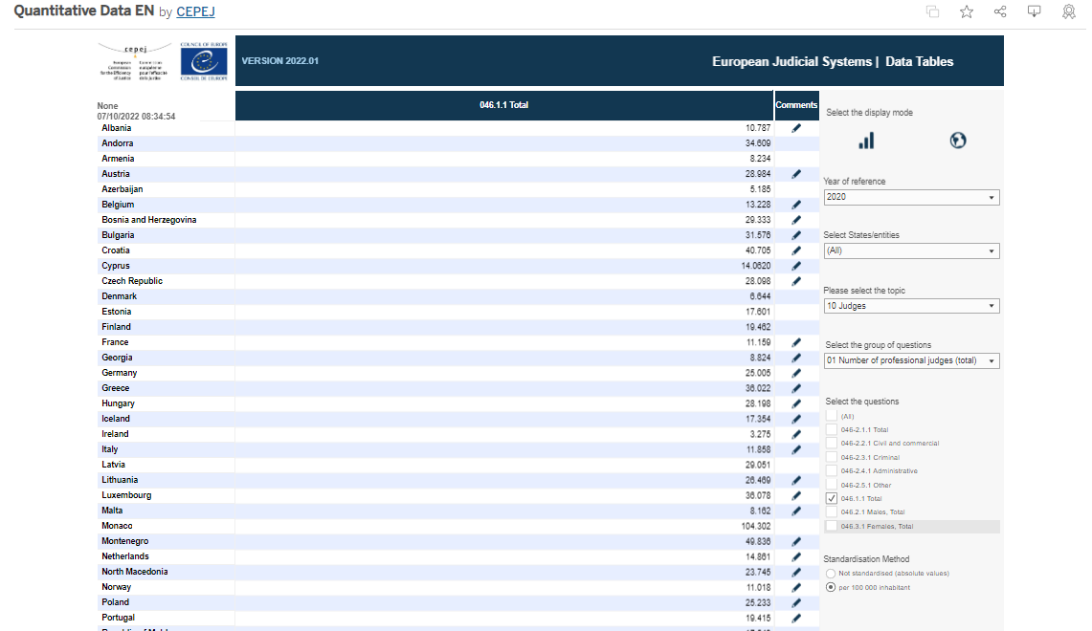
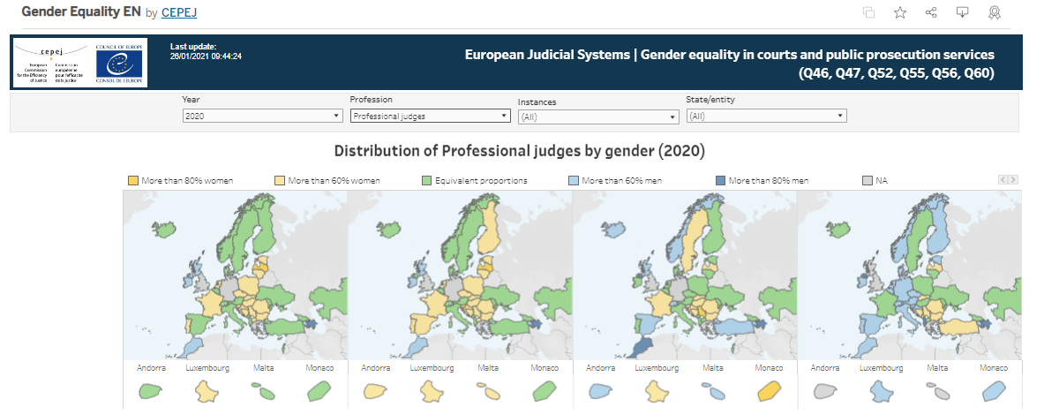
3. How CEPEJ-STAT functions?
All dashboards and explorers have a similar principle of use.
First, a user must set all the filters in the dashboard/explorer,
Then the relevant data will be displayed
Filters can be:
vertical or
horizontal

Slide 7
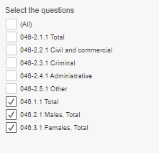
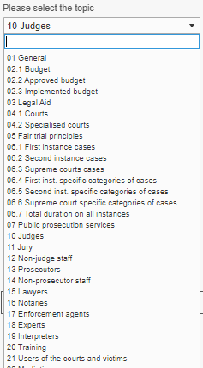
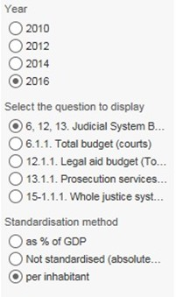
3. How CEPEJ STAT functions?
These filters presented as:
drop-down lists,
check boxes or
radio buttons

Slide 8
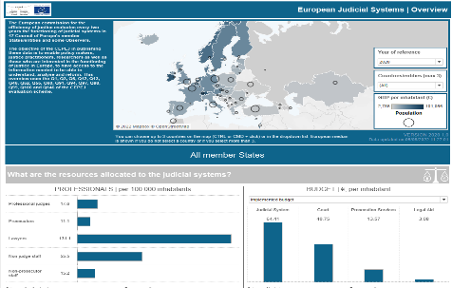
4.1 Content of the dashboards
DASHBOARDS
Overview of judicial systems
Efficiency
Budget of judicial systems
Information and communication technology
Gender equality
Judges and prosecutors
Country/entity profiles
Provides the main indicators that are particularly important for observing overall performance of judicial systems and it is a good entry dashboard to discover CEPEJ-STAT and analyse together up to 5 countries.

Slide 9
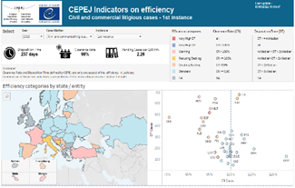
4.1 Content of the dashboards
DASHBOARDS
Overview of judicial systems
Efficiency
Budget of judicial systems
Information and communication technology
Gender equality
Judges and prosecutors
Country/entity profiles
Shows only indicators that measure efficiency of the court systems, in particular a Clearance Rate (CR) and Disposition Time (DT), as well as categories of efficiency.

Slide 10
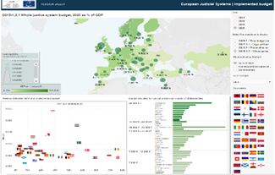
4.1 Content of the dashboards
DASHBOARDS
Overview of judicial systems
Efficiency
Budget of judicial systems
Information and communication technology
Gender equality
Judges and prosecutors
Country/entity profiles
Dashboard that focusses only on budgets of judicial systems and its components: budget of courts, prosecution service, and legal aid.

Slide 11
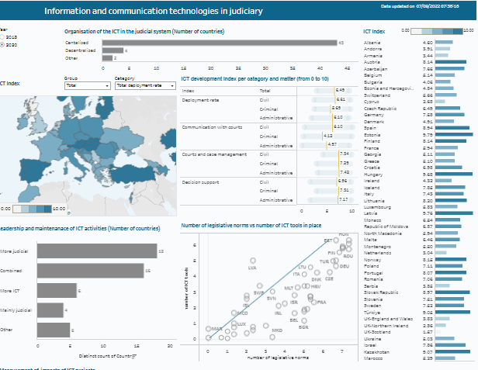
4.1 Content of the dashboards
DASHBOARDS
Overview of judicial systems
Efficiency
Budget of judicial systems
Information and communication technology
Gender equality
Judges and prosecutors
Country/entity profiles
Dashboard where you may find indicators for measuring the level of development and use of ICT in courts including as well as ICT index per different categories.

Slide 12
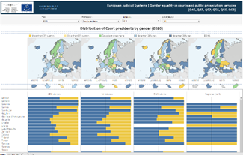
4.1 Content of the dashboards
DASHBOARDS
Overview of judicial systems
Efficiency
Budget of judicial systems
Information and communication technology
Gender equality
Judges and prosecutors
Country/entity profiles
Dashboard that provides you a possibility to see the distribution male/female professionals by instance in different state/entity.

Slide 13
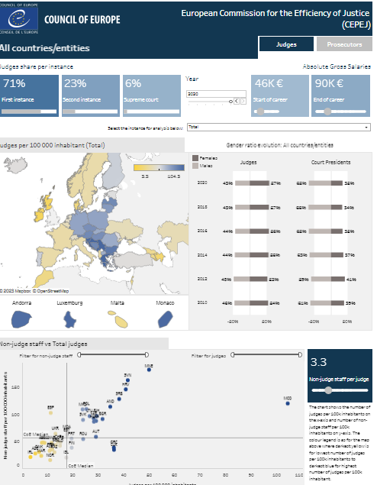
4.1 Content of the dashboards
DASHBOARDS
Overview of judicial systems
Efficiency
Budget of judicial systems
Information and communication technology
Gender equality
Judges and prosecutors
Country/entity profiles
Dashboard that provides different data on number of judges, prosecutors, non-judge staff and non-prosecutor staff and their ratios.

Slide 14
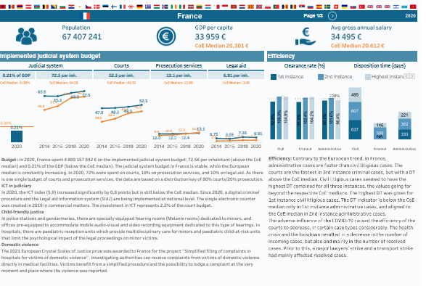
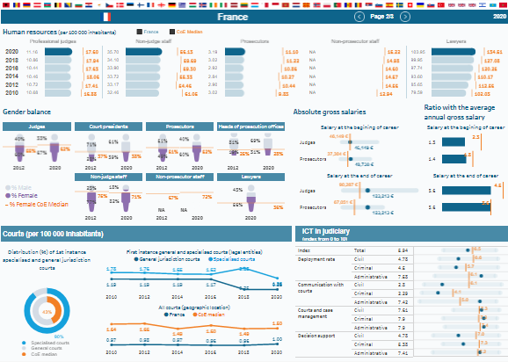
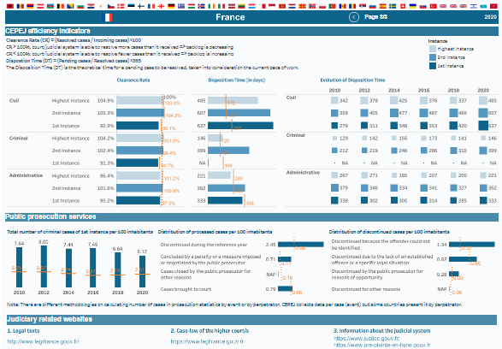
4.1 Content of the dashboards
DASHBOARDS
Overview of judicial systems
Efficiency
Budget of judicial systems
Information and communication technology
Gender equality
Judges and prosecutors
Country/entity profiles
This dashboard presents a set of selected indicators and summary analysis on main elements of each judicial system.

Slide 15
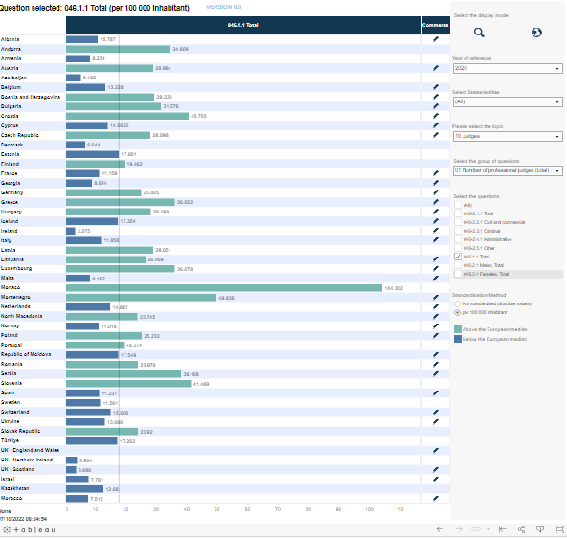
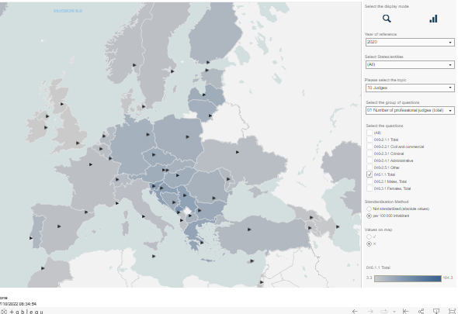
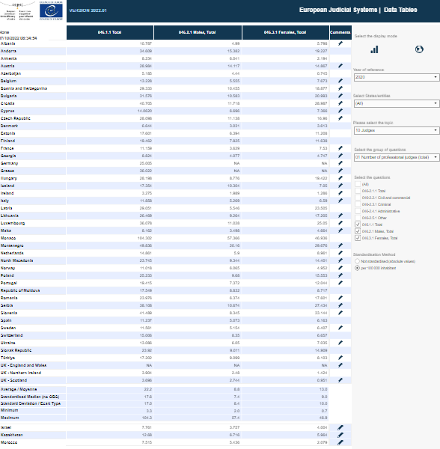
4.2 Content of the explorers
EXPLORERS
Search by topics (based on quantitative data)
Variation of quantitative data
Search by topics (based on qualitative data
Search by question numbers or CEPEJ questionnaire keys words
Reforms
This explorer includes all numeric/quantitative data collected by CEPEJ that quantify different categories such as court case flow, budgets, number of judges, length of proceedings etc organised in topics and groups of questions with a defined hierarchy.

Slide 16
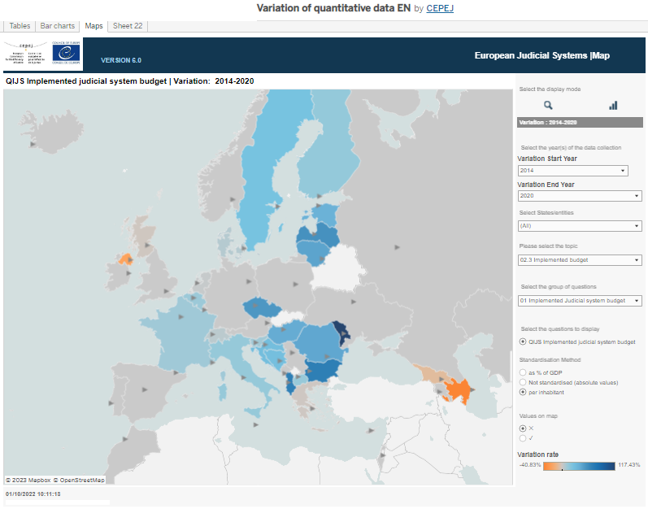
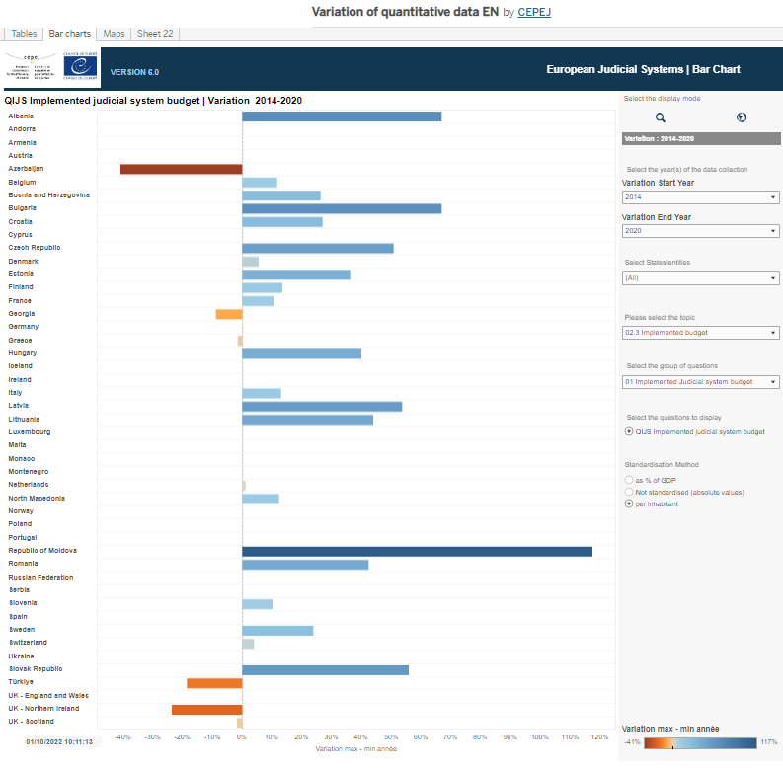
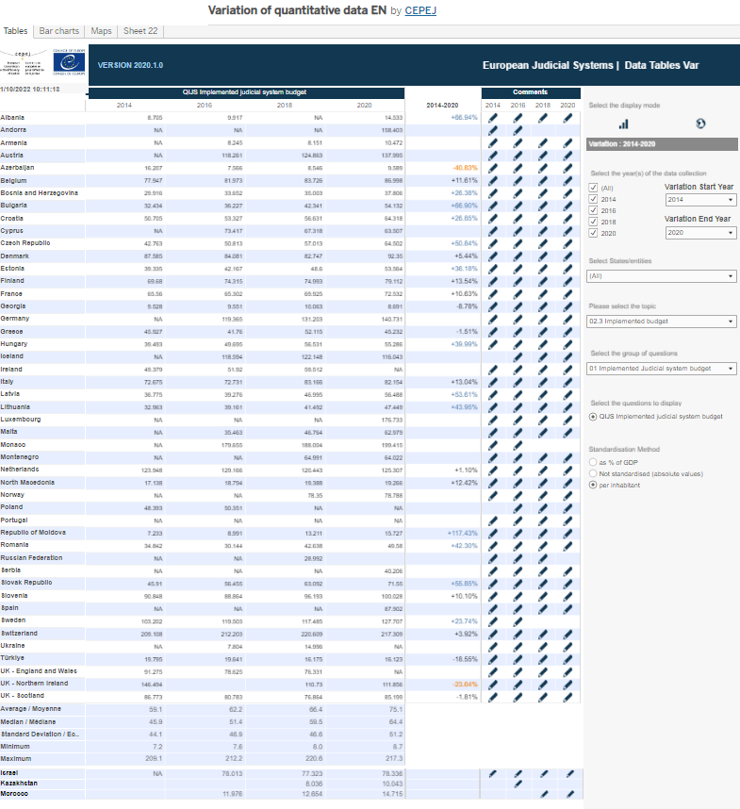
4.2 Content of specific explorers
EXPLORERS
Search by topics (based on quantitative data)
Variation of quantitative data
Search by topics (based on qualitative data
Search by question numbers or CEPEJ questionnaire keys words
Reforms
This explorer offers you a possibility to follow trends for quantitative data from year to year and see variations over selected periods of time and includes same numeric data as in the “Search by topics (based on quantitative data) and the same hierarchy of organisation.

Slide 17
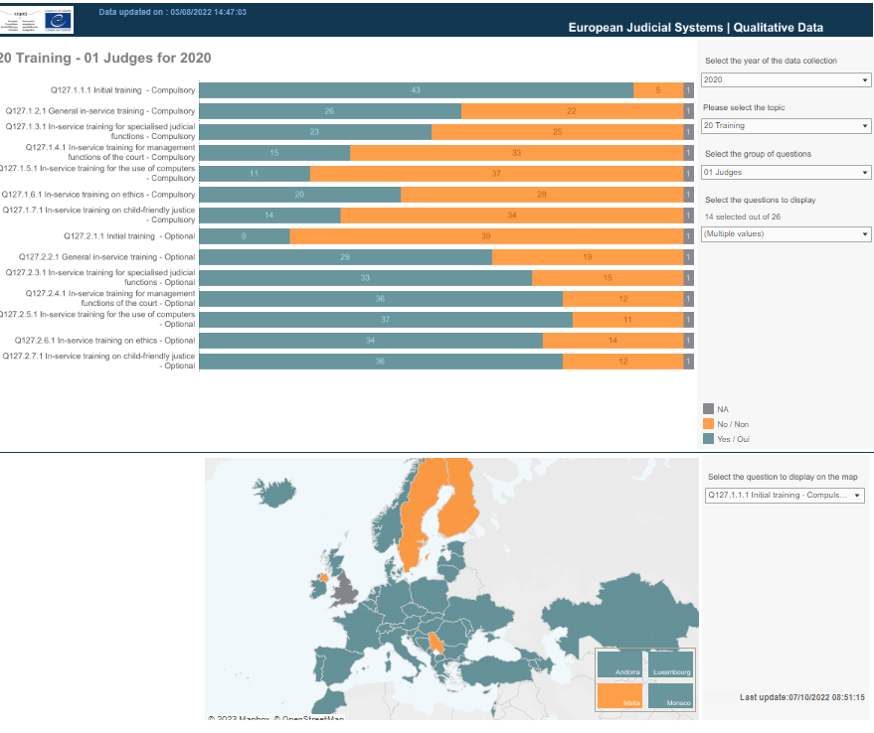
4.2 Content of specific explorers
EXPLORERS
Search by topics (based on quantitative data)
Variation of quantitative data
Search by topics (based on qualitative data
Search by question numbers or CEPEJ questionnaire keys words
Reforms
All qualitative data from the CEPEJ data collection are included in this explorer. These data relate to different aspects of the judiciary that describe the system, such as list of competencies of certain institutions, list of procedures available in the courts etc. It use the same hierarchy of organisation as the previous explorers.

Slide 18
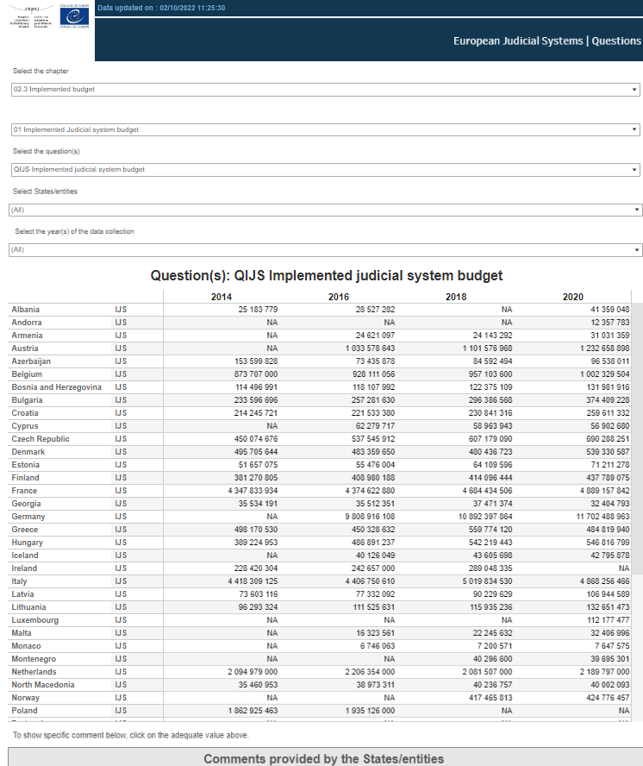
4.2 Content of specific explorers
EXPLORERS
Search by topics (based on quantitative data)
Variation of quantitative data
Search by topics (based on qualitative data
Search by question numbers or CEPEJ questionnaire keys words
Reforms
This explorer is mostly suited for people familiar with the CEPEJ questionnaire numbering since the search for all countries and all years can be done by question number or questionnaire key word.

Slide 19
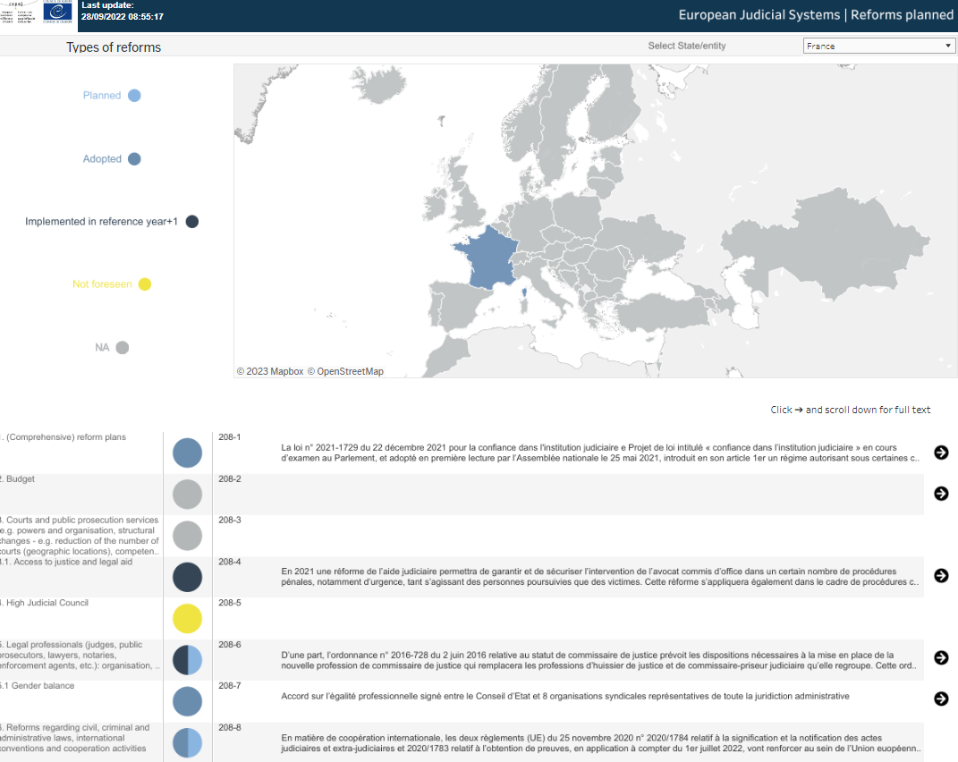
4.2 Content of specific explorers
EXPLORERS
Search by topics (based on quantitative data)
Variation of quantitative data
Search by topics (based on qualitative data
Search by question numbers or CEPEJ questionnaire keys words
Reforms
This explorer gives a possibility to see status and details of the reform plans for different member States and entities as well observer countries as presented by them in the last evaluation cycle.

Slide 20
5. Comments – what are they?
Comments are included in every explorer/dashboard, they accompany data and provide explanations specific and provided by the states/entities.
Note: For proper understanding of the data in this database, it is crucial for users to supplement the data with information available in the comments.
General Comments
apply to all evaluation cycles. Such comments refer to specificities of the national judicial system relevant to all evaluation cycles and will be helpful when analysing the replies and processing data
Specific comments
apply to the on-going cycle only. States use them to provide detailed information on the specificities of the national judicial system for the specific cycle, as well as explain substantial variations of data from previous evaluation rounds

Slide 21
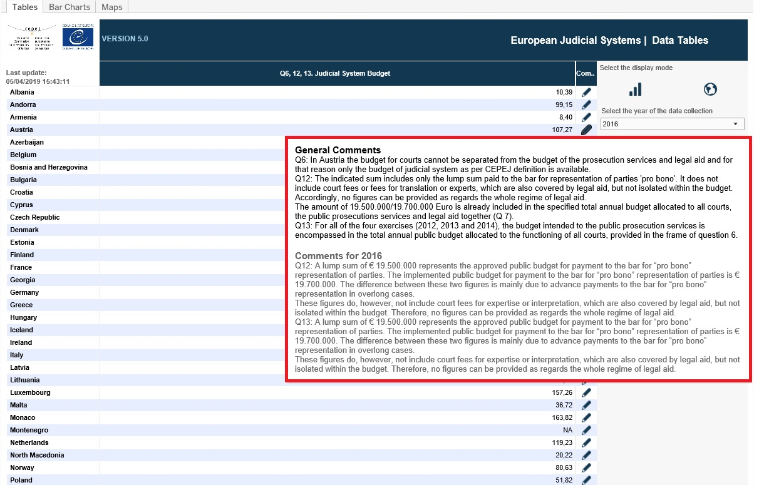
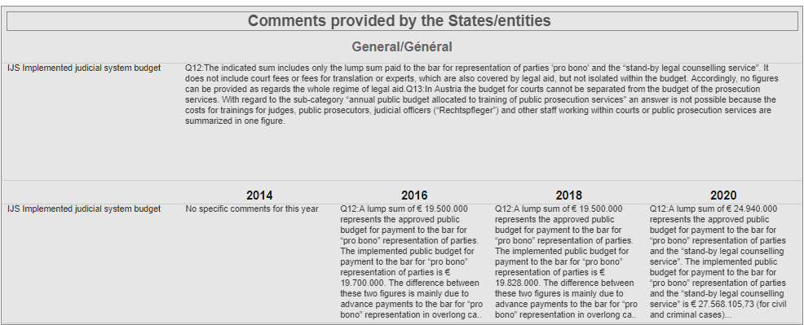
5. Comments –where they can be found?
In tooltips
Under title “Comment”, they appear as tool tips when you place cursor on appropriate place (flag, pencil,).
Specific sections
In specially designated sections like in the “Explorer by question number” on the right.

Slide 22
6. Downloads from CEPEJ-STAT?
At the right bottom part of each screen, you can find a menu with different options that enable you to do some actions among which to download or share these explorers or dashboards.
Share
by choosing this option you may share the link for the dashboard/explorer via Email, Twitter or Facebook
Download
by choosing this option you may download the dashboard/explorer you have selected in one of the following formats: Image, PDF or Power Point
Note
In case the data available online are not sufficient for your analysis due to the existing format or the quantity, please contact the secretariat at cepej@coe.int

Slide 23
7. Where to find what?
This section will show different ways to find similar information for :
Budget
Efficiency and Case flow
Professionals
Information and Communication technology
Gender equality
Qualitative data

Slide 24
7.1 Where to find Budget?
The dashboard focused on budget data (Budget of judicial systems) combining different presentation for all states/entities best for getting a general overview on budget.
For all details on budget best to use the explorers where all collected data suitable for comparing different states/entities are available:
Search by topics (based on quantitative data), for numeric data, presented as simple table, where one could select the category (Budget/Implemented budget or Approved budget) and browse all available subgroups of questions also available in format of bar charts or maps.
Or for all qualitative information on budget, one could visit the Search by topics (based on qualitative data) and select the topic “Budget”. All adequate subgroups will be then listed for selection. Data is presented as frequency charts and maps.

Slide 25
7.1 Where to find Budget? (Video)

Slide 26
7.2 Where to find Efficiency and case flow?
The dashboard dedicated to Efficiency with main indicators on efficiency like Clearance rate (CR), Disposition Time(DT) and efficiency categories. Best for initial general overview on efficiency.
In Search by topics (based on quantitative data), that contains all collected numeric data one can select, for example “First instance cases”, then different categories (civil, criminal, administrative, etc.) and finally the specific status (incoming, resolved, pending) but also CR and DT. Data is available in form of simple tables, bar charts or maps.
The efficiency and case flow data is also included in the Overview of judicial systems as well as in Country profile.

Slide 27
7.3 Where to find Professionals?
The dashboard specifically dedicated to judges and prosecutors with the essential quantitative data on judges and prosecutors, evolution of their numbers over years, distribution by gender and instance, the ratio with non-judge staff and salaries.
All numeric data for all professionals in justice (judges, prosecutors, non-judge staff, non-prosecutor staff, lawyers, notaries, mediators, enforcement agents and experts) are also available in Search by topics (based on quantitative data), where for example one can select: “notaries” then select “number of notaries” in the subgroup and finally all or some of the specific question to view different category of notary or total.
The professionals are also included in the Overview of judicial systems as well as in Country profile.

Slide 28
7.4 Where to find ICT data?
There are two dashboards where ICT (Information and communication technology data is presented.
First and detailed dashboard is the one dedicated on Information and communication technologies. In this dashboard you can find different information on ICT index and its categories as well as the structure and the organization of the ICT activities.
Another dashboard where the ICT data is included is the Country profile where the ICT index is among the selected indicators presented for each country.

Slide 29
7.5 Where to find Gender equality data?
The best way to have a view of the gender distribution for all professionals of justice is by looking at the dedicated dashboard, Gender equality. In this dashboard all data on professionals for all instances are shown by gender.
All data for gender distribution is also available in Search by topics (based on quantitative data). Just select category that includes gender distribution, for example “professional judges” and “number of professional judges” you will then find total, male and female to select in the question filter.
The gender distribution for judges and prosecutors is also included in the dedicated dashboard (Judges and Prosecutors) for these two categories of professionals.

Slide 30
8. Hierarchy - How to find data in dashboards/explorers
In the different dashboards, there are filters that follow certain hierarchy. Considering that CEPEJ database contains a big number of indicators, it is sometimes difficult to find exactly what you are looking for. Here we give an overview on how to explore the hierarchy to find what you are looking for.
First instance cases
Total other than criminal cases
Civil and commercial litigious
Administrative cases
Criminal - Total
Criminal - Severe criminal
Criminal – Misdemeanour
…
Pending cases on 1 Jan.
Incoming cases
Resolved cases
1st inst., Pending cases on 31 Dec.
older than 2 years
Clearance Rate
Disposition Time
Look at the different groups/topics and sub-groups within these topics (first and second level in the hierarchy).
Retrieve the exact item/question within the subgroups and the groups/topics.
Example

Slide 31
8. Hierarchy - Hints to find data in the explorers
In the different dashboards, there are filters that follow certain hierarchy. Considering that CEPEJ database contains a big number of indicators, it is sometimes difficult to find exactly what you are looking for. Here we give an overview on how to explore the hierarchy to find what you are looking for.
Look at the CEPEJ questionnaire to understand the scope of data collection.
Identify the question/s of your interest
Locate those question/s within the hierarchy, identifying in which group and subgroup they belong. There are 34 different groups and from 1 to 24 different subgroups within each group.
Apply the group and subgroup in the explorer to direct you to the question/s of interest.

Slide 32
Thank you
http://www.coe.int/cepej/
CEPEJ Council of Europe
@CEPEJ_CoE
@
cepej@coe.int

