Slide 1
Convention 108+ The Global Data Protection Convention
40th International Conference of
Data Protection and Privacy Commissioners Side Event
23 October 2018
Hiroshi Miyashita
Chuo University

Slide 2
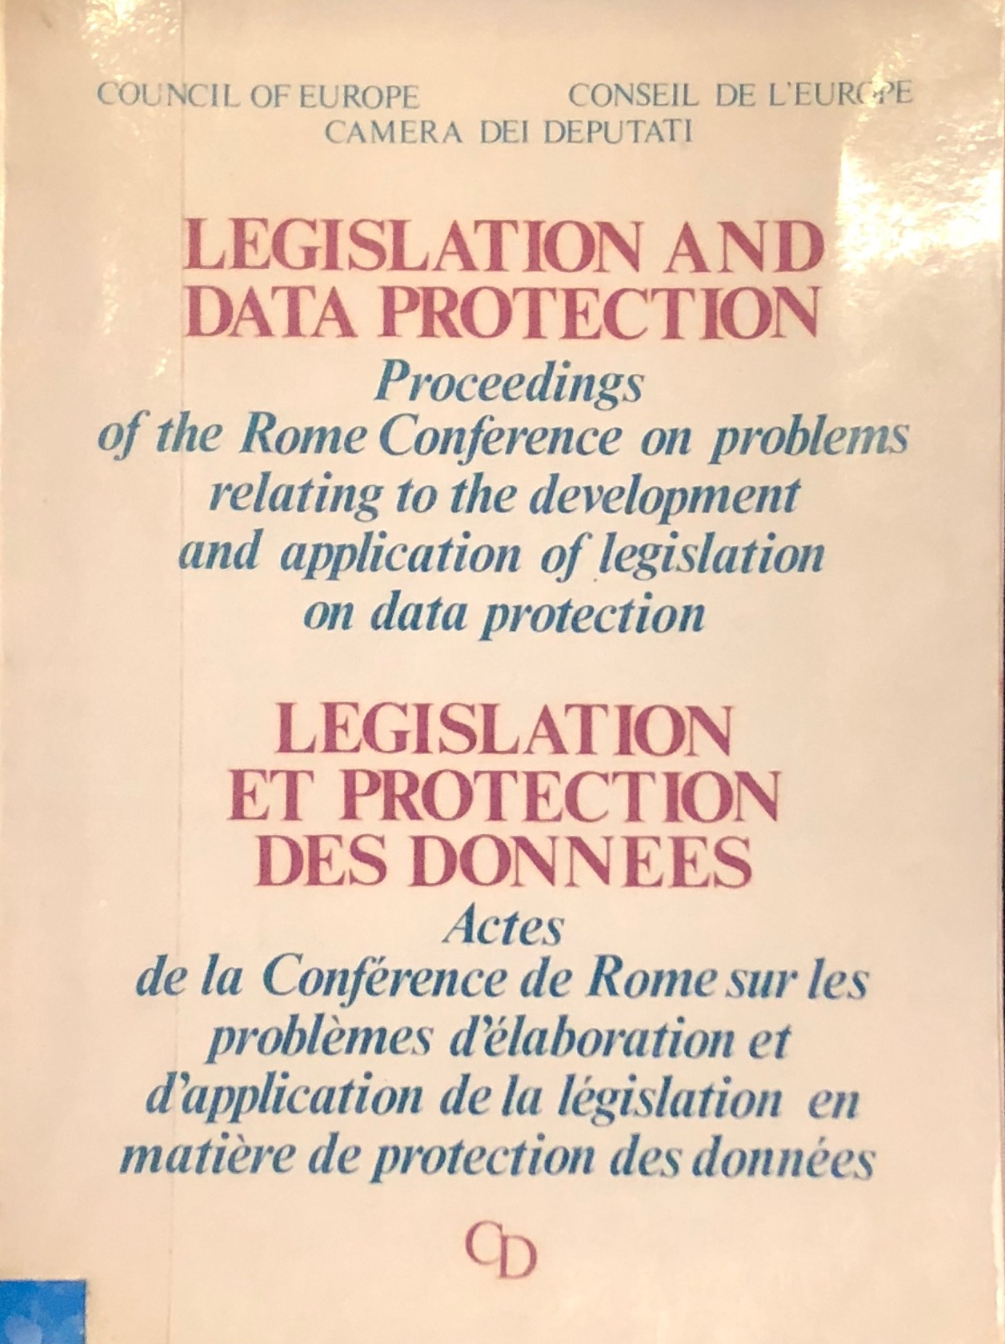
Wisdom of predecessors
”The Hessian law includes two subjects: firstly, data protection in the traditional sense, the protection of the individual against the possible dangers of automated data processing. Secondly, it includes … the question of information monopoly.”
-Professor Simitis
“the next important thing is not to write into one’s legislation things which will necessarily produce what in English is called a “non-sense.
I am not quite sure how one translates that into polite French.”
-Mr P. Sieghart

Slide 3
Convention 108 and Japan
1976 Committee of Preparing a Convention for the Protection of Privacy in relation to data processing abroad and transfrontier data processing
2013 Participation to the Ad Hoc Committee on Data Protection (CAHDATA)
2017 Japan becomes an observer (34th plenary session)
Data Protection Day event on 28 January
eg) Data Protection Day Japan Website / PrivacyMark Forum

Slide 4
Incentives
“The” international commitments (GDPR Art. 45 (2)(c) & Recital 105)
- “Japan is an observer to this Convention and, we hope, one day will become a full Party, thereby confirming its commitment to the privacy in the Asian region”. (Commissioner Jourová, speech on 31 May 2018)
Public sectors
Oversight of law enforcement & judiciary sectors
(Draft adequacy decision of Japan, 5 September 2018)
Magna Carta for data protection?
“secure the human dignity” (Preamble)
“individuals not to be treated as mere objects”

