Slide 1
Helping migrants by basic and techno communication tools (Prof Enrico Bernini Carri President CEMEC – San Marino)

Slide 2
To provide basic and easily understandable information for migrants able to help them in facing the majority of issues affecting their staying in a foreign country:
Health issues and access to local health care systems
Communication and getting vital information
Hygiene and Housing
Food related problems and risks
Climate change
Legal issues

Slide 3
Target 2017
To develop a multi-language tool on traditional booklet (Italian,English languages)
Submit booklets to a Migrant Reception Center (CARA in Italy) for feedback
Compare with the professional operators of CARA for the necessary changes
Design an app for android smartphones to convert the booklet electronically
Activate a website with all the information needed for emergencies for migrants(http://immigrant.cmstitanka.com/)

Slide 4
Target 2018
To develop a multi-language tool on electronic format (Smartphone App Android) able to help migrants to:
Take advantages for primary care by nurses and physicians
Know social and healthcare resources available in the host countries
Protect them in case of emergencies
To build up and to maintain a web site in English language providing information as above mentioned;
Present the project at the "2019 Migrant Festival” in Modena (Italy)

Slide 5
Example

Slide 6
Other examples

Slide 7
Target 2019
To develop a multi-language tool on electronic format (Smartphone App Android) able to help migrants in case of biological , chemical and nuclear disasters(NBC)
an example:
Go to sheltering
Use Iodine prophylaxis
use masks for breathing protection
Go to decontamination
Go to Health care center
Use personal protection equipment
follow ban for drinking and eating
Vaccinations

Slide 8
Integrated Territorial Training Project in case of disaster (2019)
We have chosen a small region in Italy (Molise-300.00 inhab) for our project.
Target:
Form all key figures in case of mass emergency with standard basic training;
Involve professional (Fire Dep.,Civil Defense,112 Emergency Health Serv…) and non-professional figures (Volunteers,Mayors and municipal civil defense workers, family physicians ,etc) in the management of emergencies
Obtain homogeneous training within the same territory

Slide 9
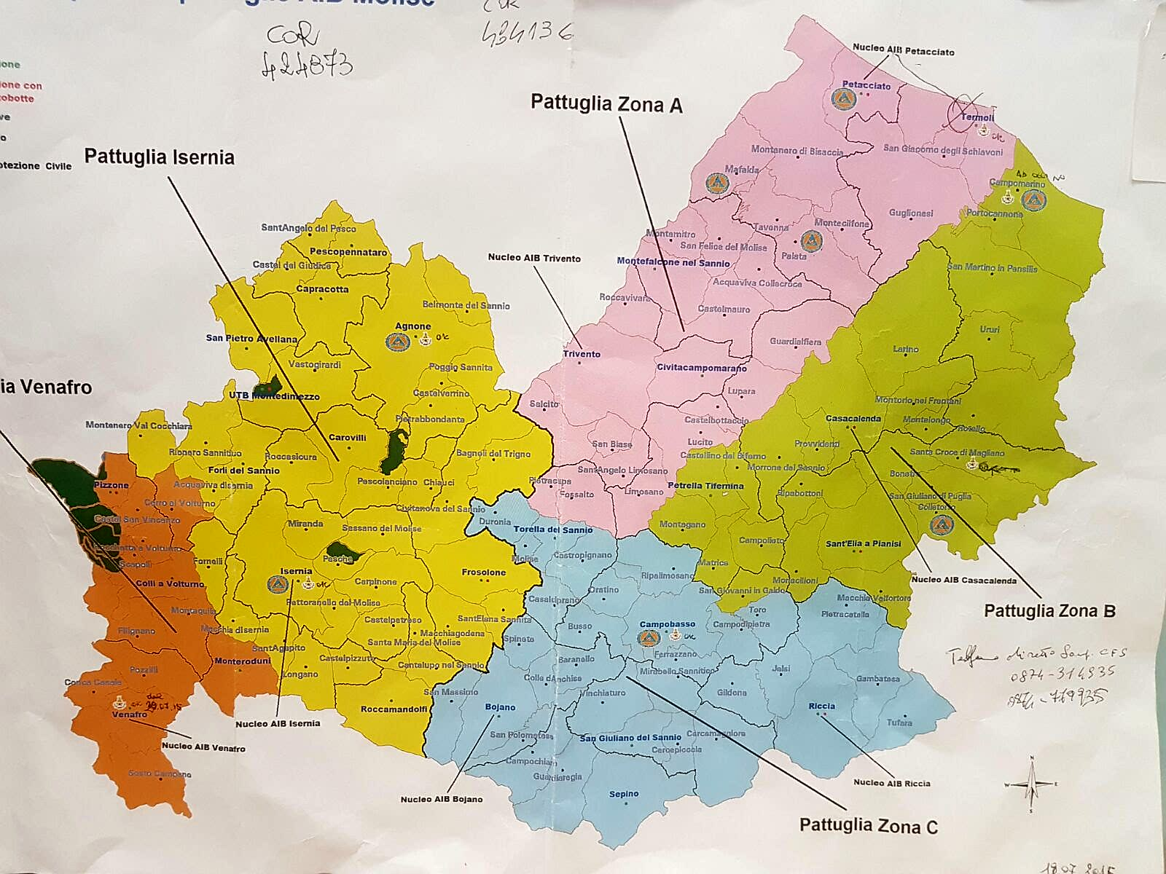
Three Different scenarios: Mountains,flatland,Coast

Slide 10
Training project:
A day of basic training (4 hours of classroom teaching and 4 hours of topographic map exercise in three-four groups) for all key-figures with different scenarios (earthquake,flood,epidemic, etc.);
Final discussion with the presentation of the results, following the drills

Slide 11
Expected results:
Involvement of "locals operators” (professional and non-professional) in a new concept of territorial organization;
Interchangeability of "key figures“;
Overcoming the concept of a “sectorial" organization and creating a homogeneous "territorial" organization according to type of territory, common problems and traditions;
Adherence to territorial issues during an event(pre-,during- and post-event);
Adequate interface and ongoing relationship with Regional/National Civil Defense

