Slide 1
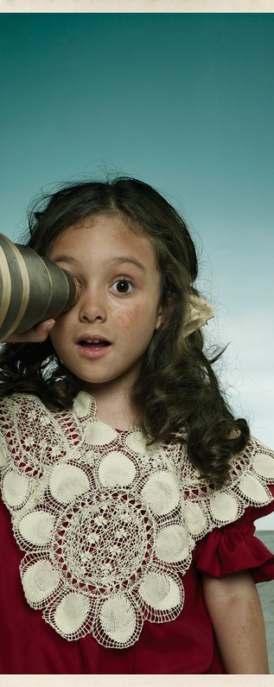
Harmful sexual behaviour displayed by children
Overview of first responses
and proposals for further action
to be discussed by the Working Group on responses to violence against children (CDENF-GT-VAE)
at its meeting on 1-2 December 2020

Slide 2
Harmful sexual behaviour by children: What are we talking about?
“Sexual behaviours expressed by children and young people under the age of 18 years old that are developmentally inappropriate, may be harmful towards self or others and/or be abusive towards another child, young person or adult” (Hackett)
High prevalence
France: 1/10 perpetrators of sexual violence were under 13 years old (2018)
UK: 3878 counselling sessions on harmful sexual behaviour delivered by ChildLine (2017-2018)

Slide 3
Harmful sexual behaviour by children: Relevant international and regional standards
International
Regional (Europe)
UNCRC
Lanzarote Convention and Explanatory report
Art. 19
(violence)
Art. 24 (health)
Art. 37
(deprivation of liberty)
Art. 40
(conflict with the law)
Lanzarote Committee Opinion on child sexually suggestive or explicit images and/or videos generated, shared and received by children
UNCRC GC No 24 on children’s rights in the child justice system
Children should be protected from all forms of violence
Criminal prosecution of children should be avoided
More appropriate measures should be preferred (e.g. educational measures, therapeutic assistance)
UNCRC GC No 13 on the right of the child to freedom from all forms of violence

Slide 4
Harmful sexual behaviour by children: What we have learned at the previous meeting
There is…
Limited research on low-risk behaviour
Increase in online harmful sexual behaviour
Children who display harmful sexual behaviour are…
Mostly boys, but there is growing proportion of girls
Children from a wide age group
Often children with additional needs (e.g. Iceland: 70%)
Generally known by the victim

Slide 5
Examples of initiatives developed at the national level
Psychological help and therapeutic support
Interventions in schools
Child helplines
Diversion
Development of tools (guidance to support children or recognise signs)
Statutory guidance (UK)
National reports

Slide 6
Initial recommendations on ways to address harmful sexual behaviour
Increase awareness of the wider public
Increase awareness and training of parents, caregivers and professionals
Promote comprehensive sex and relationship education
Step up and promote research to encourage adequate, evidence-based and non-judicial responses
Promote holistic treatments and interventions, adapted to the individual child and which engage with his/her environment
Promote rehabilitative interventions, which do not lead to or involve criminal prosecution

Slide 7
Proposals for further action
Review of legislation, policy and practice concerning the responses provided to harmful sexual behaviour displayed by children through a survey led in 2021
Preparation of a report to be finalised in October 2021

Slide 8
Questions to be discussed…
Is it of interest to undertake a survey, in the VAE Group, to learn more about the current responses to HSB and identify any good and innovative practices and measures?
Should an upcoming non-binding instrument address “harmful sexual behaviour” as such or look at more specific aspects, including specific policies that may be part of a response to the matter (e.g. sex and relationship education, awareness raising and training, targeted mental health interventions)?
Any others…?

