Slide 1
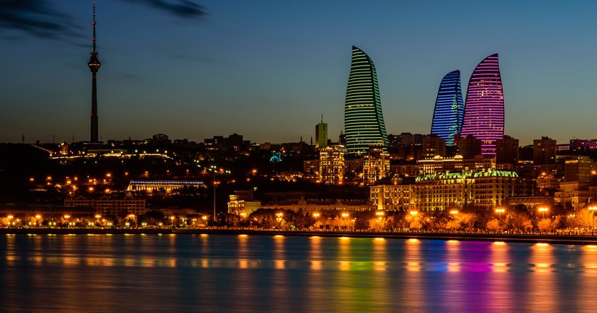
Situation in the field of
Gender Mainstreaming
in the
Republic of Azerbaijan
Gender Issues

Slide 2
Essential documents on the protection of
women's rights
01
In 1992
and
In 2000
UN Convention on the Elimination of All Forms of Discrimination Against Women
and
its Optional Protocol
02
In 2000
Decree of the President on “Implementation of the National Gender Policy in the Republic of Azerbaijan“. The Decree envisages the following:
a
Ensures equal representation of women and men in all state structures of the Republic
b
Introduces that the legislation shall be enacted taking into account the gender aspects.
c
Provides the refugee and internally displaced women with working places by preparing the relevant state program
d
Women should be appointed as one of the Deputy Heads of the Executive Power in all regions of Azerbaijan.

Slide 3
Essential documents on the protection of
women's rights
01
In 1992
and
In 2000
UN Convention on the Elimination of All Forms of Discrimination Against Women
and
its Optional Protocol
02
In 2000
Decree of the President on “Implementation of the National Gender Policy in the Republic of Azerbaijan“. The Decree envisages the following:
03
In 2000
The Cabinet of Ministers of the Republic of Azerbaijan adopted the National Plan of Action on Women Issues for 2000-2005
a
This program was elaborated on the basis of Beijing Strategies with taking into consideration the national priorities
b
It covers political, social, economic, cultural, educational, health spheres, problems of refugee and internally displaced women.
c
The National Plan of Action includes both the participation of state structures and NGOs.
d
The National Plan of Action includes both the participation of state structures and NGOs. Different projects in the field of women's political participation and their involvement into policy- and decision-making are being implemented in Baky and in the regions of Azerbaijan.

Slide 4
Essential documents on the protection of
women's rights
01
In 1992
and
In 2000
UN Convention on the Elimination of All Forms of Discrimination Against Women
and
its Optional Protocol
02
In 2000
Decree of the President on “Implementation of the National Gender Policy in the Republic of Azerbaijan“. The Decree envisages the following:
03
In 2000
The Cabinet of Ministers of the Republic of Azerbaijan adopted the National Plan of Action on Women Issues for 2000-2005
04
In 2006
State Committee on Family, Women and Gender Issues was established by Decree of the President of the Republic of Azerbaijan
The State Committee on Family, Women and Child Issues was established on the basis of the State Committee on Women Issues.
b
The main objectives and purposes of the Committee are protection of the women’s rights, increasing of women's participation in social and political life of the country.
a

Slide 5
Cooperation with International Organization
01
Distinguishing features of the UNIFEM project Under Phase I (2001-2004)
Azerbaijan closely cooperates with UN Development Fund for Women (UNIFEM). Our cooperation with this organization realized thorough the regional project entitled, “Women for Conflict Prevention and Peace Building in the Southern Caucasus” (Phase I: 2001 – 2004; Phase II: 2004 - 2007).
the mobilising of grassroots support – namely women’s organisations, activists, leaders, and youth - around gender equality, peace-building and conflict prevention issues in the country;
02
the project facilitated the creation of women’s networks and coalitions, as well as strengthened efforts around conflict prevention and peace education.
03

Slide 6
Cooperation with International Organization
01
Distinguishing features of the UNIFEM project Under Phase II (2004-2007)
Azerbaijan closely cooperates with UN Development Fund for Women (UNIFEM). Our cooperation with this organization realized thorough the regional project entitled, “Women for Conflict Prevention and Peace Building in the Southern Caucasus” (Phase I: 2001 – 2004; Phase II: 2004 - 2007).
using the Convention on the Elimination of All Forms of Discrimination Against Women (CEDAW) and UN Security Council Resolution 1325 (UN SCR 1325) as guiding frameworks to promote and protect peace-building and women’s human rights;
02
at the national level UNIFEM is forging closer partnerships with government in monitoring and implementing gender equality commitments made under CEDAW, UNSCR 1325, Millennium Development Goals and the Beijing Platform for Action. Further, UNIFEM is supporting improved linkages between gender equality advocates in government and within civil society on these issues.
03

Slide 7
Cooperation with International Organization
01
Azerbaijan also cooperates with Council of Europe in the domain of protection of the rights of women.
Our country makes use of the recommendations of the CoE for the improvement of legislation from the gender point of view and also takes an active part in the work of the different bodies of CoE in the sphere of gender mainstreaming
02
A number of round-tables and workshops were conducted with participation of this group of women.
The high-level delegation of Azerbaijan actively participated at 5th and 6th Ministerial Conferences on Gender Equality of the CoE held in Skopje and Stockholm in 2002 and 2006.
03

Slide 8
As a result of the aggression of Armenia and occupation of the 20% of territories of Azerbaijan,1 million Azerbaijanis became refugee and IDP.
54% of them are women.
Azerbaijan initiated adoption of the resolution on “Release of women and children taken hostage, including those subsequently imprisoned, in armed conflicts” at the 39th session of the UN Commission on the Status of Women in 1995. This resolution was adopted at the sessions of the CSW in 1996, 1997, 1998, 1999, 2000, 2001, 2003, 2004, 2006 and 2008.

Slide 9
Approach to the national gender strategy
RULE
1
At the moment we are in the process of building the national machinery for developing gender strategy and incorporating gender component in practical activities within the Government.
RULE
2
The gender focal points in the ministries constitute the working group under the State Committee for Women's Issues which meets every month to elaborate new gender policy within each ministry and to discuss what have been done in this field.
One of the important steps in the sphere of gender mainstreaming was the adoption of the Law of the Republic of Azerbaijan on guarantees of gender equality in December of 2006. The main purpose of this act is ensuring equal opportunities for women and men in the political, economic, social, cultural and other spheres of public life and elimination of all forms of discrimination on gender basis.
RULE
3
On January 23, 2007 the Committee on the Elimination of All forms of Discrimination Against Women (CEDAW) considered the 2nd and 3rd periodic report of the Republic of Azerbaijan on the Convention on the Elimination of All forms of Discrimination Against Women.
Report and all documents on this issue can be found on the following web site: www.un.org/womenwatch/daw/cedaw/
RULE
4

Slide 10
On 10-11 June 2008 an international forum on “Expanding the role of women in cross-cultural dialogue” was held in Baku on the initiative of
Mrs/ Mehriban Aliyeva, First Lady of the Republic of Azerbaijan, President of the Heydar Aliyev Foundation, UNESCO and ISESCO Goodwill Ambassador.
The Government of Azerbaijan also takes active part in the process of promotion of women rights in the international level.
As a proof of the increasing influence of Azerbaijan and support for promotion of women’s rights at the international level, it was decided to hold 7th Ministerial Conference of the Council of Europe on gender equality in Baku in 2010.

Slide 11
Decree of the President of the Republic of Azerbaijan of 6 March, 2000 “On state women policy of the Republic of Azerbaijan”. This document envisages ensuring equality between women and men in all state bodies, providing employment of IDP and refugee women in accordance with relevant state programmes, revision of legislation from the gender point of view.
01
02
National legislative basis of the implementation of gender policy in the Republic of Azerbaijan
Decision of the Cabinet of Ministers of the Republic of Azerbaijan of 6 March 2000 "On National Plan of Action on women's issues of the Republic of Azerbaijan for 2000-2005". The National Plan of Action was elaborated on the basis of Beijing Strategies with taking into consideration the national priorities.
03
04
Law of the Republic of Azerbaijan on guarantees of gender equality was adopted by the parliament of the Republic of Azerbaijan in December of 2006. The main purpose of this act is ensuring equal opportunities for women and men in the political, economic, social, cultural and other spheres of public life and elimination of all forms of discrimination on gender basis. This act defines main directions and purposes of state policy on achieving gender equality in the country.

Slide 12
Women and economics
Women and education
Women and health
Women and violence
Women and armed conflicts
Refugee and IDP women
Women and mass media
Women and Environment
The girl child
Participation of women in state structures and in decision-making
Development of contacts with international women's organizations
01
02
National Plan of Action on women's issues of the Republic of Azerbaijan for 2000-2005“ covers following issues
03
04

Slide 13
Purposes:
01
- to arrange the implementation of gender policy in state structures and increase the representation of women in Government at the decision-making level;
- to create gender disaggregated statistical data;
- to arrange legislative review with a view to make appropriate amendments and changes into the existing laws and strengthen the protection of women’s rights;
- to prepare and implement the program aimed at providing employment opportunities for women refugees and IDPs.
02
The Presidential Decree on Strengthening of gender policy
03
04
05
The Cabinet of Ministers of the Republic of Azerbaijan was authorized to provide the implementation of the Decree.

Slide 14
protects the rights of women in political, economic and social fields;
encourages the active participation of women in social and political life of the country;
elaborates the relevant national policy in the field of women's employment;
01
This is the only Government body responsible for the implementation and coordination of gender policy in Azerbaijan, the status of which is equal to that of a ministry.
02
takes joint measures aimed at resolving women's problems, protection of women's rights, employment of women in co-operation with the relevant state structures;
takes measures aimed at development of co-operation between the relevant state structures and national and international women's organisations;
prepares of annual reports on social and economic status of women in Azerbaijan;
State Committee on Family, Women and Child Issues
03
04
studies and disseminate legislation on women's rights;
co-ordinates the implementation of the National Plan of Action on Women Issues of the Republic of Azerbaijan (adopted in 2000);
provides assistance to the refugee and IDP women and women from low-income families in social sphere;
elaborates the National Mechanism on Gender Policy.

Slide 15
01
Gender focal points were to be appointed in all Government structures, as well as in the Executive Power institutions in all regions of Azerbaijan
02
They were appointed at the expert level, but in some ministries they act at the level of Deputy Minister/Chair or Adviser to the Minister/Chair.
Gender Focal Points in State structures
03
One of the main functions of the gender focal points is to implement the relevant provisions of the National Plan of Action on women’s issues and to participate in working groups to discuss different documents to be adopted at national (inter-ministerial) level.
04
There is no any specific item in the national budget for the implementation of the state gender policy.

Slide 16
THANK YOU FOR THE ATTENTION !!

