Slide 1
  Level 5 in ETF Partner Countries
  4 September 2018
  Michael Graham, ETF
Notes:
MSE 15.06 draft 16.05.2011
1

Slide 2
EQF Level 5 | Knowledge | Skills | Responsibility and autonomy
Level 5 (*1) The Learning outcomes relevant to Level 5 are | comprehensive, specialised, factual and theoretical knowledge within a field of work or study and an awareness of the boundaries of that knowledge | a comprehensive range of cognitive and practical skills required to develop creative solutions to abstract problems | exercise management and supervision in contexts of work or study activities where there is unpredictable change; review and develop performance of self and others
Notes:
MSE 15.06 draft 16.05.2011
2

Slide 3
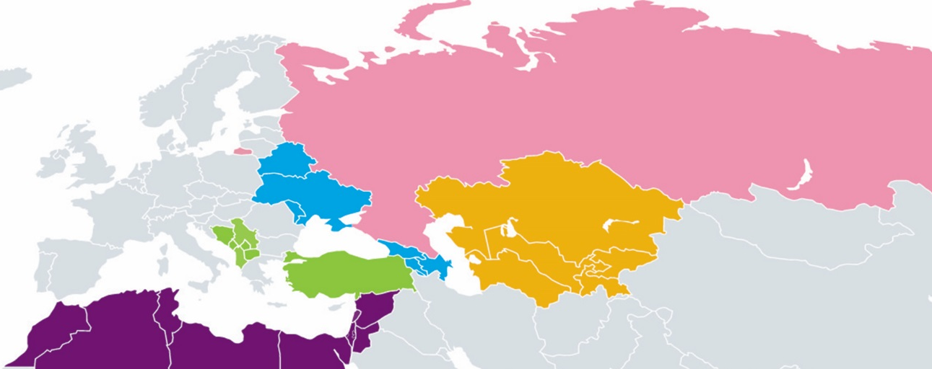
South Eastern Europe
Albania, Bosnia and Herzegovina, Kosovo*, former Yugoslav Republic of Macedonia, Montenegro, Serbia
Turkey
Southern and Eastern Mediterranean
Algeria, Egypt, Jordan, Lebanon, Libya, Morocco, Palestine**, Syria, Tunisia and Israel
Eastern Partnership:
Armenia, Azerbaijan, Belarus, Georgia, Republic of Moldova, Ukraine
Central Asia:
Kazakhstan, Kyrgyzstan, Tajikistan, Turkmenistan, Uzbekistan
Russia
* This designation is without prejudice to positions on status, and is in line with UNSCR 1244 and the ICJ Opinion on the Kosovo declaration of independence.
** This designation shall not be construed as recognition of the State of Palestine and is without prejudice to the individual positions of the EU Member States on this issue.
Notes:
Comms to update

Slide 4
  ETF and Level 5: local conditions and our strategy
  Actions and outputs integral to our support to wider NQF reform
  But our picture is partial – HE and VET walls…..
  14 ETF partner countries in Bologna
  Level 5 opens door to levels 6-8; aim: link sectors, achieve parity
Notes:
MSE 15.06 draft 16.05.2011
4

Slide 5
  ETF Partner country provision at L5: issues
  Numbers of qualifications available; types, characteristics – outcomes, units etc.
  Providers
  Place in NQF
  Above all - function (related to type)
  Identify our role relative to other actors
Notes:
MSE 15.06 draft 16.05.2011
5

Slide 6
  ETF Partner country picture: general findings on qualifications
  Information not easily accessible; absence of databases/non-formal provision/unused qualifications from projects or donors
  Many qualifications not outcomes-based; not levelled in NQF
  Little coverage of transversal skills, ICT, languages, team-working etc.
Notes:
MSE 15.06 draft 16.05.2011
6

Slide 7
  ETF Partner country picture
  Balkans: no short-cycle HE
  Turkey: strong links, VET colleges to HEIs
  Eastern Europe: diverse functions, labour market access and short-cycle HE
Notes:
MSE 15.06 draft 16.05.2011
7

Slide 8
  ETF Partner country picture :challenges
  Limited permeability up the levels
  Where NQF is slow in implementation, L5 is scarce
  Weak employer role
  Capacity
Notes:
MSE 15.06 draft 16.05.2011
8

Slide 9
  Aims, actions, outputs, 2019-20
  In Balkans, expand types and provision; linked to Bologna and HE provision.
  In Eastern Partnership, build and consolidate integration of HE and VET via NQFs.
  Ensure outcomes in qualifications (all)and curricula; and train teachers.
Notes:
MSE 15.06 draft 16.05.2011
9

