Slide 1


Geodynamical Hazards of High Dams GHHD– 2022 Report
Tamaz Chelidze, Ekaterine Meparidze, Zurab Chelidze, Tengiz Kiria,
European Centre GHHD, Council of Europe
M. Nodia Institute of Geophysics, Tbilisi State University
2022

Slide 2
According to project proposal for 2022:, GHHD planned to perform the following activities:
a. Application of new measures of high dams stability using nonlinear dynamics tools and compilation of guidelines;
b. Preparation of chapter for the Monograph “Dam Engineering” (Publ. House InterOpen);
c. Testing the new strain/acceleration monitoring equipment for the Enguri dam
In addition, the GHHD take part in the International project DAMAST. The DAMAST project – Dams and Induced Seismicity (2019-2022) - aimed to make contributions to long-term safe and efficient operation of large dams. The objective was to develop, install and test monitoring systems transferrable to other dams. In the DAMAST project, German, Georgian and Armenian partners use the Enguri dam as example to investigate the underlying processes and safety-relevant parameters of water reservoirs.
On the final DAMAST International conference (Karlsruhe April 2022) “Monitoring for Hydropower Lifetime” T. Chelidze presented the report on the work carried out by CHHD in the frame of the above project: Nonlinear Dynamics Tools in the Real Time Monitoring of Large Dams: the case of High Enguri Arc Dam (see attachment).
The succeeding project DAMAST - “Monitoring for High Dam Lifetime: Reliable Supply of Water and Electricity in times of Decarbonization” is projected for 2022-2024. It aims on sharing the knowledge gained within the first DAMAST (2019-2022) project to help the freshwater management and to supply the public with clean, reliable and affordable power. This project is the first step towards a Scientific Centre of Competence in the Caucasus. Such center would be ideal to combine the goals of climate change and energy security.

Slide 3
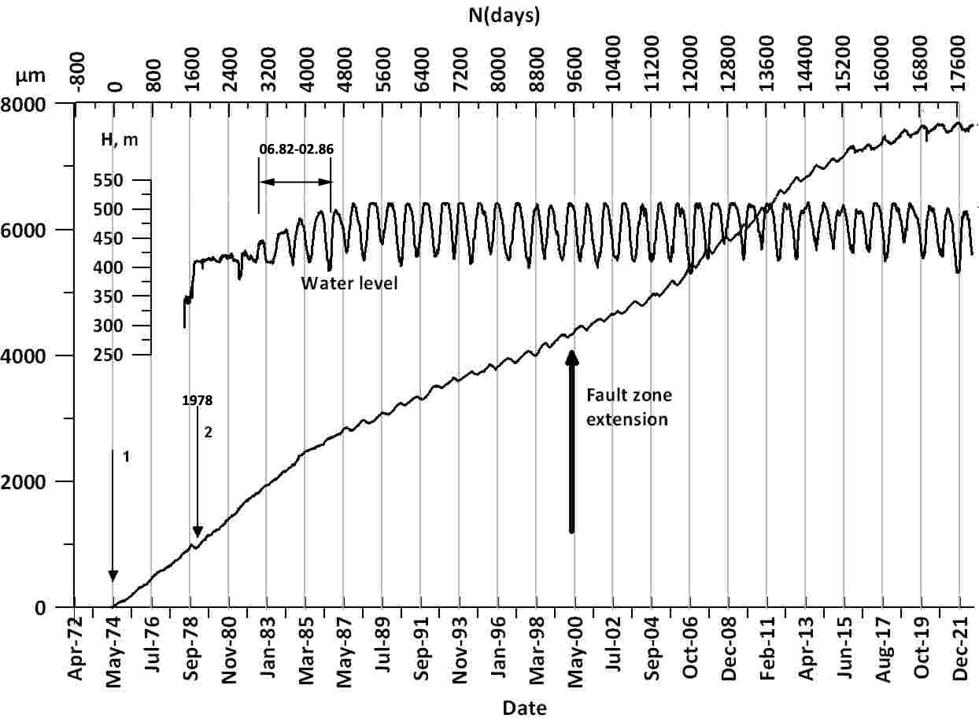
Water level change in the Enguri lake (upper curve) and strains (lower4 curve) (lower curve) from 1974 to 2021. Arrow 1 - the start of strainmeter monitoring, arrow 2 – the beginning of significant lake filling
N | Periods, months– years | Number of days within the periods 1–7; in the brackets the same from the zero day (01.04.1964) to the end of a given period | Strain rate microns/year
1 | May 1974– Sep 1984 | 1600 (3,807) | 250
2 | Sep 1984–May 1987 | 973 (4780) | 160
3 | May 1987–Sep 2004 | 6332 (11,112) | 147
4 | Sep 2004–Apr 2013 | 3379 (14,400) | 233
5 | Apr 2013–June 2017 | 1551 (16,000) | 147
6 | June 2017-Dec 2021 | 1160 (17,600) | 44
On the final DAMAST International conference (Karlsruhe April 2022) “Monitoring for Hydropower Lifetime” T. Chelidze presented the report on the work carried out by CHHD in the frame of the above project: Nonlinear Dynamics Tools in the Real Time Monitoring of Large Dams: the case of High ri Arc Dam (see attachment).
The on sharing the knowledge gained within DAMAST to help the freshwater management and to supply the public with clean, reliable and affordable power. This project is the first step towards a Scientific Centre of Competence in the Caucasus. Such a centre would be ideal to combine the goals of climate change and energy security.
The strain rate pattern in the fault, crossing the dam foundation changed significantly during last 5 years. This strain rate deceleration can be caused by the decrease of geodynamical potential of the fault or by the effect of the retarding torque (braking effect) due to the strong asperity on the fault surface.
The last effect can lead to accumulation of tectonic strain on the asperity, which eventually can be released in a slow (creep) or fast (earthquake) manner. Thus, it is necessary to sustain the systematic observations on the tilts/strains of the dam and the fault in its foundation.

Slide 4

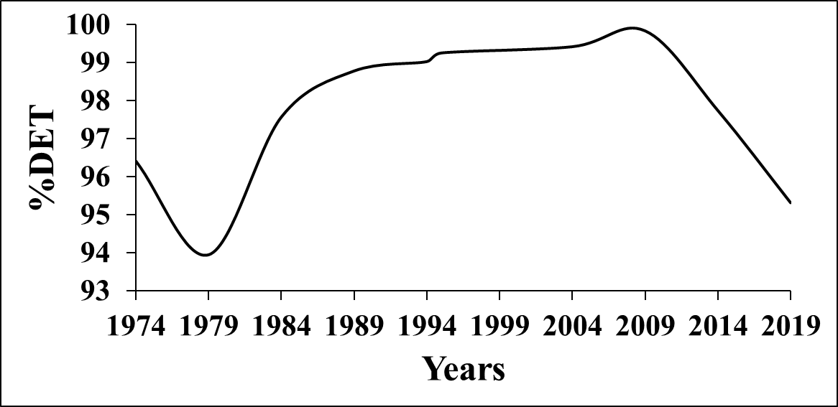
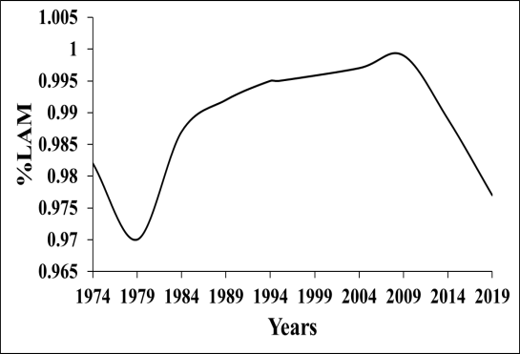
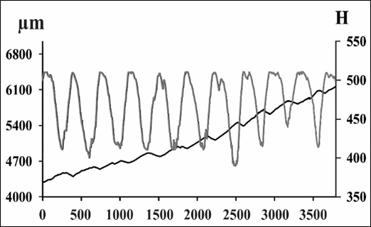
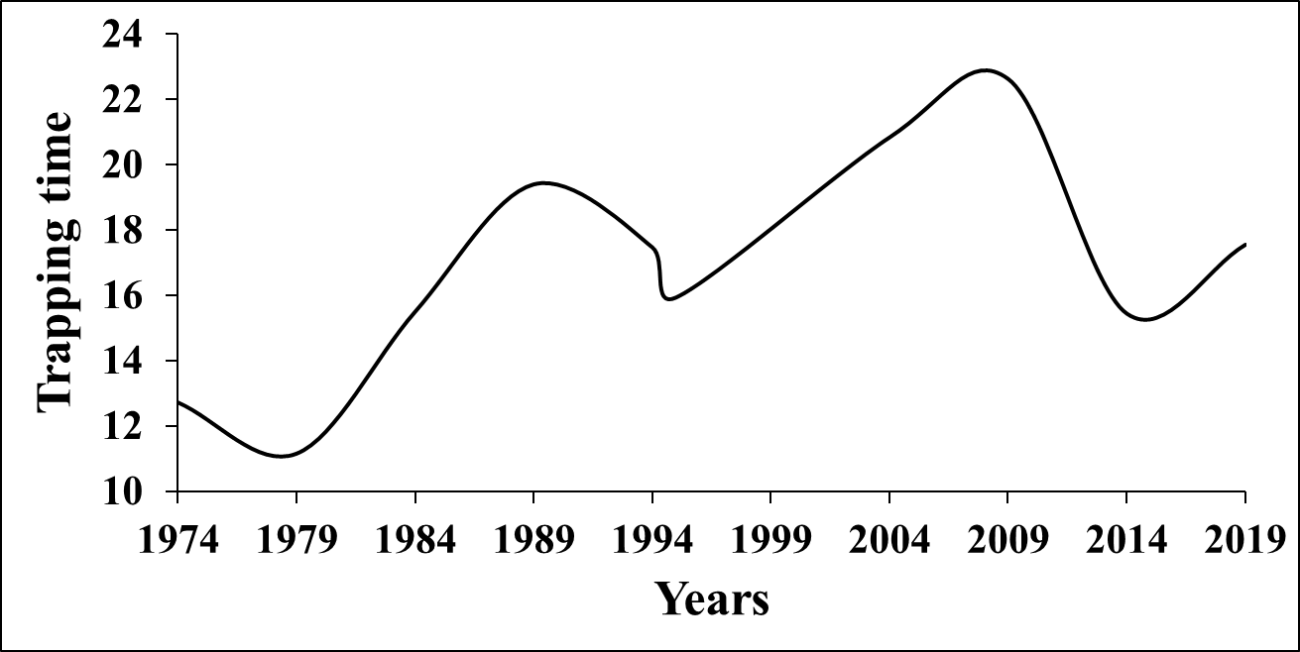
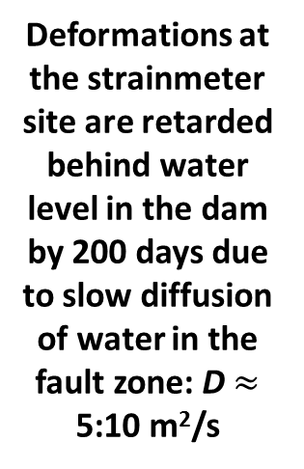
Reccurence Quantification Analysis characteristics of displacement d of the fault in Enguri Dam foundation in 1974-2019: 1. %DET; 2 - %LAM; 3. Trapping times TT.
characteristics
Before regular d
Regular d
Less regular d
Water level regular
Note: from approximately 2013—2014 the pattern of WL is less regular and all determinism characteristics also decrease.
1
2
Deformations at the strainmeter site are retarded behind water level in the dam by 200 days due to slow diffusion of water in the fault zone: D $≈$ 5:10 m²/s
3

Slide 5
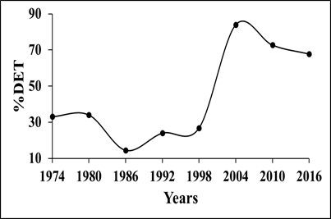
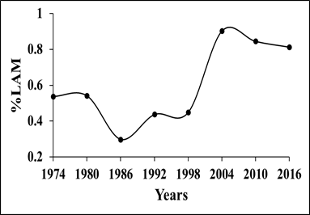
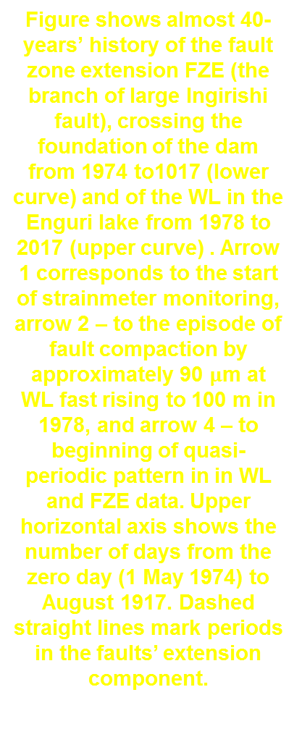
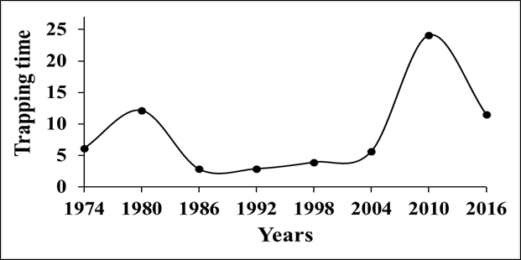
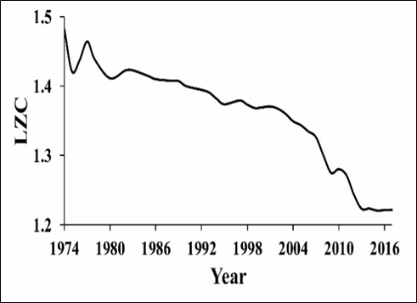
Reservoir-Induced Seismicity Synchronization - RISS.
RQA characteristics of earthquake waiting (interevent) times in 1974-2017 in the original seismic catalog in the Enguri dam area within 100 km radius: 1. %DET; 2 - %LAM; 3. Trapping times TT; 4. LZC analysis
Reservoir-Induced Seismicity Synchronization - RISS.
RQA characteristics of earthquake waiting (interevent) times in 1974-2017 in the original seismic catalog of the Enguri dam area within 100 km radius: 1. %DET; 2 - %LAM; 3. Trapping times TT; 4. LZC analysis
regular RISS
Less regular RISS
Water level regular
Before regular RISS
RQA characteristics of earthquake waiting (interevent) times became more ordered much later than deformations: if deformation is retarded from water level by 200 days, the seismicity became more ordered only after approximately 20 years

Slide 6
The chapter: Potential of Nonlinear Dynamics Tools in the Real Time Monitoring of Large Dams: the case of High Enguri Arc Dam, T. Chelidze, et al. was accepted for publication in 2022 in the “Special Topics in Dam Engineering ” edited by Prof. Hasan Tosun by publishing house INTECHOPEN LIMITED, London.
Presentation of results, obtained by CHHD: The report “Nonlinear Dynamics Tools in the Real Time Monitoring of Large Dams: the case of High Enguri Arc Dam” was presented on the International Conference “Monitoring for Hydropower Lifetime” (Karlsruhe April 2022).

Slide 7
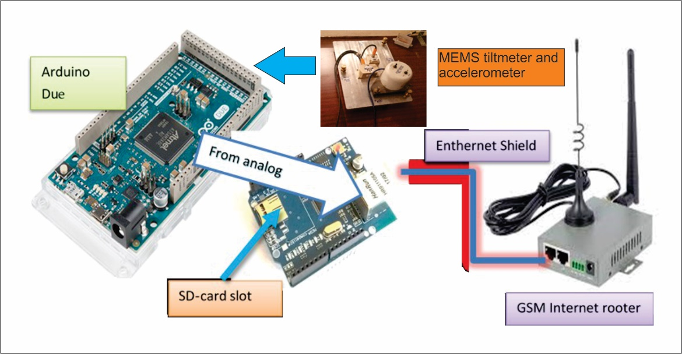
c. Development of new technological tools for monitoring dam performance (creation of cost-effective telemetric acceleration/tilt monitoring unit)
In the frame of 2022 project GHHD assembled and tested the cost-effective system for tilt/acceleration monitoring and the GSM platform for data transmitting at Enguri HPS. We used the modern MEMS type three-channel accelerometer AMA-3-02-G-V1 and two-channel tiltmeter AMI-2-10-V1. The signals registered by sensors and transmitted in a balanced way delivered to the Arduino Uno module of data digitizer, recording and GSM transmitting units. In the same compartment are the energy supply module, reserve supply battery and charging unit. The signals registered by sensors and transmitted in a balanced way delivered to the Arduino Uno module of data digitizer, recording and GSM transmitting units. In the same compartment are the energy supply module, reserve supply battery and charging unit.
3
2
1
The block scheme of the monitoring unit: 1 – Platform tiltmeter ‘Applied Geomechanics” 701, used for calibration of MEMS tiltmeter; 2- MEMS Tiltmeter AMI-2; 3- MEMS Accelerometer AMA-3-02-G-V1

