Slide 1
Academic Freedom, Institutional Autonomy and the Future of Democracy
Council of Europe, June 20-21, 2019
Rapporteur’s Report
Tony Gallagher, Queen’s University Belfast
am.gallagher@qub.ac.uk
@tgeducation

Slide 2
'About eighty-five institutions in the western world established by 1520 still exist in recognisable forms ... including the Catholic Church, the parliaments of the Isle of Man, of Iceland, and of Great Britain, several Swiss cantons, and seventy universities.'
Labaree, 2017, A Perfect Mess: the unlikely ascendancy of American higher education.

Slide 3
Mass higher education
More institutions
More diverse students
More young institutions
More diverse missions
Diverse political contexts

Slide 4
The purpose of higher education
Preparing for the labour market
Personal development
Development of a broad and advanced knowledge base
Preparing for life as active citizens in democratic societies

Slide 5
‘intelligence is not enough, intelligence plus character is the goal of education’

Slide 6
Magna Charta Universitatum
Universities … must be morally and intellectually independent of all political authority and economic power
Rejecting intolerance and always open to dialogue … meeting-ground for teachers capable of imparting their knowledge and for students entitled, able and willing to enrich their mind with that knowledge

Slide 7
The challenges
Commodification
Populism

Slide 9
Eatwell, R and Goodwin, M (2018) National Populism: the revolt against liberal democracy, UK: Pelican
Brexit 2016
Under 37 yrs old voting REMAIN
80% of those with degrees
37% of those without degrees
Trump 2016
College graduates backed Clinton (52%-43%), while those without a college degree backed Trump (52%-44%)
‘Education … has a very strong influence on our values and the way in which we interpret the world around us’ (Pp25-27)

Slide 10
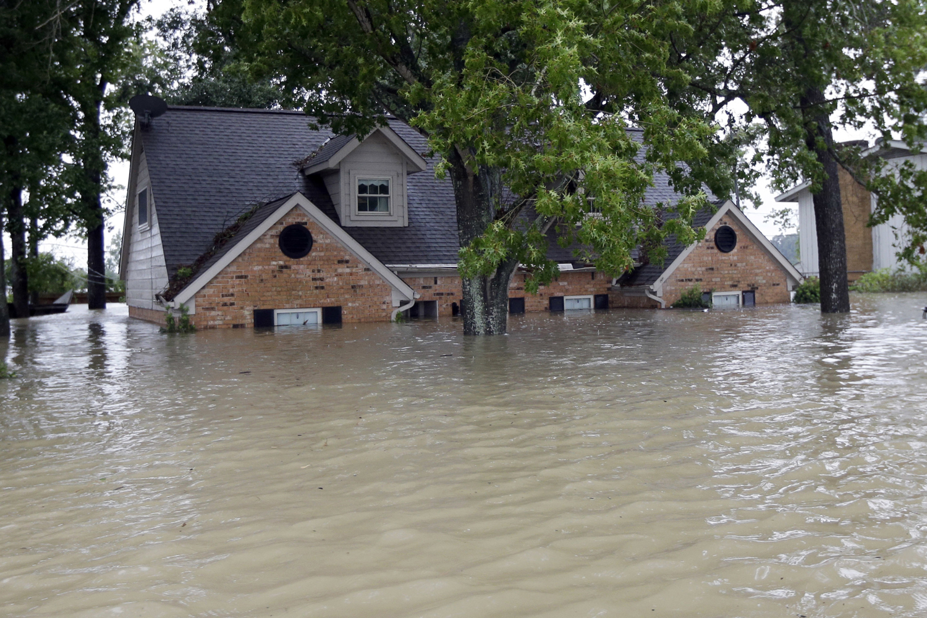
‘It’s very difficult to find drinking water in a flood’

Slide 11
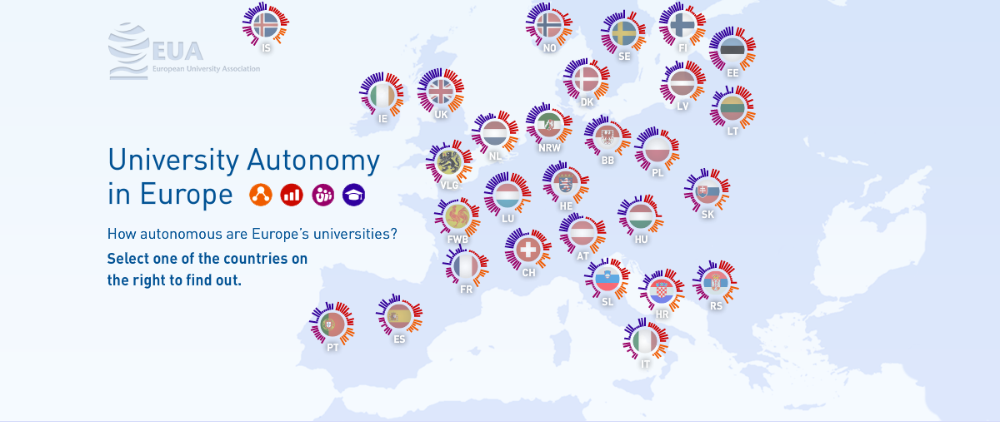
https://www.university-autonomy.eu/

Slide 12
Higher education
Public authorities
Society
Institutional Autonomy
Responsibility
Engagement
Negotiation
Context
Political legitimacy of public authorities
Cultural consensus in society

Slide 13
Academic freedom
Freedom of expression

Slide 14
Chemerinsky, E and Gillman, H (2017) Free Speech on Campus, New Haven/London: Yale University Press
Professional space
Public space

Slide 15
The problem(s) with academic freedom
We have not articulated with clarity what we mean by academic freedom within our own community
We are unable to negotiate with public authorities as we are unclear what we want or need
We are unable to consider the relationship between academic freedom and institutional autonomy while our understanding of the former is opaque

Slide 17
Academic freedom: definition & standards
Ethics
Academic
Professional
Legal

Slide 18
Aspiration into action
Democratic culture
Affirmatively acting in the interests of democracy
Doing what needs to be done even when it is risky
Promoting equity in inequitable societies

Slide 19
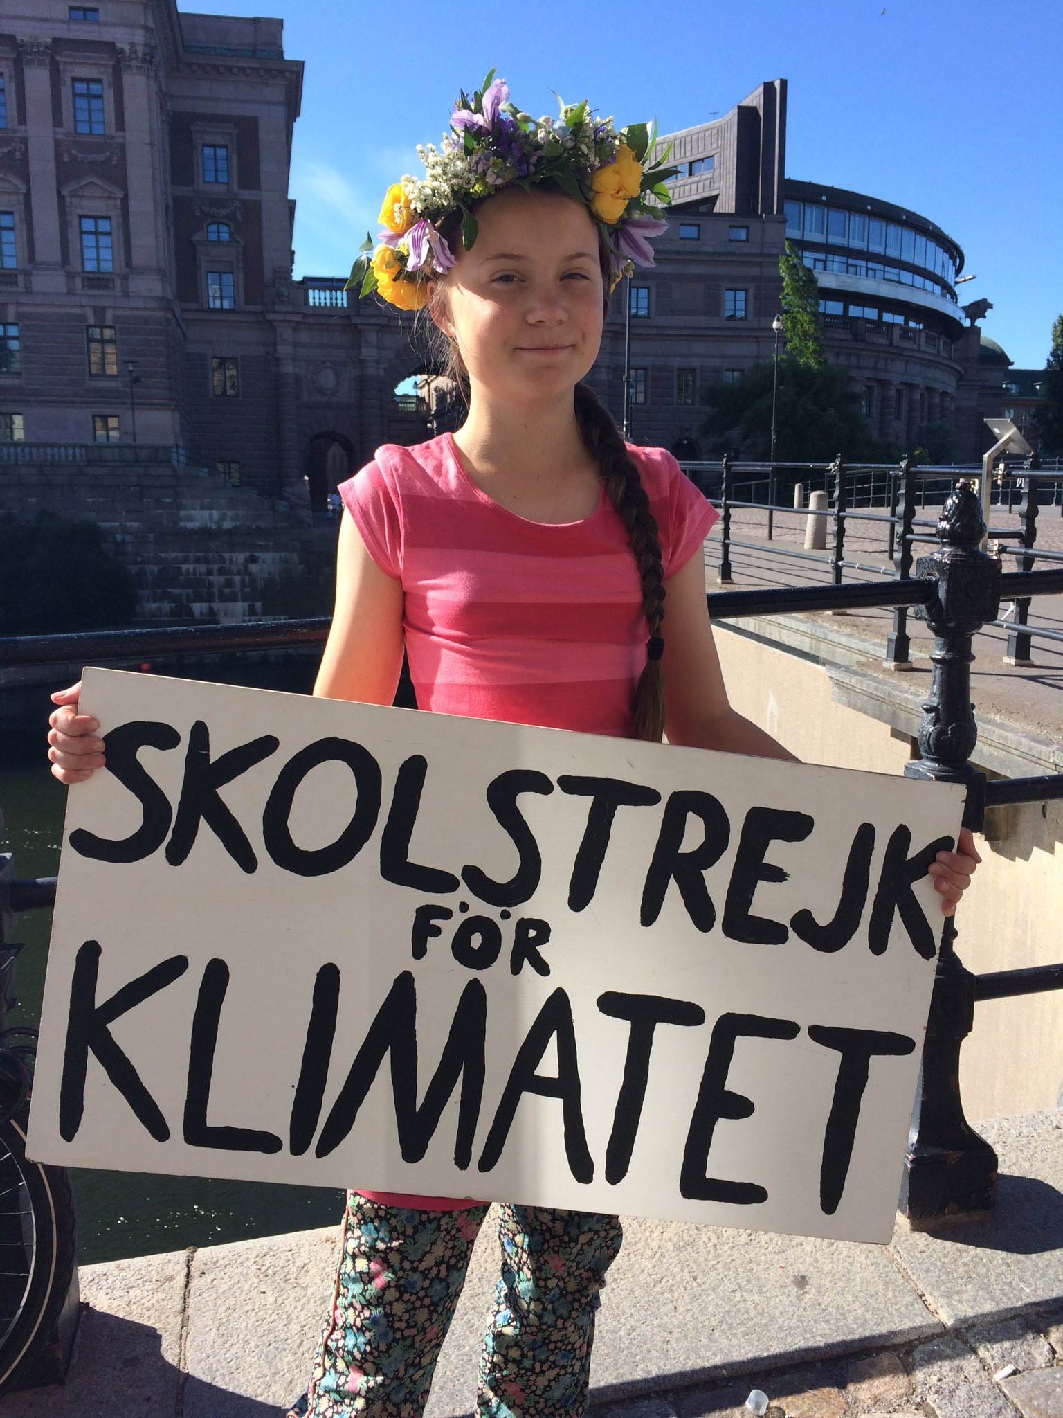
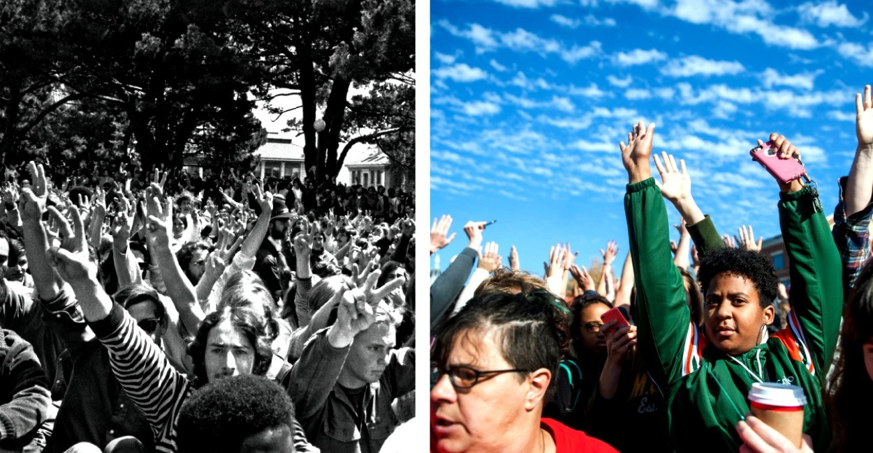
@GretaThunberg 3h3 hours ago
School strike week 44. And happy midsummer! #fridaysforfuture #schoolstrike4climate #climatestrike

