Slide 1
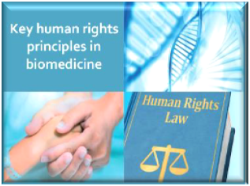
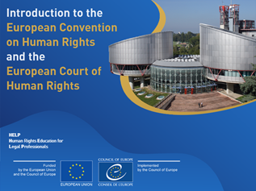
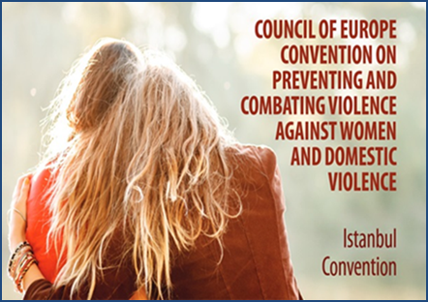
Italy – HELP COURSES
National Training Programs for lawyers
Consiglio Nazionale Forense
2020-2022
Avv. Giovanni Pansini

Slide 2
1. Judicial training after the pandemic
2. The role of lawyers
3. The role of institutions

Slide 3
Judicial Training after the pandemic
"Some things benefit from shocks; they thrive and grow when exposed to volatility, randomness, disorder and stress factors; and they love adventure, risk and uncertainty. (...) Since there is no word for the exact opposite of fragile, let us call it antifragile. Antifragility goes beyond resilience or toughness. Resilient resists impact and stays the same; antifragile improves.“
Nassim Taleb “The black swan”

Slide 5
The role of lawyers
A new challenge for European lawyers: to be the eyes on the law
"Montesquieu said that the judge must be the voice of the law.
I think that the lawyer must be something different…In Italy we are seeing a very exciting experience. At the highest level of the Republic is the Constitutional Court, whose function is to cancel laws that are contrary to the constitution.
But the Court cannot proceed ex officio: the exception must be raised in the context of a trial. Now, it is in fact the lawyers are the most active in discovering the laws that are contrary to the constitution and in promoting the transformation of positive law towards the goal indicated by the constitution itself.“
Piero Calamandrei 16th Congress of the 'Union Internationale des Avocats', held in Paris in July 1956

Slide 6
Codice Deontologico Forense
Articolo 1
'The lawyer … shall ensure that the laws comply with the principles of the Constitution and the EU Law, as well as those of the ECHR...’
The role of lawyers
to be the «eyes on the law»

Slide 7
The role of institutions
"The Governments signatory hereto, being members of the Council of Europe…
Reaffirming their profound belief in those fundamental freedoms which are the foundation of justice and peace in the world and are best maintained on the one hand by an effective political democracy and on the other by a common understanding and observance of the Human Rights upon which they depend;"
Preamble ECHR

Slide 8
No one shall be held in slavery
Everyone has the right to liberty
it is primarily the duty of the High contracting parties, in accordance with the principle of subsidiarity, to ensure respect for rights and freedoms

Slide 9
Rights, Fundamental Freedoms, Justice, Peace, Ideals.
Point of arrivals

Slide 10
Avv. Giovanni Pansini
Thanks!

