Slide 1
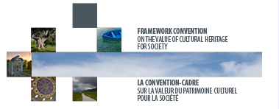

COUNCIL OF EUROPE FRAMEWORK CONVENTION
ON THE VALUE OF CULTURAL HERITAGE FOR SOCIETY
The Faro Convention in Research-Action:
Community involvement in a post-disaster heritage revitalisation.
Faro Convention – from a standard to civil society
9 October 2017, 9.30/10.45 - Fontecchio, Italy
Prosper WANNER
. FARO NETWORK .

Slide 2
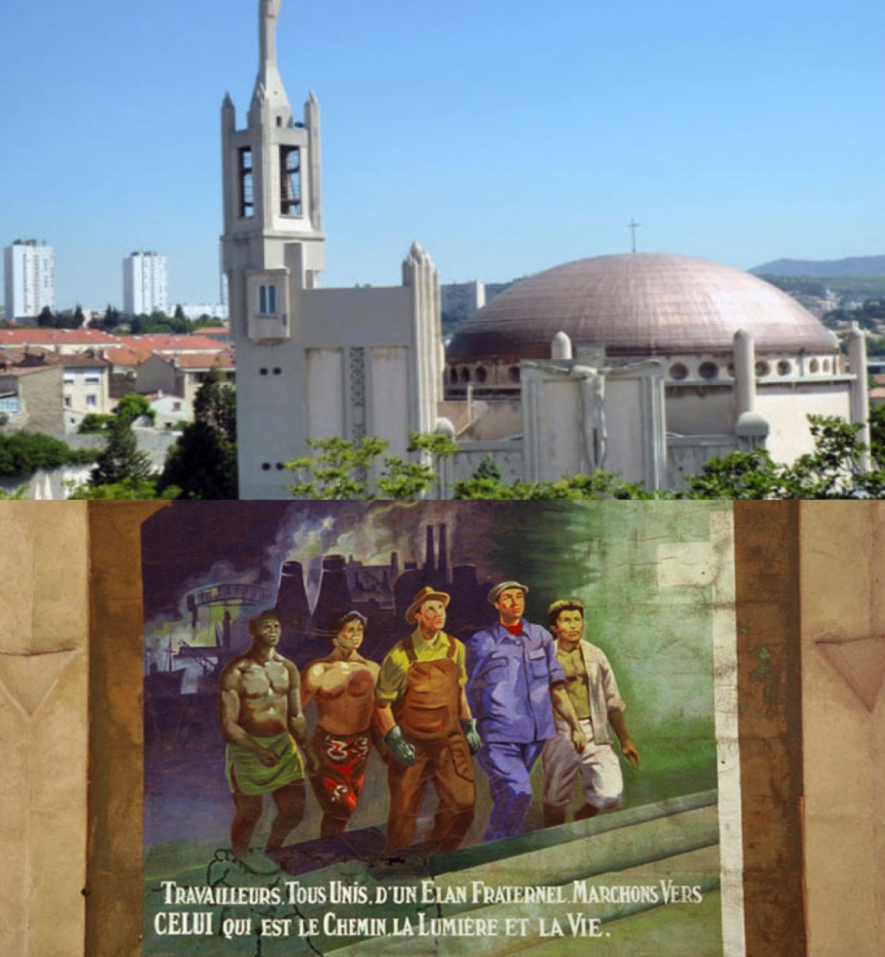
Marseille:
cultural heritage as a resource for sustainable development and quality of life.
#common
#community

Slide 3
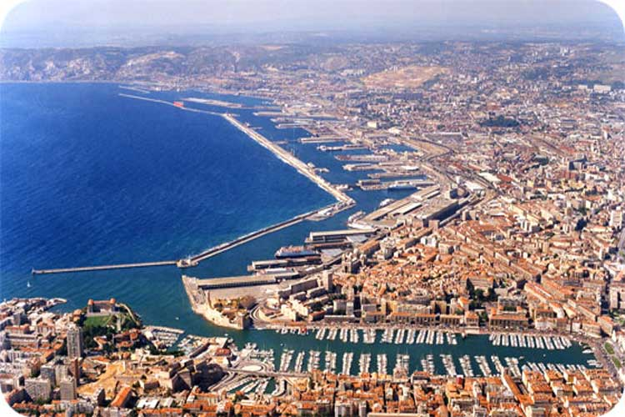
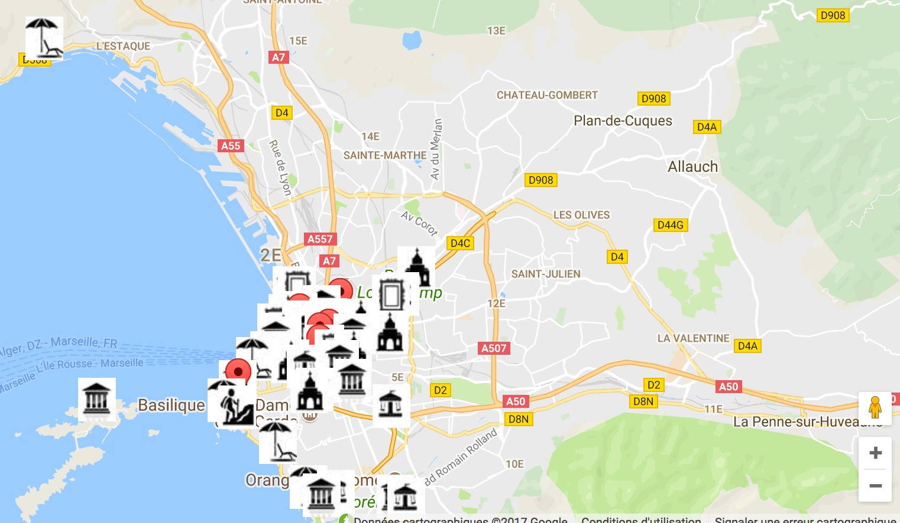

Slide 4
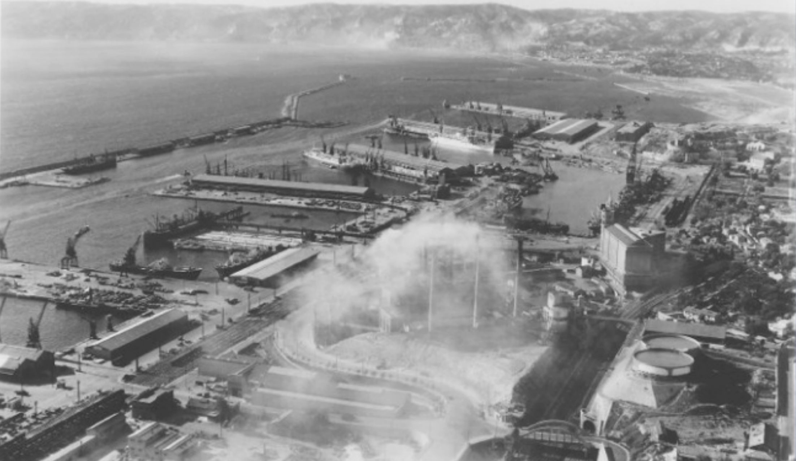
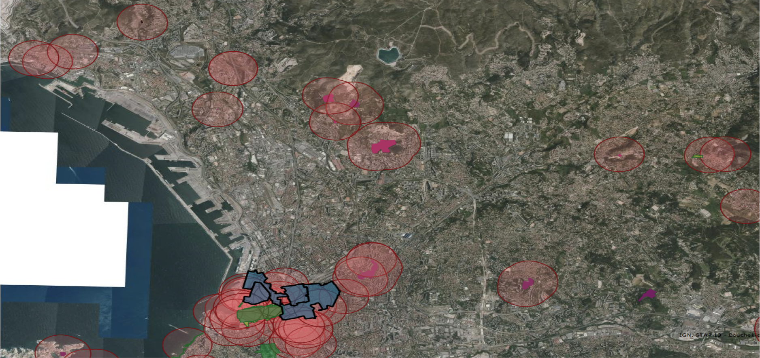

Slide 5
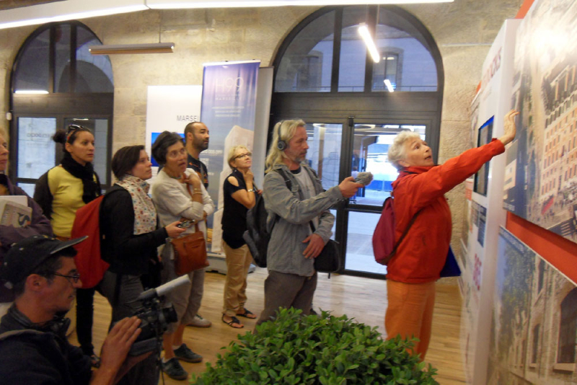
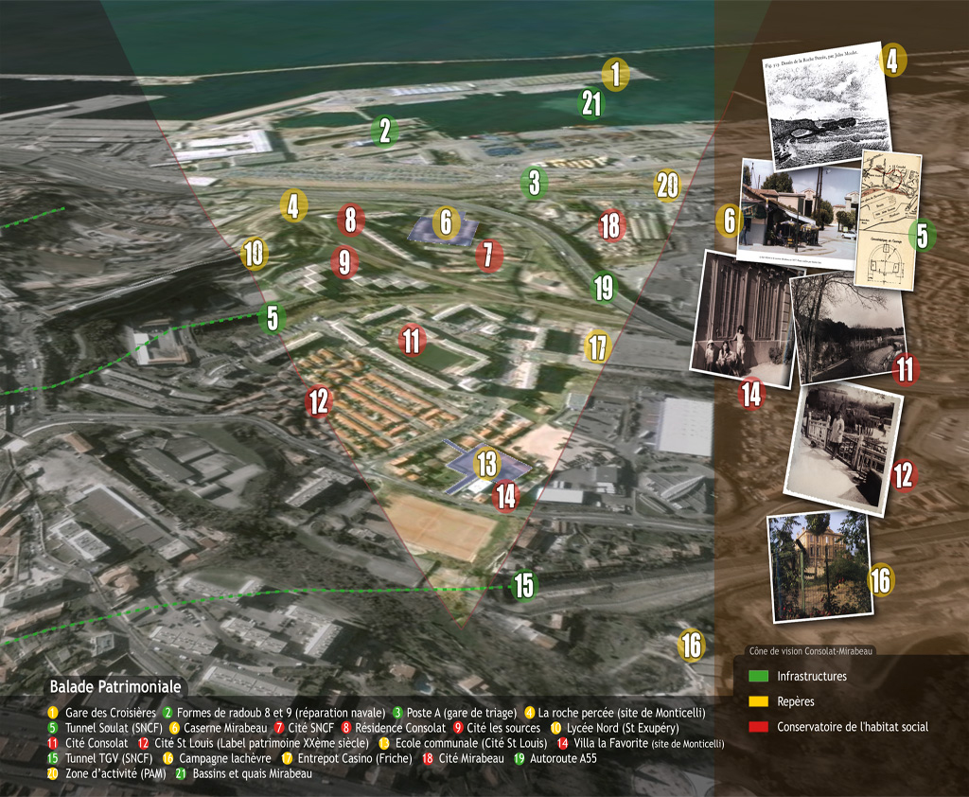

Slide 6
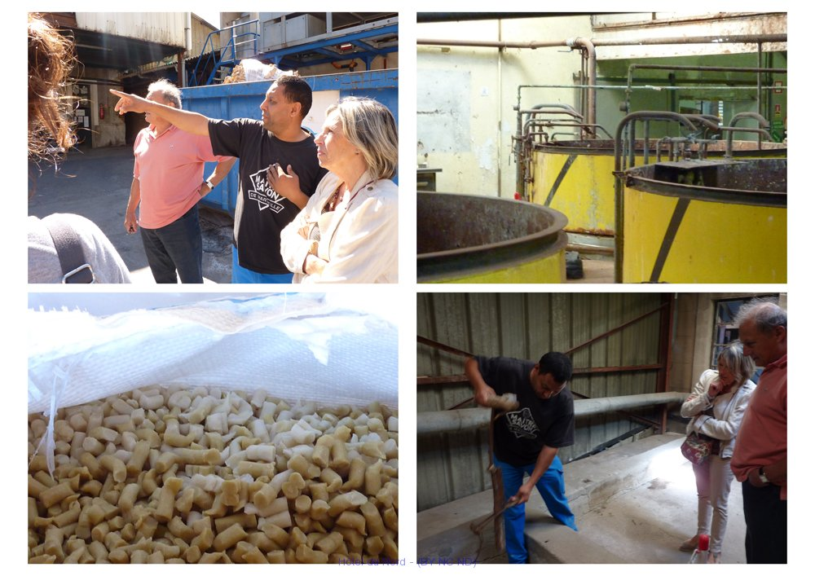

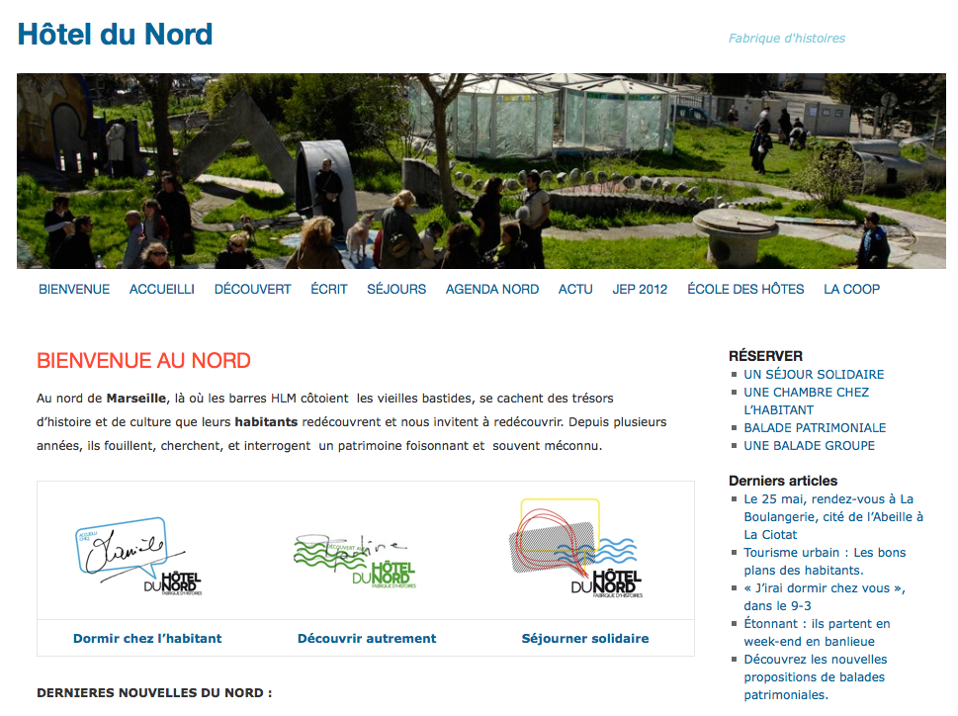
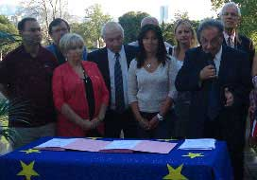
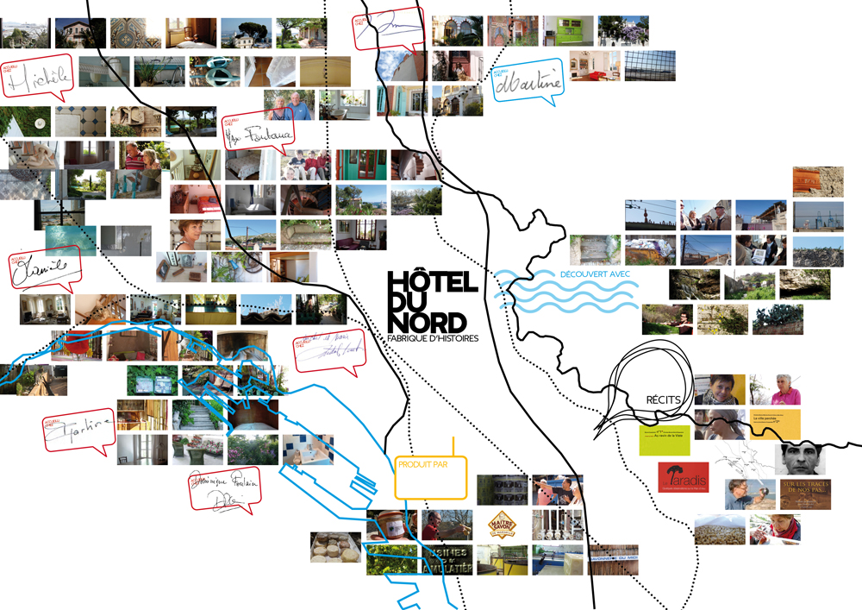

Slide 7
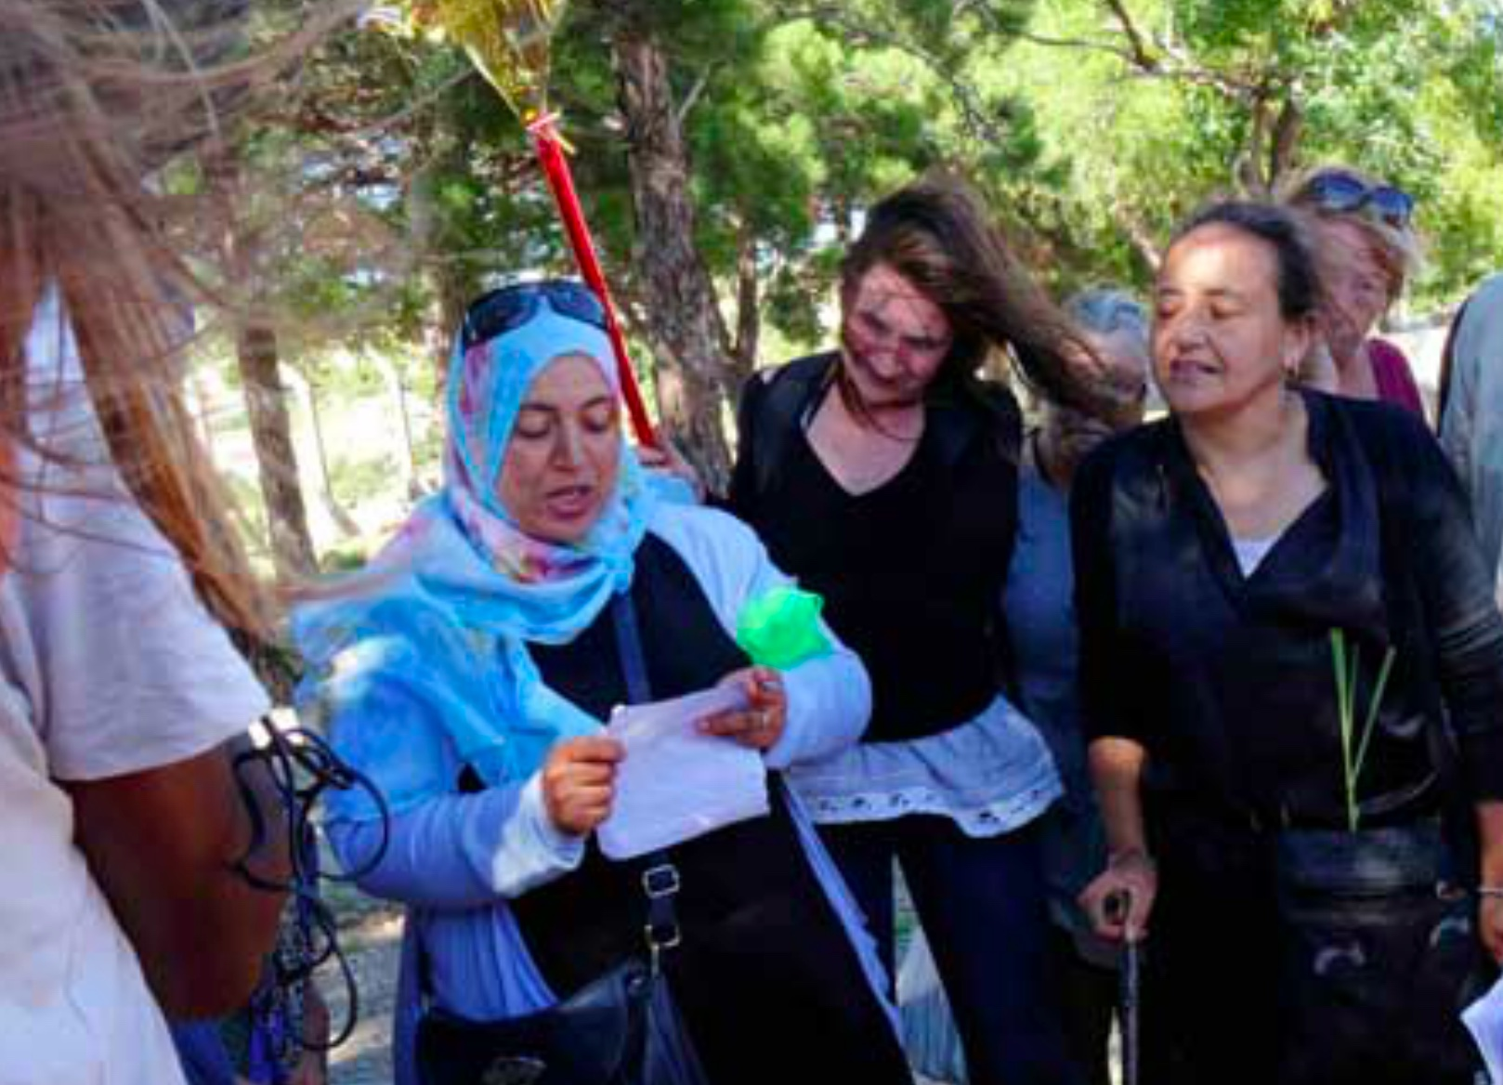
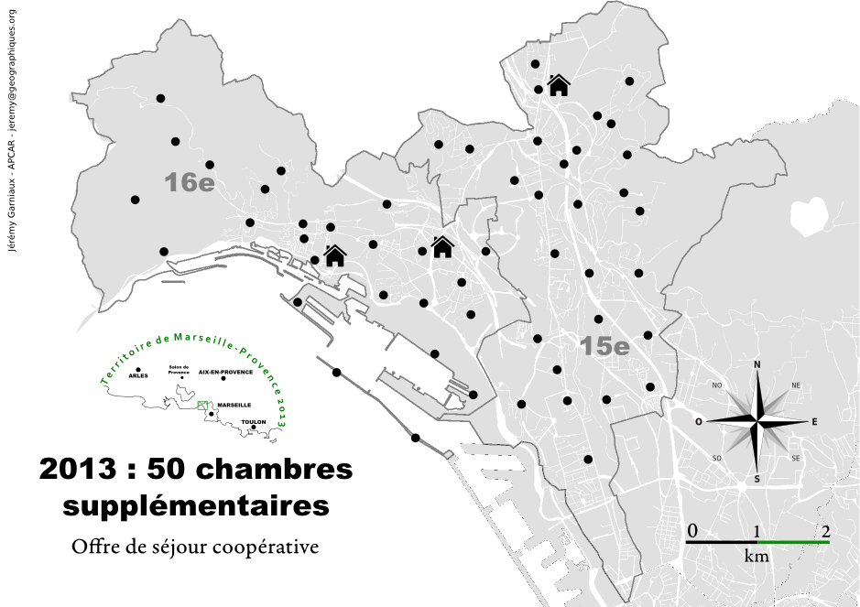

Slide 8
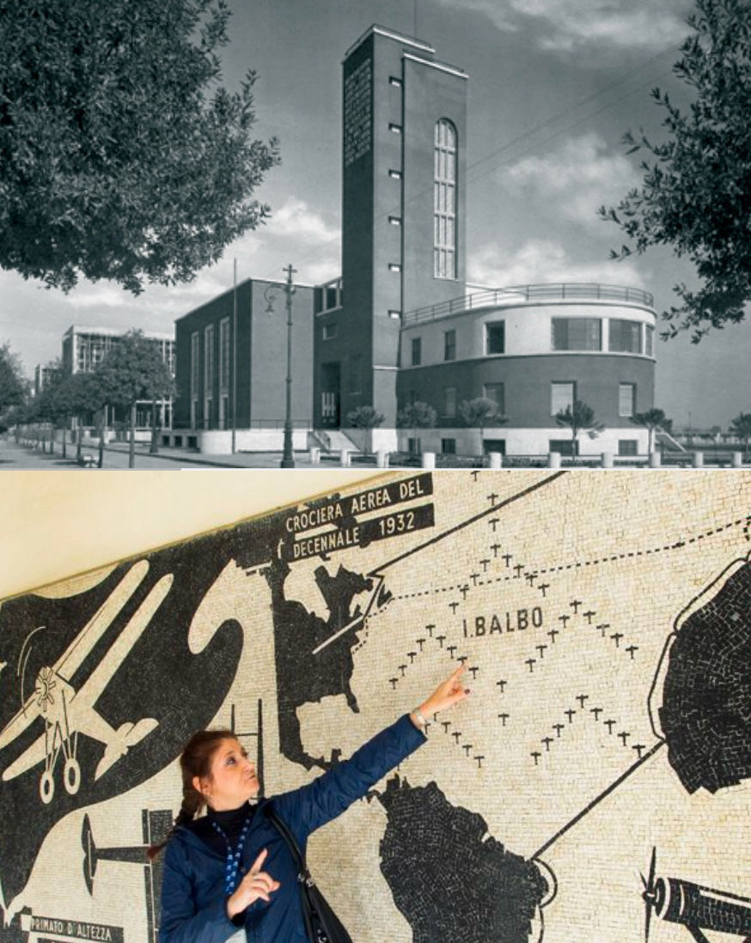
Forlì: Establish processes for conciliation, prevention and resolution of conflicts.
# cooperation
# public action

Slide 9
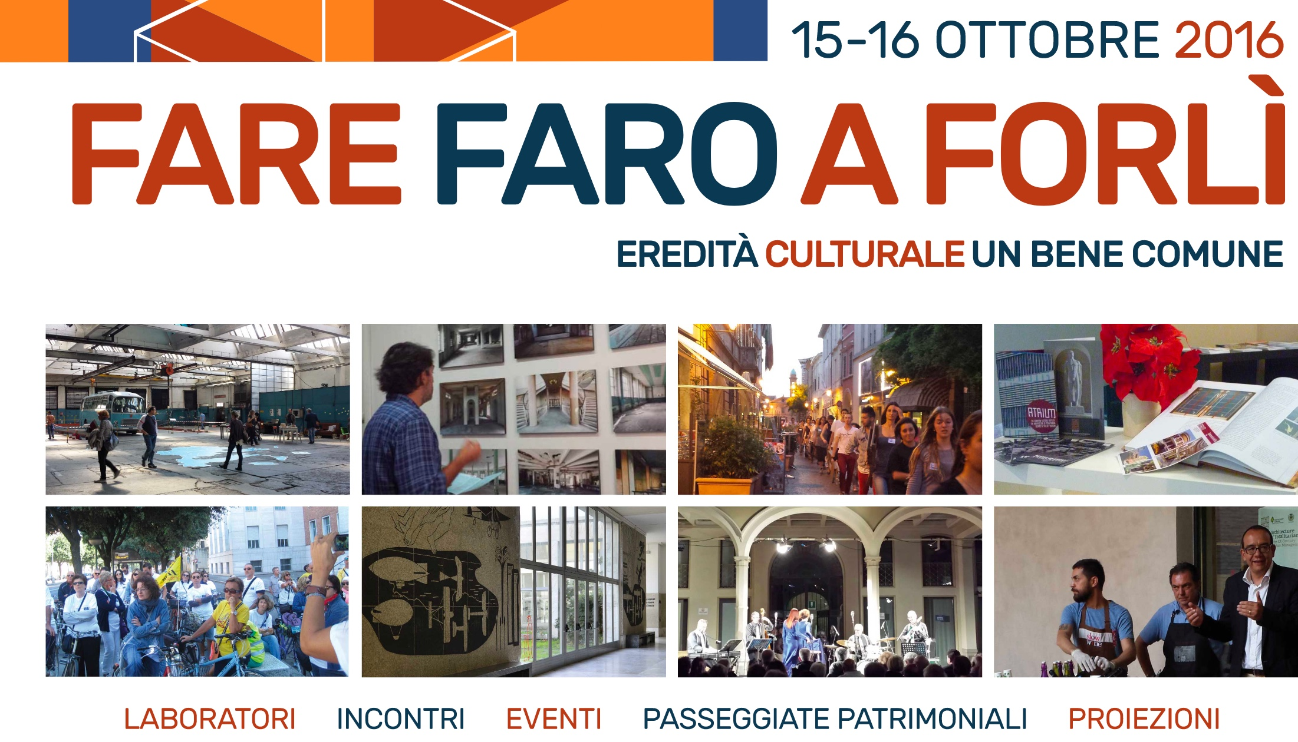

Slide 10
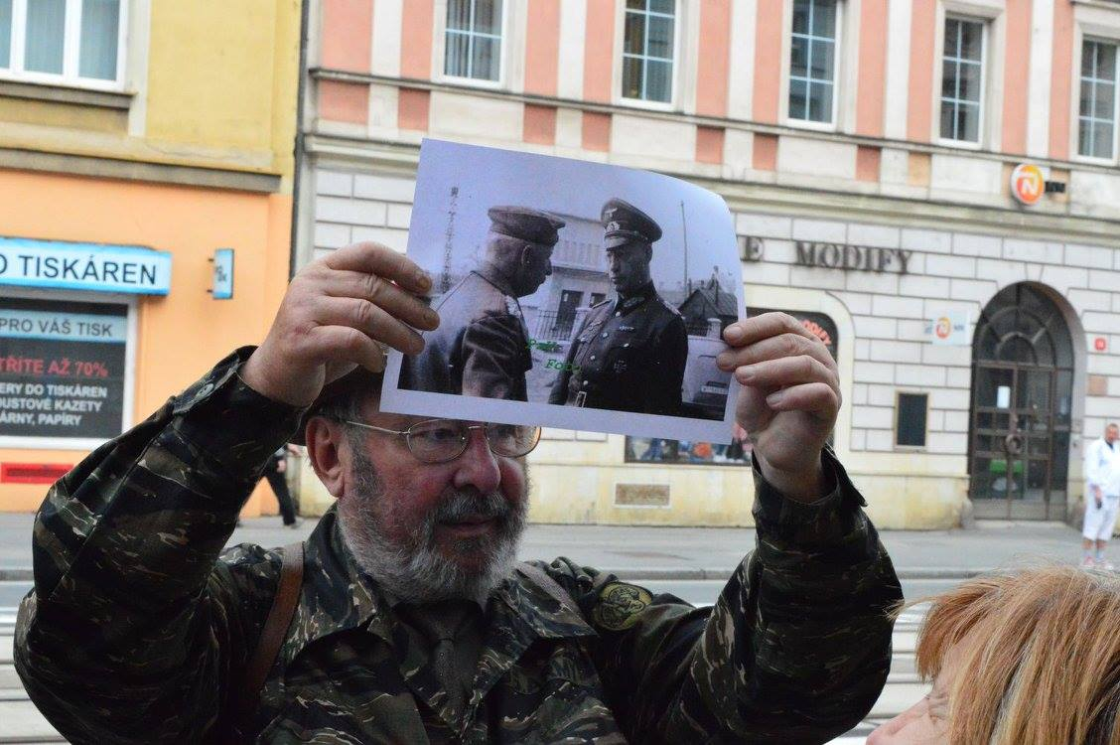
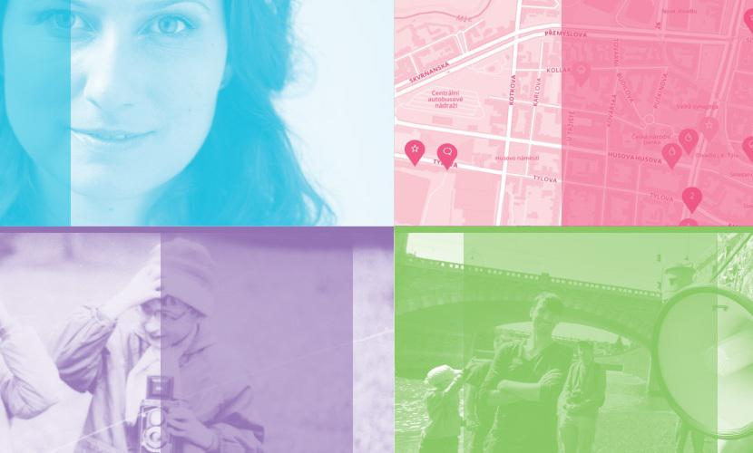
Pilsen: respect for diversity of interpretations.
#narratives
#co-existance

Slide 11
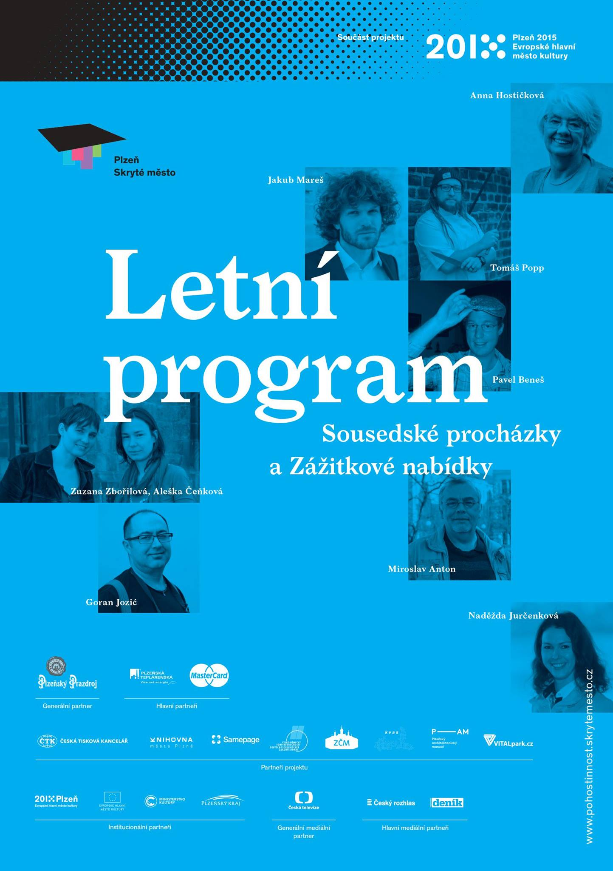
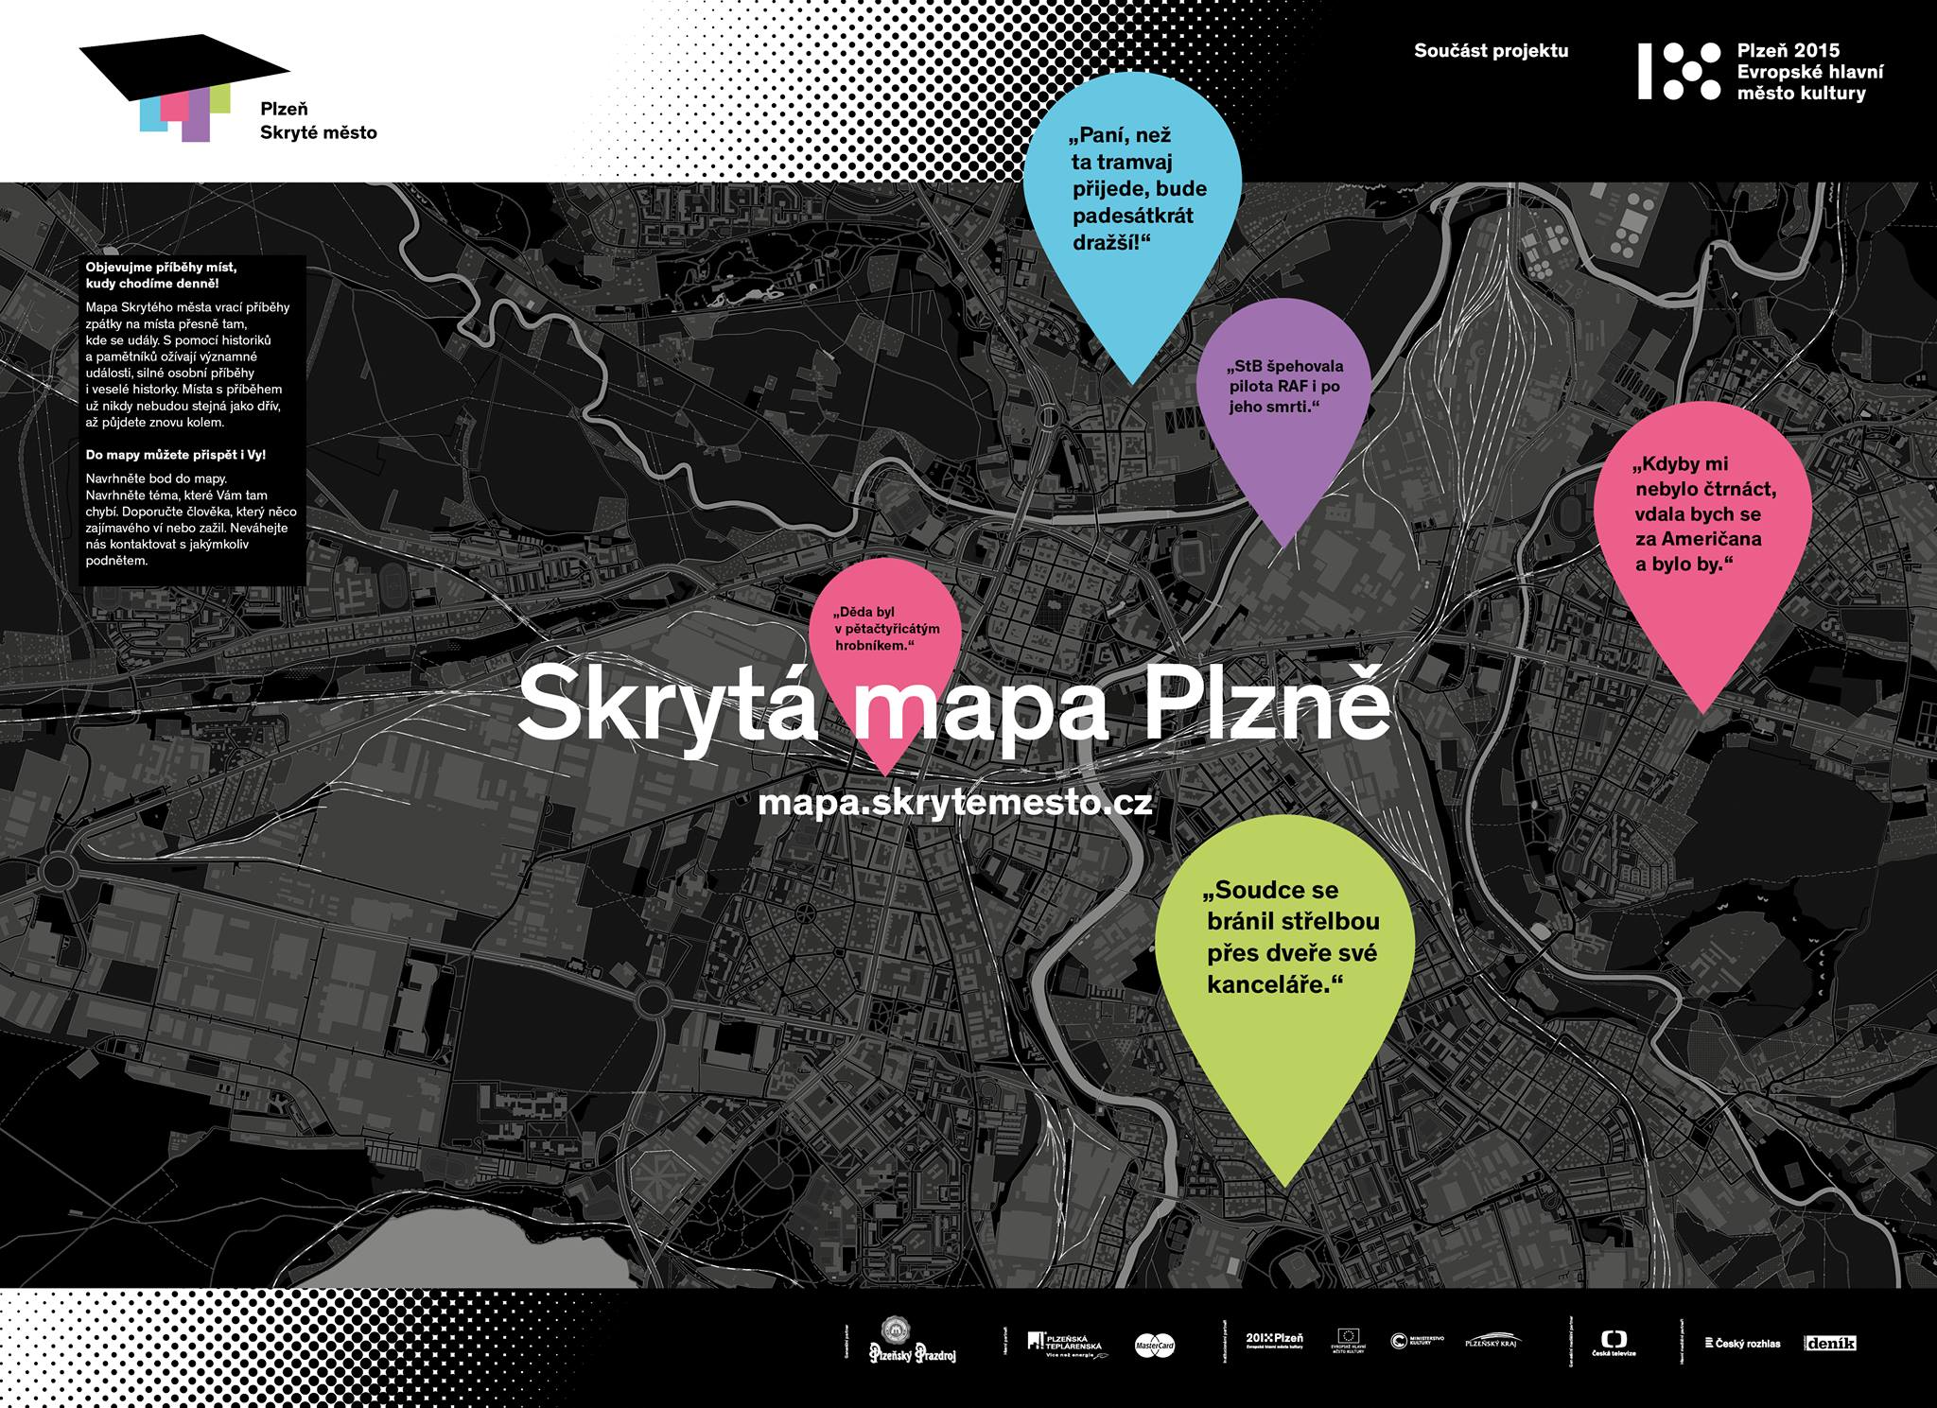
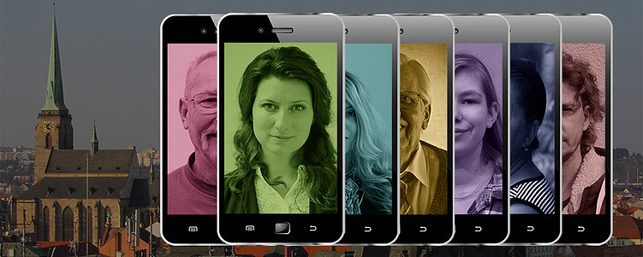

Slide 12
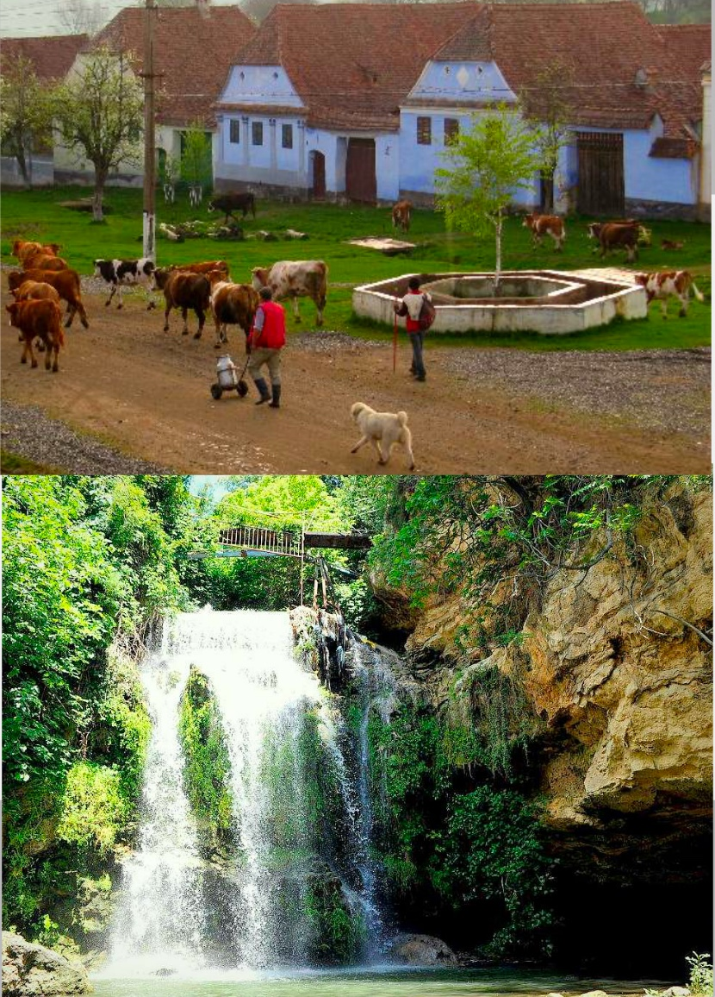
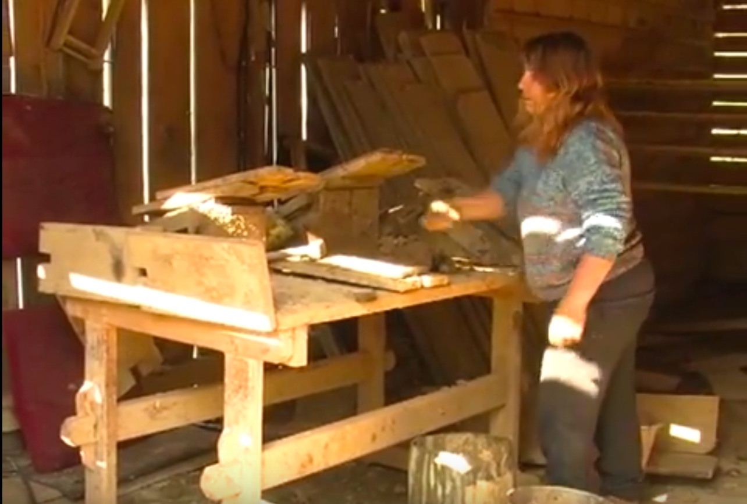
Viscri: consider cultural heritage as a resource to facilitate peaceful co-existence.
#human rights
#democracy
#rule of law

Slide 13
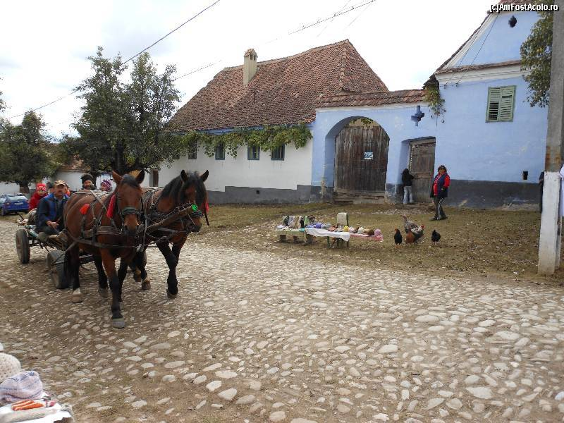
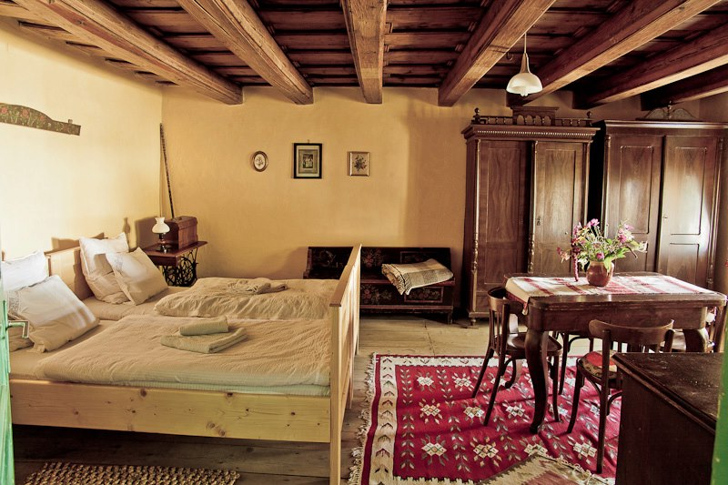

Slide 14

Promote the quality of contents and diversity of cultures in the information society.
#europe
#peaceful society

Slide 15
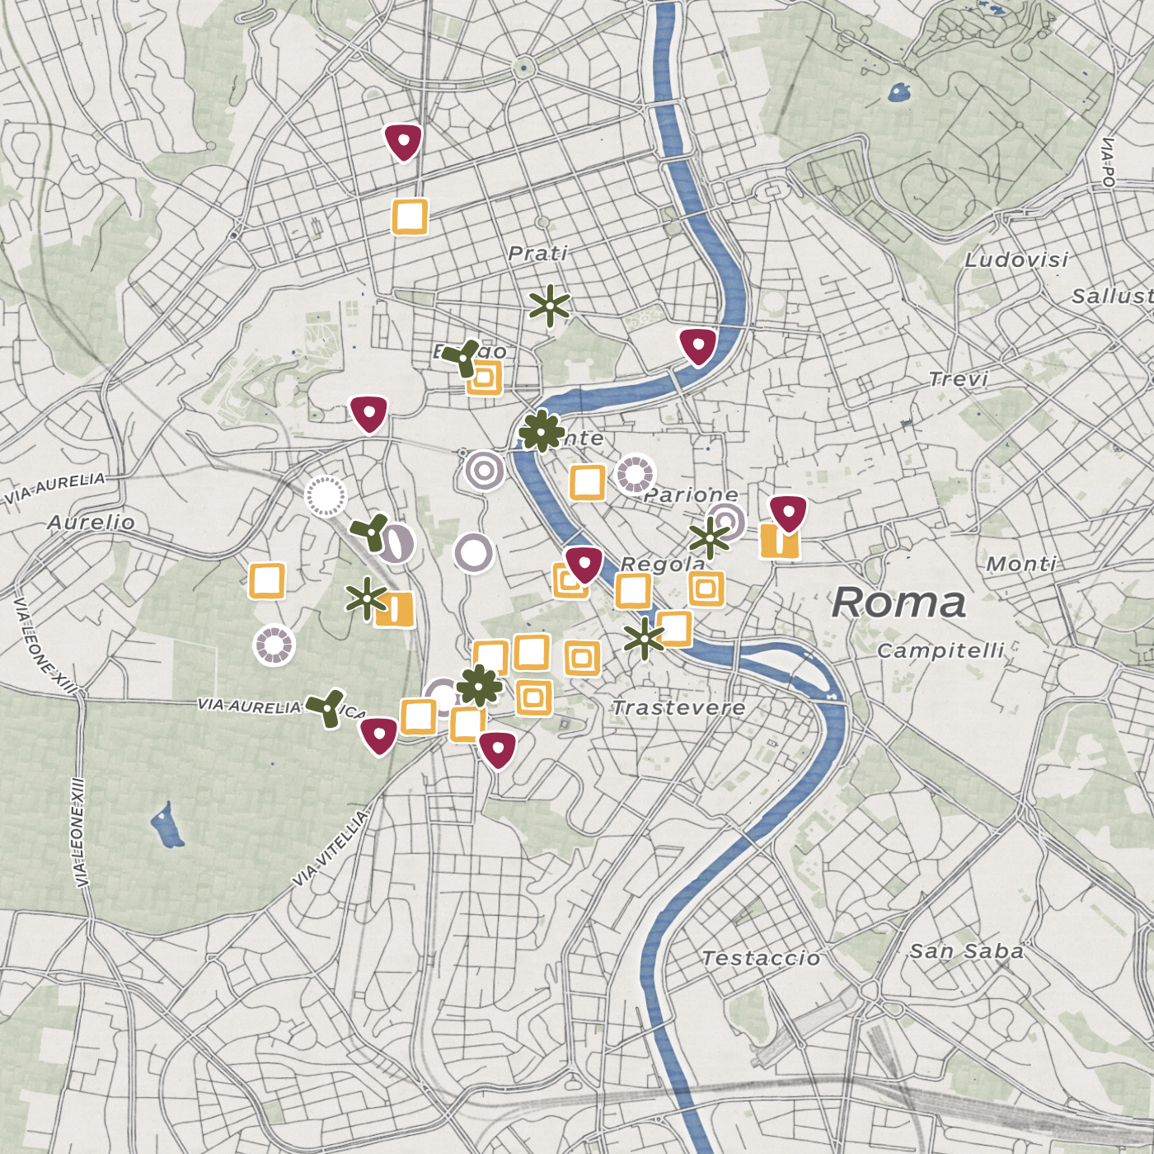
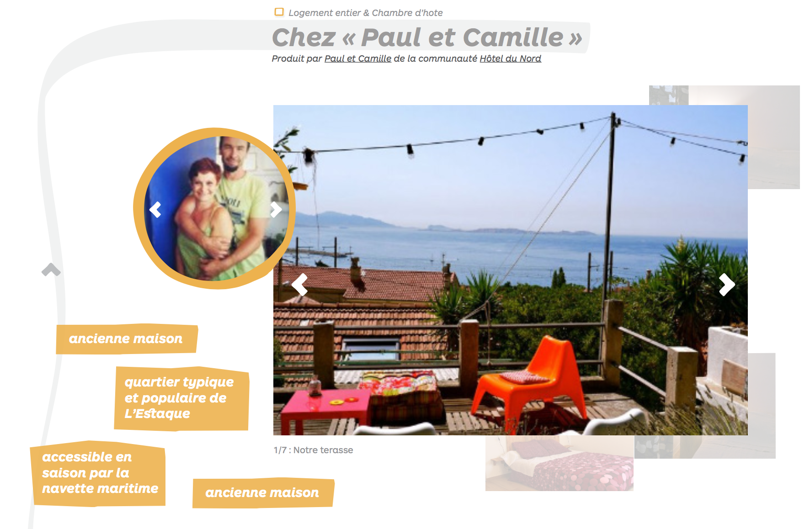
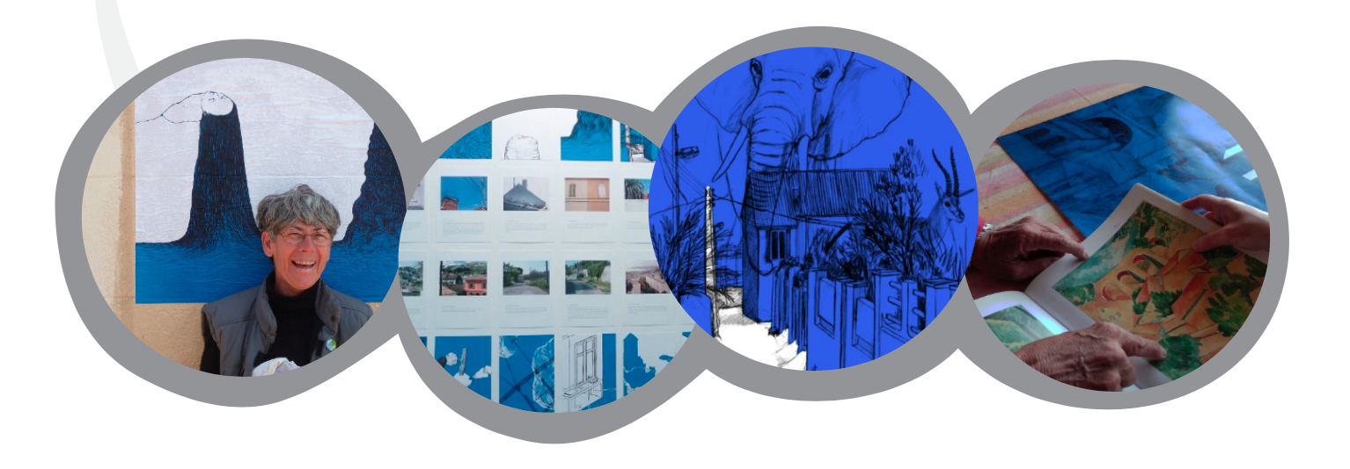

Slide 16
www.hoteldunord.coop
www.skrytemesto.cz
www.atriumroute.eu
www.mihaieminescutrust.org/viscri
www.lesoiseauxdepassage.coop
www.coe.int/en/web/culture-and-heritage/faro-community
Thank you

