Slide 2
Non-Discrimination Ombudsman
Autonomous and independent authority
administratively under MoJ
Ombudsman is Ms. Kirsi Pimiä
Office has 16 permanent and 3 temporary staff
The main tasks are to promote equality and to prevent discrimination
Special tasks:
to supervise the removals from the country
to act as the National Rapporteur on Trafficking in Human Beings
to monitor foreigners’ rights (in particular asylum seekers)
Mandate concerning discrimination was changed in 2015

Slide 3
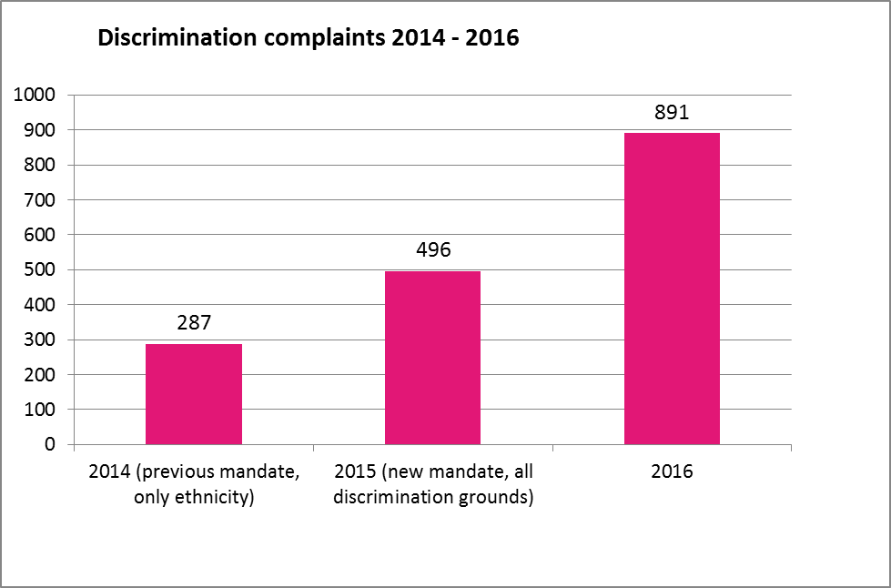
Increase in complaints due to new legislation 2014 → 2016

Slide 4
CONTACTS FROM ROMA IN 2017
All contacts | 1532
Contacts from Roma | 73
Contacts regarding Discrimination | 1107
Contacts from Roma regarding Discrimination | 68
* 5 % contacts from Roma of all the contacts received
* 6 % contacts from Roma of all the Discrimination contacts received

Slide 5
CONTACTS OF ROMA IN 2017 DIVIDED BASED ON AREAS OF LIFE
N = 68 kpl)

Slide 6
OPPOSITE PARTY IN CASES INVOLVING ROMA IN 2017

Slide 7
CONTACTS REGARDING ROMA HOUSING
YEAR | All the contacts regarding discrimination in housing (number) | ..out of which contact came from Roma (number) | % of Roma concerning housing complaints
2015 | 69 | 60 | 86
2016 | 60 | 16 | 27
2017 | 103 | 29 | 28

Slide 8
CONTACTS REGARDING ROMA DISCRIMINATION BETWEEN 2008-2017

