Slide 1

The Finnish hate crime monitoring system
Jenita Rauta, PhD
Police University College, Finland

Slide 2
Suspected hate crimes reported to police
The Criminal Code of Finland does not include a definition of hate crime
  Motive as grounds for increasing the severity of the punishment (aggravating circumstances)
Statistical reports on racist crime have been published annually since 1998
  the Ministry of Interior's Police Department (reports from years 1997-2002)
  the Police University College (reports from years 2003-2016)
Collection of information developed into a more extensive system of monitoring hate crime in 2009
Notes:
-Criminal code of Finland does not include a definition of hate crime, only as an aggravating circumstances
-Statistical reports on racist crime have been published by the Police University College of Finland and the Ministry of Interior’s Police Department since 1998.
-In 2009 the system of compiling information on racist crime was developed into a more comprehensive system of monitoring hate crime.
-since 2003, statistical reports have been compiled annually by the Police University College of Finland and financed by the National Police Board

Slide 3
Suspected hate crimes reported to police
Definition of hate crime for the purpose of the hate crime statistics in Finland:
  a crime against a person, group, somebody’s property, institution, or a representative of these, motivated by prejudice or hostility towards the victim’s real or perceived ethnic or national origin, religion or belief, sexual orientation, transgender identity or appearance, or disability.
Notes:
International agreements on statistics hate crimes have provided the basis for developing the practice.

Slide 4
Collection of raw data
Police reports searched from the police information system
Search parameters
  All reports the police have marked with the hate crime code
  All reports with the letter combination "racist" or "racism"
  All reports that include one of specified criminal titles AND one of the used search terms (271 keywords)
  All reports classified as discrimination, work/extortionate work discrimination, ethnic/aggravated ethnic agitation, genocide, preparation for the commission of a genocide, crime/aggravated crime against humanity or torture
  All reports with a special (TUPA) code that is used to monitor crimes and police action in relation to the asylum situation

Slide 5
Classification of hate crimes
Raw material ~7000 – 10 000 reports annually
Police reports of offences are read through carefully
Classified as hate crimes
  if one of the parties or the police considered the motivation for the crime to be the victim's real or perceived membership of a "protected" group
  if there is other clues about the bias motivation for example insults used during the offence
  if police have marked the report with the hate crime code
Selected reports categorized based on the different bias motives: ethnic or national origin, religion or belief, sexual orientation, transgender identity or appearance, disability
Notes:
-Police reports of offences are read through carefully to decide which cases to include in the final data (based on the narrative incidents descriptions)
International agreements on statistics hate crimes have provided the basis for developing the practice.

Slide 6
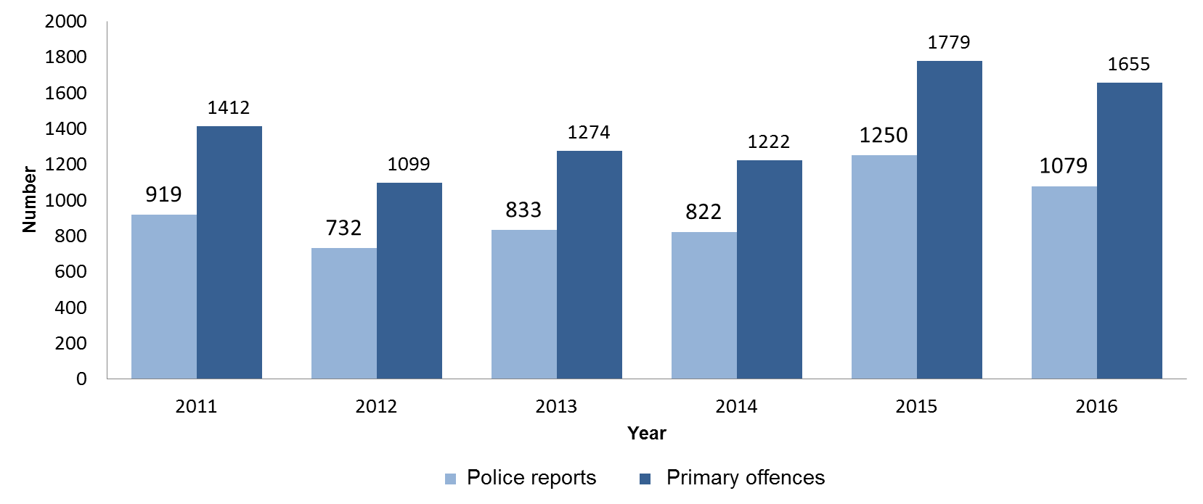
Number of suspected hate crimes 2011-2016
Notes:
-Primary offence= the most serious offence directed towards each victim/complainant
-reports (-14 %), offences (-7 %)
-direction of getting back to the normal levels (normal variation, fluctuation)
-2015 → 32400 refugees
-2016 → 5500 refugees
-so many hate crime cases that processing of the cases in police started to back up (get jammed) → happened with the hate crimes in the internet (hate speech)

Slide 7
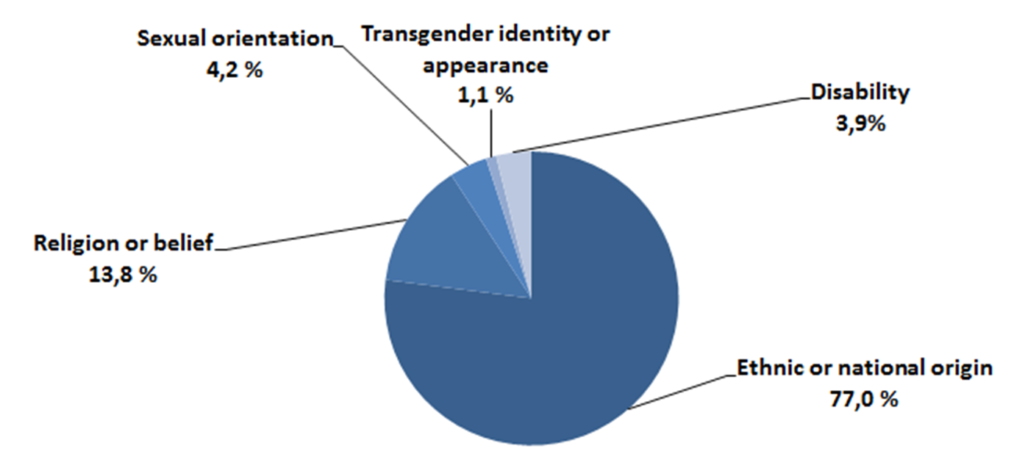
Hate crime reports by bias motive 2016
Notes:
-only crimes based on religion or belief increased

Slide 8
Principal offences of suspected hate crimes by crime type and motive in 2016

Slide 9
Available variables
Suspected hate crimes grouped by different bias motives
Type of crime
Circumstances of crime
Location of crime
Regional occurrence of crimes
Time of crime
Information on victims and offenders (for example age, gender, nationality)
Relationship between the victim and the offender
Notes:
International agreements on statistics of hate crimes have provided the basis for developing the practice. (FRA & OSCE)

Slide 10
Critical factors and things to consider
Suspected hate crimes reported to the police
  Court decides if the crime is considered as a hate crime and if the aggravating circumstances are met
Hate crimes not reported to the police are not included
The identification of suspected hate crimes depends significantly on how the case report has been written by the police officer
Reports with typing errors might not be found
The backgrounds of the victims/offenders can only be derived from what is written in the police report
  Information on nationality and place of birth available
  No separate recording criterion for ethnic background
Notes:
-reported to civil society etc. → not included

Slide 11
Hate crimes against Roma
Ethnic descent is not recorded in the police system
Nationality or place of birth is used to indicate whether there is a hate motive based on ethnicity
→ data on crimes against Roma has not been included previously
This year and with the consent of the Roma community, hate crime against Roma people will be included as a new category
The information will be retrieved as the selected raw data is being analyzed
Notes:
-will be presented in the 2017 statistics

Slide 12
Related issues
Training of Trainers, Training Against Hate Crimes for Law Enforcement (TAHCLE) by OSCE, ODIHR held at the beginning of 2017
  Effect on hate crime recognition, reporting and investigation?
Additional resources and police officers directed to investigating hate crimes and hate speech
  Hate speech investigation group, March 2017

Slide 13








Partners

Slide 14

Thank you! jenita.rauta@poliisi.fi www.polamk.fi/julkaisut

